Slide 1
Salahaddin University – Erbil.
Agriculture Engineering Sciences College
Field Crop Departement
Technology of Pulse Production
Practical Part – Field crop Dept.
Third Stage – Second Lecture
Vicia faba
Broad bean

Slide 2
broad bean, (Vicia faba), also called fava bean or faba bean, species of legume (family Fabaceae) widely cultivated for its edible seeds. The broad bean is the principal bean of Europe, though it is generally less well known in the United States, as with other vetches, broad beans are frequently planted as cover crops and green manures, as they add nitrogen to the soil by means of nitrogen-fixing bacteria. The plant is also used as livestock and poultry fodder, where it is sometimes called field, or tick, bean.
As with other beans, broad beans are rich in protein and provide moderate amounts of iron, thiamin, and riboflavin. Ingestion of broad beans can cause acute hemolytic anemia in people with favism, a genetic disorder.

Slide 3
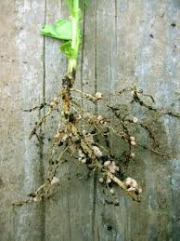
Plant Description:
1-Root:
Tap root, and branched of it secondary roots, it is characterized by feature bacteria nodules on root, and different root depth in the soil depending varieties and the nature of the soil.

Slide 4
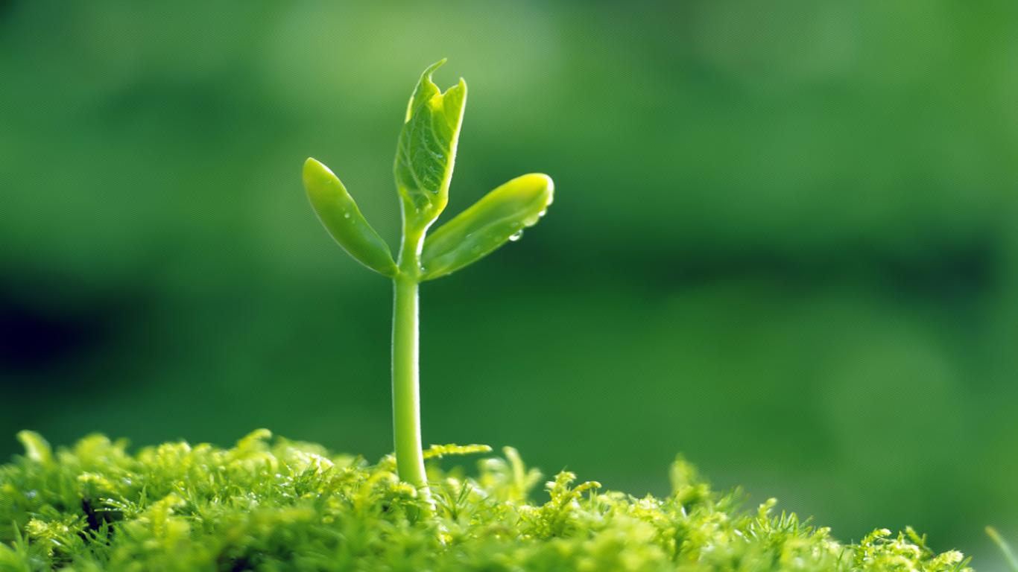
2-Stem:
The stem is erect, hollow, ribbed with four ribs, and green in color, plant height about 60-180 cm in height varieties and about 30-45 cm in small varieties.

Slide 5
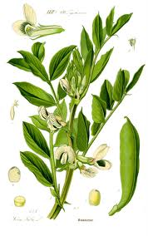
3- Leaves:
The leaf is compound with several leaflets 2-6, Oval shape at alternative positions on the stem, and contain small stipulates relatively at leaf base.

Slide 6
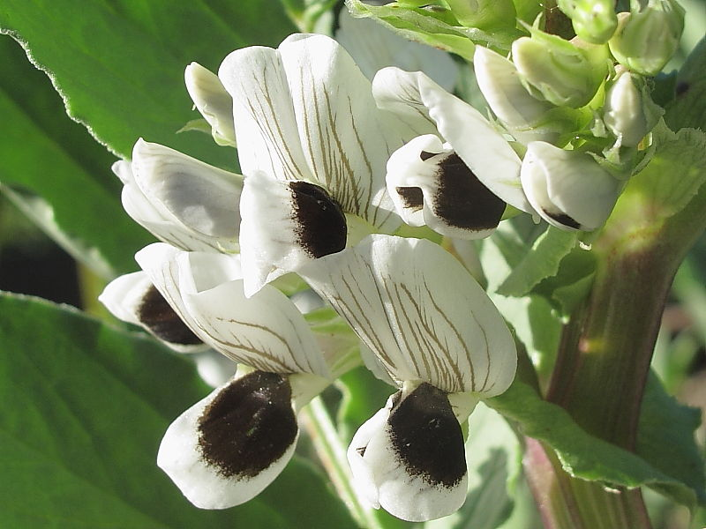
4- Flower:
Be in the form of aggregates (Clusters) and number from 1-9. A white flower with black spots slashes to brown in the middle of each wing. Start the flowering process from the bottom to up, the flowering process will continue one to three weeks or more. It is self- pollination in bean by 90%, either by cross pollination depends on the degree of insects and nature of the crop has grown the percentage of cross pollination in some varieties to 30% or more.

Slide 8
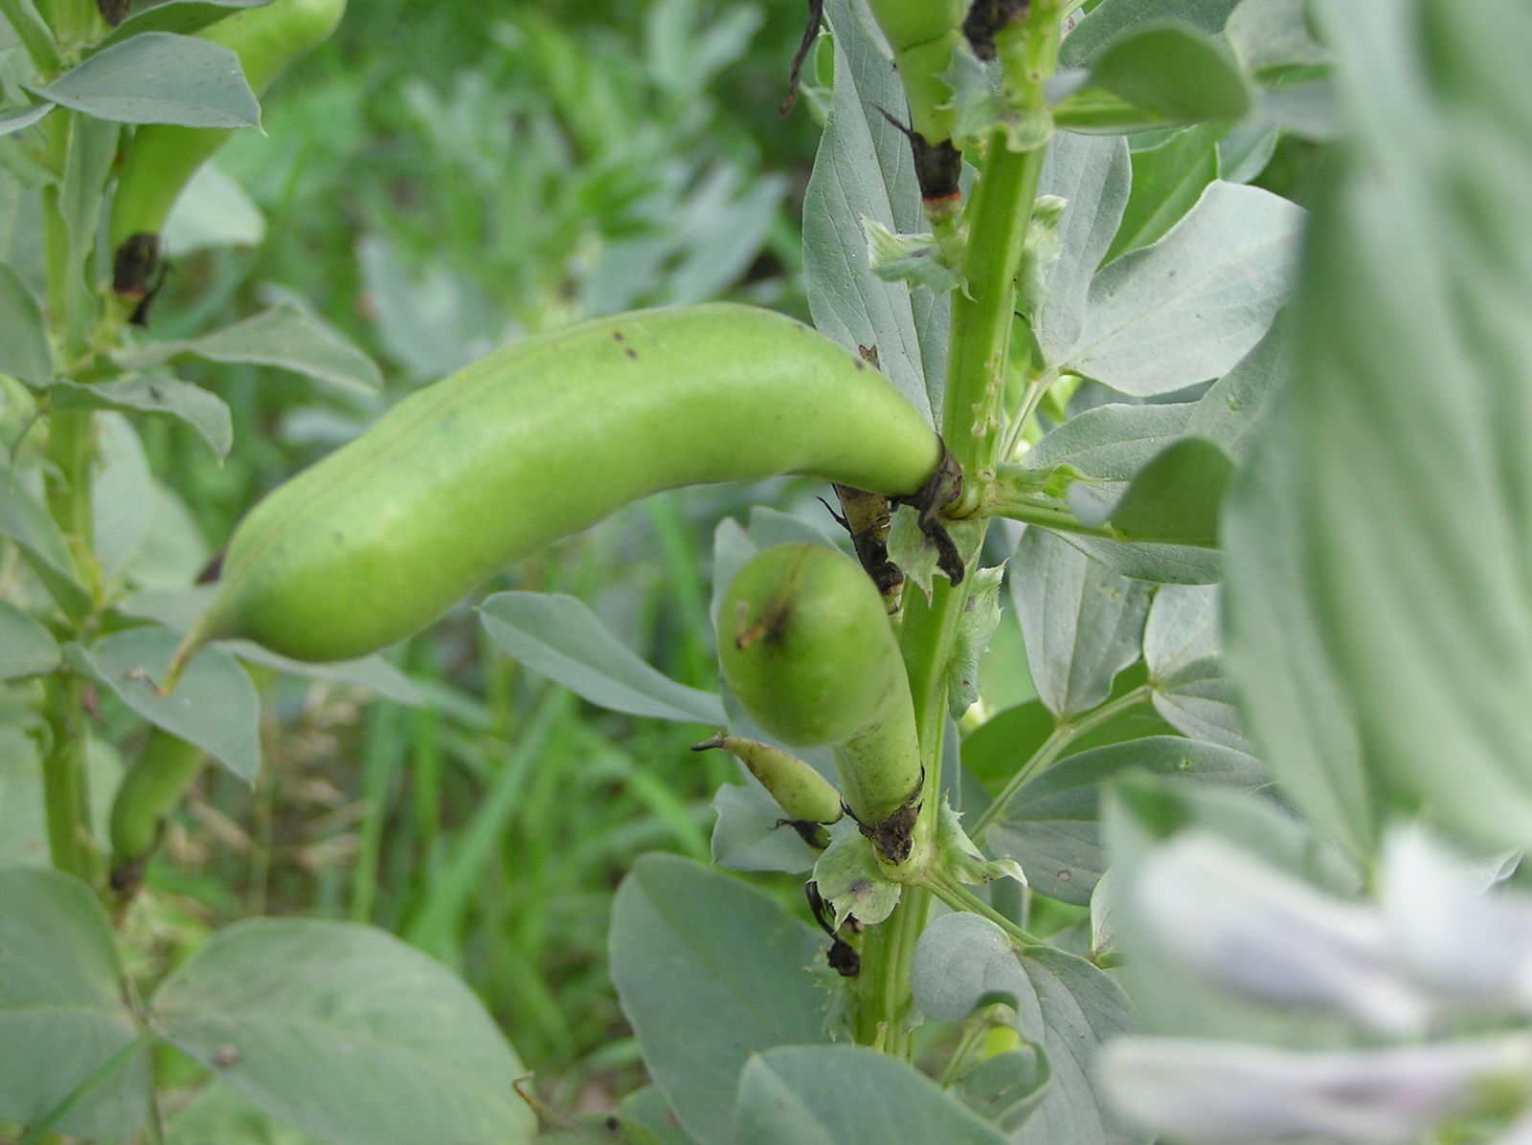

Slide 9
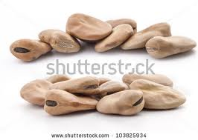
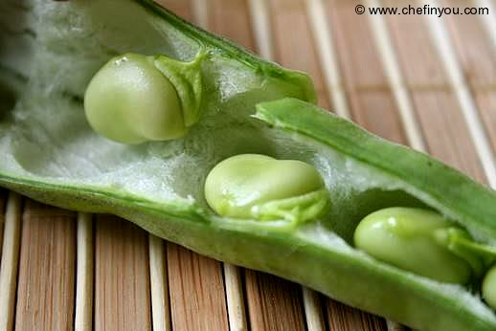
5- Pod:
It is composed of one carpel contains a number of seed (2-7) or more. And green color, that changes color to brown or black when plant is mature. Seed is related to fruit coat in the place called hilum which is brown scar on the seed coat.
Seed:
Seed shape is rounded flattened edge, the length of seed different with varieties.

Slide 10
