Slide 1
Technology of Pulses Production
Vigna radiata
Mungbean Practical Part – Field crop Dept. Third Stage – Fifth Lecture

Slide 2
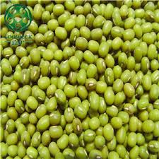
Scientific classification:
Kingdom Plantae
Division Magnoliophyta
Class Magnoliopsida
Order Fabales
Family Fabaceae
Genus Vigna
Species radiata

Slide 3
It is one of the oldest legume crops in the world. The origin of original of mungbean is India. Some common names are green gram and black gram.
Mungbean (Vigna radiata L.) is one of the most important food legume crops in South, East and Southeast Asia, where 90% of global production currently takes place. Mungbean is a relatively drought-tolerant and low-input crop that can provide green manure as well as livestock feed and thus is favored by smallholder farmers.
Mung bean is a warm season crop requiring 90–120 days of frost-free con- ditions from planting to maturity (depending on the variety). The optimum temperature range for growth is between 27 °C and 30 °C. This means that the crop is usually grown during summer.

Slide 4
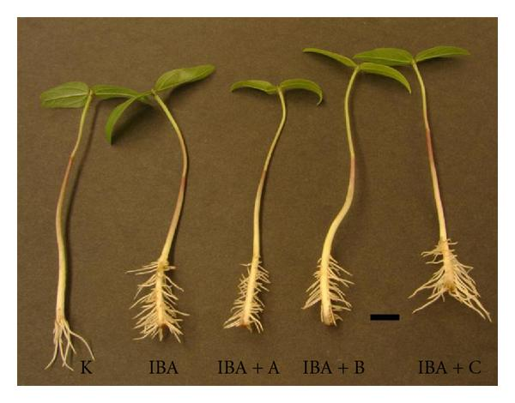
Plant description:
1- Root:
Tap root, few depth in the soil, have few branches and contain root nodules.

Slide 5
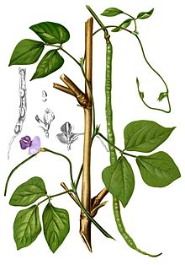
2-Stem:
The stem is Erect or Semi erect, the length about 25-125 cm, it is covered by white yellowish hairy.

Slide 6
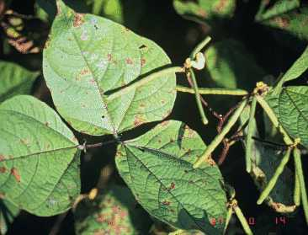
3- Leaf:
It is compound with three oval-shape leaflets pendulous. The length of it 5-10 cm, light green in color, and covered by hairy.

Slide 7
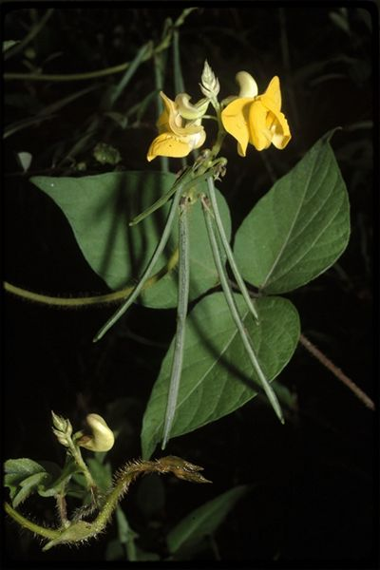
4- Flower:
It is yellow to green, accumulation in cluster with number of flowers and be portable on the axis of the inflorescence and length is 2-10 cm, 5-15 flowers, it is self- pollination.

Slide 8
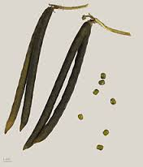
5-Pod:
Cylindrical pod covered by hairy, it green in the beginning and then it turns into a brown, black, length about 5-10cm, containing 8-12 seeds depended on varieties.

Slide 9
7- Seed:
It is short cylindrical, small in size and divided into groups by color:
1- Green gram:
It is recognize by dark green- color such as (domestic varieties), and it is used as food for humans can also be used as green fertilizer and animal feed.
2- Black gram:
It is recognize by dark gray color seed which tends to black, it is cultivate for animal feed purposes and to improve the soil.
3- Golden gram:
It is characterize by yellow- color seed also that pods easy burst shatter and used for animal feed purposes and improve soil after buried in the shape green manure.

Slide 10
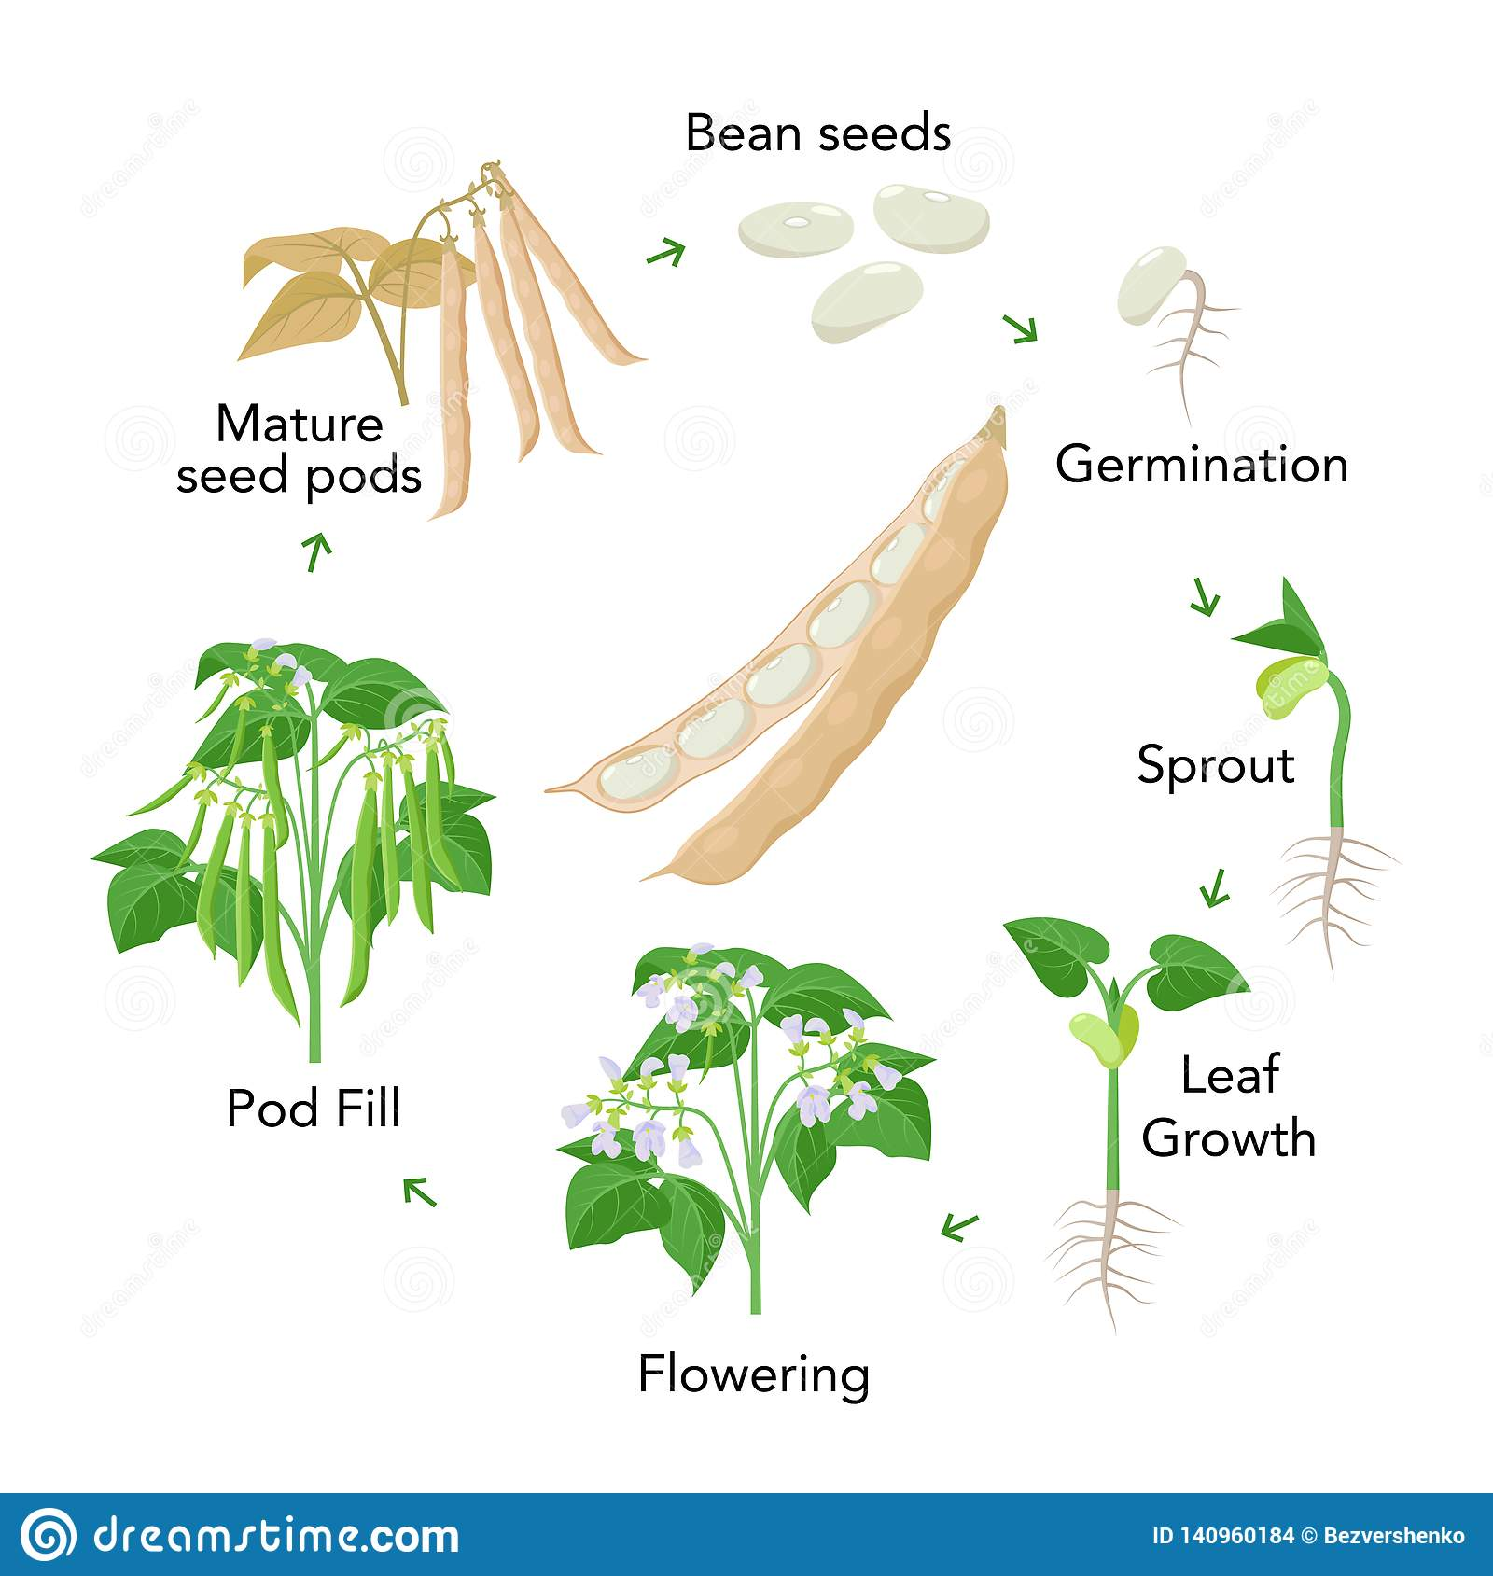
Mungbean growth stages

Slide 11
Climate:
Mungbean grows in a wide range of climatic conditions. A warm humid climate with temperature ranging from 25⁰ C to 35⁰ C, with 400-550 mm rainfall, well distributed during the growing period of 60 - 90 days, is suitable for cultivation.
Soil:
Mungbean is grown on a wide range of soils including red laterite soils, black cotton soils and sandy soils. A well-drained loamy to sandy loam soil is best for its cultivation. The crop does not grow well on saline and alkaline soil or waterlogged soils.

Slide 12
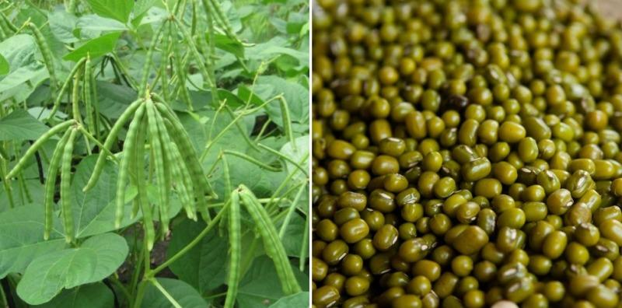
Seed rate
Seeds which are healthy, undamaged and free from insect pests and fungi should be selected. The seed rate varies with seed size and season. In the case of bold-seed types a seed rate of 20 kg/ha is appropriate in spring and autumn, and 16 kg/ha in summer. It is advised to establish a plant population of 25 plants/m2 for obtaining good seed yield.

Slide 13
Harvesting
Harvest when pods are mature and dry, but before they start shattering. Manual harvesting is usually practiced, but mechanical harvesting can save labour cost and time.
Desiccation of the plants is needed before mechanical harvesting. If you are following manual harvesting then threshing must be done as soon as the pods are dry. Beat pods with a stick until pods are opened, or put dry pods in a jute bag, place the bag on the floor, and walk on it. Remove any foreign materials by winnowing. Sun dry for 3–5 days. Drying of seed to 9-10% moisture level is very important for good storage. Use a seed moisture meter for accurate determination of the moisture content. Use of solar dryers would be a better option for quicker drying. Collect only good seeds (free from diseases, seed coat cracking, split, or immature).

