Slide 1
Soybean
Practical Part – Field crop Dept. Third Stage – Seventh Lecture

Slide 2
INTRODUCTION
Scientific Name: Glycine max.
Family: leguminoseae
Soybean is the major legume crop of the world in terms of total production.
Soybean seeds contain 40% protein and 20% oil on dry basis.

Slide 3
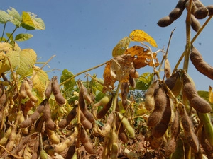

Slide 4
The soybean is economically the most important bean in the world, providing vegetable protein for millions of people and ingredients for hundreds of chemical products. Because soybeans contain no starch, they are a good source of protein for diabetics.
Soybean is an important source of food, protein, and oil, and hence more research is essential to increase its yield under different conditions, including stress. The most important countries of the world with the highest rate of soybean production include the USA, Brazil, Argentina, China, and India.

Slide 5
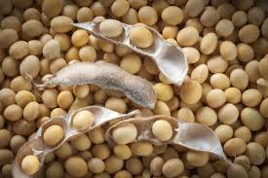
ORIGIN
This crop originated in china and is currently grown in 35 countries of the world.
United states is the largest producers followed by Brazil, China, and Argentina.

Slide 6
USES OF SOYBEAN
1.SOYBEAN MEAL
A.FEED.
Poultry feed; livestock feeds; fish food.
B.SOYFLOUR.
(1)Edible uses.
Bakery ingredents; noodles; meat products, confections.
(2) Industrial uses:
Adhesive, plywood, insecticidal spray, texture paints, nutrients, antibiotics ,beer and ale.

Slide 7
2. SOYBEAN OIL.
A.EDIBLE USES.
Cooking oils; coffee whiteners creamers.
B.TECHNICAL USES.
Disinfectants;electrical insulation; insecticides; pesticides; fungicides; herbicides; soaps.

Slide 8
SOYBEAN GROWTH STAGES.
Germination and Emergence (VE).
Cotyledon (VC) to First Trifoliate (V1)
Second Node (V2)
Third to Fifth Nodes (V3-V5)
Sixth Node (V6)
Beginning Bloom (R1)
Full Bloom (R2)
Full Pod (R4)
Beginning Seed (R5)

Slide 9
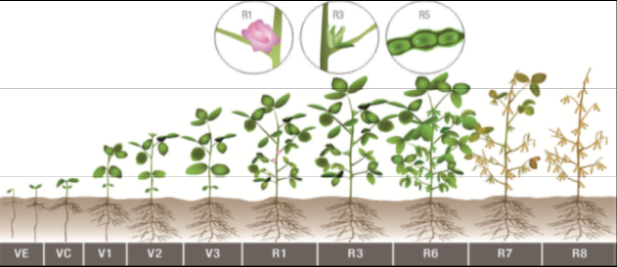
Full Seed (R6)
Beginning Maturity (R7)
Full Maturity (R8)
Figure 2. Soybean growth stages. Plants that are indeterminate in growth habit continue vegetative growth after flowering. The rate of development is directly related to temperature and moisture. Picture courtesy of University of Illinois.

Slide 11
PLANTING TIME
Spring is the time to plant soybeans. As an annual crop, soybeans grow from seed, produce and die in a single growing season. In areas that experience winter frosts, wait until two to three weeks after the last frost date to plant soybeans. In mild, Mediterranean and frost-free climates, plant soybeans in late winter or early in spring when the soil warms to 60 degrees Fahrenheit. Soybeans prefer an air temperature of around 70 degrees Fahrenheit so plant as early in the season as possible in warm climates.
SPACING
Adopt a spacing of 30 cm between rows and 5 cm between plants in the row. Dibble or drill the seeds is apply.

Slide 12
PREPARING TO PLANT SOYBEANS
Pick a spot that gets full sun. You can grow soybeans in part shade but the harvest potential will be limited. Like most beans, soybeans are "nitrogen fixing" meaning that they capture atmospheric nitrogen and transfer it into the soil. This makes bean crops ideal for deep soil with moderate nutrient levels. Extra amendments before planting are only needed in poor soil conditions. Soybeans grow best when the soil pH is between 6 and 6.8.
The best way to plant soybeans is by direct seeding in the garden bed. Wait until the soil warms to 60 degrees Fahrenheit or warmer before planting the seeds. Plant soybean seeds 1 1/2 inch deep in the soil and cover. Keep the area damp during germination and early growth. When growing soybeans in pots, use containers that are at least 8 inches deep to accommodate the deep root system.

Slide 13
HARVESTING SOYBEANS
Once 95% of pods are a mature tan color and moisture levels reach the 13% to 15% range, it’s time to start harvest. With moisture levels lower than 13%, beans have a much higher shattering chance and may be brittle or split. The University of Nebraska-Lincoln Extension warns against harvesting soybeans when they are at their driest, like on a hot afternoon, to avoid additional shattering.

Slide 14
SOYBEAN YIELDS
High yields are always the goal for soybeans, but corn often gets the most attention in terms of management. Give your soybean crop a little extra attention this year and implement these 5 steps to boost your soybean yields.
Although yield contests can inspire farmers to manage crops differently, it’s important to remember that some fields will realistically never be able to produce 100-bushel or more yields based on location and soil quality. That being said, there’s always something to be learned from the high yield contests. One Illinois family set a new state record for highest verified soybean yield and have tips for how they managed the 108-bushel contest plot.

