Slide 1
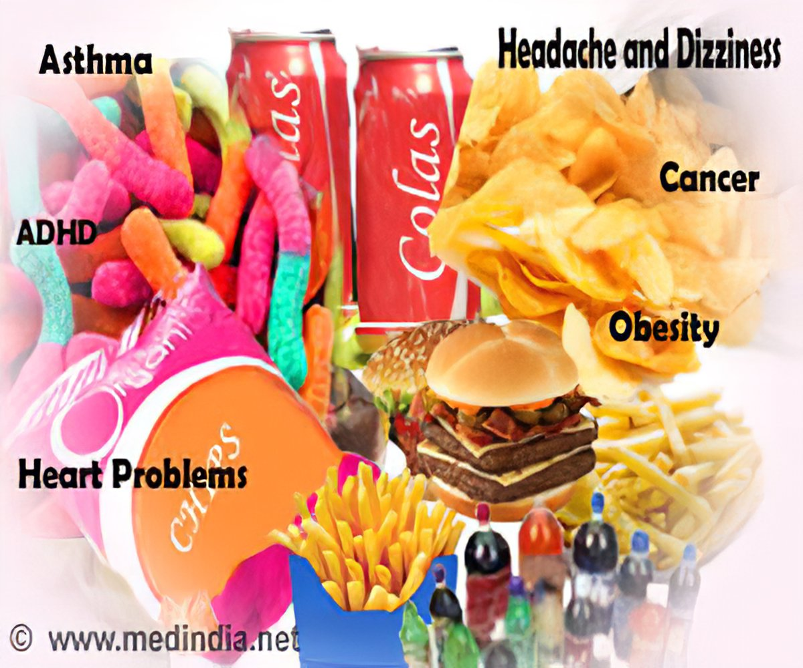
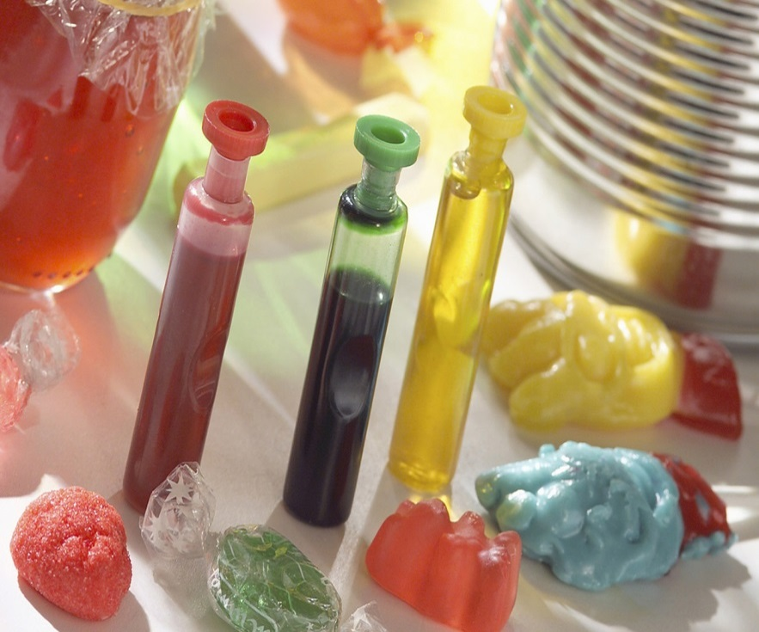
Toxicity of additive compound
Dr. Jwan Khidhr
31-10-2023

Slide 2
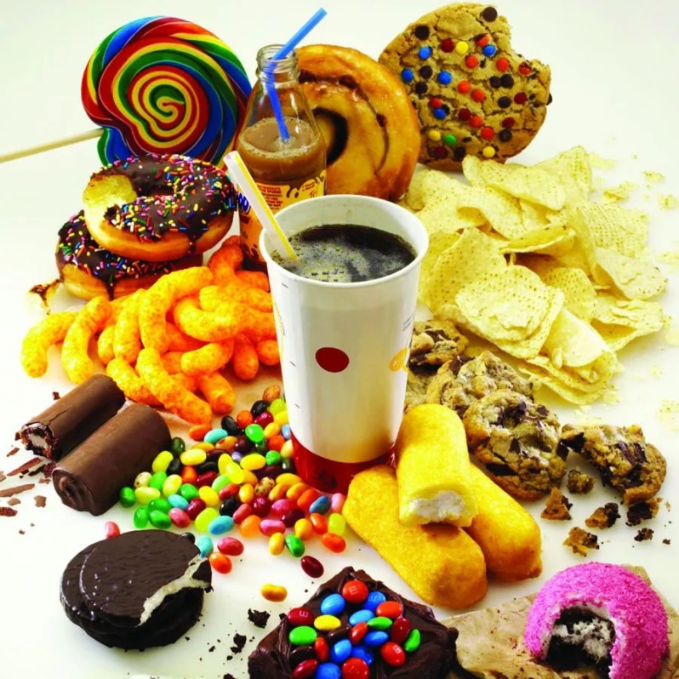
Food additive
Substances that are added to food to maintain or improve the safety, freshness, taste and texture.

Slide 3
Types of additive food
1- Acidifiers
Use: Acidity, sour taste
e.g: Ammonium hydroxide, calcium sulfate, citric acid, sodium diacetate
Toxic effect: Weight gain, acidity

Slide 4
2- Acidity regulators
Use : pH regulator
e.g: Sorbic acid, acetic acid, benzoic acid, citric acid
Toxic effect: Chromosomal aberration, mutation, dental cell toxicity

Slide 5
3- Antioxidants
Natural and synthetic antioxidants are used in the food industry for prolonging the appearance and shelf life of foodstuffs.
Natural antioxidants like vitamin C, vitamin E, rosemary, pepper.
Synthetic antioxidants such as butylated hydroxyl toluene, propyl gallate.
Toxic effect: Asthma, joint pain, dermatitis, stomach and eye problems.

Slide 6
4- Color
Use: Coloration of food
e.g: Erythrosine, Tartrazine
Toxic effect: Cancer, hyperactivity asthma, DNA damage

Slide 7
5- Flavor enhancers
Use: Enhancement of taste and color
e.g: Monosodium glutamate, aspartame
Toxic effect: Cancer, DNA damage, fetal abnormalities, lung tumors

