Slide 1
Salahaddin University-Erbil
College of Agricultural Engineering Sciences
Department of Forestry
Environmental protection
Dr. Jwan Khidhr Rahman
11-10-2023

Slide 2
1- Use Public Transport -odd no.

Slide 3
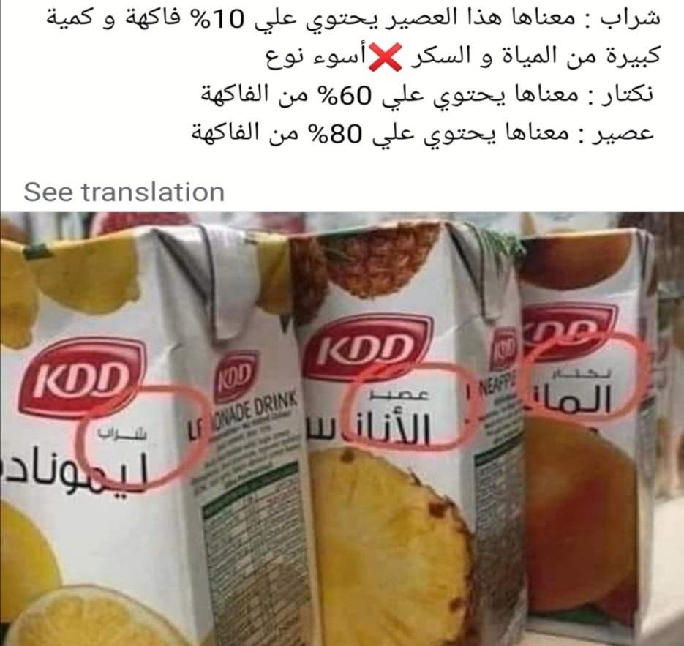
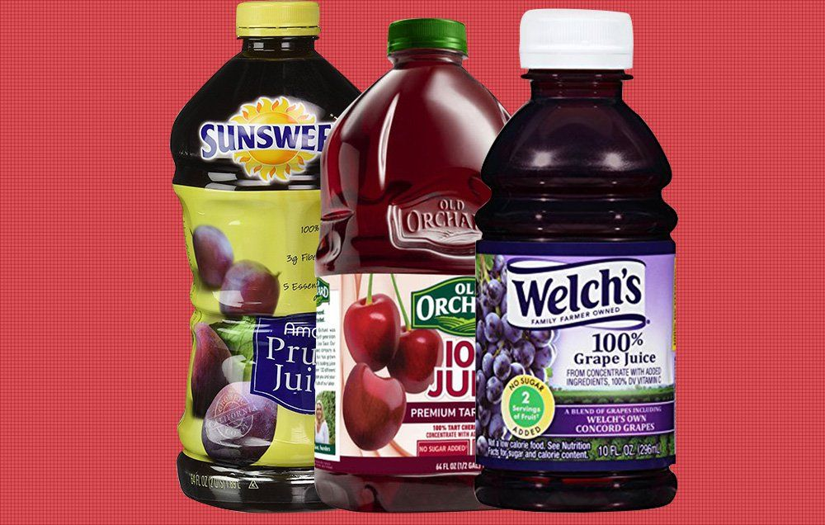
2- Use at Least One Natural Product

Slide 4
3- Save Electricity
Turn down the heat before you go on vacation

Slide 5
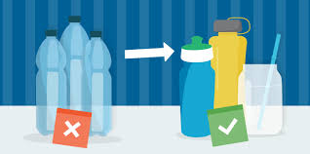
4- Avoid Single-Use Plastics
Single-use plastics, such as plastic bags, water bottles are major contributors to plastic pollution

Slide 6
Toxic compound

