Slide 1
Salahaddin University-Erbil College of Agricultural Engineering Sciences Department of Forestry Ground Water Quality Assessment Near Municipal Landfill and Characterization of Leachate in Kaniqrzhala Area, Kurdistan Region of Iraq
Asst.Prof. Jwan Khidhr Rahman
2-5-2024

Slide 2
Introduction
Groundwater is a crucial natural supply needed for human intake, irrigation, urbanization, industrialization, home usage, etc. It changes according to the kind of soil, the volume of water mined, geological and geomorphological factors.
In the Kurdistan region, landfills are the most popular method of garbage disposal,many landfills, like the Kaniqrzhala landfill, lack environmental protections.
A liquid called landfill leachate is mostly created when precipitation percolates through an open landfill. Leachates may contain significant levels of suspended particles, heavy metals, inorganic salts, and other organic contaminants .
Landfill leachate differs based on various factors such as landfill age, pH, type of municipal waste being buried, site weather, site hydrology, soil used for capping, decomposition, biodegradability ratio, moisture content, and stage of landfill .

Slide 3
The aims of the study
The current study aimed
To assess the levels of several physicochemical properties and heavy metals in groundwater in different wells located near landfill for drinking purposes by using WQI.
The study also quantified the leachate contamination potential generated from landfills by applying leachate pollution index (LPI)
Furthermore, the study evaluated the removal of heavy metals in leachate with the different plants was also evaluated.

Slide 4
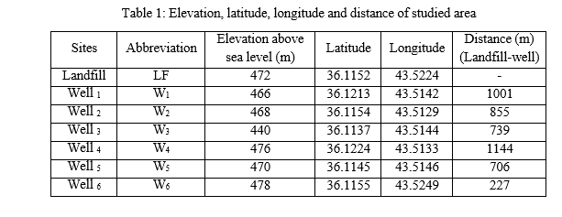
Methods and Materials Description of the studied area

Slide 5
Plant Collection
The leaves of these plant were collected in 2021 from Erbil in Iraq's Kurdistan area.
1-Hypericum triquetrifolium Turra
2- Tribulus terrestris L.
3- Caper spinosa L.

Slide 6
Results and Discussion

