Slide 1
Salahaddin University-Erbil
College of Agricultural Engineering Sciences
Department of Forestry
Down-regulation of abaI, abaR, Bap and OmpA genes in Acinetobacter baumannii by ethanol extract of Glycyrrhiza glabra after toxicity assessment
Published in Journal Cellular and Molecular Biology,
Impact factor = 1.6
Asst .Prof. Jwan Khidhr Rahman
9/5/2024

Slide 2
Introduction
Wild plants have been used by many different cultures, dating all the way back to ancient times. Glycyrrhiza glabra (G. glabra), a member of the Leguminoseae family, the properties of G. glabra Linn is antibacterial, antioxidant, anti-inflammatory, antiviral,.. etc.
An elevation of antibiotic-resistant Gram-negative bacteria prevalence has been detected along with biofilm-forming activity.
Biofilm-associated protein gene, Bap is translated into invariability protein. Outer membrane protein A (OmpA) is described virulence factor possessed by A. baumannii.
AbaI and AbaR, a two-component system, have recently been reported as making up A. baumannii's qurum sensing (QS) system.
The aim of this research was to examine G. glabra ethanol extract efficacy against A. baumannii strains and toxicity of this plant

Slide 3
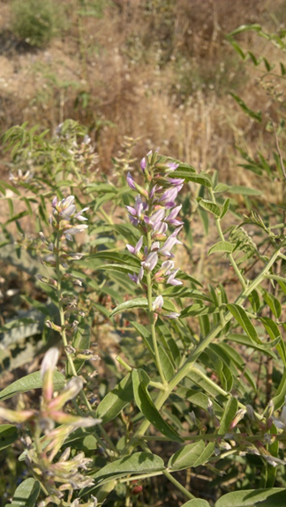
Plant gathering
Glycyrrhiza glabra L. leaf parts were taken in the Spring of 2021 from the Gomaspan area in the Northern part of Iraq.

Slide 4
Bacteria collection
Fifty A. baumannii isolates were gathered from a variety of patient specimens at various hospitals in Erbil, including cerebrospinal fluid (CSF), blood, pus, sputum and wound swabs

Slide 5
Plant extraction
The G. glabra L. leaves were harvested, cleaned, and then dried until they gained constant weight at forty to fifty °C. After being finely powdered over time by grinders.
Leaf powder of G. glabra (30g) was stirred at constant intervals consuming 300ml of 99.9% ethanol for 72 hours at room temperature. The extract was purified by Whatman no. 1 filter paper. Next, a rotovaps at 45 °C and lower pressure condensed the filtrated extract.

Slide 6
Toxicity Assessment
Female rats (Rattu norvegicus), with 180–200 g weight were used. All of them were kept in a typical setting that included 27±2°C temperature, the cycles of light and dark periods were set as light for 12 hours and 12 hours dark, regular feeds, and unrestricted tap water access.
The animals were housed in standard plastic crates and were divided into several clusters at random (n=5). The untreated (control) group was set as the first cluster and given only DMSO, whereas other specified clusters received only one dosage of the ethanol extract of G. glabra at doses of 0.5, 1, 2, 4, 4.5, and 5 g/kg based on previos studies.

