Slide 1
Theoretical Inorganic Chemistry Second year Class
Representative and Lanthanides Elements
Prepared by Assistant Professor -
Kamaran Basheer Hussein
Email : kamaran.hussein@su.edu.krd
2022-2023

Slide 2
Dobereiner’s triads
In 1829, Dobereiner, a German scientist made some groups of three elements each and called them triads. All three elements of a triad were
similar in their properties. He observed that the atomic mass* of the middle element of a triad was nearly equal to the arithmetic mean of atomic masses of other two elements. Also, same was the case with their

Slide 4
Newland’s law of Octaves
In 1864 John Alexander Newland, an English chemist noticed that “when elements are arranged in the increasing order of their atomic masses* every eighth element had properties similar to the first element.” Newland called it the Law of Octaves. It was due to its similarity with musical notes where, in every octave, after seven different notes the eighth note is repetition of the first one as shown below.

Slide 6
Mendeleev’s periodic law
a Russian chemist while trying to classify elements discovered that on arranging in the increasing order of atomic mass*, elements with similar chemical properties occurred periodically. In1869, he stated this observation in the following form which is known as Mendeleev’s

Slide 7
The Electron configuration of orbitals
n=1 1s
n=2 2s 2p
n= 3 3s 3p 3d
n=4 4s 3d 4p
n=5 5s 4d 5p
n= 6 6s 4f 5d 6p

Slide 8
Shielding and Lanthanide Contraction
As a result of the poor shielding of the 4f electrons there is a steady (fixed) increase in effective nuclear charge and related reduction in atomic size . Although his trend is apparent from the atomic radii .
The Lanthanide Contraction describes the atomic radius trend that the Lanthanide series exhibit. Another important feature of the Lanthanide Contraction refers to the fact that the 5s and 5p orbitals penetrate the 4f sub-shell so the 4f orbital is not shielded from the increasing nuclear change, which causes the atomic radius of the atom to decrease. This decrease in size continues throughout the series.

Slide 9
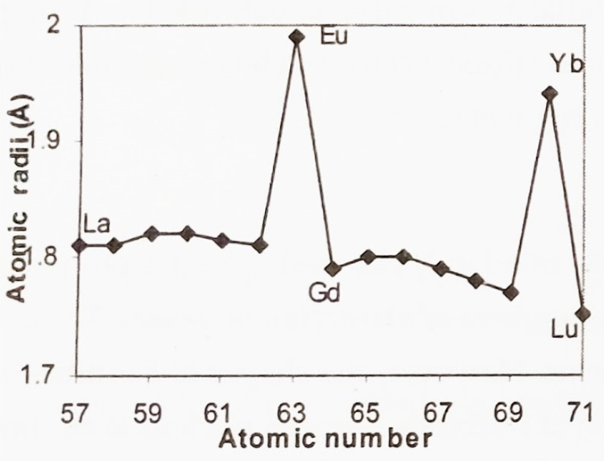

Slide 10
The Lanthanide Contraction applies to all 14 elements included in the Lanthanide series. This series includes Cerium(Ce), Praseodymium(Pr), Neodymium(Nd), Promethium(Pm), Samarium(Sm), Europium(Eu), Gadolinium(Gd), Terbium(Tb), Dysprosium(Dy), Holmium(Ho), Erbium(Er), Thulium(Tm), Ytterbium(Yb), and Lutetium(Lu). The atomic radius, as according to the Lanthanide Contraction, of these elements decreases as the atomic number increases. We can compare the elements Ce and Nd by looking at a periodic table. Ce has an atomic number of 58 and Nd has an atomic number of 60. Which one will have a smaller atomic radius? Nd will because of its larger atomic number.

Slide 11
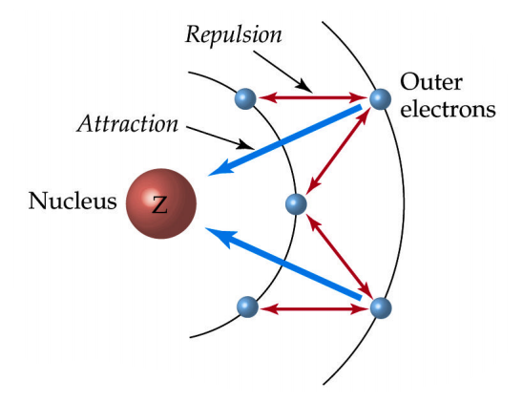

Slide 12
Hydrogen: the simplest atom
Introduction
An atom of hydrogen consists of one proton (constituting the nucleus) and one electron. This simplicity of atomic structure means that H is of great importance in theoretical chemistry, and has been central in the development of atomic and bonding theories . The nuclear properties of the hydrogen atom are essential to the technique of ¹H-NMR spectroscopy .

Slide 13
Ortho- and para-hydrogen
All homonuclear diatomic molecules having nuclides with non-zero spin are expected to show nuclear spin isomers. The effect was first detected in dihydrogen where it is particularly noticeable, and it has also been established for D₂, T₂, ¹⁴N₂, ¹⁵N₂ , ^{I7}O₂, etc. When the two nuclear spins are parallel (ortho-hydrogen) their sultant nuclear spin quantum number is 1 (i.e. ½ + ½) and the state is threefold degenerate (2s +1). When the two proton spins are antiparallel, however, the resultant nuclear spin is zero and the state is non-degenerate.

