Slide 1
Regression Analysis
تحليل الانحدار
Department of Statistics
Third stage
2019 - 2020

Slide 2
Chapter One

Slide 3
Introduction
The word (regression) was used for the first time by the (Sir Francis Galeton) in year 1877. He was one of the first researchers who studied the relationship between the heights of fathers and sons.

Slide 4
Definition
Regression Analysis: it is statistical process for estimating the relationships between the dependent (response) variable and one or more explanatory (independent) variables.
Dependent variable (Y_{i}): it is the variable that changes its values with changing the independent variable, and must be quantitative (continuous) variable.
Independent variable (X_{i}): it is the variable used to predict the values of the dependent variable, and must be either continuous or qualitative (dummy) variable.

Slide 5
Uses of Regression Analysis:
  Uses the regression analysis for:
  1. Description of the data: to describe the data through the estimated regression model
2. Estimating & Testing: to estimate the relationship between the dependent variable (Y_{i}) and the independent variables (X’s), and to test power of independent variables and its effect on behavior of dependent variable.
  3. Prediction: to predict the value of dependent variable based on the values of independent variable.

Slide 6
Types of regression analysis:
1- Simple regression: involves only one independent variable.
2- Multiple regression: involves more than one independent variables (X₁ , X₂ , …. X_{k}).

Slide 7
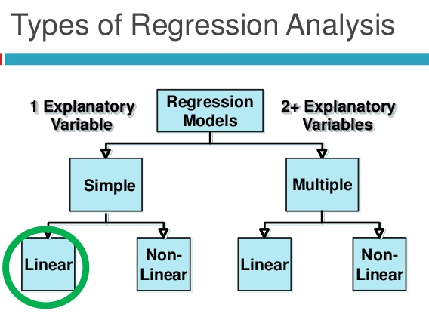
• Regression analysis may involve linear model or nonlinear model. The term linear can be interpreted in two different ways:
1- Linear in variables
2- Linearity in the parameters

Slide 8
Example
1-
2-
3-
Linearity in variable (X_{i}) and in the parameters (β₀ , β₁)
Non-linearity in variable but linearity in the parameters
Non-linearity in variable and in the parameters

Slide 9
Note:
In linear regression, the proposed model is that the dependent variable, (Y_{i}) is a linear combination of the parameters (β₀ , β₁).
Linear Regression Analysis: is statistical process for estimating the “line of best fit” for dependent variable based on one or more independent variables.
Regression line
dependent Variable (Y)
Independent Variable (X)

Slide 10
Chapter Two:
Simple Linear Regression

Slide 11
Simple Linear Regression Model
It is simplest kind of relation which is studying the relation between two variables, the first one called independent variable (X_{i}) and the second called dependent variable (Y_{i}). We can express this relation with the following functional relation:
Y = f (X )
The simplest form of this relation is linear relation called simple linear regression model, as follows;
Y_{i} = β_{o} + β₁X_{i} (Mathematical relation)

Slide 12
To transform this mathematical relation to the statistical relation must be add the random error (U_{i}), as follows;
Y_{i} = β_{o} + β₁X_{i} + U_{i}
Regression Coefficients
Random Error

Slide 13
Definition of Coefficients of Simple Regression Model
β_{o}: is called constant or intercept, it is represent the point that intercept the Y-axis.
mathematically β_{o} is the expected value of (Y) at the value of (X) equal to zero.
Geometrically β_{o} is vertical distance between origin and intercept point regression line with Y-axis.
β₁: is the slope of the regression line and represent amount of variation in dependent variable (Y) when the independent variable (X) changes with unity one.

Slide 14
Regression Line for Population

Slide 15
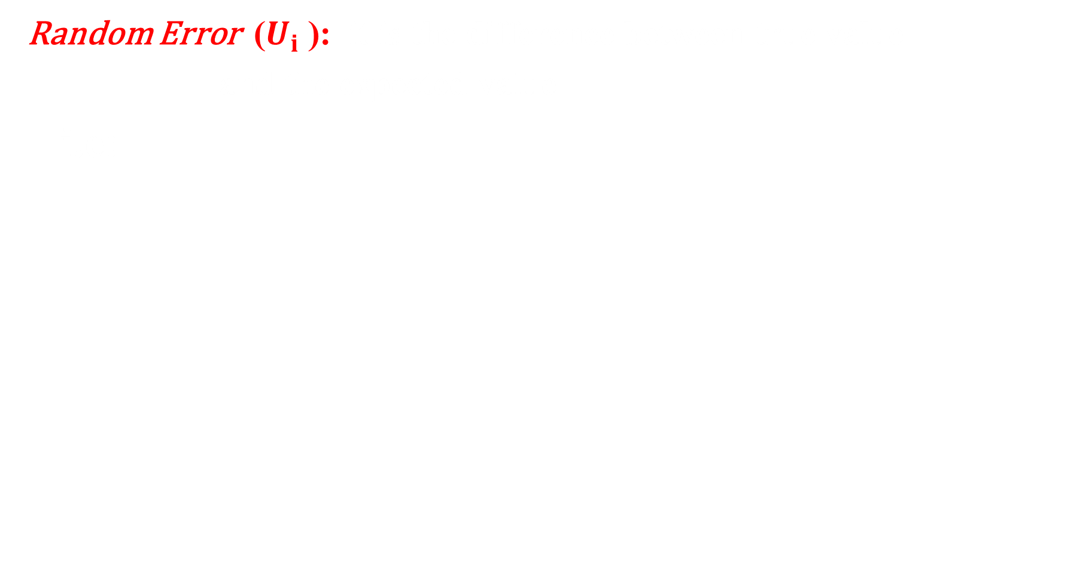
Random Error ($U_{i}$):
Random Error ($U_{i}$): it is the difference between true value
and the expected value
i.e:
for Population Regression Line
(Y)
(X)

Slide 16
Assumptions About the Random Error (U_{i}):
1-The error (U_{i}) is a random variable with mean of zero.
2- The variance of (U_{i}) is the same (constant) for all values of the independent variable (X_{i}).
this means there is no heteroscedasticity problem between variance of errors.
3-The error (U_{i}) have a normally distribution.
We can write the previous assumptions briefly as;

Slide 17
4- The values of errors (U_{i}) are independent of each other, (i.e: the error of any time does not depend on error of another time, and this means there is no autocorrelation problem among errors)
5- The values of random error (U_{i}) are independent than the values of independent variable (X_{i}).
i.e., there is no correlation between U_{i} & X_{i} , and this means there is no heteroscedasticity problem.

Slide 18
Assumptions of dependent variable (Y_{i})
Y_{i} = β₀ + β₁X_{i} + U_{i}
Constant quantity Random quantity
1- The dependent variable (Y_{i}) represents the sum of two quantities
2- (Y_{i}) have a normal distribution because there is linear relation between Y_{i} and U_{i}

Slide 19
Where:
3-The values of (Y_{i}) are independent of each other.

Slide 20
Estimation of Linear Regression Model
To estimate the regression model we need to estimate the regression parameters (β₀ , β₁).
Ordinary Least Squares (OLS ) Method:
The OLS method gives best linear unbiased estimates (BLUE) for coefficients (β_{o} , β₁). It helps to compute the values of (β_{o} , β₁), where making the sum squares (errors) as minimum (small).

Slide 22
Then the OLS estimators are:
Note:

Slide 23
Example (1):
The following data represents the demanded quantity (Y) and the price (X) for one of commodity:
Y | X
3 | 11
5 | 8
6 | 7
4 | 8
6 | 6
4 | 9
9 | 5
8 | 5
9 | 4
6 | 7

Slide 24
Requirements: if we have the following linear regression model
1- Explain the relation between (X) and (Y) through the scatter plot.
2- Estimate the regression line equation (Linear Regression Model) and explain it.
3- Draw the regression line equation.
4- Explain the relation between (X) and (Y) through the regression line equation.

Slide 25
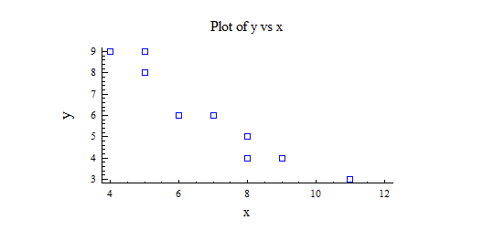
Solution: 1-
Y | X
3 | 11
5 | 8
6 | 7
4 | 8
6 | 6
4 | 9
9 | 5
8 | 5
9 | 4
6 | 7
There is negative strong relation between the demanded quantity (Y) and the price (X) for this commodity

Slide 26
2-
X ² | XY | Y | X
121 | 33 | 3 | 11
64 | 40 | 5 | 8
49 | 42 | 6 | 7
64 | 32 | 4 | 8
36 | 36 | 6 | 6
81 | 36 | 4 | 9
25 | 45 | 9 | 5
25 | 40 | 8 | 5
16 | 36 | 9 | 4
49 | 42 | 6 | 7
530 | 382 | 60 | 70
This means the demanded quantity (Y) is decreasing with magnitude (0.95) when the price (X) for this commodity increasing with unity one

Slide 27
4- There is negative relation between the price (X) and the demanded quantity (Y) for this commodity because the sign of (β ₁) is negative.

Slide 28
Properties of the Ordinary Least Squares (OLS)Estimators
The OLS estimators (β_{o} , β₁) describes by the best linear unbiased estimates for (β_{o} , β₁) (BLUE Property) if the random variable (U_{i}) satisfies the general assumptions:
And this properties are:
1. Linearity Property.
2. Unbiasedness Property.
3. Minimum variance Property.

Slide 29
First: Linearity Property
0

Slide 31
Second: Unbiasedness Property

Slide 32
H.W.

Slide 34
H.W.

Slide 35
The Variance of estimated regression parameters
1- Variance estimation of

Slide 36
2- Variance estimation of

Slide 37
The distribution of
1- Distribution of
2- Distribution of

Slide 38

Residuals: البواقي
Residuals ($e_{i}$): it is the difference between true value
and the estimated value
i.e:
for Sample Regression Line

Slide 39
Sum squares of errors (SSE )

Slide 40


Prove that $SSE=\sum{{Yi}^{2}−{\hat{β}}_{°} \sum{Y_{i}}−{\hat{β}}_{1}\sum{{X_{i}Y}_{i}}}$
We know that : $SSE=SYY−{\hat{β}}_{1}SXY$
$= \sum{{Yi}^{2}−n{\overline{Y}}^{2}−{\hat{β}}_{1}(\sum{{X_{i}Y}_{i}−n\overline{X}\overline{Y}})}$
$= \sum{{Yi}^{2}−n{\overline{Y}}^{2}−{\hat{β}}_{1}\sum{{X_{i}Y}_{i}+n {\hat{β}}_{1} \overline{X}\overline{Y}}}$
$=\sum{{Yi}^{2}−n{\overline{Y}}^{}\left(\overline{Y}−{\hat{β}}_{1}\overline{X}\right)−{\hat{β}}_{1}\sum{{X_{i}Y}_{i}}}$
${\hat{β}}_{°}=\overline{Y}−{\hat{β}}_{1}\overline{X}$
$n\overline{Y}=\sum{Y_{i}}$
$∴ SSE= \sum{{Yi}^{2}−{\hat{β}}_{°} \sum{Y_{i}}−{\hat{β}}_{1}\sum{{X_{i}Y}_{i}}}$

Slide 41

The estimation of the error variance (${S_{e}}^{2})$
$${S_{e}}^{2}=\frac{SSE}{n−2}=\frac{\sum{{Y_{i}}^{2} −{\hat{β}}_{° } \sum{Y_{i}}−{\hat{β}}_{1}\sum{X_{i}Y_{i}}}}{n−2}$$
The sum squares of errors (SSE) contains (n - 2) degrees of freedom, because it is related to the estimate
Note: In regression model the degrees of freedom for Error = n – number of regression parameters.

Slide 42
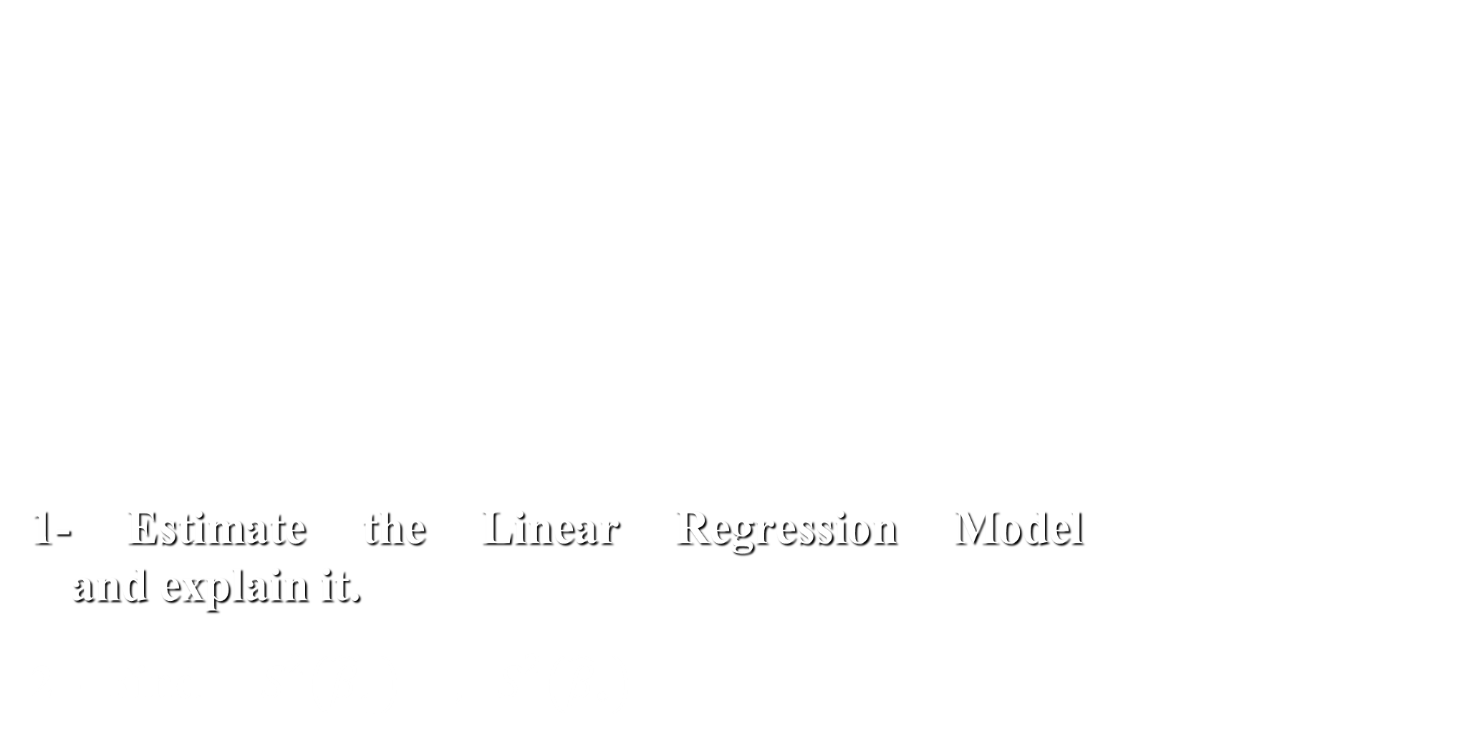
Example (2): From the following data:
1- Estimate the Linear Regression Model and explain it.
2 - Find $S^{2}\left({\hat{β}}_{1}\right) , S^{2}\left({\hat{β}}_{°}\right)$
Y | X
10 | 1
12 | 4
14 | 5
13 | 2
11 | 6
15 | 8
16 | 7
18 | 9
20 | 10
21 | 8

Slide 43
Solution: 1-
Y_{i}² | X_{i}² | X_{i}Y_{i} | Y_{i} | X_{i}
100 | 1 | 10 | 10 | 1
144 | 16 | 48 | 12 | 4
196 | 25 | 70 | 14 | 5
169 | 4 | 26 | 13 | 2
121 | 36 | 66 | 11 | 6
225 | 64 | 120 | 15 | 8
256 | 49 | 112 | 16 | 7
324 | 81 | 162 | 18 | 9
400 | 100 | 200 | 20 | 10
441 | 64 | 168 | 21 | 8
2376 | 440 | 982 | 150 | 60
This means that the dependent variable (Y) increases by (1.025) when the independent variable (X) increases by one unit.

Slide 44

2-
$$S^{2}\left({\hat{β}}_{1}\right)=\frac{{S_{e}}^{2}}{S_{xx}}= \frac{{S_{e}}^{2}}{\sum{{X_{i}}^{2}− n{\overline{X}}^{2}}}$$
$${S_{e}}^{2}=\frac{SSE}{n−2}=\frac{\sum{{Y_{i}}^{2} −{\hat{β}}_{° } \sum{Y_{i}}−{\hat{β}}_{1}\sum{X_{i}Y_{i}}}}{n−2}$$
$${\hat{β}}_{1}=1.025$$
${\hat{β}}_{°}=8.85$
$SSE=\sum{{Y_{i}}^{2} −{\hat{β}}_{° } \sum{Y_{i}}−{\hat{β}}_{1}\sum{X_{i}Y_{i}}}$
$$=2376−\left(8.85\right)\left(150\right)−\left(1.025\right)\left(982\right)=41.95$$
$∴{S_{e}}^{2}=\frac{SSE}{n−2} =\frac{41.95}{10−2}=5.24$

Slide 45


Slide 48
Properties of the Residuals:
1- Sum of the residuals equal zero:
Proof

Slide 49
Proof

Slide 50
Proof

Slide 51
Proof

Slide 52

Testing Hypotheses about the Regression Coefficients
First: Testing Hypotheses about
This test is used to know is the regression line passes from the origin point or not?, according to the following hypothesis:
$H_{0} : β0$= 0
$H_{1} : β0 ≠0$
The t-test is used to test this hypothesis because:
$$\frac{{\hat{β}}_{0}−β_{0}}{S({\hat{β}}_{0})} \sim t(d.f=n−2)$$

Slide 53

The steps of this testing:
1- Writing the hypothesis:
$H_{0} : β0$= 0
$H_{1} : β0 ≠0$
2- Compute the value of calculated t :
Where:
3- Find the value of t-tabular under the significance level ($α$) and the degrees of freedom ($n−2$): $[ t (\frac{α}{2} , n−2)$ ]

Slide 54

4- Compare the Cal.t with Tab.t
We reject $H_{0}$
That’s mean the regression line not passes from the origin point.
We don’t reject $H_{0}$
That’s mean the regression line passes from the origin point.

Slide 55

2- Testing Hypotheses about
Uses this test to know is there significant relation between the independent variable (Xi) and the dependent variable (Yi).
Or to know does the independent variable (Xi) have significant effect on the dependent variable (Yi), according to the following hypothesis:
$H_{0} : β1$= 0
$H_{1} : β1 ≠0$
The t-test is used to test this hypothesis because:
$$\frac{{\hat{β}}_{1}−β_{1}}{S({\hat{β}}_{1})} \sim t(d.f=n−2)$$

Slide 56

The steps of this testing:
1- Writing the hypothesis:
$H_{0} : β1$= 0
$H_{1} : β1 ≠0$
2- Compute the value of calculated t :
Where:
3- Find the value of t-tabular under the significance level ($α$) and the degrees of freedom ($n−2$): $[ t (\frac{α}{2} , n−2)$ ]

Slide 57

4- Compare the cal.t with tab.t
We reject $H_{0}$
That’s mean there is significant linear relation between the independent variable (Xi) and the dependent variable (Yi)
Or
the independent variable (Xi) have significant effect on the dependent variable (Yi).
We don’t reject $H_{0}$
That’s mean there isn't significant linear relation between the independent variable (Xi) and the dependent variable (Yi)
Or
the independent variable (Xi) haven't significant effect on the dependent variable (Yi).

Slide 58
Example (3): From the following information
Test these Hypotheses

Slide 59
Solution: 1-

Slide 61
Solution: 2-

Slide 62
The Confidence Intervals (C.I.) of the parameters (β₀, β₁):
Confidence Intervals are the process of finding the true value of the coefficients (β₀ , β₁) between the lower and upper confidence limits with confidence (1-α).

Slide 63
The Confidence Intervals (C.I.) of the (β₀)
In the confidence limits using (t – test), as follows;
We will chooses (1 – α) confidence level;

Slide 65
The Confidence Intervals (C.I.) of the (β₁)
In the confidence limits using (t – test), as follows;
We will chooses (1 – α) confidence level;

Slide 67
Example (4): From Example (3)
The required:
1- Find the confidence intervals of the population parameter for (β₀) (intercept) with confidence (0.95)
2- Find the confidence intervals for the slope of regression line (β₁) with confidence (0.95)

Slide 68
Solution:

Slide 70
The Analysis of Variance (ANOVA):
The analysis of variance depend on fractionating the Total Sum of Squares (SST) into two parts:
1- Sum Squares for Regression (SSR) (explained deviations)
2- Sum squares of Error (SSE) (unexplained deviations)

Slide 71
Total Sum of Squares = Explained (Regression) SS +
Unexplained (Error) SS
SST = SSR + SSE

Slide 72
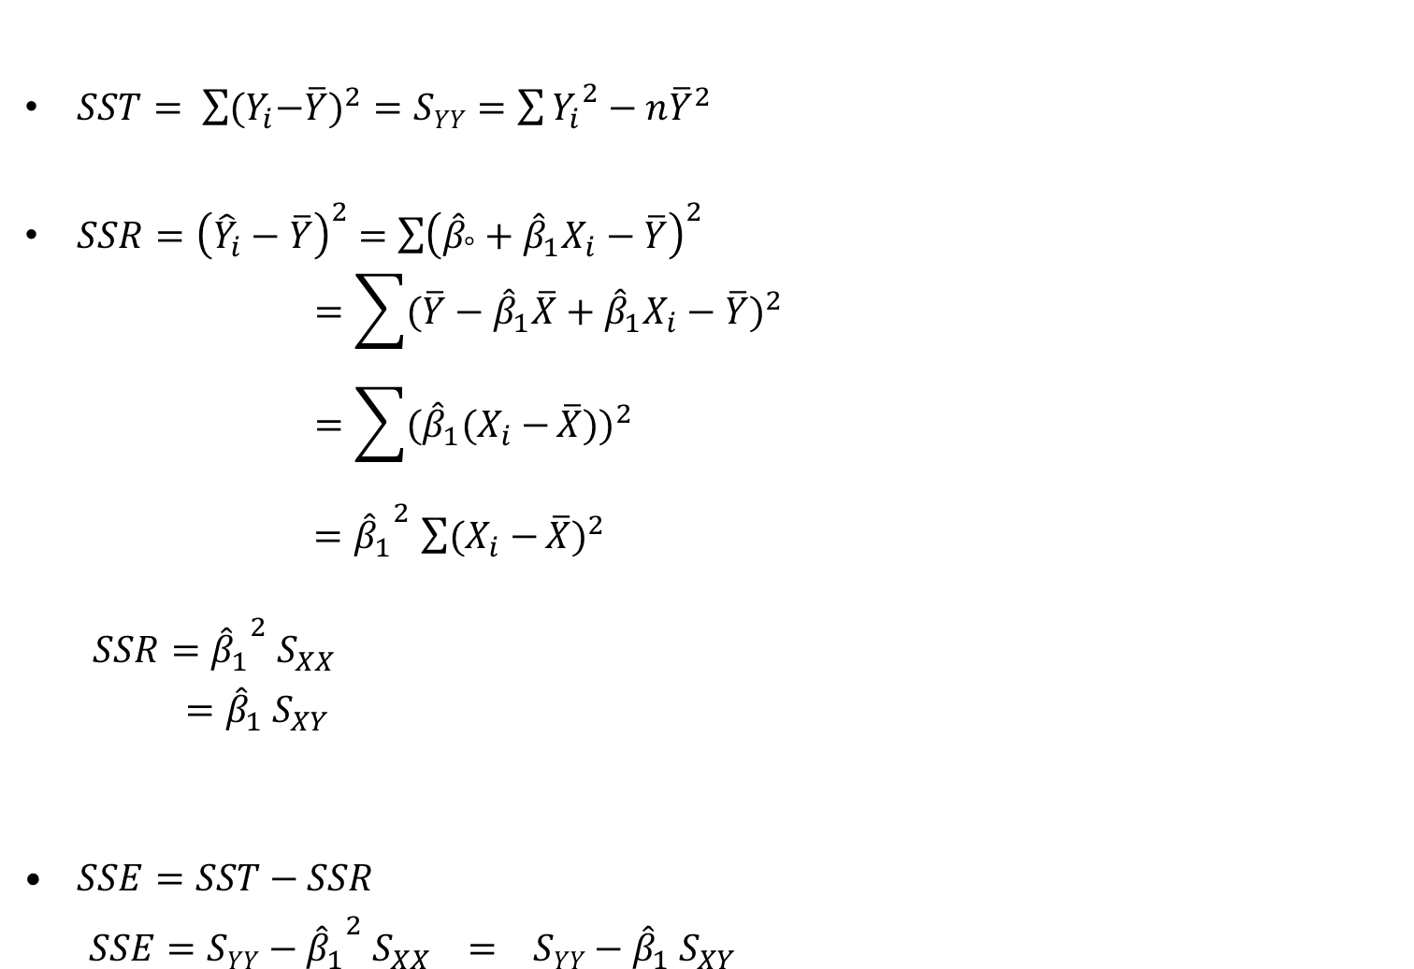
$SST= \sum{{{(Y}_{i}−\overline{Y})}^{2}}=SYY=\sum{{Y_{i}}^{2}−n{\overline{Y}}^{2}}$
$SSR{=\left({\hat{Y}}_{i}−\overline{Y}\right)}^{2} =\sum{{\left({\hat{β}}_{°}+{\hat{β}}_{1}X_{i}−\overline{Y}\right)}^{2}}$
$$=\sum{{(\overline{Y}−{\hat{β}}_{1}\overline{X}+{\hat{β}}_{1}X_{i}−\overline{Y})}^{2}}$$
$$={\sum{{(\hat{β}}_{1}(X_{i}−}\overline{X}))}^{2}$$
${{=\hat{β}}_{1}}^{2}{\sum{(X_{i}−}\overline{X})}^{2}$
$${{ SSR=\hat{β}}_{1}}^{2} S_{XX}$$
$={\hat{β}}_{1} S_{XY}$
$SSE=SST−SSR$
$SSE=SYY−{{\hat{β}}_{1}}^{2} S_{XX} = SYY−{\hat{β}}_{1} S_{XY}$

