Slide 1
Ministry of Higher Education and Scientific Research Salahaddin University
College of Agricultural Engineering Sciences Soil and Water Department
Lecture-3- Third Stage
By
Kamyar M. Mohammed
2023-2024

Slide 2
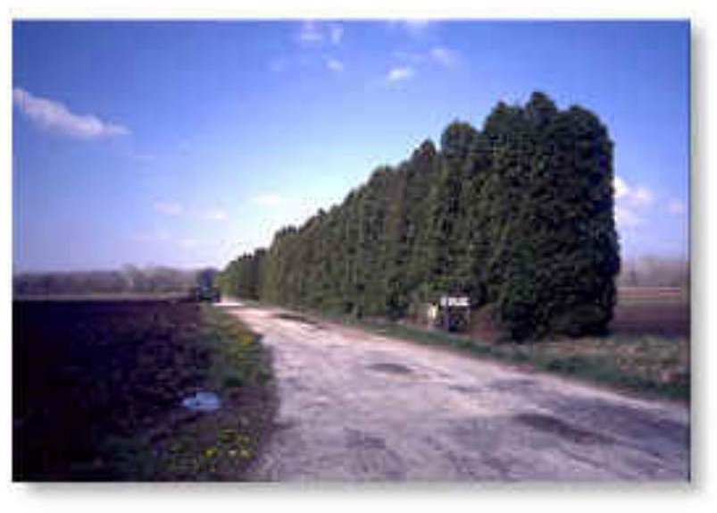
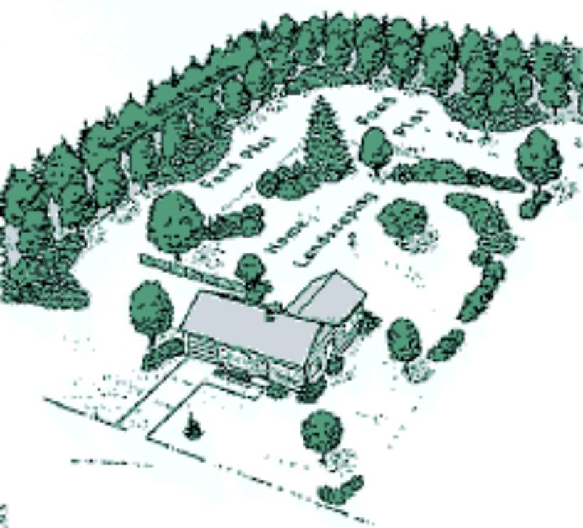
Windbreaks were first used in
connection with the dust bowl.
A windbreak causes the wind to swirl and it therefore does not cause as much damage.
Wind blowing in the same direction for a long time is able to gain speed and therefore evaporate more water from the soil and move more topsoil.

Slide 4
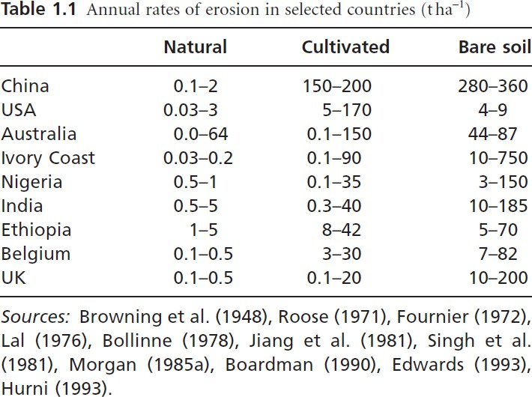

Slide 5
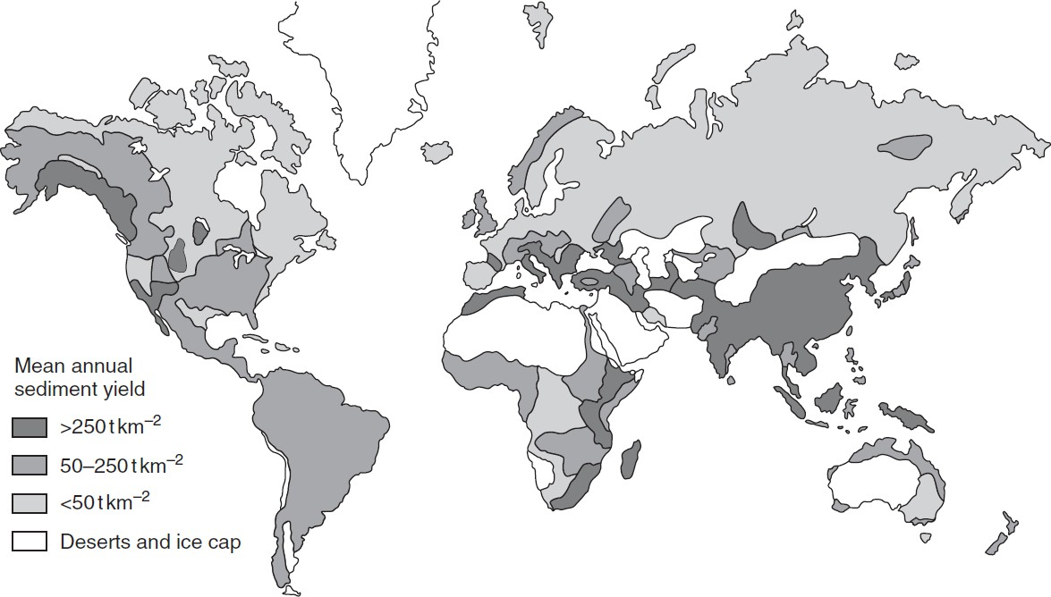

Slide 6
The energy available for erosion takes two forms:
1. Potential energy (PE)
PE = mhg
PE = potential energy in (Joule) m = mass in (kg)
h = height difference in (m)
g = acceleration due to gravity in (ms⁻²)

Slide 7
2. Kinetic energy (KE)
KE = ½ mv²
KE = kinetic energy in (joule) m = mass in (kg)
v = velocity in (ms⁻¹)

Slide 8
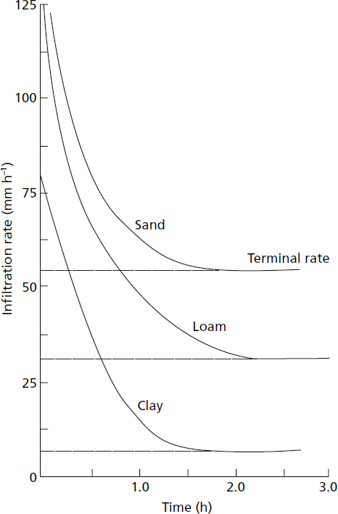
Fig. Typical infiltration rates for various soils.

Slide 9
1. Detachment of soil particles by flow
detachment of an individual soil particle from the soil mass occurs when the forces exerted by the flow exceed the forces keeping the particle at rest.
_{D = Q}1.12 _{s}0.64
D = detachment rate
Q = discharge or flow rate s = land slope

Slide 10
2. Transport of soil particles by flow
Once sediment has been entrained within the flow, it will be transported until
such time as deposition occurs.
_{T = 0.0085 Q}1.75 _{s}1.625 _{D}-1.11
T = transport of the soil particles
Q = discharge rate
s = slope of land
D = diameter of particle size of the surface material

Slide 11
3. Deposition of soil particles
D_{p} = v_{s} * C
D_{p} = rate of deposition of soil particles
C = actual sediment concentration
Vs = settling velocity of the particles

Slide 12
Now lets talk about wind

Slide 13
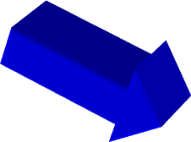
WIND EROSION
SUSPENSION
SALTATION
CREEP
SALTATION DETACHES PARTICLES
SMALLER PARTICLES SUSPENDED
LARGER PARTICLES CREEP
SANDY AND SILTY SOILS MOST SUSCEPTIBLE
SOIL ACCUMULATION IN DITCHES AND FENCE ROWS

Slide 14
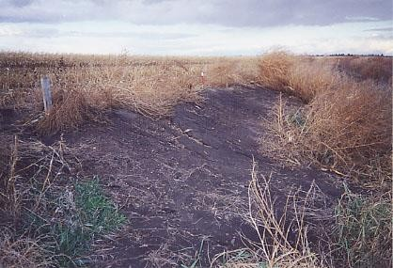
WIND EROSION CAN BE SIGNIFICANT
Near Mitchell, SD

Slide 15
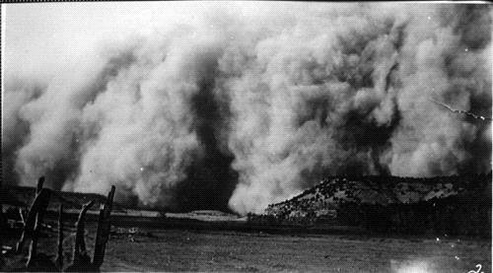
Severe dust storm. An example erosion by wind.

Slide 16
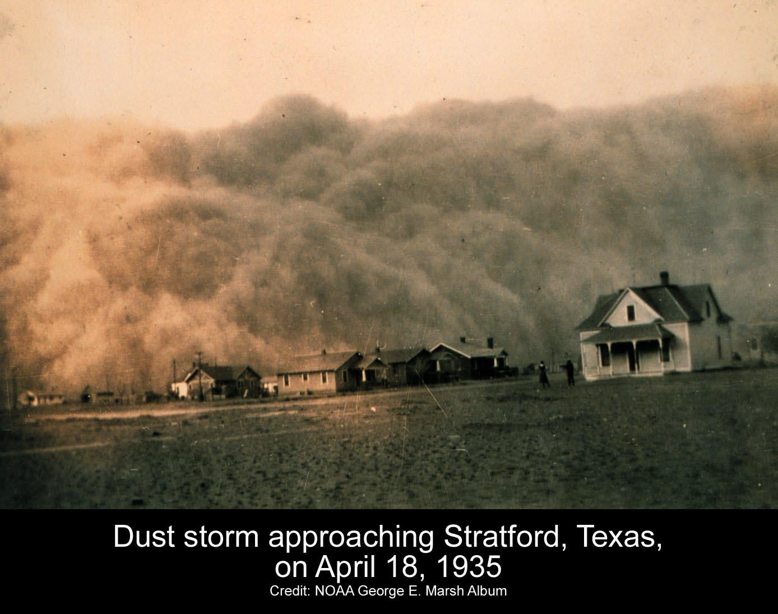

Slide 17
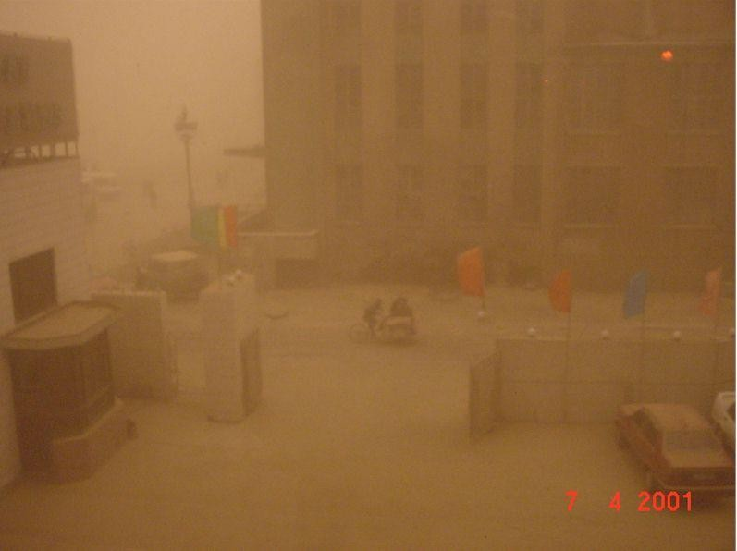
Dust storms can carry loose unprotected soil into cities, too.

Slide 18
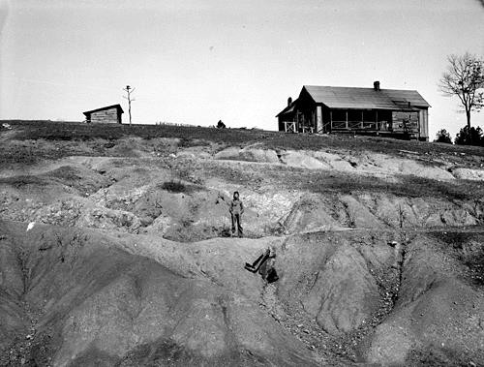

Slide 19
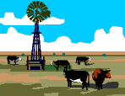
What about animals?

Slide 20
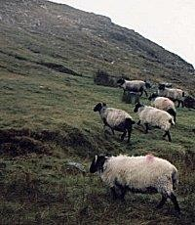
Many animals graze….is this good or bad for the soil??

Slide 21
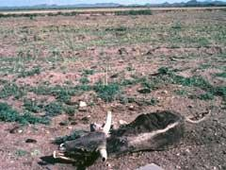
Overgrazing leads to the extinction of indigenous plant and animal species, soil erosion, and eventual desertification that renders once- fertile land barren.

Slide 22
How do people effect soil erosion?

Slide 24
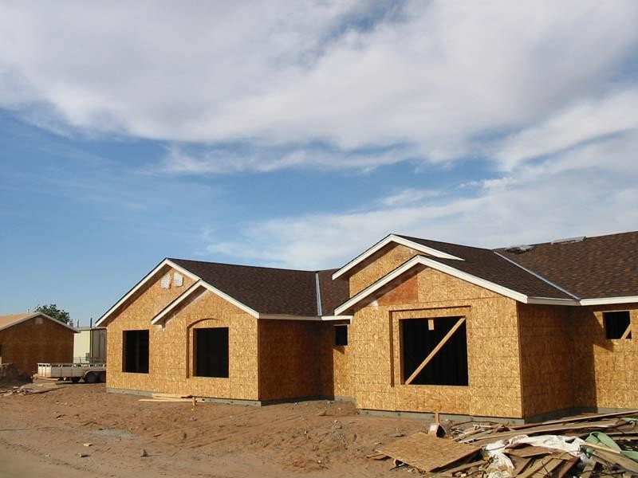
Residential construction effects on soil

Slide 25
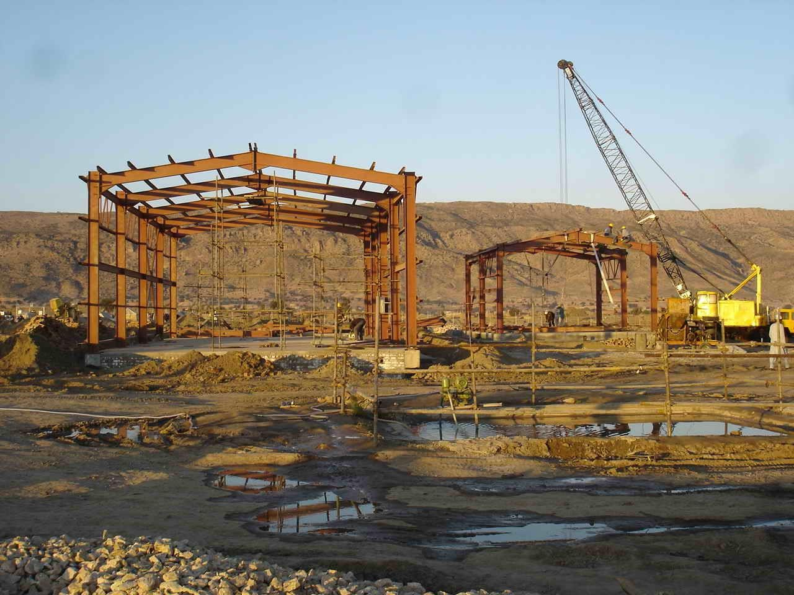
Commercial construction

Slide 26
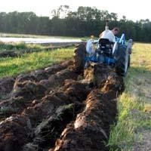
Traditional Plowing

Slide 27
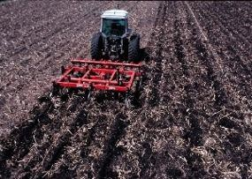

Slide 28
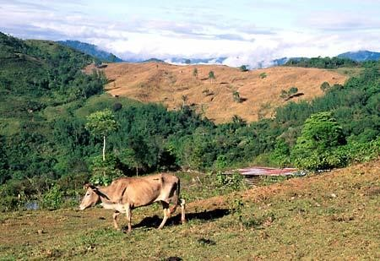
Deforestation

Slide 29
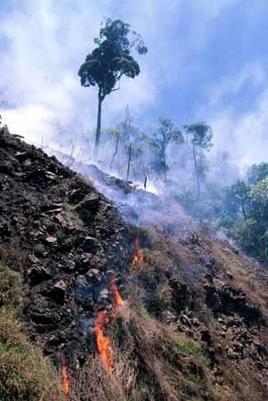

Slide 30
