Slide 1
Ministry of Higher Education and Scientific Research Salahaddin University
College of Agricultural Engineering Sciences Soil and Water Department
Lecture-4- Third Stage
By
Kamyar M. Mohammed
2023-2024

Slide 2
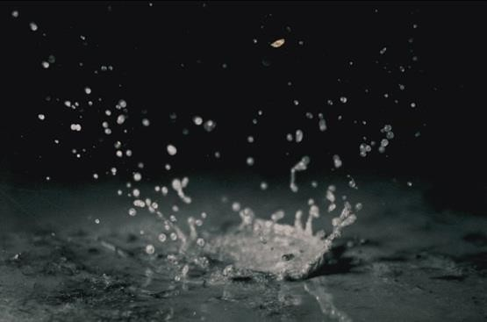
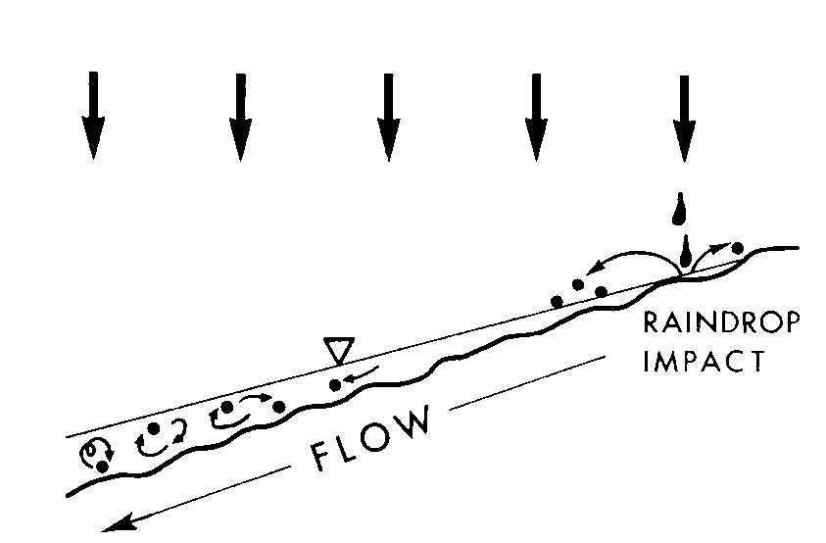
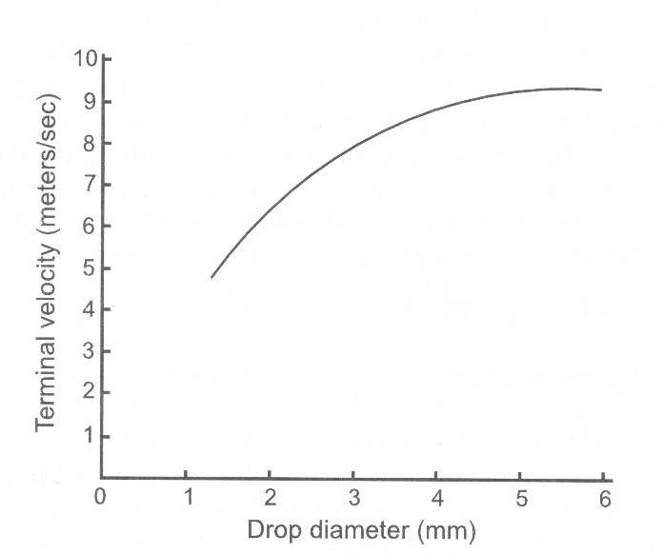
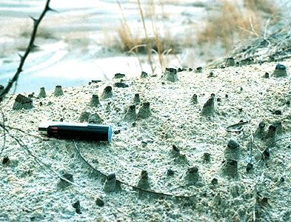
Splash Erosion - Raindrop Impact
Brook et al, Fig 7.2
Notes:
Soil aggregates destroyed
Saltation
Erosivity threshold ~25 mm/h
Erosive power = Σ kinetic energy (E_{K} = mv²/2) and
momentum (M = mv)
Fog ~ 0.05 mm/h
Light rain ~ 1.02 mm/h
Heavy rain ~ 15.24 mm/h
Torrential rain ~ 101.60 mm/h
Hillel, 1998; Selby, 1993
P. Gary White

Slide 3
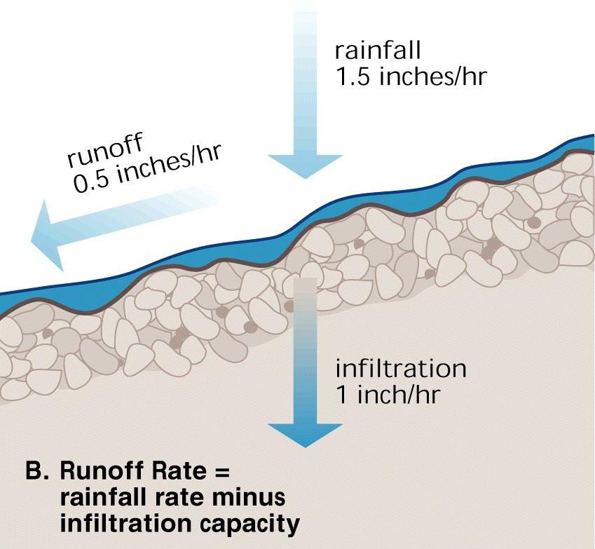
Surface flow induced erosion
Requires overland flow (thin surface films or concentrated) and often is intensified by raindrop impact
The generation of surface flow depends on:
Rain intensity
Water content of the soil
Density of the soil
Surface roughness of the soil
SCS CN method: “Water moves through a watershed as sheet flow, shallow concentrated flow, open channel flow, or some combination of these…After a maximum of 300 feet, sheet flow usually becomes shallow concentrated flow”
Important in range and agricultural
systems

Slide 4
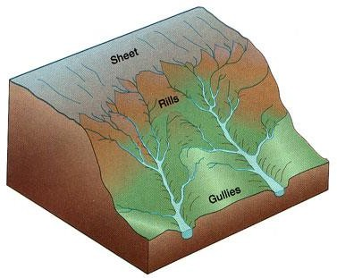
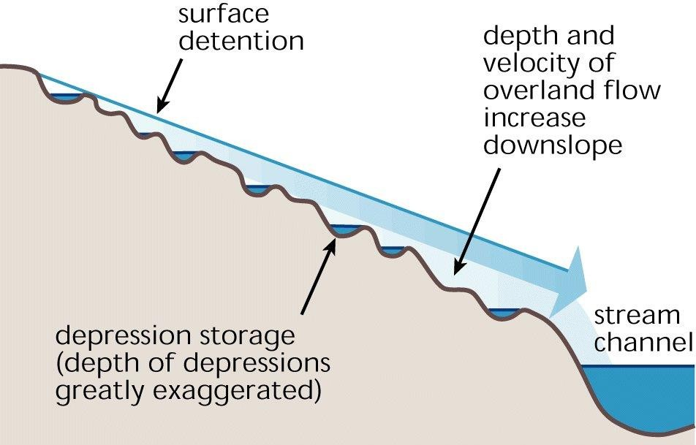
Overland flow
Sheetflow
Rill
Gully
Exceeds detention storage
Begins with detachment: requires a force (shear) created by small eddies in flow or raindrop impact
τ₀ = f (density, water depth, slope)

Slide 5
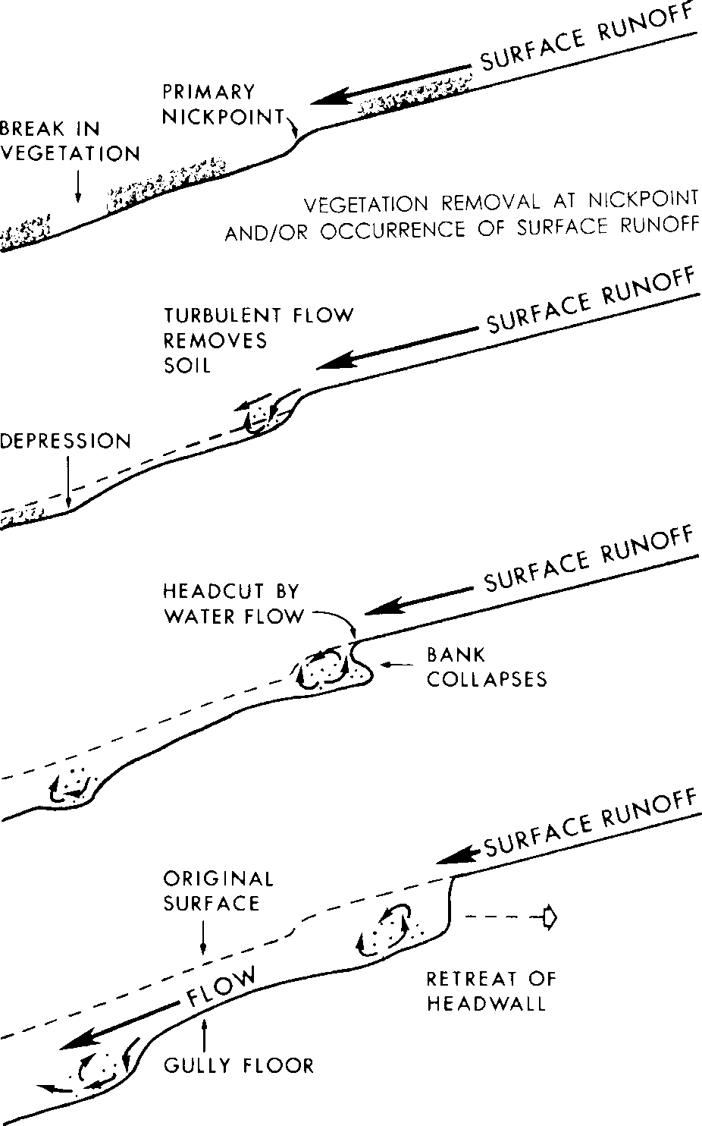
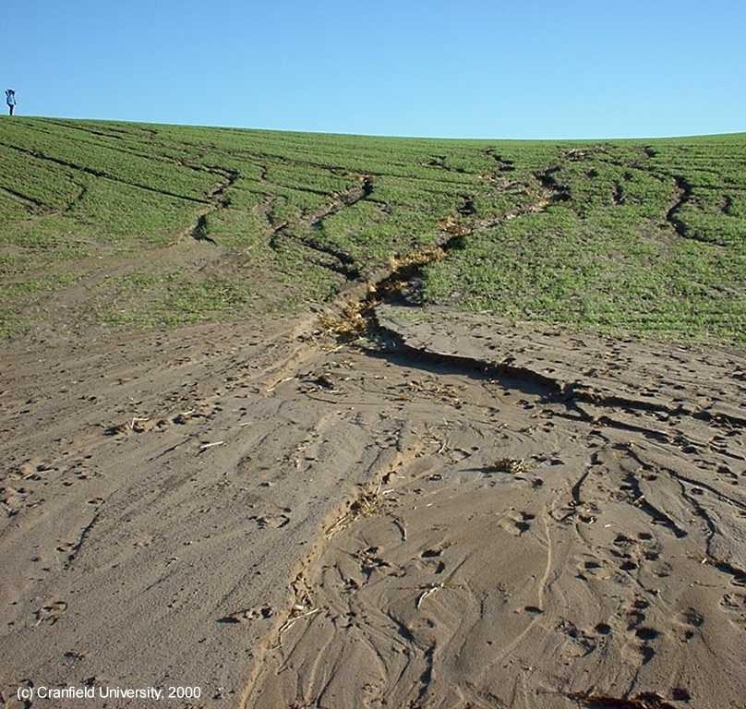
Rill and Gully Formation
Brooks et al., Fig 8.1

Slide 6
Interrill Erosion
D_{i} = K_{i} i q S_{f} C_{v}
D_{i} = Interrill erosion rate (kg/m²-s)
K_{i} = Interrill erodibility of soil (kg-s/m⁴) i = Intensity of rainfall (m/s)
q = Runoff rate (m/s)
(Equation 7.1)
(Table 7.1)
S_{f} = Interrill slope factor = 1.05 – 0.85 e^{(-4sinθ)} where θ = slope angle (degree)
C_{v} = Cover adjustment factor (0 - 1)

Slide 7
Rill Erosion Rate
⎛ ⎞
q
D = K τ
( )
−τ
⎜
1−
s
(Equation 7.2)
_{T} ⎟
r r
c
⎝ c ⎠
D_{r} = Rill detachment rate (Kg/m²-s)
K_{r} = Rill erodibility, due to shear (s/m)
𝜏 = Hydraulic shear of flowing water (Pa) = γ R S
γ = Specific weight of water (9810 N/m³)
R = Hydraulic radius of rill (m)
S = Hydraulic gradient or slope (m/m)
𝜏_{c} = Critical shear below which no erosion occur (Pa)
q_{s} = Rate of sediment flow in rill (Kg/m-s)
T_{c} = Sediment transport capacity of rill (Kg/m-s) = B 𝜏^{1.5}
(Equation 7.3)
(Equation 7.4)
B = Transport coefficient based on soil and water properties generally between 0.01 and 0.1 (dimensionless)

Slide 8
Rill Erosion Rate
⎛ q_{s} ⎞
D_{r} = K_{r} (τ −τ_{c} )⎜1−
⎟
: defines erosion or deposition
⎝ ^{T}c ⎠
If T_{c} > q_{s} : erosion takes place
If T_{c} < q_{s} : deposition takes place
If 𝜏 > 𝜏_{c} : erosion takes place
If 𝜏 < 𝜏_{c} : no erosion
The interrill and rill erosion processes are used in several process-based erosion prediction computer models, including the Water Erosion Prediction Project (WEPP) model

Slide 9
Example: Rill Erosion
A rill channel is observed at a location 20 m from the top of the hill during a storm. The slope is 5%, the rill width is 150 mm, and the hydraulic radius is estimated to be 0.01 m, respectively. The sediment transport rate (q_{s}) is measured and found to be 0.2 kg/m-s. The rill erodibility (K_{r}) is estimated to be 0.004 s/m, critical shear (𝜏_{c}) to be 2.5 Pa, and transport coefficient (B) to be 0.1. Assume that the specific weight of water is 9810 N/m³. Calculate the sediment transport capacity and erosion rate for the location. If the hillslope is 120 m long and rainfall duration is 1 hour, how much soil will be eroded from the hillslope by rill erosion?
𝜏 = γ R S (Pa)
T_{c} = B 𝜏^{1.5} (Kg/m-s)
•
(Kg/m²-s)
𝜏 = 4.905 Pa
T_{c} = 1.086 Kg/m-s
D_{r} = 0.00785 Kg/m²-s
= 0.1629 Kg/s
= 0.001177 Kg/m-s
= 423.8 Kg
( )
⎛
q
⎞
D = K τ −τ 1−
s
r r c
⎜ _{T} ⎟
⎝ c ⎠

Slide 10
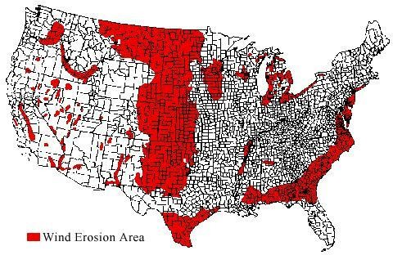
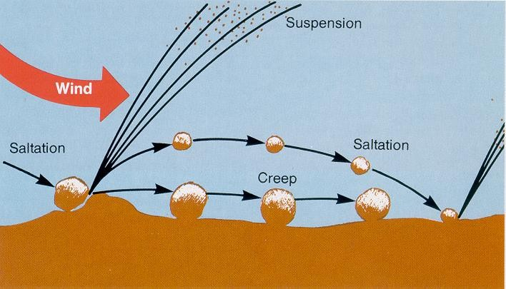
Wind erosion
Important especially in arid regions
Dependent on
Wind speed and exposure
Soil particle- and aggregate sizes
Surface roughness
Tillage
Surface roughness creates turbulence in the surface-near air layer →
Under pressure sucks particles in the air
Form of movement:
< 0.1 mm → Suspension (“dust storm”)
< 1 mm → Saltation (“jumping”)
> 1mm → Creep (“rolling”)

