Slide 1
Methods and Estimation of Excess Runoff

Slide 2
Runoff
Portion of precipitation that makes its way towards streams, lakes or oceans as surface or subsurface flow
Factors affecting runoff
Climatic factors
Physiographic factors

Slide 3
Runoff measurement methods
1. Rational Method
Where,
Q I C A
=Peak rate of runoff, m³/sec;
=Intensity of rainfall, mm/hour (time of concentration)
=runoff coefficient
=Area of the catchment, ha

Slide 4
Runoff coefficient (C)
Sl No. | Soil type | Land use
 |  | Cultivation | Pasture | Forest
1 | Soil with above average infiltration rate i.e. sandy or gravel | 0.29 | 0.15 | 0.1
2 | Soil with average infiltration rate, no clay pans, loams and similar soil | 0.4 | 0.35 | 0.3
3 | Soil with below average infiltration rates, heavy clay soils or soils with a clay pan near the surface, shallow soils above impervious rock | 0.5 | 0.45 | 0.4

Slide 5
Intensity of rainfall (I)
I : calculated for the period equal to the time of concentration of the catchment.
The Time of Concentration (Tc) is defined as the time required for water flow from the most remote point of the catchment to the outlet

Slide 6
Time of Concentration (Tc)
This is the longest time it takes for a part of the catchment to contribute water to the outlet.
It is the time it takes for all the parts of the watershed to be contributing water to the outlet.
The divide or watershed divides the flow of water along different slopes.
All runoffs flow from the whole catchment to the stream or outlet.

Slide 7
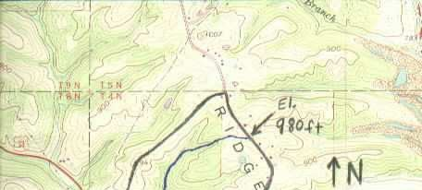
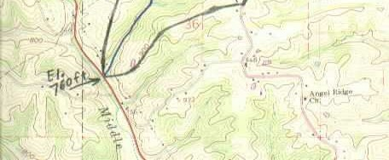
Time of Concentration (Tc)
Where,
t_{c} =Time of concentration, min; L =Length of channel reach, m;
S =average slope of the channel reach, m/m

Slide 8
Limitations
It assumes that rainfall intensity is uniform over the entire watershed during the duration of the storm, which is very rare
The initial losses due to depression storage and initial infiltration are not considered.
Runoff coefficient changes with respect to season as well as rainfall characteristics, which is not considered in rational formula

