Slide 1
Methods and Estimation of Excess Runoff
Soil and Water Conservation
Lecture -6-
2023-2024

Slide 2
2. Curve number method
Where,
F =Actual retention, mm;
S =Potential maximum retention, mm;
Q =accumulated runoff depth, mm;
P =accumulated rainfall depth, mm I_{a} =Initial abstraction, mm

Slide 3
Factors determining curve number values
Indicate runoff response characteristics of the drainage basin.
Parameters like
1. Land use
2. Land treatment
3.Hydrological condition
4. Hydrological soil group
5. Antecedent soil moisture drainage basin are related
values.
condition in the to curve number

Slide 4
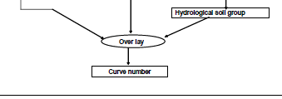
3. Estimation of Runoff by Using Remote Sensing and GIS

Slide 5
3. Estimation of runoff by using
remote sensing and GIS
Processes
Preparation of Land use/Land cover map by using the remote sensing and GIS.
Preparation of hydrologic soil group map for making appropriate hydrological soil classification A, B, C & D
Decide the curve number (CN) values based on field condition.
Calculate S value and then estimate runoff Q

Slide 6
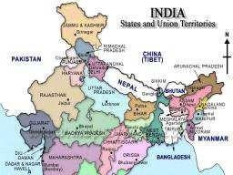
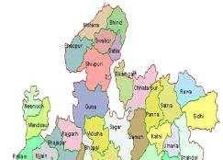
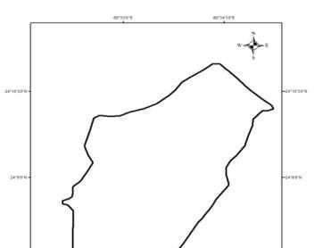
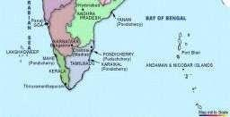
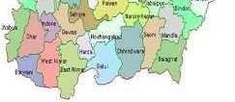
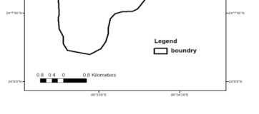
Estimation of runoff depth -Example
Kanhaiya nala watershed
Preparation of Various Thematic Maps:
Contour map
Drainage map
DEM
Slope map
Land land use/ land cover map.
In Tons River catchment
Elevation - 480 to 620 m aboveMSL
Satna District (M.P.)

Slide 7
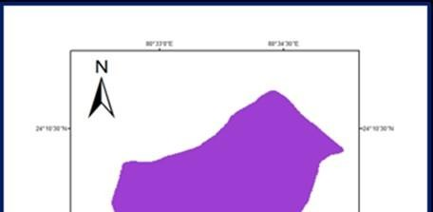
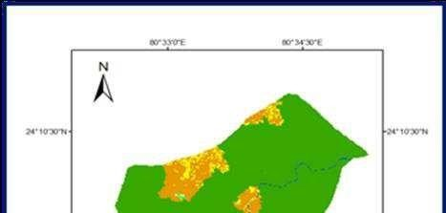
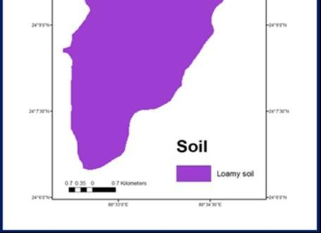
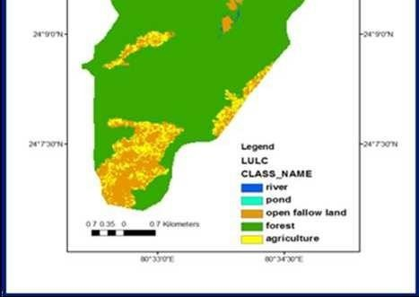
Soil and Land use land cover

Slide 8
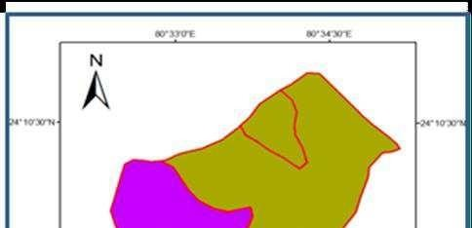
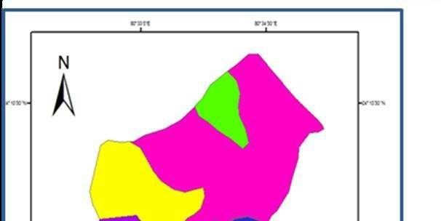
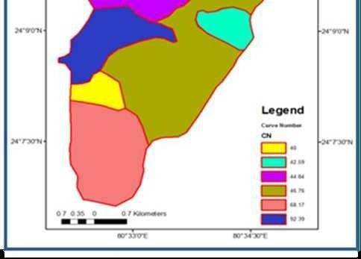
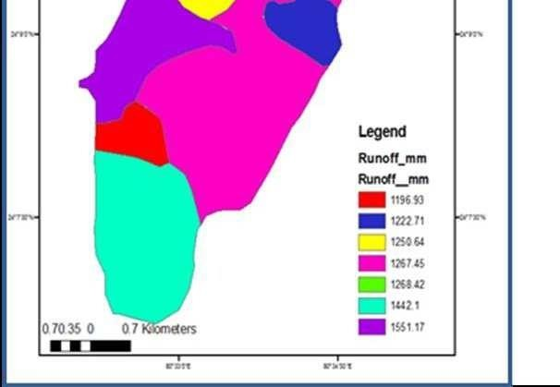
Generating CN and runoff depth map

Slide 9
Runoff measuring devices
Direct Discharge Methods
Weirs
Orifices
Flumes
Velocity - Area Methods
Float method
Current meter
Tracer method

Slide 10
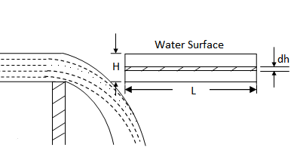
Weir
Q = C L H^{m}
Where,
Q = discharge;
C = coefficient dependent
on the nature of weir
Rectangular weir with no end contraction
crest and approach conditions;
L = length of crest;
H = head on the crest
m = exponent depending on weir opening.
Rectangular weir with two end contraction
Weirs should
be calibrated to these
determine
parameters
before use.

Slide 11
Orifice
Where,
Q = discharge rate, l/sec;
C = coefficient of discharge (0.6 - 0.8);
a = area of the orifice opening, cm²;
g = acceleration due to gravity, cm/s²
h = head of water causing the flow, cm

Slide 12
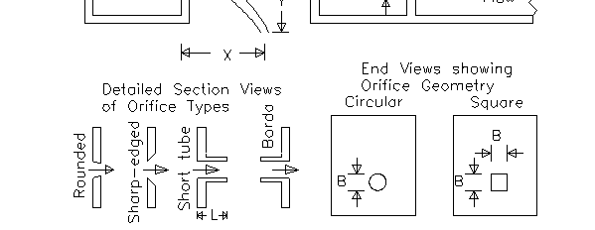
Orifice

Slide 13
Flumes Parshal Flumes
Used under free flow and submerged flow condition.
The single, primary point of measurement, denoted as Ha, which determine the flow rate through the flume.
In short throated flume, the H_{a} is
upstream of the
throat at a specific location - 2/3 of the sidewall length as measurement back from where the converging section meets the throat
For large Parshall flumes the point of measurement is closer to the throat

Slide 14
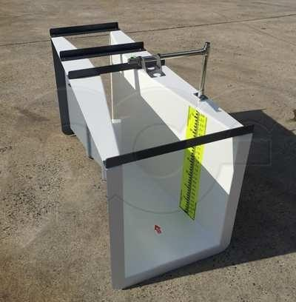
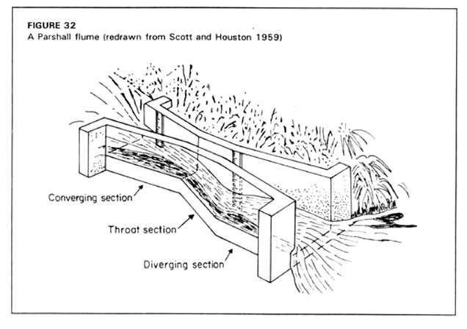
Flumes

Slide 15
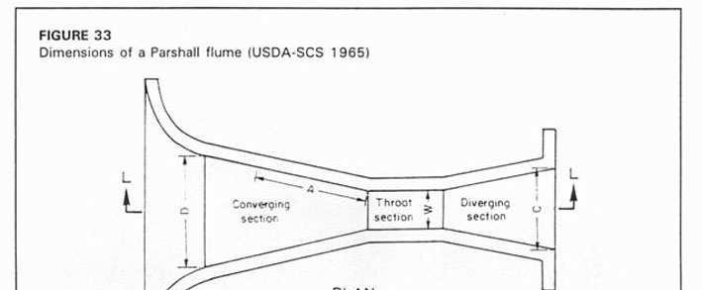
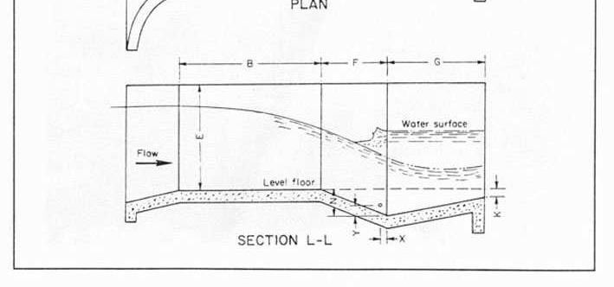
Standard design dimensions
(from USDA-SCS 1965)
Throat width | A (feet, inches) | B | C | D
W
(feet) 1 | 3-0 | 4-4 7/8 | 2-0 | 2-9 1/4
1½ | 3-2 | 4-7 7/8 | 2-6 | 3-4 3/8
2 | 3-4 | 4-10 7/8 | 3-0 | 3-11½
3 | 3-8 | 5-4 3/4 | 4-0 | 5-1 7/8
4 | 4-0 | 5-10 5/8 | 5-0 | 6-4 1/4
5 | 4-4 | 6-4½ | 6-0 | 7-6 5/8
6 | 4-8 | 6-10 3/8 | 7-0 | 8-9
7 | 5-0 | 7-4½ | 8-0 | 9-11 3/8
8 | 5-4 | 7-10 1/8 | 9-0 | 11-1 3/4
Dimension A = 2/3 (w/2+ 4)

Slide 16
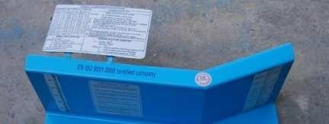
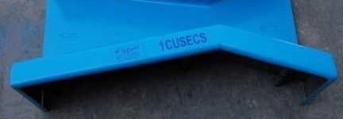
Cut Throat Flume
Improved version of Parshal
flume.
It is having flat bottom, vertical wall and no throat section.
For free flow critical depth is measured at throat.
Free flow depends on flume size and submergence ratio.

Slide 17
Stream flow monitoring methods
The
volume of water that
Selecting the channel location
Step 2: Developing a cross- section of the site and establishing a reference or staff gauge
Step 3: Measuring interval and depth
Step 1:
moves through the channel is then calculated by dividing the channel into smaller units of known or approximated areas (width
× depth)
Measuring the flow within each area (velocity - distance over time).
By multiplying area and velocity, flow is calculated from the location

Slide 18
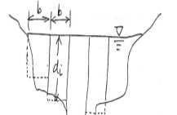
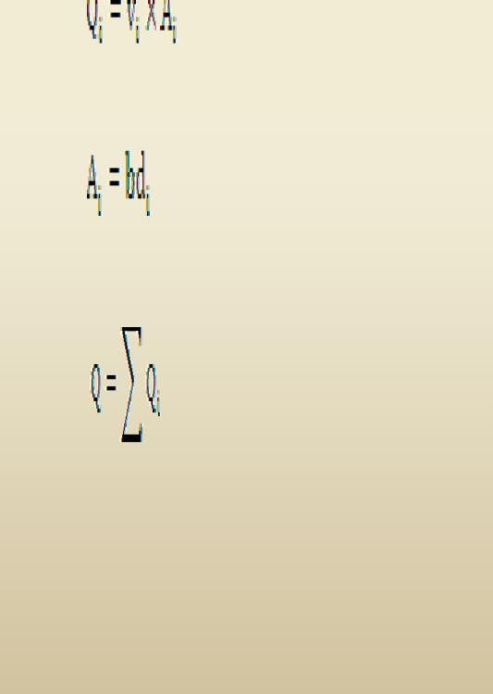
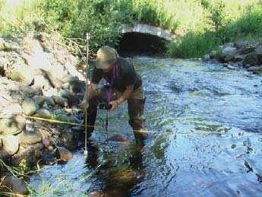
Measurement of stream flow discharge
Mid sectionmethod

Slide 19
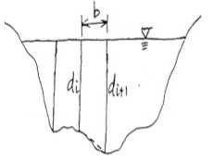
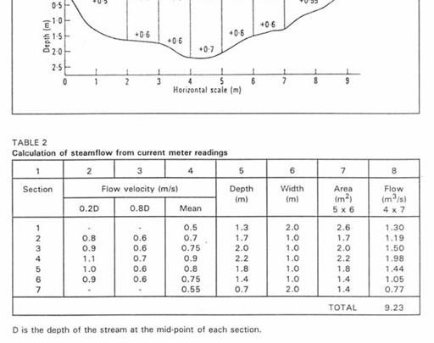
Velocity-area method

Slide 20
Velocity-area method

Slide 21
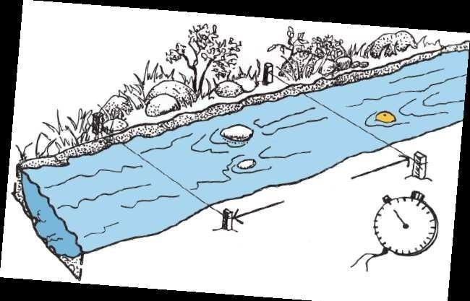
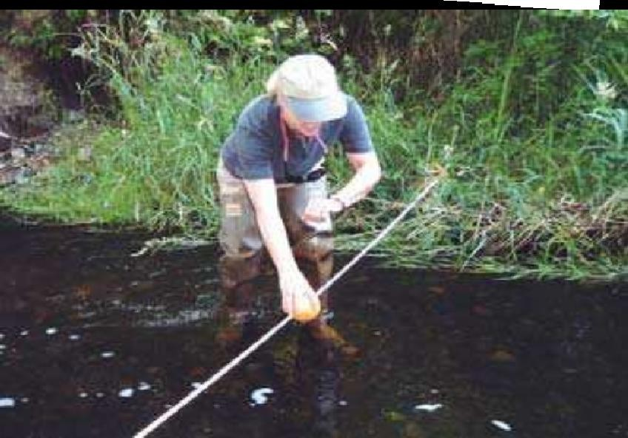
Float Method
A floating object is put in water and time is recorded to cover a known distance.
Assuming the float travels ‘D’ meters in ‘t’ seconds
Velocity of water at surface =
(D/t) m/s,
Average velocity of flow = 0.8 (D/t),
Flow rate, Q sectional area × flow
= Cross
velocity of

Slide 22
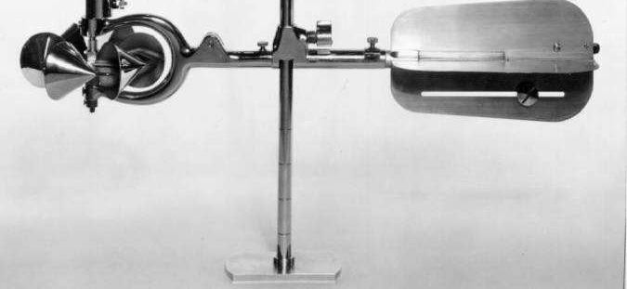
Current meter
Current meter is a small instrument containing a revolving wheel or vane that is turned by the movement of water.
Current meter is inserted to the depth = 0.6 d (d = depth of flow).
Number of rotations (rpm) was recorded and then velocity of flow is calculated from calibrated chart.
A current meter is used to measure velocity at 0.2 and 0.8 depth or at only 0.6 depth.

Slide 23
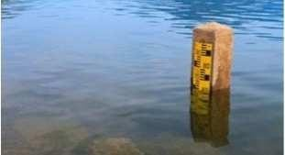
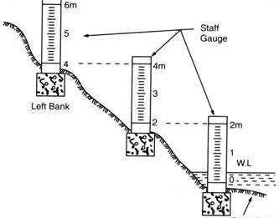
Stage level recorder
Non recording stream gage
Staff
Wire(String)
Crest staff
Recording stream gage
Float type
Digital gage

Slide 24
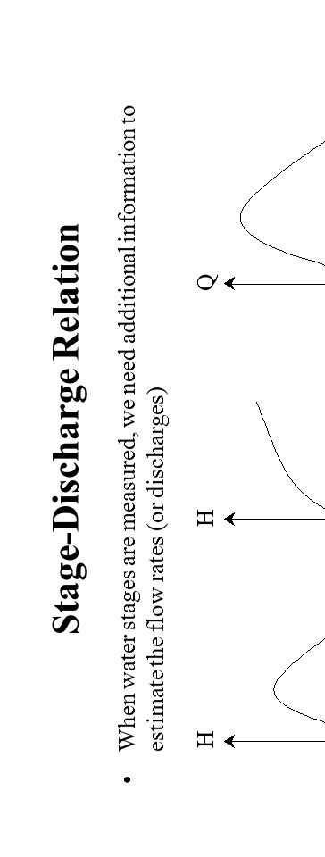
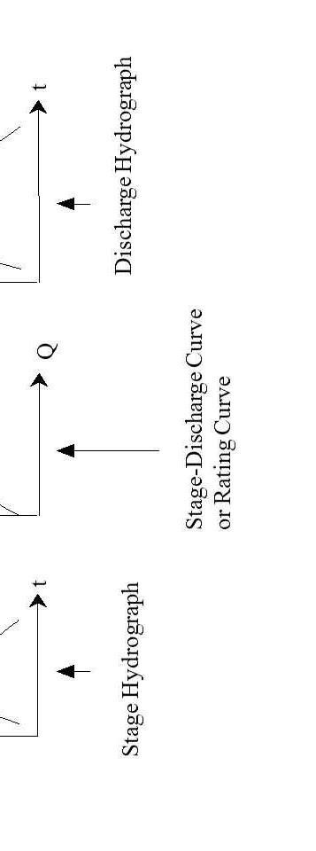

Slide 25
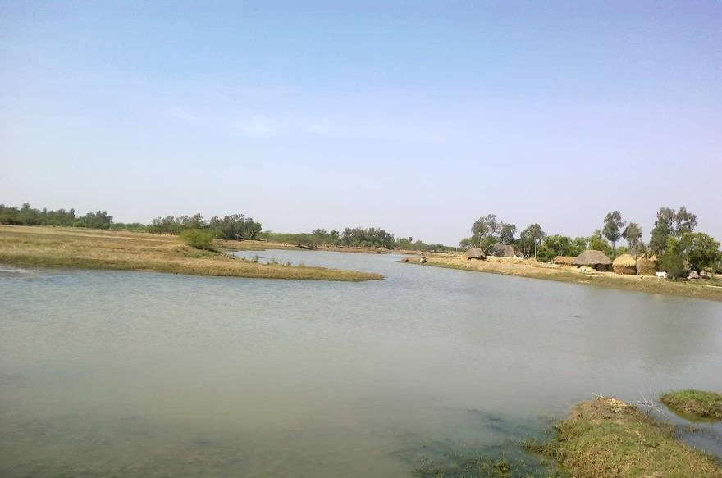
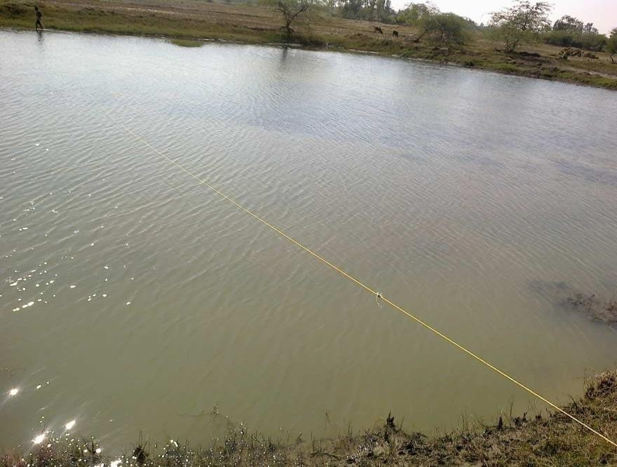
Measurement of discharge in Sunity Creek
Sl. No | Distance from mouth, | Av. Count/ minute | Measured Velocity, | Top width, | Bottom width, | Water depth, | Area, (A) | Discharge, Q
 | m |  | m sec⁻¹ | m | m | m | _{m}2 | m³ sec⁻¹
1 | 60 | 80 | 0.40 | 40.00 | 38.80 | 0.40 | 15.76 | 6.33
2 | 120 | 80 | 0.40 | 60.00 | 59.10 | 0.30 | 17.87 | 7.12
3 | 180 | 71 | 0.36 | 50.00 | 49.10 | 0.30 | 14.87 | 5.28
4 | 240 | 78 | 0.39 | 50.00 | 49.04 | 0.32 | 15.85 | 6.21
5 | 300 | 80 | 0.40 | 51.00 | 50.10 | 0.30 | 15.17 | 6.09
6 | 360 | 80 | 0.40 | 42.00 | 41.04 | 0.32 | 13.29 | 5.34
7 | 420 | 82 | 0.41 | 46.00 | 45.07 | 0.31 | 14.12 | 5.79
8 | 480 | 80 | 0.40 | 49.00 | 48.10 | 0.30 | 14.57 | 5.80
9 | 540 | 82 | 0.41 | 40.00 | 38.92 | 0.36 | 14.21 | 5.83
10 | 600 | 76 | 0.38 | 53.00 | 52.04 | 0.32 | 16.81 | 6.36
11 | 660 | 77 | 0.39 | 38.00 | 36.86 | 0.38 | 14.22 | 5.48
12 | 720 | 67 | 0.34 | 55.00 | 54.10 | 0.30 | 16.37 | 5.51
13 | 780 | 63 | 0.32 | 71.00 | 70.28 | 0.24 | 16.95 | 5.29
14 | 840 | 65 | 0.33 | 63.00 | 62.25 | 0.25 | 15.66 | 5.09
15 | 900 | 56 | 0.28 | 61.00 | 60.13 | 0.29 | 17.56 | 4.89
16 | 960 | 44 | 0.22 | 52.00 | 51.16 | 0.28 | 14.44 | 3.20
17 | 1020 | 36 | 0.18 | 63.00 | 62.16 | 0.28 | 17.52 | 3.18
18 | 1080 | 44 | 0.22 | 92.00 | 91.40 | 0.20 | 18.34 | 2.63
19 | 1140 | 40 | 0.20 | 40.00 | 39.16 | 0.28 | 11.08 | 2.22
20 | 1200 | 39 | 0.20 | 52.00 | 51.10 | 0.30 | 15.47 | 3.04
21 | 1260 | 34 | 0.17 | 49.00 | 48.22 | 0.26 | 12.64 | 2.17
22 | 1320 | 35 | 0.17 | 47.00 | 46.10 | 0.30 | 13.97 | 2.42
23 | 1380 | 73 | 0.37 | 47.00 | 46.04 | 0.32 | 14.89 | 5.46
24 | 1440 | 65 | 0.33 | 49.00 | 48.10 | 0.30 | 14.57 | 4.73
25 | 1500 | 57 | 0.29 | 58.00 | 57.25 | 0.25 | 14.41 | 4.11
26 | 1560 | 57 | 0.28 | 44.00 | 43.16 | 0.28 | 12.20 | 3.46
27 | 1620 | 48 | 0.24 | 42.00 | 41.13 | 0.29 | 12.05 | 2.89
28 | 1680 | 62 | 0.31 | 37.00 | 36.10 | 0.30 | 10.97 | 3.38
29 | 1740 | 65 | 0.32 | 41.00 | 40.04 | 0.32 | 12.97 | 4.19
30 | 1800 | 77 | 0.38 | 31.00 | 29.92 | 0.36 | 10.97 | 4.20
31 | 1860 | 66 | 0.33 | 32.00 | 30.86 | 0.38 | 11.94 | 3.96
32 | 1920 | 62 | 0.31 | 30.00 | 28.80 | 0.40 | 11.76 | 3.65
33 | 1980 | 74 | 0.37 | 34.00 | 32.80 | 0.40 | 13.36 | 4.97
34 | 2040 | 63 | 0.32 | 30.00 | 28.80 | 0.40 | 11.76 | 3.70

Slide 26
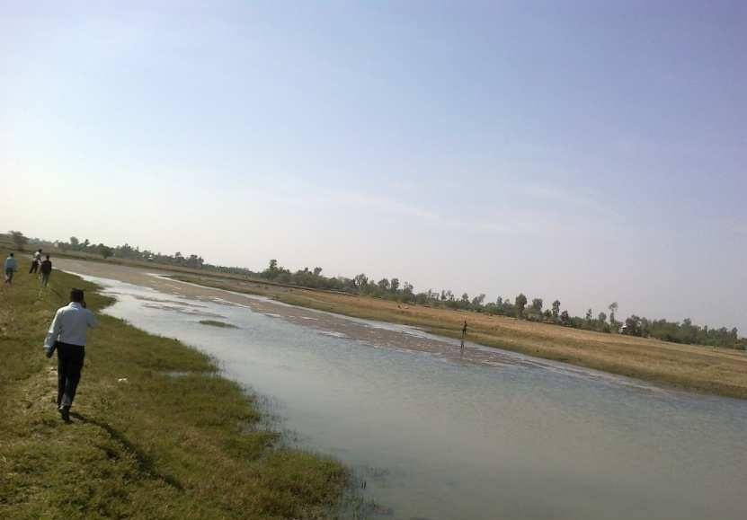
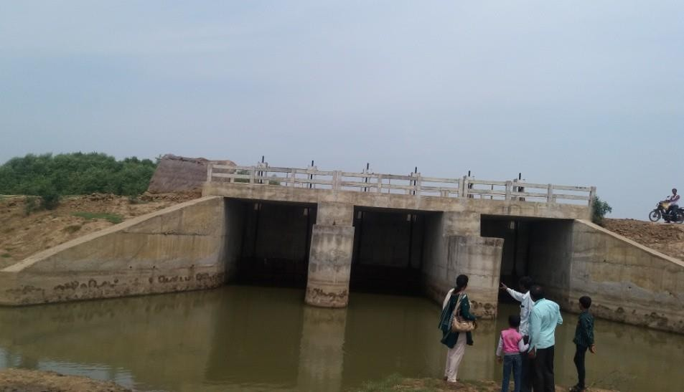
Water availability in creeks and water quality
Creek | Discharge at creek cross section ( m³/sec) | Volume of Water available (November - January), _{m}3
Creek Q1 | 11.03
Creek Q2 | 9.35
Creek Q3 | 7.84
Creek Q4 | 7.04
Average (Creeks) | 8.81 | 31474958
Sub Creek Q1 | 10.5
Sub Creek Q2 | 5.87
Sub Creek Q3 | 4.73
Sub Creek Q4 | 4.42
Average (Sub creeks) | 6.38 | 22324896
Total |  | 53799854

