Slide 1
Animal Farm
2nd Lecture

Slide 2
What is Animal Farm?
A farm is an area of land where animals are raised for use as food sources and economic profit.
Farm includes all buildings that used for animal house, stores for food and equipment.

Slide 3
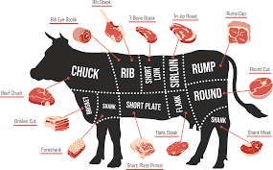
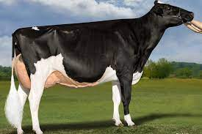
Animal farm types According to production:
1.Sheep and Goat Farm (meat, milk, wool)
2.Cattle Farm (meat, milk)
3.Poultry Farm ( Egg, Meat)
4.Aquaculture Farm (Fish)

Slide 4
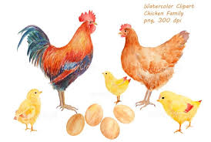
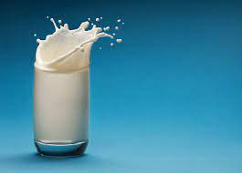
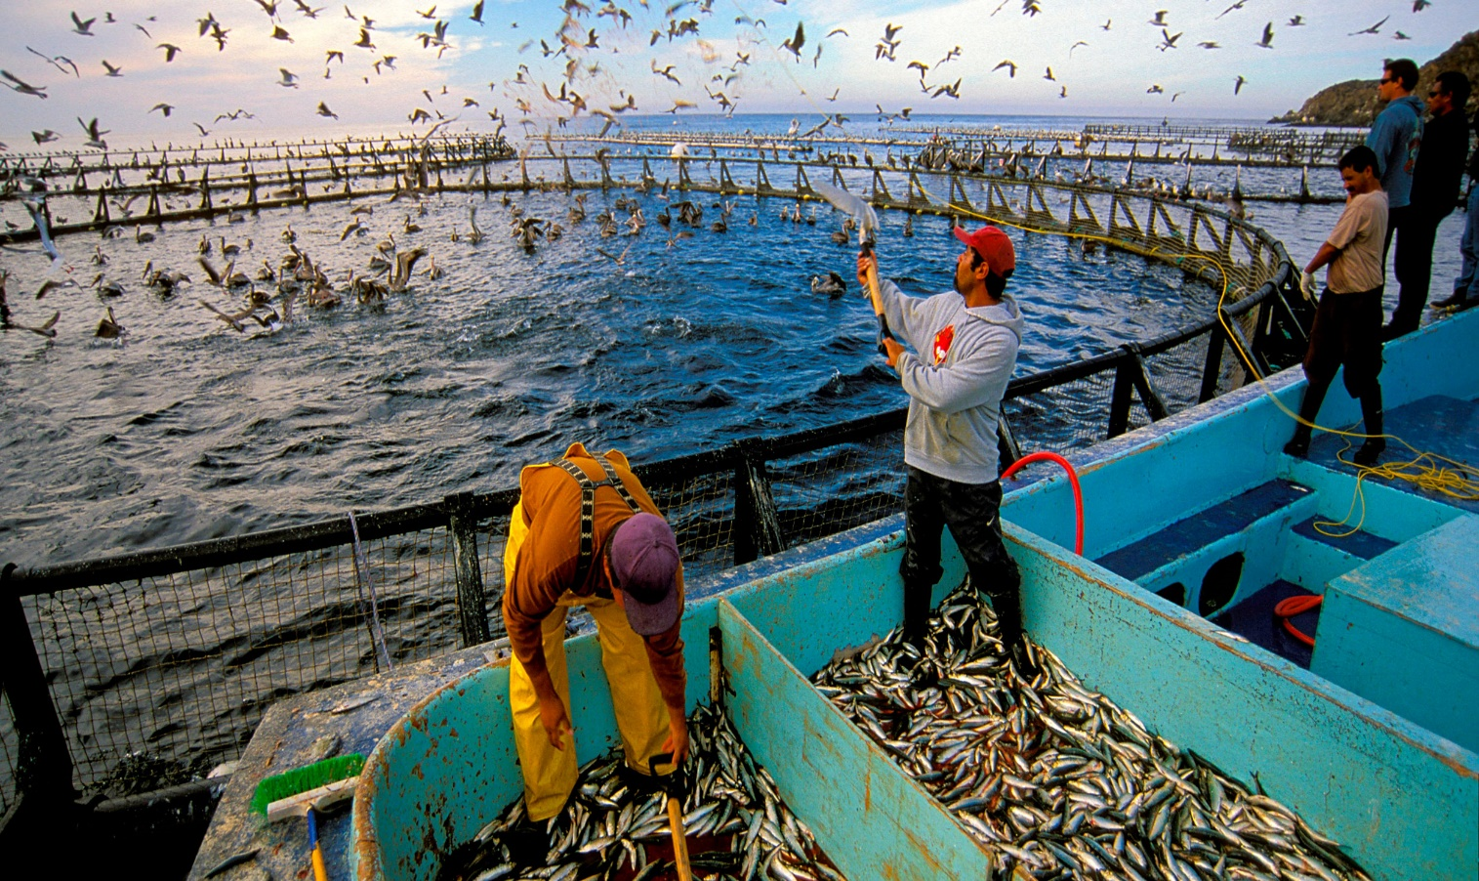

Slide 5
Factors to consider in selecting a site for livestock farm:
Distance to residence houses
Direction of winds
A suitable source of water
Close to main road
Land for manure management
Topography of place
Soil type
Depth to groundwater

Slide 6
Factors to consider in establishing new animal farm:
1.The species, strain, and breed of the animal and individual characteristics, such as sex, age, size, behavior, experiences, and health
2.The ability of the animals to form social groups with conspecifics through sight, smells, and possibly contact,
3.The design of housing.
4.The project goals (e.g., production, breeding, research, testing, and teaching).

Slide 7
5.The intensity of animal
6.The duration of rearing.
Types of Livestock Houses:
1.Closed House: including cage, pen, or stall
•House should be built with good materials and they should have flat, water-resistant surfaces with minimal ledges, angles, corners.
•Ventilation in this system should be very well and daily cleaning is very important to keep floor dry

Slide 9
Advantages of Closed House
1.Remain animals clean and dry
2.Allow adequate ventilation
3. Provide a secure environment
4.Are free of sharp edges
5. Allow observation

Slide 10
2- Open House:
Is type of house that opened to air and fully roofed or half roofed.
Advantages of open house:
1-The system requires less roofed area per animal
2- This technique requires only 2 kg/animal/day of hay
3-The system improves labour efficiency
4- Low coast to build

Slide 12
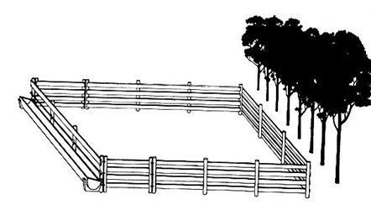
Types of open house:
1- The unroofed open house: no-roof open-yard system is to be recommended where the conditions are suitable.

Slide 13
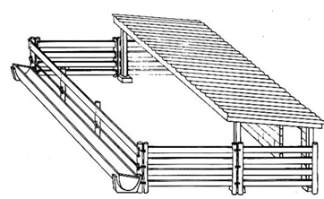
2-Half roofed open house: this system includes a covered area, the lying area, and an outdoor area for feeding and exercise.
The system must always focus on the direction of usual winds. The shelter must be against the wind.

Slide 14
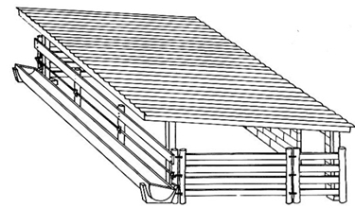
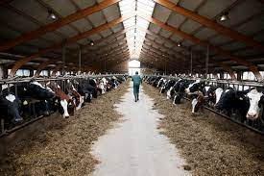
3-Full roofing: full roofing is housing completely protected by a roof, his kind of housing will only be recommended under highly specific conditions

Slide 15
3-Semi-open house: it is a combination of close house and open, which include a close house with an open yard. It can be used for different season.
Feeding system in farm
The feeding system must be well designed to succeed good performance.
Characterize of feeder: design feeder should be
•Provide livestock with free and continual access to feed
• Minimize waste, spilled feed and spoilage
•Easy delivery of feed and easy cleaning
•Minimize environmental impacts (odor, flies, dust)

Slide 16
Types of feeder:
1-Self-feeders: a device for providing feed to livestock automatically.
Advantages of self-feeders include that they
1.Have own storage
2.Are transportable, can be installed quickly, and used as a temporary feeder
3.Can be moved around within pens.

Slide 18
2-Bunk Feeder: Most commercial feedlots use in the farm. Feed bunks should locate along the fence line.
3-Hay feeder: is type of feeder use to feed hay in the farm. Hay saver design will reduce waste by 35%-50%.
4-Automatic feeding systems: Feeding will be carried out fully automatically through computer control. Used to mix and distribution feed.

Slide 19
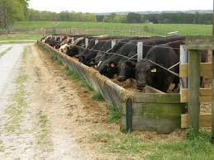

Slide 20
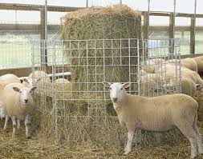
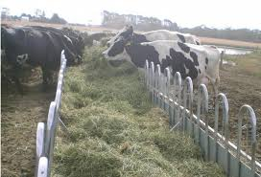

Slide 21
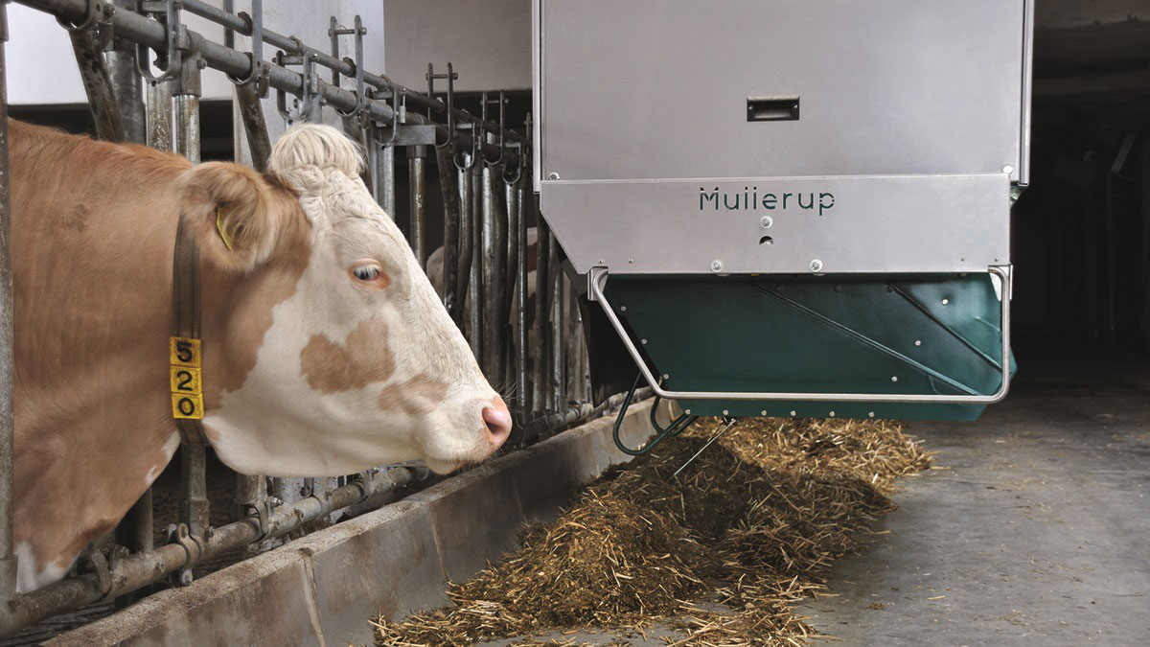

Slide 22
Water system in the farm
Livestock watering systems vary with different livestock and pastures.
It is necessary to provide fresh and clean source of water in the farm.
Water requirement depend on: animal type, level of production, season and ambient temperature, type of food.
Types of watering system:
1- surface water 2- pumping water

Slide 23
1-surface water:
The advantages are Low cost and freely available
Problems are Environmental Risk, Seasonal –drought/winter, health issue
2-Pump Systems:
Advantages: Can move water to different location, provide water in all season
Problems: Need electric power, expensive, need regular maintains, not portable

Slide 25
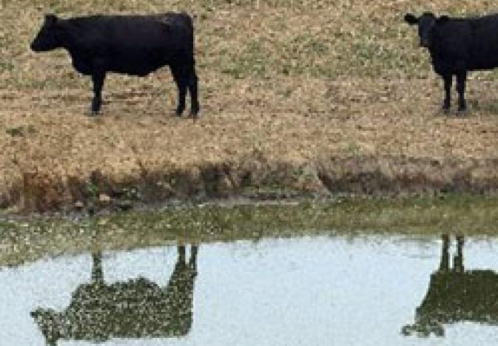
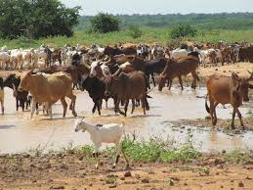

Slide 26
Numerate purpose of rearing livestock?

