Slide 1
Farm Management

Slide 2
Record keeping: each farm should have a record to keep all the information in it.
Farmers should keep records of:
All animal populations on the farm
All animal arrivals
Changes to feeding or health regimes.
Origin and use of all feeds, drugs, disinfectants, herbicides
Known diseases/infections,

Slide 3
Animal Identification (Tagging)
The reason for animal identification is allowed producers to keep records on an animal's parentage, birth date, production records, health history, and a host of other important management information.
The method of identification should be easy to use, easy identification, removable and inexpensive

Slide 4
Identification Methods
1-Ear Tagging: is the most common method, it attached to the ear and there are a variety of shapes, sizes, types and colours. They can also have names or numbers on them.
2-Ear notches: Notches is cut small part of animal’s ear for identification.

Slide 5
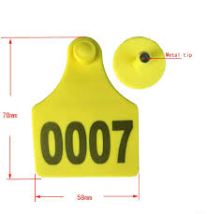
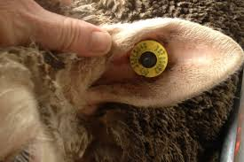
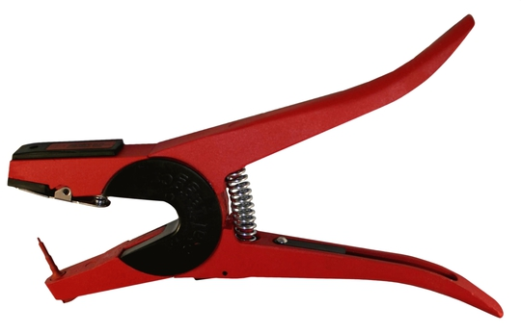

Slide 6
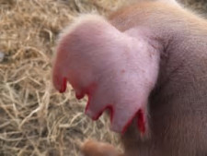
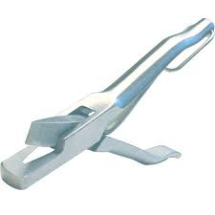

Slide 7
3-Tattoo: Tattoos and can be applied inside the ear, and on the thigh or abdomen. They can also be placed on the wattles of birds. it consist of letters, numbers or symbols.
4-Brands: is a very common method of identifying livestock and horses. Branding can be done by heat (livestock) or cold (common in horses).
5-Electronic Identification: There are many different forms of electronic identification. The most common include electronic ear tags, microchips.

Slide 8
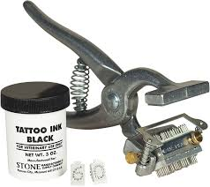
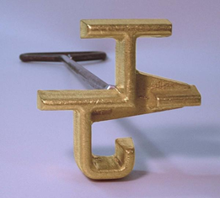
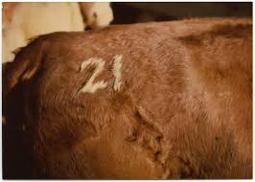
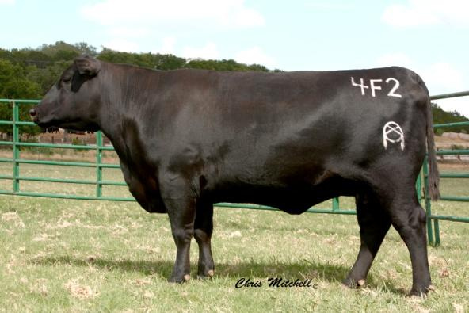

Slide 9
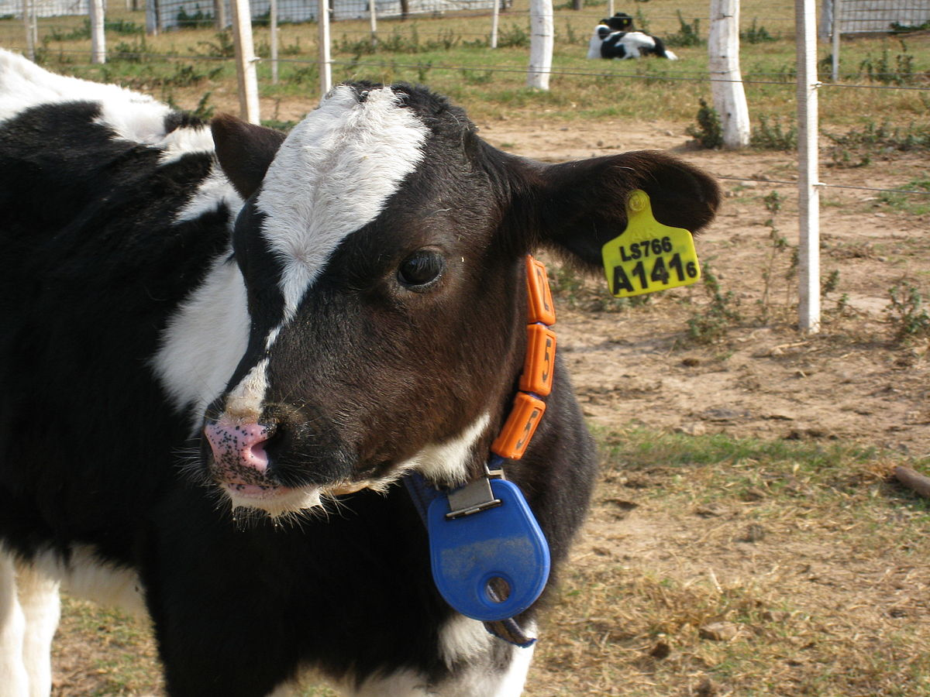
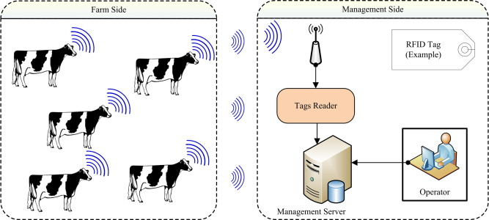

Slide 11
Hoof trimming (Claw trimming): is the most important farm operation that could be done regularly to keep animal’s feet healthy and behave naturally.
The purpose of hoof trimming is to be functional in the environment by dividing loading on the hooves and sole , high pressures cause different kinds of claw injuries.

Slide 12
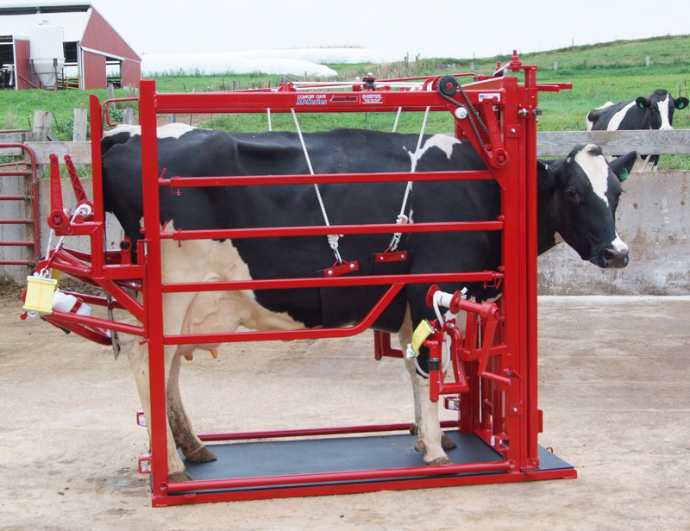
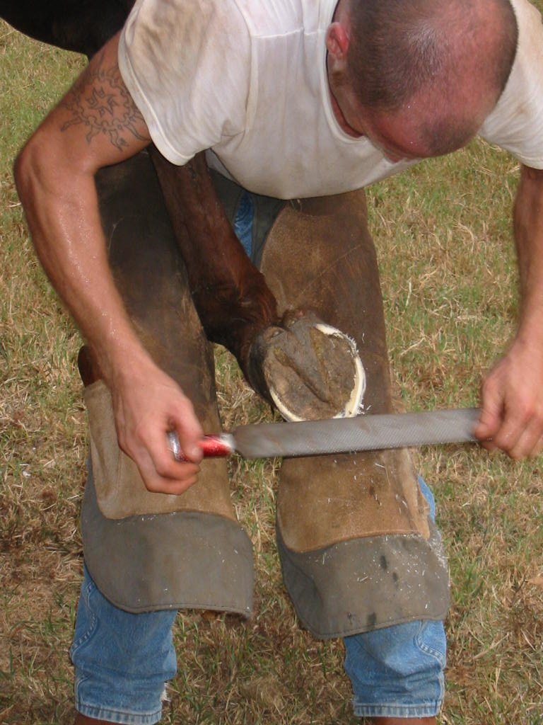
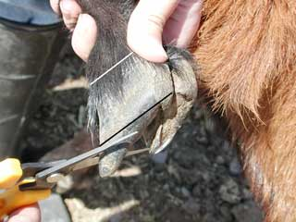
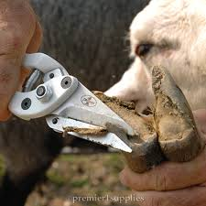

Slide 13
Overgrown hooves make walking difficult and foot problems such as foot rot; Bad hooves make walking painful and competing for feed difficult.
This may cause sheep and goats to not eating and stop exercising.
Animals with overgrown hooves are also having joint/tendon problems.

Slide 14
Wool and hair clipping (Shearing): Shearing should be done once a year.
Most sheep grow wool continuously and they should be shorn annually.
Wool removed from a single sheep is called a fleece.
There are two types of shear tools (Electric and manual). Wet sheep should not be shorn.

Slide 15
Sheep should be sheared on a clean, dry surface to get clean fleece.
Belly wool and tags should be separated from the rest of the fleece.
Goat also needs clipping its hair annually.
Shorter hair helps goat cooler and allows sunlight to reach their skin, and reduce lice and other parasites.

Slide 16
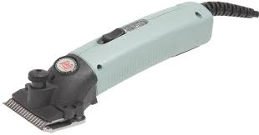
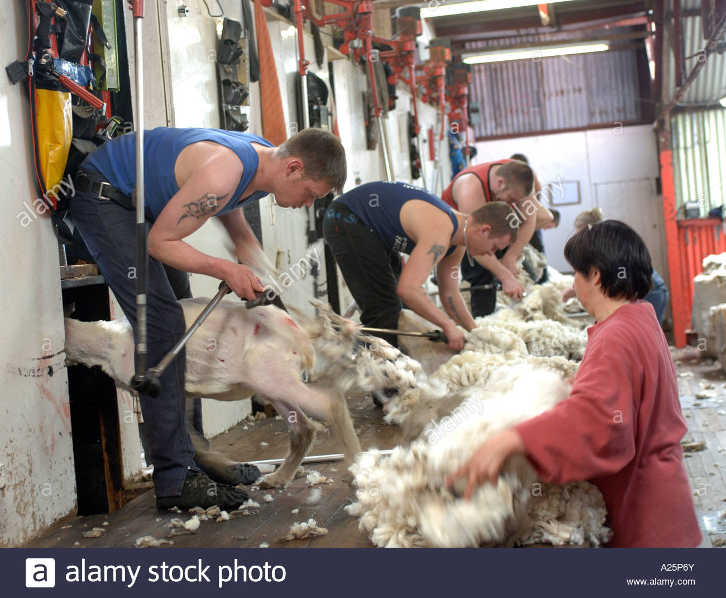
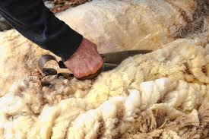

Slide 17
Dehorning
Dehorning is the removal of the horns from an animal that originally has a horn.
Animal horns are different length, shape, and size, but all horns are harmful to the animal from a welfare and production viewpoint.
Horn tipping is cutting grown horn.

Slide 18
The disadvantages of the horn
1. Hurt and damage another animal, deliberately or accidentally
2. Difficult to handle
3. Require more space
4. More damage to gates, yards, fences or any other material in the farm
5. Require more space in feedlots

Slide 20
