Slide 1
Ruminant Nutrition Practical
Lecture 1

Slide 2
Feed Analysis:
It’s a chemical analysis on the feedstuff which is on the result of the analysis the amount of feed will be offered to the animals.
If the result was not correct or imprecise will effect on the animal production.
Also selling and buying feedstuff depend on the chemical analysis of the feedstuff especially protein.

Slide 3
Proximate analysis of feedstuff:
It’s a chain of chemical analysis of the feedstuff to determine the percentage of nutrients.
The objective of feed analysis:
Determine nutritive value of feedstuff.
Determine the price of the feedstuff.
Detect alteration in the feedstuff.

Slide 4
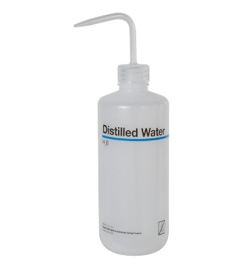
General rules in Nutrition lab
Student must wear special cloth when working in the lab. To protect him from chemicals.
Using chemicals carefully.
Washing all glasses after using, first wash by using tap water with detergent and then wash with distil water after that dried in the oven before using it again.

Slide 5
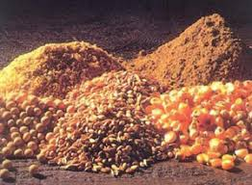
4. Using chemicals and distil water economically to reduce the cost of determination.
5. For each student in the lab. There will be a special place. The student must read procedure before starting the experiment.
Feedstuff

Slide 6
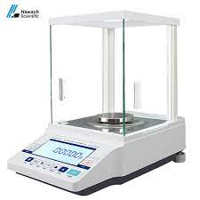
Not on the feed analysis:
Cleanness of the equipment after washing with tap water and soap if still there is dirty we wash by chromic acid solution with is prepared by adding 10gm of dipotassium chromate to 100ml of sulfuric acid H₂SO₄ after using the acid solution will be washed with distill water to remove the acid.
Electrical balance: the correct using of electrical balance necessary to obtain the correct weight of the sample we must follow:
Electrical balance

Slide 7
Placing the balance on the stable table to avoid any movement of balance.
Clean the balance before using by special brush.
Adjust the zero point of the balance.
Close all the door of the balance when weighing to avoid the air effect.

Slide 8
C. Don’t weigh any hot samples with balance we must wait until the temperature of the sample equal the temperature in the lab.
D. All chemical analyses will be done on two samples or more at the same time and condition.
E. During conducting the experiment we must apply the pointed duration.

Slide 9
Determination of experimental error:

Slide 10
The outcome of the experimental error must not be more than 3%.
In case using triplicate of one sample we will discard the result which is not near to results to other results.

Slide 11
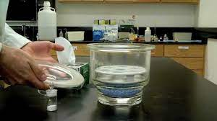
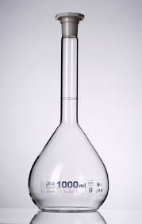
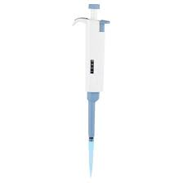
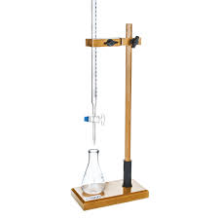
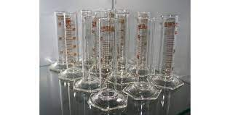
Lab. device and glassware used in lab. Feeding:
Electrical balance.
Desiccators.
Burette.
Pipette.
Measuring flasks.
Graduated cylinders.

Slide 12
Desiccators: the moisture in the air is not constant, for this reason the amount of moisture which is added to the sample will be different. For this reason the sample will be kept inside the desiccation to prevent these cases.
The desiccators is a closed space, which contain calcium chloride (CaCl₂), which absorb the moisture from the space. The desiccator used in the nutrition lab for cooling the sample.
When using the desiccators, we must not close the cover, when the sample is hot
We wait unit the sample become cool then we close the cover.

Slide 13
Thanks for your attention
Dr.Kanyaw i.mahmud

