Slide 1
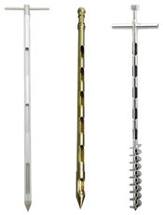
Feed sampling for chemical analysis:
L2

Slide 2
The sample is defined as a part of the total amount, represent the total correctly.
When we take a feed sample, it must be free of adulteration in order to determine their nutritive value correctly.
On the feed packages (bags) their chemical composition is written.
The feed is stored in the fields or in the local markets are displayed in the forms of bags or in the form of pellets or it may be in the form of plants in the field, for each of these forms of feedstuffs special method for sampling.

Slide 3
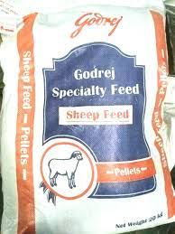
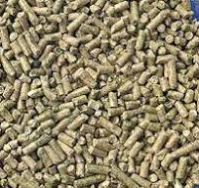
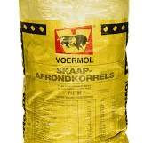
Feed bages
pellets

Slide 4
Conditions for feedstuff sampling:
Sample of feedstuff must be carried out when there is enough light available, to distinguish feedstuff compounds. One person must take the feed samples to get accurate samples.
Prepare the sampling tools for starting the sampling.
Designation of the places to take the samples.

Slide 5
Feedstuff sampling methods:
Sampling from the cereal bags:
it is carried out by taking 10% of total bags present. By using special probes for taking samples from different positions on the feed bags,
the preliminary sample will be mixed thoroughly and spread on clean and smooth surface in form of big square after that divided into small square and then we obtain the sample

Slide 6
Pellet sampling:
The same previous procedure will be conducted by taking number of pellets from each bag from different position then reduced the sample to (1) kg as previous procedure.

Slide 7
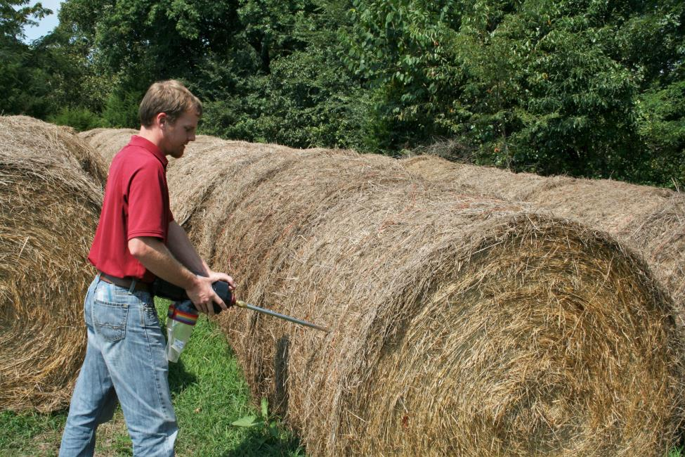
Hay or straw bills sampling:
from each ten to twenty bills one bill will be taken for sampling.
If number of bills less than ten bills, in this case we will take sample from most of them, after that the primary sample will be reduced as the same previous procedure.

Slide 8
Sampling straw or field by-products pills:
some field by products like straw or plant steams and leaf stored in the field in the form of pill. To take primary sample from the pills, ten spots will be set on the pile in different direction to get samples, and then will be reduced in the same previous procedure.

Slide 9
Sampling green plants in the field:
30-50 spots will be identified in the field randomly,
then 3-5 plants will be taken from each spot by using sharp tool with ground level, all plant parts must be preserved, this will represent the primary sample.
then this primary sample will be cut to 2-3cm tall in the laboratory by using sharp scissor to avoid loss of water. Then take 100-200gm of sample will be used to determination of primary moisture.

Slide 10
Sampling liquid material:
the size of primary sample of liquid material it depend on the purpose analysis, if the purpose to carry out complete analyses, the amount of dry matter must not be less than 150gm. the sample taken after mixing the liquid by using sampling tools.

Slide 11
The sample prepared for chemical analysis as follows;
Exclude foreign materials like stones an sand from the sample if the sample is cereal.
Grind the sample by using special mill, which called (cereal mill or ball mill).
Green forage material samples: dried to remove primary moisture by drying it by using 60-70C° for 16 hours, then the sample will be grinded and stored in glass bottles for chemical analyses.
Meat or animal part sample: after removing the meat from the bone, then crushed and minced by using special mortar or using the mixers.

Slide 12
Storing the samples until the chemical analysis:
Some feed material decompose quickly, this will lead to change nutrient content of the feed. Therefore there are ways to stop these enzymatic or microbial activities or changing in moisture content.
The green forage can be preserved by drying it then grinding and storing it in glass bottles.
To stop the activity of enzyme, when feed sample stored after grinding by adding hot alcohol 95% concentrate.

