Slide 1
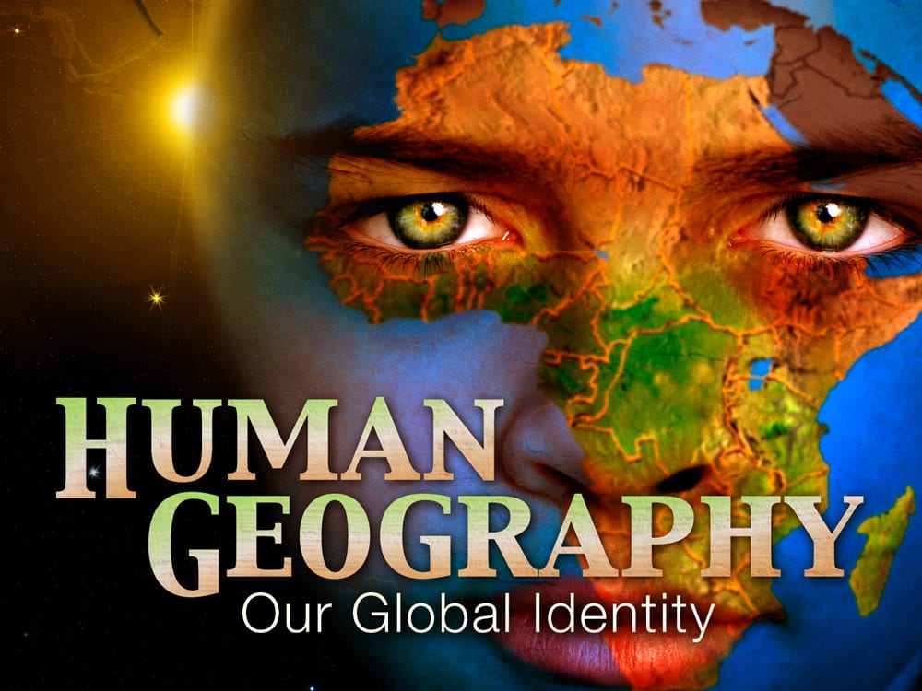
Department of Geography Salahaddin University
Human Geography
What is Human Geography? What are braches of Human Geography Geography ? Concepts and Importance of Human Geography By: Dr. Krawan Sabah Hawrami

Slide 2
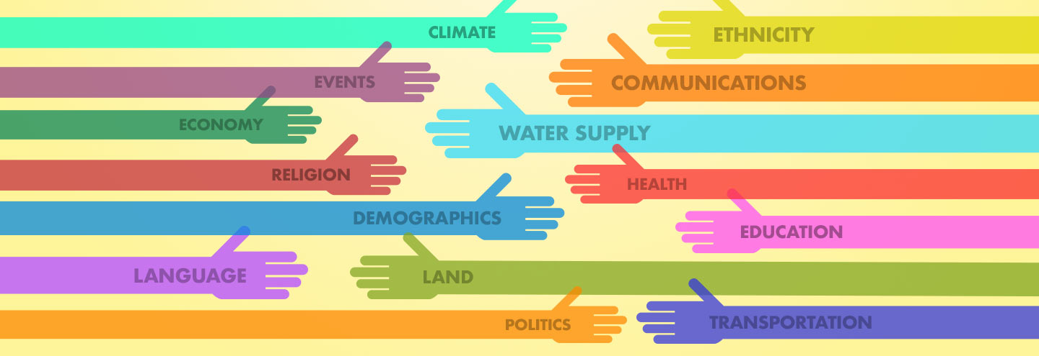
Definitions:
Human Geography: in a study of the interrelationships between people, place, and environment, and how these vary spatially and temporally across and between locations.
Physical Geography: concentrates on spatial and environmental processes that shape the natural world.

Slide 3
Branches of Human Geography
Human geography consists of a number of sub-disciplinary fields that focus on different elements of human activity and organisation, for example
cultural geography, economic geography, health geography, historical geography, political geography, population geography, rural geography, social geography, transport geography, and urban geography.
What distinguishes human geography from other related disciplines?
The application of a set of core geographical concepts to the phenomena under investigation, including space, place, scale, landscape, mobility, and nature.

Slide 4
Long-term development of human geography
Since the Quantitative Revolution in the 1950s and 1960s, the philosophy underpinning human geography research has diversified enormously.
The 1970s saw the introduction of behavioural geography, radical geography, and humanistic geography.
These were followed in the 1980s by a turn to political economy, the development of feminist geography, and the introduction of critical social theory underpinning the cultural turn.
Together these approaches formed the basis for the growth of critical geography, and
Introduction of postmodern and post-structural thinking into the discipline in the 1990s.

Slide 5
Why study human geography?
Human geography is a wide-ranging discipline that draws together for understanding the world today.
It examines human societies and how they develop, their culture, economy and politics, all within the context of their environment.
With the rise of globalisation and climate change, it has become increasingly relevant.
Examine the relationship between global and local issues

Slide 6
Five basis of Human Geography
There first needs to be and understanding of the 5 themes of geography.
Location
Place
Human-environment interaction
Movement
Region
Human Geography also, study population, Migration, Culture, language, race, religion, international development, Agriculture, Urban and improve for the future.

Slide 7
Thanks for your attention

