Slide 1


Architectural Design
University of Salahaddin
Department of Architecture
3’rd Stage
WIDE SPAN ENCLOSURES SYSTEMS
BY:
KARZAN ABDULLA

Slide 2
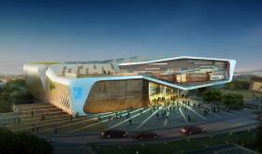
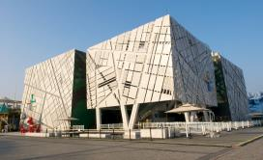
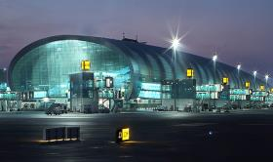
Introduction
Long span structures are today widely applied mainly for:
Sport buildings
− Stadia
− Sport halls
− Olympic swimming pools
− Ice tracks and skating rinks
Social buildings
− Fair pavillions
− Congress halls
− Auditorium and theatres
− Open air activities
Industrial buildings
− Hangars
− Warehouses
− Airport terminals
− Waste material storage

Slide 3
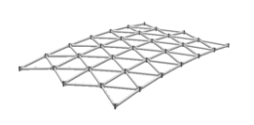
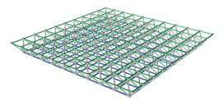
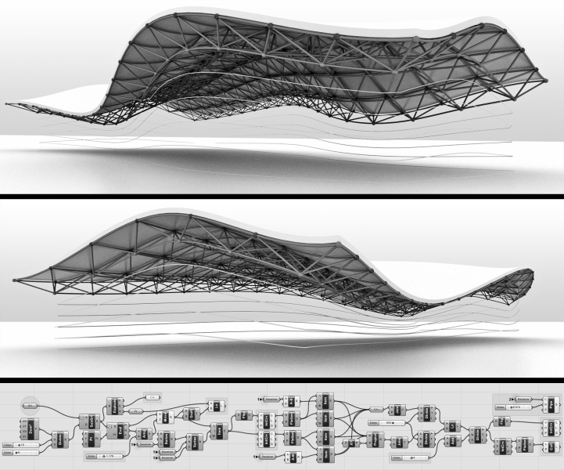
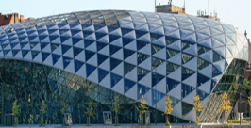
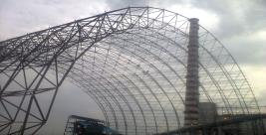
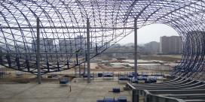
Space Structures
Space Structures mainly consist of three types:
- Single layer grids
- Double and Multi layer grids
- Single and Double curvature space frames

Slide 4
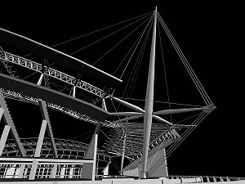
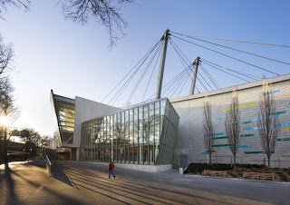
Cable Structures
Cable Structures mainly consist of Four types:
1 - Cable stayed roofs

Slide 5
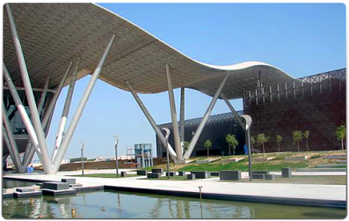
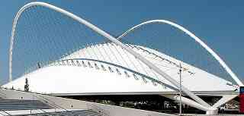
Cable Structures
2 – Suspended Roofs

Slide 6
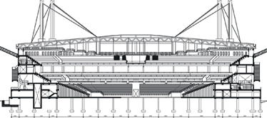
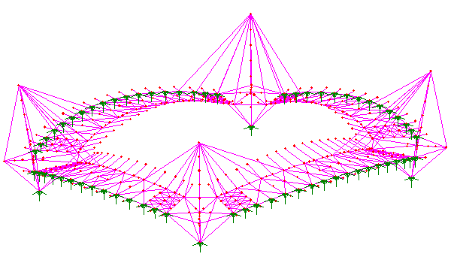
Cable Structures
3 – Cable Trusses

Slide 7
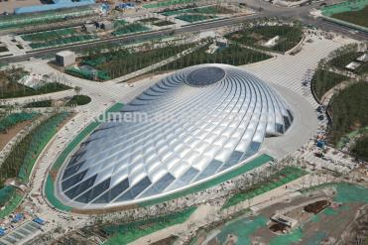
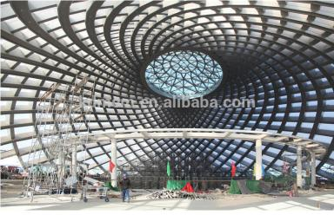
Cable Structures
4 – Single and multilayer nets

Slide 8
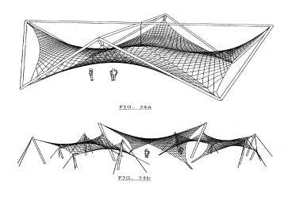
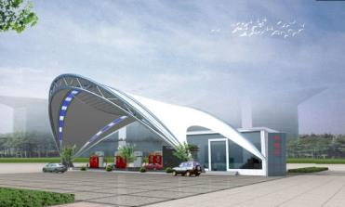
Membrane Structures
1 – Pre-stressed anticlastic membranes

Slide 9
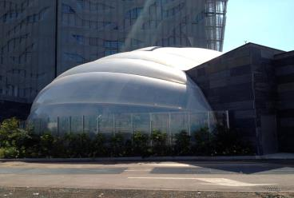
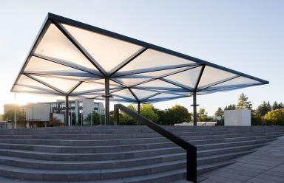
Membrane Structures
2 – Pneumatic Membranes

Slide 10
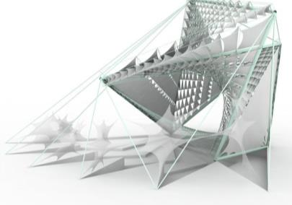
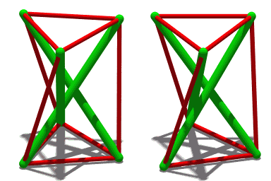
Hybrid Structures
1- Tensegrity Systems

Slide 11
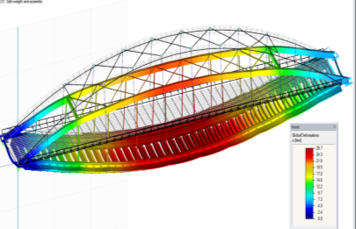
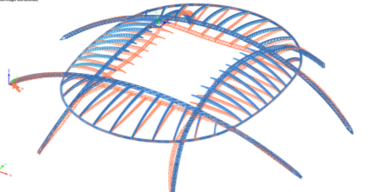
Hybrid Structures
2- Beam-cable Systems

Slide 12
Convertible Roofs
1- Overlapping Sliding System
2− Pivoted System
3− Folding System

Slide 13
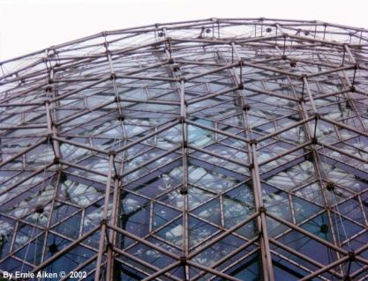
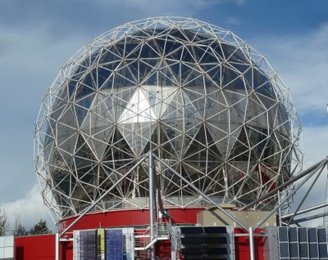
Three Dimensional System
1- Dome

Slide 14
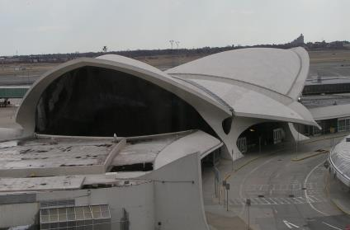
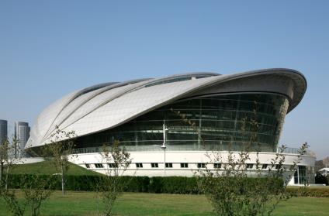
Three Dimensional System
2- Shell

Slide 15
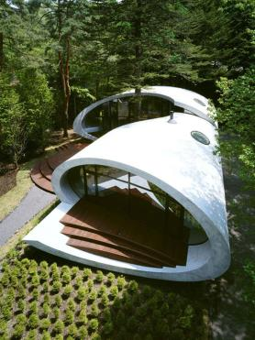
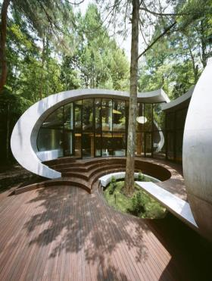
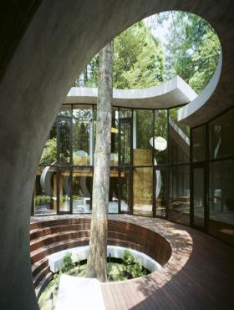
Three Dimensional System

Slide 16
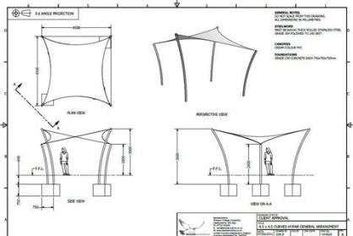
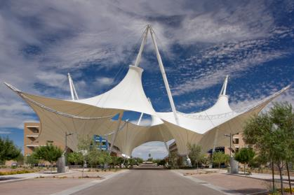
Three Dimensional System
3- Fabric

Slide 17
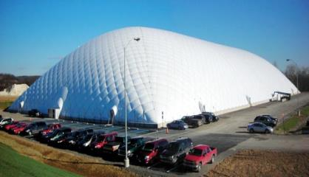
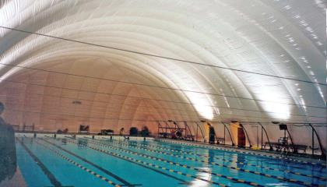
Three Dimensional System
4- Air Supported Structure

Slide 18
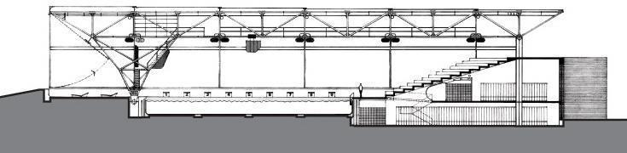
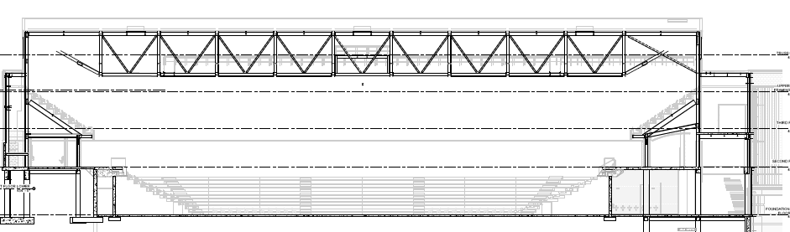
Examples

Slide 19
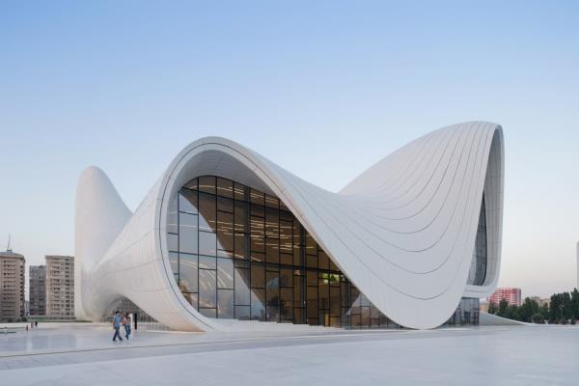
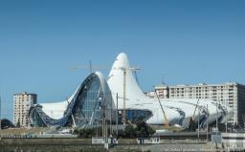
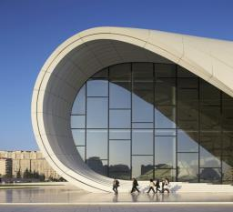
Heydar Aliyev Centre - Zaha Hadid

Slide 20
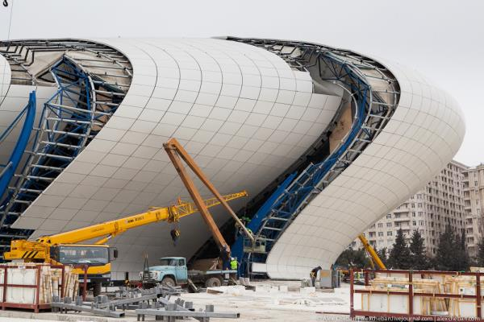
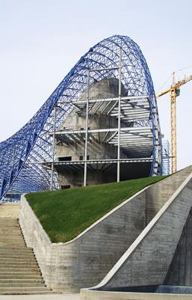
Heydar Aliyev Centre - Zaha Hadid

Slide 21
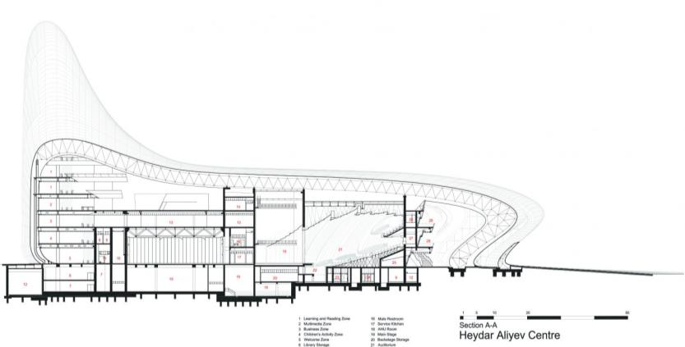
Heydar Aliyev Centre - Zaha Hadid

Slide 22

The End

