Slide 1
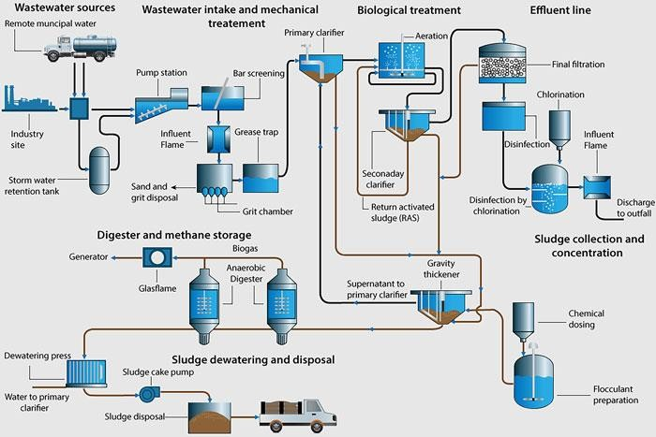
Wastewater Engineering, 2022-2023 Wastewater Treatment Plant Prof. Dr. Shuokr Qarani Aziz and D. Khasro Dizayee
WASTEWATER TREATMENT PLANT
A typical wastewater treatment plant is shown in Figure 1.
Figure 1: A typical wastewater treatment plant
CONCEPT OF TREATMENT
The treatment of wastewater, in general, means the partial reduction or removal of excessive
impurities (solids) present in wastewater. The excessive impurities imply to the constituent concentration that is more than the acceptable levels for final disposal or suitable r euse of the treated wastewater.
  Treatment Methods
Usually, physical, chemical or biological methods are applied for wastewater treatment and
all treatment units separately or combined to be designed to perform the treatment. Based on the means used, treatment methods classified as unit operations and unit processes.
12.1.1 Unit Operations
501

Slide 2
Wastewater Engineering, 2022-2023
Wastewater Treatment Plant
Prof. Dr. Shuokr Qarani Aziz and D. Khasro Dizayee
The physical applications used in the treatment are known as unit operations. Major components come under this method are as following:
Screening
Mixing
Flocculation
Sedimentation
Floatation
Filtration
12.1.2 Unit processes
The types of treatment in which the removal of contaminants is brought about by the addition of chemicals or the use of biological mas or microbial activates are known as unit processes.
Base on the type of approaches used, these are further classified as follows:
a) Chemical unit process
Removal or reduction is brought about by using chemical reactions and consists of the below categories:
Chemical neutralization, to control or adjust the system pH
Chemical coagulatiom: To remove collides particles by chemical destabilization and flocculation.
Chemical Precipitation: to enhance the removal of suspendedsolid,phosphorou, heavy metals and BOD in spesific system conditions.
Chemical oxidation: to remove greases, ammonia, BOD, COD and for odour control. Chemical disinfection: to kill pathaogens in influent and treated effluents..
➢
➢
➢
The chemical processes are expensive due to cost of chemicals that are used and the expenditure that occurs in handling the large volume of sludge generated.
501

Slide 3
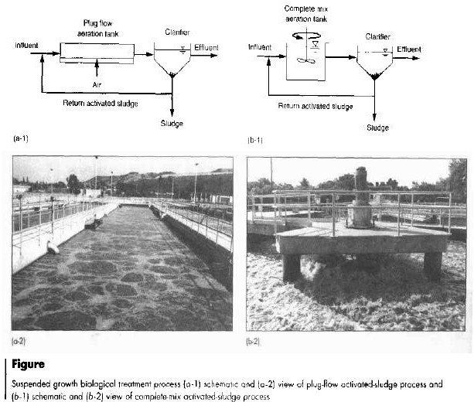
Wastewater Engineering, 2022-2023
Wastewater Treatment Plant
Prof. Dr. Shuokr Qarani Aziz and D. Khasro Dizayee
Biological processes
Reduction and removal is brought about by microorganisms. and consists of the below categories:
  Suspended growth process: Activated Sludge Process, Aerated Lagoon, Oxidation Pond, Aerobic and Anaerobic Digesters, etc.
  Attached growth process: Trickling Filter, Rotating Biological Contactors, Bio Towers, etc.
Figure 2 shows suspended and attached growth processes.
:2
501

Slide 4
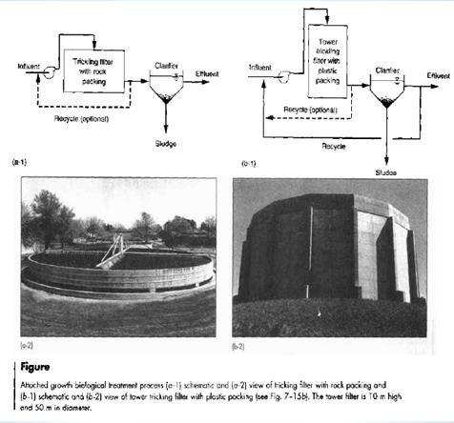
Wastewater Engineering, 2022-2023
Wastewater Treatment Plant
Prof. Dr. Shuokr Qarani Aziz and D. Khasro Dizayee
Figure 2: Suspended and attached growth processes
TREATMENT SYSTEMS
The type of combination used from the available unit operations and processes for treatment of a particular wastewater is known as the treatment system. Normally a wastewater treatment plant is designed for either of the following treatment systems:
  Preliminary Treatment System
Preliminary treatment system is mainly selected to remove floating materials and large inorganic particulate contents of wastewater that usually cause maintenance or operational problems in primary and secondary treatments. It is also known as pretreatment process. The preliminary treatment system includes:
Sump and Pump unit: Municpal wastewater is ususally collected in a sump or holding tank and pumped to the higher levels of reatemnt units.
501

Slide 5
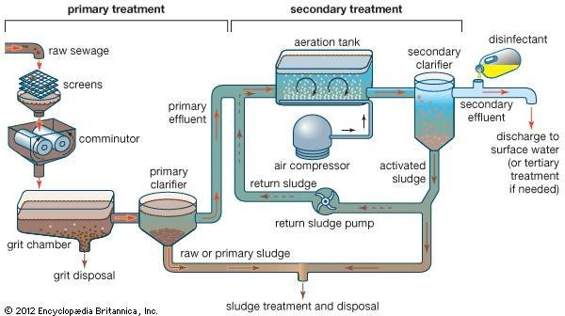
Wastewater Engineering, 2022-2023 Wastewater Treatment Plant Prof. Dr. Shuokr Qarani Aziz and D. Khasro Dizayee
Approach channel: To conveyand dampen the flow of wastewater pumped to treatment plant.
Screen chamber; To remove large size floating materials.
Grit chamber: To remove up to 0.20 mm size suspended settleable solids of specific gravity 2.60.
Skimming tank (oil and grease traps): To remove excessive oil and grease from the wastewater.
•
•
•
13.2 Primary Treatment System
The primary treatment system includes all the units of preliminary treatment system and the primary Sedimentation Tank, also known as primary clarifier, when only these units are provided for treatment; it is called primary treatment of wastewater, Figure 3.
Figure 3: Primary and secondary treatment processes
In the primary treatment system, the removal of most of the large floating materials take place in the screen chamber, and most of the heavy suspended soil are separated in the grit chamber. The primary clarifier then reduces about 60-70% of fine settleable suspended solids, which include about
501

Slide 6
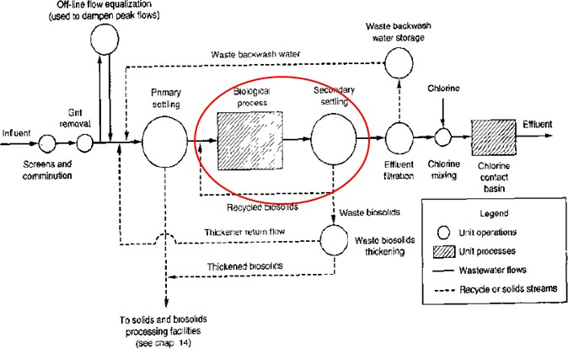
Wastewater Engineering, 2022-2023 Wastewater Treatment Plant Prof. Dr. Shuokr Qarani Aziz and D. Khasro Dizayee
30-32% of organic suspended solids. It should be noted that colloidal and soluble (dissolved) organic content of wastewater is not removed in this system.
13.3 Secondary Treatment System
This process is responsible for the removal of colloidal and soluble organic matter present in wastewater . Normally biological processes are employed to remove the remaining colloidal and soluble organic contents, the treatment system provided usually Activated Sludge Process, Figure 4.
Figure 4: Location of unit operations and unit processes in a wastewater treatment plant
13.4 Tertiary or Advanced Treatment System
This process is used when the quality of conventionally treated wastewater (secondary effluent) is unsuitable for final disposal requirement into the body of water or into the land. Also, when the concentration of residual organic materials or suspended solid require further reduction or complete removal for specific reuse or recycling of wastewater after the secondary treatment. Furthermore, when the concentrations of residual nutrients such as nitrogen and phosphorous is high for final disposal or reuse/recycling of wastewater. Different techniques are available for the tertiary treatment as given below, Table 1.
550

Slide 7
Wastewater Engineering, 2022-2023 Wastewater Treatment Plant Prof. Dr. Shuokr Qarani Aziz and D. Khasro Dizayee
Table 1: Different techniques for tertiary treatment
No. | Techniques | For complete removal or further reduction impurities
1 | Granular- media filtration, Ultra filtration and Micro-strainers | Residual suspended solids
2 | Biological nitrification/denitrification, Ion exchange and air stripping | Removal of nitrogen, chlorine and dissolved gases
3 | Biological and chemical processes | Residual nitrogen and phosphorous
4 | Ion exchange, Reverse osmosis, Electro dialysis, chemical precipitation, adsorption | Residual dissolved inorganic solids, refractory organics, toxic and complex orgnic compounds
14. SELECTION OF TREATMENT SYSTEM
Selection of a particular treatment system mainly depends of the degree of treatment required to bring the quality of raw wastewater to permissible level of treated wastewater. Other significant factors that will influence the selection of a treatment system are as following:
Availability of land at the treatment site.
The topography of land at the treatment site.
Non-availability of suitable mechanical equipment and skilled personal for running and maintaining the plant.
14.1 SCREENING
Screens are the devices with clear openings of uniform size used to remove floating
materials and coarse solids from wastewater.
Figure 12-16 5-6 shows a bar rack and a traveling screen. Bar racks (also called bar screens) are composed of larger bars spaced between 25 to 80 mm. The rack is used to exclude large objects; the traveling screen following it is used to remove smaller objects such as leaves, twigs, small fish, and other materials that pass through the rack. The arrangement then protects the pumping station that lifts this water to the treatment plant. Figure 12-16 5-6 shows a bar screen installed in a detritus
555

Slide 8
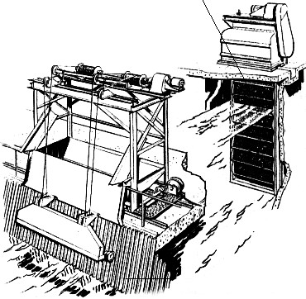
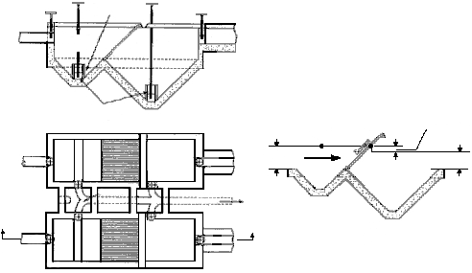
Wastewater Engineering, 2022-2023 Wastewater Treatment Plant Prof. Dr. Shuokr Qarani Aziz and D. Khasro Dizayee
tank. Detritus tanks are used to remove grits and organic materials in the treatment of raw sewage. Bar screens are either hand cleaned or mechanically cleaned. The bar rack of Figure 5a is mechanically cleaned, as shown by the cable system hoisting the scraper; the one in Figure 5b is manually cleaned.
a) Bar rack and traveling screen.
b) Bar screen in a detritus tank. Figure 5: Bar screen in WWTP
552

Slide 9
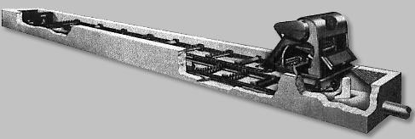
Wastewater Engineering, 2022-2023 Wastewater Treatment Plant
14.2 OUTLET CONTROL OF GRIT CHANNELS
Prof. Dr. Shuokr Qarani Aziz and D. Khasro Dizayee
Grits are composed of sand, small gravels, cinders, broken glass or other heavy solid
materials present in the water
Grit channels (or chambers) are examples of units that use the concept of discrete settling in removing particles. Grit particles are hard fragments of rock, sand, stone, bone chips, seeds, coffee and tea grounds, and similar particles. In order for these particles to be successfully removed, the flow-through velocity through the units must be carefully controlled. Experience has shown that this velocity should be maintained at around 0.3 m/s. This control is normally carried out using a proportional weir or a Parshall flume. A grit channel is shown in Figure 6.
Figure 6: A grit channel
  MIXING
Is a unit operation that distributes the components of two or more materials among the materials
producing in the end a single blend of the components. This mixing is accomplished by agitating the materials.
  FLOCCULATION
Is a unit operation aimed at enlarging small particles through a very slow agitation of the water suspending the particles. The agitation provided is mild, just enough for the particles to stick
together and agglomerate and not rebound as they hit each other in the course of the agitation. Flocculation is effected through the use of large paddles such as the one in flocculators used in the
coagulation treatment of water.
551

Slide 10
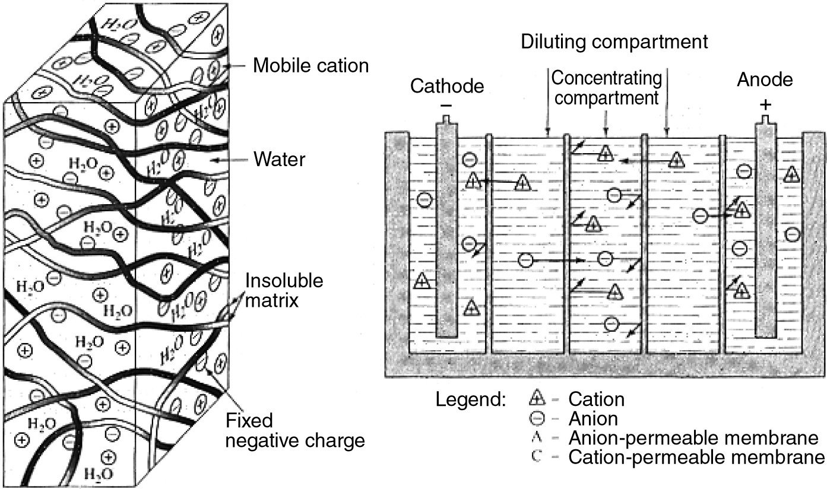
Wastewater Engineering, 2022-2023
Wastewater Treatment Plant
Prof. Dr. Shuokr Qarani Aziz and D. Khasro Dizayee
14.5 FILTERING MEMBRANE
Figure 7 shows a cut section of a filtering membrane. The filtering membranes are sheet-like
barriers made out of high-capacity, highly cross-linked ion exchange resins that allow passage of ions but not of water.
Figure 7: Filtering membrane
14.6 ADSORPTION
Adsorption is the process of accumulating substances that are in solution on a suitable interface, it is
a mass transfer operation in that the element (constituents) in the liquid phase transferred to the solid phase. The adsorbate is the substance that is being removed from the liquid phase at the interface. The adsorbent is the, solid, liquid, or gas onto which the adsorbate accumulates.
Types of adsorption:
Depending upon the nature of forces existing between adsorbate molecules and adsorbent, the adsorption can be classified into two types:
551

Slide 11
Wastewater Engineering, 2022-2023
Wastewater Treatment Plant Prof. Dr. Shuokr Qarani Aziz and D. Khasro Dizayee
Physical adsorption (physisorption): If the force of attraction existing between adsorbate and adsorbent are Vander Waal’s forces, the adsorption is called physical adsorption. It is also known as Vander Waal’s adsorption. In physical adsorption the force of attraction between the adsorbate and adsorbent are very weak, therefore this type of adsorption can be easily reversed by heating or by decreasing the pressure.
Chemical adsorption (chemisorption):
If the force of attraction existing between adsorbate and adsorbent are almost same strength as
chemical bonds, the adsorption is called chemical adsorption. It is also known as Langmuir adsorption. In chemisorption the force of attraction is very strong, therefore adsorption cannot be easily reversed.
Factors affecting adsorption:
The extent of adsorption depends upon the following factors:
1.
2.
3.
4.
Nature of adsorbate and adsorbent. The surface area of adsorbent.
Activation of adsorbent.
Experimental conditions. E.g., temperature, pressure, etc.
Solids are formed because of the attraction of the component atoms within the solid toward each other. In the interior of a solid, attractive forces are balanced among the various atoms making up the lattice. At the surface, however, the atoms are subjected to unbalanced forces the ones toward the interior are attracted, but the ones at the surface are not. Because of this unbalanced nature, any particle that lands on the surface may be attracted by the solid. This is the phenomenon of adsorption, which is the process of concentrating solute at the surface of a solid by virtue of this attraction.
Adsorption may be physical or chemical. Physical adsorption is also called van der Waals adsorption, and chemical adsorption is also called chemisorption. In the former, the attraction on the surface is weak, being brought about by weak van der Waals forces. In the latter, the attraction is stronger as a result of some chemical bonding that occurs. Adsorption is a surface-active phenomenon which means larger surface areas exposed to the solutes result in higher adsorption.
551

Slide 12
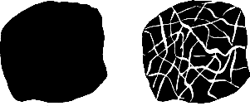
Wastewater Engineering, 2022-2023 Wastewater Treatment Plant Prof. Dr. Shuokr Qarani Aziz and D. Khasro Dizayee
The solute is called the adsorbate; the solid that adsorbs the solute is called the adsorbent. The adsorbate is said to be sorbed onto the adsorbent when it is adsorbed, and it is said to be desorbed when it passes into solution, Figure 8.
Figure 8: Raw carbon material on the left transforms to the carbon on the right after activation.
14.7 AERATION, ABSORPTION, AND STRIPPING
Aeration, absorption and stripping are unit operations that rely on flow of masses between phases,
Figure 9. When a difference in concentration exists between two points in a body of mass, a flow of mass occurs between the points. When the flow occurs between two phases of masses, a transfer of mass between the phases is said to occur. This transfer of mass between phases is called mass transfer.
Absorption is a unit operation that removes a solute mass or masses from a gas phase into a liquid phase. Aeration of water dissolves air into it; thus, aeration is absorption. Another example of absorption is the “washing” of ammonia from an ammonia-polluted air. In this operation, ammonia is removed from the air by its dissolution into the water. The reverse flow of masses from the liquid phase into the gas phase is called stripping. In stripping, the solute molecule is removed from its solution with the liquid into the gas phase.
551

Slide 13
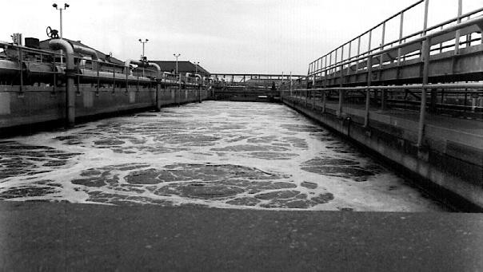
Wastewater Engineering, 2022-2023
Wastewater Treatment Plant
Prof. Dr. Shuokr Qarani Aziz and D. Khasro Dizayee
Figure 9: An activated sludge aeration tank at Back River wastewater treatment plant,
  SOFTENING
Is the term given to the process of removing ions that interfere with the use of soap. These ions are called hardness ions due to the presence of multivalent cations, mostly calcium and magnesium. In
natural waters, other ions that may be present to cause hardness but not in significant amounts are iron, manganese, strontium, and aluminum.
  ION EXCHANGE REACTIONS
Ion exchange is the displacement of one ion by another. The displaced ion is originally a part of an insoluble material, and the displacing ion is originally in solution. At the completion of the process,
the two ions are in reversed places: the displaced ion moves into solution and the displacing ion becomes a part of the insoluble material. Two types of ion exchange materials are used: the cation
exchange material and the anion exchange material. The cation exchange material exchanges cations, while the anion exchange material exchanges anions.
551

Slide 14
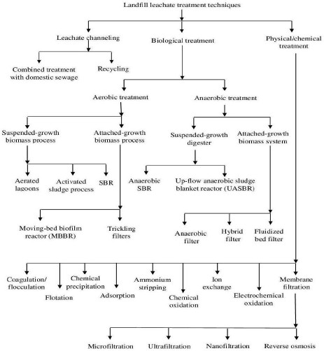
Wastewater Engineering, 2022-2023 Wastewater Treatment Plant Prof. Dr. Shuokr Qarani Aziz and D. Khasro Dizayee
15. LANDFILL LEACHATE TREATMENT
Landfill is a method for treatment of municipal solid waste. Chemical and biological processes occurred on the buried wastes in the landfills. Landfill leachate produces from municipal solid
waste landfill sites. On the other hand, gas and waste residue produce as well. Figure 10 shows a diagram for landfill leachate treatment techniques.
Figure 10: Diagram of landfill leachate treatment techniques (Aziz, 2011).
551

Slide 15
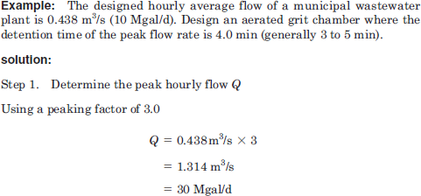
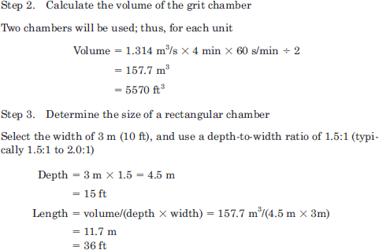
Wastewater Engineering, 2022-2023 Wastewater Treatment Plant
Example 9: GRIT CHAMBER
Prof. Dr. Shuokr Qarani Aziz and D. Khasro Dizayee
551

Slide 16
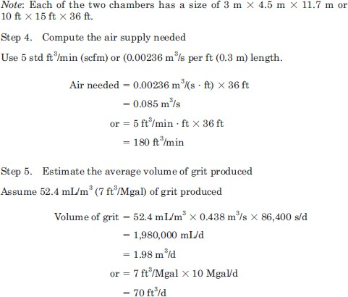
Wastewater Engineering, 2022-2023
Wastewater Treatment Plant
Prof. Dr. Shuokr Qarani Aziz and D. Khasro Dizayee
520

Slide 17
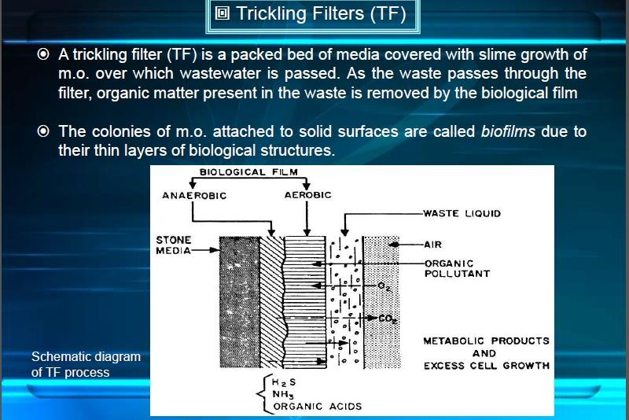
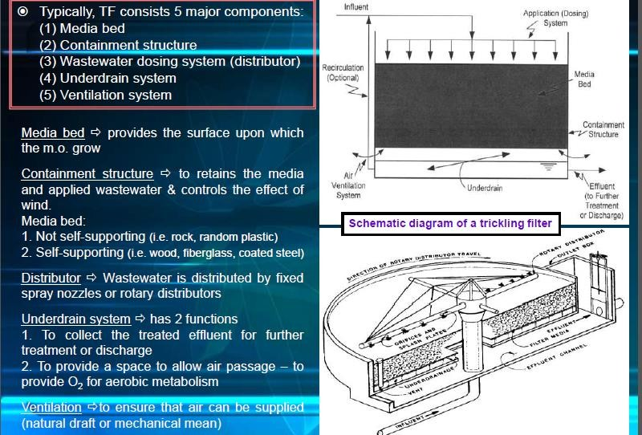
Wastewater Engineering, 2022-2023
Wastewater Treatment Plant
Prof. Dr. Shuokr Qarani Aziz and D. Khasro Dizayee
16. TRICKLING FILTER
525

Slide 18
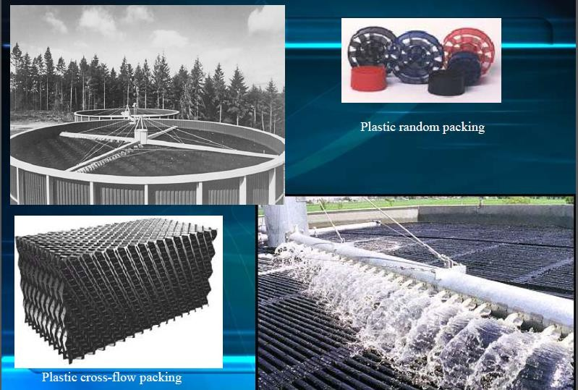
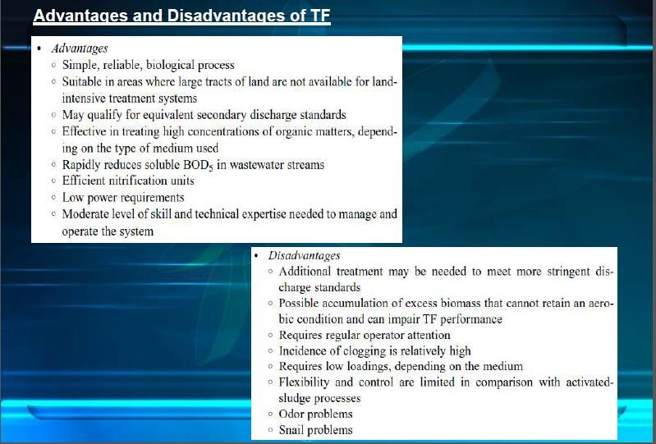
Wastewater Engineering, 2022-2023
Wastewater Treatment Plant
Prof. Dr. Shuokr Qarani Aziz and D. Khasro Dizayee
522

Slide 19
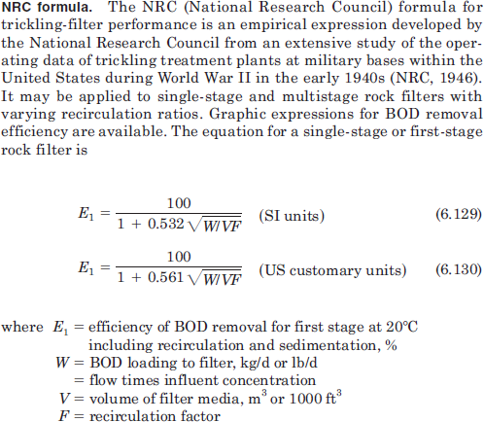
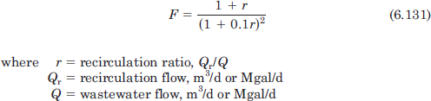
Wastewater Engineering, 2022-2023
Wastewater Treatment Plant
Prof. Dr. Shuokr Qarani Aziz and D. Khasro Dizayee
521

Slide 20
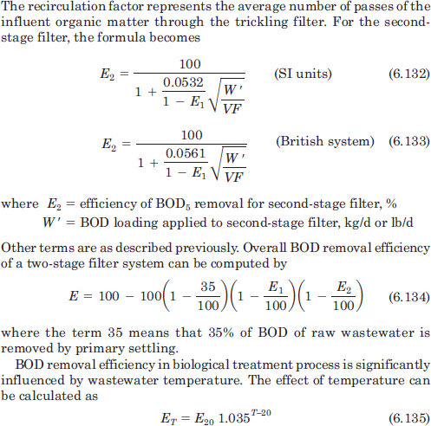
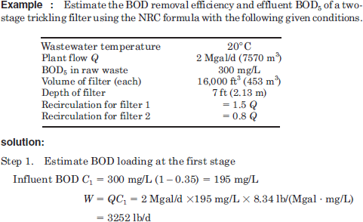
Wastewater Engineering, 2022-2023
Wastewater Treatment Plant
Prof. Dr. Shuokr Qarani Aziz and D. Khasro Dizayee
Example 10:
521

Slide 21
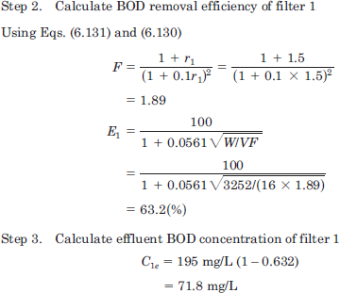
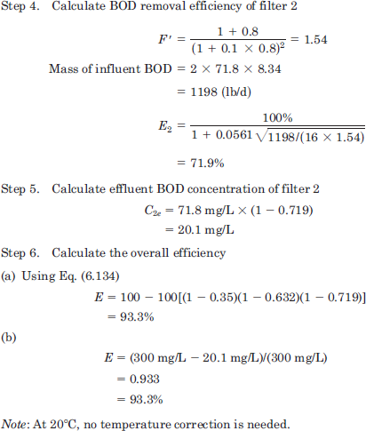
Wastewater Engineering, 2022-2023
Wastewater Treatment Plant
Prof. Dr. Shuokr Qarani Aziz and D. Khasro Dizayee
521

Slide 22
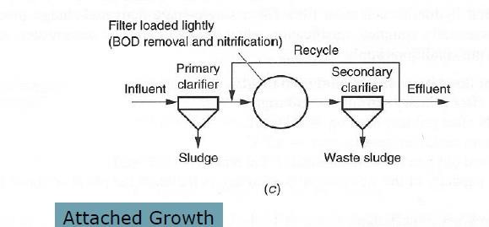
Wastewater Engineering, 2022-2023
Wastewater Treatment Plant
Prof. Dr. Shuokr Qarani Aziz and D. Khasro Dizayee
Example 11 (Q 3B, Final Second Exam., 2018-2019):
A single stage trickling filter is designed to treat an average domestic wastewater flow of 10000 m³/d having BOD₅ equal to 250 mg/L. After treatment by the trickling filter, the effluent BOD₅ is 75 mg/L. Recirculation ratio = 2. Determine volume of the trickling filter tank (m³).
Solution:
521

