Slide 1
Inflation accounting: Price Index during Inflation vs. Historical Cost Dr. Kawa Wali Bnar Karim Darwish Dr. Rodrigo Velasco
4th ICMIAR-2023
Aklan State University,
College of Industrial…
July 7 - 8, 2023
Presenter: Dr. Kawa Wali
PhD in Financial Accounting
Salahaddin University-Erbil
Kurdistan Region-Iraq
Notes:
Starting with the salutation:
Hello everyone, our dear followers. I am d. Kawa Wali from Salahaddin University - Erbil. On behalf of my fellow paper contributors, Lecturer Bnar Karim Darwish and dr. Rodrigo Velasco, It gives me great pleasure to stand here to present to you our research paper entitled:
Inflation Accounting: Price Index during Inflation vs. Historical Cost

Slide 2
Introduction
Our research paper investigates the effects of inflation on financial reporting and accounting procedures, with a focus on the comparison between price index and historical cost accounting methods. It also considers the use of the Constant Purchasing Power Accounting (CPPA) method and the regulations outlined in IAS 29 and FAS 33 for adjusting net assets in the presence of inflation. The study aims to highlight the importance of accurate inflation accounting and its impact on financial statements.
Notes:
Introduction:
Our research paper investigates the effects of inflation on financial reporting and accounting procedures, with a focus on the comparison between price index and historical cost accounting methods. It also considers the use of the Constant Purchasing Power Accounting (CPPA) method and the regulations outlined in IAS 29 and FAS 33 for adjusting net assets in the presence of inflation. The study aims to highlight the importance of accurate inflation accounting and its impact on financial statements. Investigate the effects of inflation on financial reporting and accounting practices.
The paper begins with an introduction to the importance of inflation accounting and the comparison between price index and historical cost methods. It highlights the regulations outlined in IAS 29 and FAS 33 for adjusting net assets in the presence of inflation. The study then explores the use of the Constant Purchasing Power Accounting (CPPA) method for restating financial statements. It analyzes the implications of different accounting methods on financial ratios and performance indicators. The paper concludes by summarizing the findings and emphasizing the significance of accurate inflation accounting in financial reporting
A comprehensive review of the relevant literature on accounting for inflation and its impact on financial reporting is conducted. This includes studies by Humphrey (1981), Bulow & Shoven (1982), Smith and Johnson (2018), Javid (2019), and Binns et al. (2023). The review provides background for the research, identifies key concepts and challenges in inflation accounting, and lays out the rationale for the necessity of adjustments in the financial statements.

Slide 3
Introduction , Cont. Objectives:
Examine the use of the Constant Purchasing Power Accounting (CPPA) method for restating financial statements.
Analyze the implications of different accounting methods on financial ratios and performance indicators.
Notes:
Introduction, continue:
The paper will achieve several objectives including:
Investigate the effects of inflation on financial reporting and accounting practices.
Compare the price index method with historical cost accounting, taking into account the regulations outlined in IAS 29 and FAS 33.
Examine the use of the Constant Purchasing Power Accounting (CPPA) method for restating financial statements.
Analyze the implications of different accounting methods on financial ratios and performance indicators.
The study aims to highlight the importance of accurate accounting for inflation and its impact on the financial statements.

Slide 4
Research Methodology
The research methodology includes a comprehensive analysis of restated financial data tables using the Constant Purchasing Power Accounting (CPPA) method with different inflation assumptions. Research design focuses on practical application and scenario analysis. Ethical considerations related to the use of financial statements and adherence to accounting principles and standards are essential in conducting the research.
Notes:
Research Methodology:
The research methodology includes a comprehensive analysis of restated financial data tables using the Constant Purchasing Power Accounting (CPPA) method with different inflation assumptions. Research design focuses on practical application and scenario analysis.
To illustrate the practical application of the CPPA method, the balance sheet, income statement and cashflow statement of Royal Dutch Airlines Company are considered.
The study explores three scenarios with different levels of inflation and applies the restatement methodology. Assumptions are made regarding the indexing of revenues.
The corresponding ratios are computed and compared to assess the impact on performance indicators.
The analysis reveals that indexing revenues improves liquidity, profitability, and solvency ratios, particularly in the cash flow statement analysis where corrections are minimized compared to historical cost accounting.
Inflation accounting using the CPPA method provides additional information to analysts and stakeholders, enhancing the understanding of financial performance.

Slide 5
Research Methodology, Cont.
The CPPA method involves adjusting the balance sheet and income statement based on the relationship between non-monetary assets (N), monetary assets (M), liabilities (L), and proprietor's net worth (P) as demonstrated by the balance sheet equation:
(Nt + Mt = Lt + Pt)………………………………………………………………eq.1
The opening balance sheet is corrected using a general price index (p) to derive the restated closing balance sheet
(Pt+1 = Nt(1+p) + Mt - Lt)…………………………………………………..eq.2
Additionally, the CPPA profit (YCPPA) is calculated by subtracting the restated opening balance sheet from the restated closing balance sheet, highlighting the impact of inflation on profits, including gains on borrowings and losses.
Notes:
Research Methodology, continue
The CPPA method involves adjusting the balance sheet and income statement based on the relationship between non-monetary assets (N), monetary assets (M), liabilities (L), and proprietor's net worth (P) as demonstrated by the balance sheet equation:
(Nt + Mt = Lt + Pt)..………………………………………………………………eq.1
The opening balance sheet is corrected using a general price index (p) to derive
the restated closing balance sheet
(Pt+1 = Nt(1+p) + Mt - Lt)………………………………………………………eq.2
Additionally, the CPPA profit (YCPP) is calculated by subtracting the restated opening balance sheet from the restated closing balance sheet, highlighting the impact of inflation on profits, including gains on borrowings and losses on lending and holding money.
Overall, the research contributes to the understanding of the effects of inflation on financial statements and highlights the benefits of the CPPA method in providing additional insights to analysts and stakeholders.

Slide 6
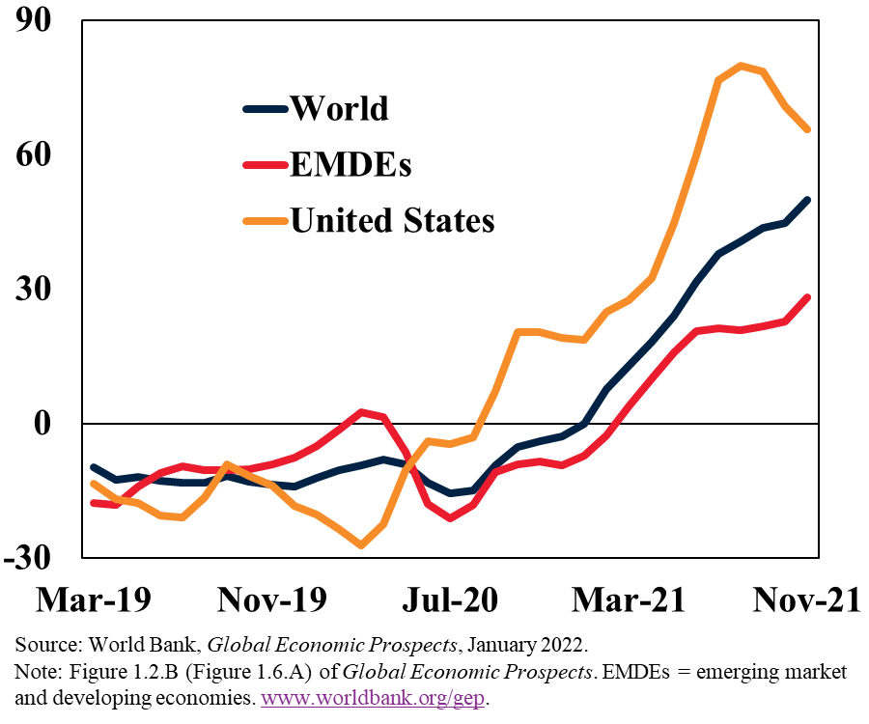
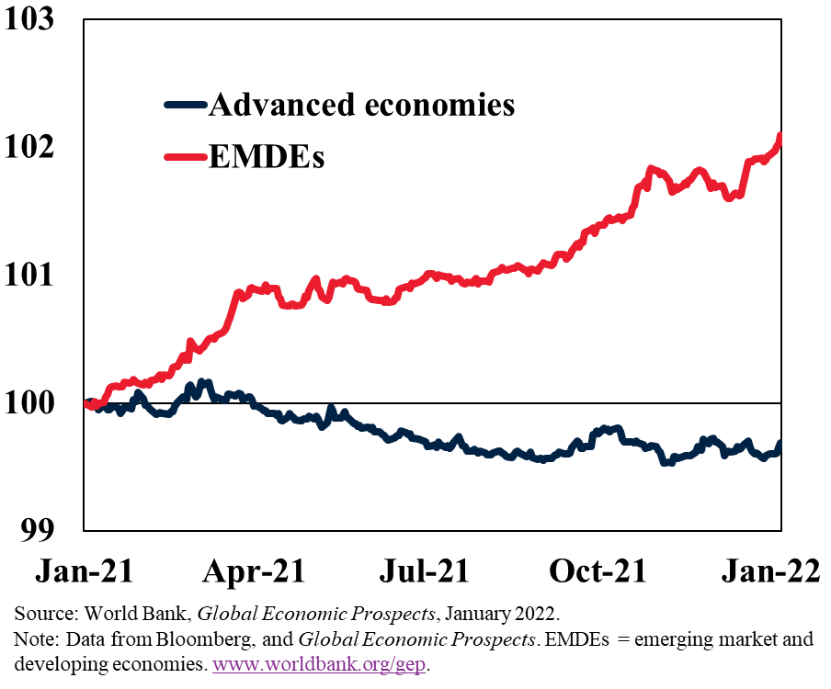
Interconnected Risks Higher Inflation; Tightening Financial Conditions
Notes:
High-Inflation Environment: The worst inflation in decades and the persistent effects of Russia's conflict in Ukraine on the European and international energy markets have exacerbated the threats to financial stability. An abrupt, disruptive tightening in financial conditions runs the danger of interacting with preexisting vulnerabilities amid low market liquidity.
Rising rates, shaky economic fundamentals, and significant capital flight have increased borrowing costs in developing markets, especially for frontier nations, increasing the likelihood of further defaults. The property crisis in China has gotten worse as a result of the dramatic drops in home sales, which have increased pressure on developers and raised the possibility of financial sector spillovers.
Emerging Market and Development Economies EMDEs: To reduce emissions and prepare for climate change, poor and emerging market economies require major climate financing. The crucial role that private money plays in achieving these goals. It concludes that novel financial mechanisms can assist expand the investment base while overcoming some of the difficulties. To increase private investment and offer capacity for risk-taking, multilateral development banks must be involved. Through its policy guidance, oversight, and capacity building as well as through funding from its new Resilience and Sustainability Trust, which might assist in addressing longer-term structural difficulties brought on by climate change, the IMF can play a catalytic role.
Source: World Bank. www.worldbank.org/gep

Slide 7
Findings
The restated financial statements with the CPPA method account for the impact of inflation on historical costs, allowing for a more accurate assessment of the company's financial performance and position.
The restated balance sheets reveal the significant impact of different inflation assumptions on the company's financial position. Higher inflation rates result in substantial increases in both assets and liabilities, highlighting the importance of considering the effects of inflation when evaluating a company's financial statements.
The restated income statement shows higher revenues, EBITDA, income from current operations, and profit for the year. This reflects the impact of inflation on the financial performance of the company.
EBITDA is short for earnings before interest, taxes, depreciation and amortization. It is one of the most widely used measures of a company's financial health and ability to generate cash.
Notes:
Findings:
The restated financial statements with the CPPA method account for the impact of inflation on historical costs, allowing for a more accurate assessment of the company's financial performance and position.
The restated balance sheets reveal the significant impact of different inflation assumptions on the company's financial position.
Higher inflation rates result in substantial increases in both assets and liabilities, highlighting the importance of considering the effects of inflation when evaluating a company's financial statements.
The restated income statement shows higher revenues, income from current operations, and profit for the year.
The restated income statement shows short for earnings before interest, taxes, depreciation and amortization EBITDA.
This reflects the impact of inflation on the financial performance of the company.

Slide 8
Conclusion
Inflation accounting is essential for accurately representing a company's financial position, performance, and cash flows by restating balance sheets and income statements using price indices.
The constant purchasing power accounting (CPPA) method addresses limitations in historical cost accounting in inflationary environments.
The application of inflation accounting varies across countries and depends on economic and regulatory factors.
Financial ratios analyzed with respect to inflation provide insights into profitability, asset utilization, debt levels, and solvency under different assumptions.
Further research should explore the impact of inflation on financial ratios, analyze challenges and practical considerations in implementing inflation accounting, and examine the ongoing relevance and discussion surrounding these methods in different contexts.
Notes:
Conclusion:
Inflation accounting plays a crucial role in adjusting financial statements to reflect the impact of inflation on the economy.
By restating balance sheets and income statements using price indices, inflation accounting provides a more accurate representation of a company's financial position, performance, and cash flows.
The constant purchasing power accounting (CPPA) method, which adjusts historical costs based on changes in a general price level index, is a useful technique for addressing the limitations of historical cost accounting in inflationary environments.
The application of inflation accounting varies across countries and depends on economic and regulatory factors.
Companies operating in hyperinflationary economies may have specific inflation accounting standards, while others may have the option to choose between historical cost accounting and inflation accounting methods.
The financial ratios analyzed with respect to inflation and compared to price index and historical costs provide insights into the company's profitability, asset utilization, debt levels, and solvency under different inflation assumptions.
Additional research should investigate the impact of inflation on financial ratios, analyze challenges and practical considerations in implementing inflation accounting, and examine the ongoing relevance and discussion surrounding these methods in different perspectives.

Slide 9
Thank you, Any Questions
Notes:
Discuss any questions or comments you have in mind:
The impact of inflation accounting on financial statements can be significant. Let's discuss a few key points:
A type of accounting known as inflation accounting modifies financial statements to take into account changes in overall price levels over time.
By restating assets and liabilities in terms of a common unit of measurement, such as the purchasing power of the currency, this strategy aids in maintaining the relevance of financial information.
In inflationary situations, this restatement aids in correctly portraying a company's financial position and performance.
By enabling comparisons across various time periods, inflation accounting also has an impact on income statements, profitability indicators, and improved financial analysis.
Inflation accounting is a specific strategy that, although not widely used, helps users make informed decisions in an inflationary environment. For example, as a result of the Russian-Ukrainian war, the allied countries of both countries must implement accounting procedures, due to the repercussions and results of this conflict, which made it difficult to implement appropriate procedures due to high inflation, which differs from one country to another, so accounting inflation using method like CPPA is the most appropriate way to track financial data in these countries.

Slide 10
Dr. Kawa Wali
Senior Lecturer and Financial Adviser, Salahaddin University-Erbil,
Kurdistan Region-Iraq,
Tel: 009647503803755
Email:
kawa.wali@su.edu.krd
Website: https://academics.su.edu.krd/kawa.wali
ORCID iD
https://orcid.org/0000-0003-2724-6900
Notes:
Personal Biography:
Kawa Wali is a seasoned academic with more than ten years of experience at Salahaddin University in Erbil. He specializes in the subjects of managerial and financial accounting. In addition to a PhD in Accounting/Financial Accounting from Salahaddin University in collaboration with Erasmus University-Rotterdam, he has a bachelor's and master's degree in accounting and finance from Erasmus University-Rotterdam in the Netherlands. His areas of interest in research include risk management, corporate governance, IFRS, and financial reporting. His extended tenure at Salahaddin University, where he continues to guide and encourage students seeking professions in accounting and finance, demonstrates his commitment to teaching and research.

