Slide 1
An introduction to Phonology
Khalil Alsayyid
Translation Department
khalil.hasan@su.edu.krd

Slide 2
What is linguistics? Prescriptivism vs Descriptivism
Prescriptivism
Descriptivism
To describe language objectively and systematically.
To observe and analyse language as it is used naturally in any given speech community.
Discover the rules and regularities of the underlying language system, or code.
To prescribe (rather than describe) correct usage of language.
Prescriptive language scholars- rules- based on Latin and Greek.
Proper language- on a classical canon of literary works, on the origin of particular words, on logic.

Slide 3
Prescriptivists are purists
Prescriptivists have been criticised for not taking sufficient account of ongoing language change and stylistic variation.
Descriptivists attempt to discover the rules and regularities of the underlying language system, or code.

Slide 4
Parole vs. langue
In order to separate the two meanings of the word language, the Swiss linguist Ferdinand de Saussure (1857–1913) proposed the French terms:
parole to refer to actual language use (i.e. to concrete utterances)
langue for a speech community’s shared knowledge of a language (i.e. for the language system).

Slide 5
Performance vs. Competence
the American linguist Noam Chomsky (b. 1928), put forward a similar dichotomy, but he used performance and competence.
Performance is the actual language use of an individual speaker.
Competence is that individual speaker’s knowledge of the language.

Slide 6
Four Core Areas of Linguistics
The system or structure of a language (langue or competence) can be described at four different levels.
They form the core areas of linguistics, sometimes called microlinguistics

Slide 7
Microlinguistics
(1) Phonetics and phonology deal with pronunciation, or, more precisely, with speech sounds and the sound system.
(2) Morphology covers the structure of words.
(3) Syntax explains sentence patterns. (Morphology and syntax, often combined into morphosyntax, have traditionally been referred to as grammar.)
(4) Lexicology and semantics describe the vocabulary, or lexicon, and explore different aspects of meaning.

Slide 8
Macrolinguistics
Utilising the core areas with various other branches of linguistics, sometimes referred to as Macrolinguistics.
Most of these are interdisciplinary fields because they overlap with other sciences.

Slide 9
Variational Linguistics
The first four branches are concerned with language variation, and are therefore often subsumed under the label variational linguistics:
(1) Dialectology is at the interface between linguistics and geography. It is the study of regional variation within a language.
(2) Sociolinguistics connects linguistics with sociology. It is concerned with language variation according to age, sex, social class, etc.

Slide 10
Variational Linguistics
(3) Ethnolinguistics overlaps with anthropology and investigates language variation and the role language plays in ethnic groups.
These three branches study the way language is used in different speech communities.
They are therefore often referred to as sociolinguistics, which is then used in a broader sense as a superordinate term.

Slide 11
What is a dialect?
The language variety spoken in a particular speech community is referred to as a lect.
Thus we speak of dialects, sociolects, and ethnolects.
The characteristic speech of an individual person is called an idiolect.

Slide 12
Language variation in text types
(4) Discourse analysis, text linguistics, and stylistics are closely related disciplines that also deal with language variation.
They, however, do not look at the way language is used in different speech communities, but rather at the language characteristics of different text types, especially beyond the sentence level.
Text types can be communicated either through the medium of speech (e.g. personal conversations, broadcast discussions, lectures) or the medium of writing (e.g. personal letters, newspaper articles, academic papers, social media comments, religious sermons, etc).

Slide 13
Stylistics
Even though many linguists tend to be primarily interested in spoken language,
One important field of study, stylistics, which connects linguistics with literary science, is the characteristic use of language in works of literature.

Slide 14
Other Branches
The next four branches of linguistics are not concerned with language variation:
(5) Contrastive linguistics describes the similarities and differences between two or more modern languages, especially in order to improve language teaching and translation.
(6) Psycholinguistics overlaps with psychology and explores mental aspects of language, such as language learning.

Slide 15
Medical Science and Computers
(7) Neurolinguistics overlaps with medical science and investigates the connection between language and the nervous system.
It is especially interested in the neurological processes necessary to produce speech sounds and in language disorders
(8) Computational linguistics overlaps with artificial intelligence. Some of its concerns are machine translation, automatic speech recognition, and speech simulation.

Slide 16
Applied Linguistics and General Linguistics
The practical application of linguistic findings to the field of foreign language teaching, is called (9) applied linguistics.
This term is contrasted with general or theoretical linguistics, which denotes a more theoretical orientation.

Slide 17
Synchronic or Diachronic
linguists usually study the state of a language or variety at one particular period of time (e.g. present-day English or English at the time of Shakespeare). This approach is called synchronic linguistics [from Greek ‘together with time’].
But linguists may also study and compare the states of a language or variety at different points in time. This approach is called (10) historical or diachronic linguistics [from Greek ‘through time’].
It connects linguistics with history and is concerned with language change and with the origin of words.

Slide 18
Comparative Linguistics
Diachronic linguistics overlaps with (11) comparative linguistics, which also compares the states of languages or varieties at different points in time,
but uses its findings to study the historical relations between different languages.

Slide 19
There are no clear-cut boundaries
It is important to note that the various linguistic disciplines can hardly be kept apart, and that the borders between them are often blurred.
If, for example, we were doing a study of the use of the ’s-genitive (as in the girl’s father) and the of-genitive (as in the father of the girl) in working-class speech in London over the past two hundred years, we would be doing morphology, syntax, sociolinguistics, dialectology, and historical linguistics at the same time.

Slide 20
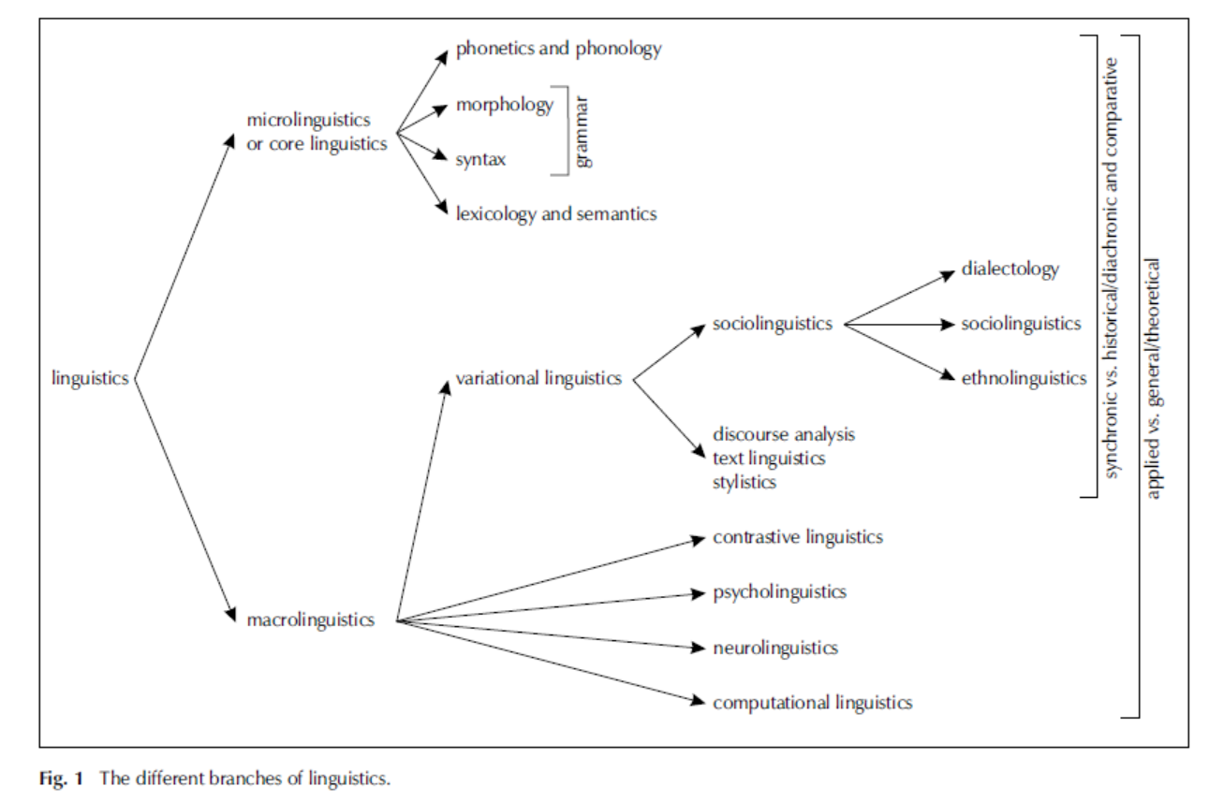
Linguistics Diagram

Slide 21
What are Phonetics and Phonology?
We have already learnt that phonetics and phonology are concerned with speech sounds and the sound system.
Linguists analyse actual language use (parole or performance),
Then they try to infer the underlying language system (langue or competence).

Slide 22
Phonetics
first of all , phonetics divides, or segments, concrete utterances into individual speech sounds.
Phonetics is therefore exclusively concerned with parole or performance.
Phonetics can then be divided into three distinct phases:
(1) articulatory phonetics,
(2) acoustic phonetics,
(3) auditory phonetics.

Slide 23
Articulatory phonetics
(1) Articulatory phonetics deals with the speech organs, (also called vocal organs or articulators)
It tackles the articulators in the vocal tract
It also describes in detail how they are used in order to produce, or articulate, (specific) speech sounds.

Slide 24
Acoustic phonetics
(2) Acoustic phonetics studies the physical properties of speech sounds, i.e. the way in which the air vibrates as sounds pass from speaker to listener.
A spectrograph is a machine that measures the soundwaves and depicts them as images, called spectrograms or sonograms.
This device shows the duration, frequency, intensity, and quality of the sounds.

Slide 25
Auditory phonetics
(3) Auditory phonetics investigates the perception of speech sounds by the listener.
They delineate how the sounds are transmitted from the ear to the brain, and how they are processed.

Slide 26
Phonetics as Natural Science
Phonetics is sometimes considered a natural science, rather than a branch of linguistics due to its close association with physics (and also with medicine).
No matter how we classify it, regardless, phonetics is an indispensable prerequisite for phonology, and is therefore an integral part of all introductions to linguistics, phonology in particular.

Slide 27
Rationale
In the language departments of most universities, however, the study of phonetics is largely restricted to articulatory phonetics owing to its applications to the learning and teaching of pronunciation.
This course, therefore, will only be concerned with articulatory phonetics, as an introduction to phonology.

Slide 28
Phonology
Phonology deals with the speakers’ knowledge of the sound system of a language.
It is therefore exclusively concerned with langue or competence.
Phonology, then, is the study of speech sound patterns.

Slide 29
Segmental Phonology
Phonology can be divided into two branches: (1) segmental phonology and (2) suprasegmental phonology.
(1) Segmental phonology is based on the segmentation of language into individual speech sounds provided by phonetics.
Unlike phonetics, however, segmental phonology is NOT interested in the production, the physical properties, or the perception of these sounds,
Segmental phonology rather studies the function and possible combinations of sounds within the sound system.

Slide 30
Suprasegmental phonology
(2) Suprasegmental phonology, also called prosody, is concerned with those features of pronunciation.
These features cannot be segmented because they extend over more than one segment, or sound.
Such features include stress, rhythm, and intonation (also called pitch contour or pitch movement).

Slide 31
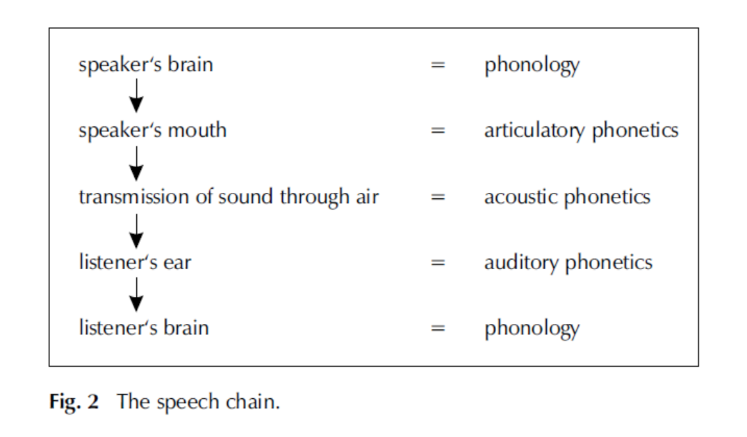
The speech Chain

Slide 32
Whose pronunciation are we describing?
In all linguistic research, we have to define the language variety that we are concerned with by delineating the speech community and/or the text type.
For example, we can investigate the Manchester dialect, the language used in e-mail messages, or the speech of children in conversations with their peers.

Slide 33
Whose pronunciation are we describing?
In language teaching, on the other hand, it is customary to use a more idealized standard variety, or simply standard, as a model.
A standard variety is the form of a language that is generally associated with educated speakers.
Even though it may have a regional base, we regard it as regionally neutral in that it can be found anywhere in a country.

Slide 34
Received Pronunciation RP: An accent
A standard is therefore a sociolect, rather than a dialect. The standard variety of English in Great Britain is called Standard British English (popularly referred to by such non-linguistic terms as King’s English, Queen’s English, BBC English, or Oxford English).
The standard variety spoken in the United States is called General American (English) or Standard American English.

Slide 35
Received Pronunciation RP: An accent
A standard variety has a fixed grammar and vocabulary, but its pronunciation may vary according to the regional origin, social group, or ethnicity of the speaker.
We use the term accent to refer to the way a variety is pronounced.
It is quite possible, then, that a standard variety is spoken in different accents. One of these accents usually carries the most prestige, and is used as a model in the teaching of pronunciation.

Slide 36
RP and AmE Network Standard
The most prestigious accent of Standard British English, for example, was first called Public School Pronunciation and renamed Received Pronunciation, or simply RP, in the 1920s.
There is no widely used term for the most prestigious accent of General American, but it is sometimes referred to as Network Standard or Network English.

Slide 37
Whose pronunciation are we describing?
Received Pronunciation- the dialect spoken in the south-east of England.
The word received means ‘generally accepted as proper’.
First described by Daniel Jones (1881-1967), the British phonetician in his English Pronouncing Dictionary in 1917.
RP- most discussed accent around the world.
Still, RP is a minority pronunciation used by 3-4 % of the British population.
Most educated speakers in Britain speak a modified RP or near RP.
In this course, we use RP, or near RP, as our model to illustrate English phonetics and phonology.

Slide 38
How do we write down spoken language?
Sounds of a language variety need to be written down as accurately as possible.
Traditional alphabetical spelling system, also called orthography is one method.
One problem! It is not very consistent.
In English, the second sound in the word he, for example, is represented differently in see, sea, seize, people, key, Caesar, believe, amoeba, machine, and silly.
Same letters may indicate different sounds, such as the a in dad, father, many, call, village, and Dame.
Godfrey Dewey conducted a survey [English Spelling: Roadblock to Reading from 1971], he reported:
13.7 different spellings per sound, and 3.5 sounds per letter, some letters like the b in debt are silent.

Slide 39
Evolution of English Spelling
1476: William Caxton establishes the first printing house near London.
Printing stabilizes English orthography.
Modern spellings often reflect pronunciations from Chaucer to Shakespeare.
Example: "knight" once sounded like the German "Knecht."
English has absorbed numerous loanwords with unchanged spellings.
Surprisingly, fewer than 500 words exhibit significant spelling irregularities.
Many of these irregular words are among the most commonly used in the language.

Slide 40
Spelling Reform Through History
16th century: Efforts to remove spelling irregularities begin.
Advocates of spelling reform include notable figures like Benjamin Franklin, Charles Darwin, Alfred Lord Tennyson, Andrew Carnegie, Theodore Roosevelt, and George Bernard Shaw, along with language professionals.
Organizations like the Simplified Spelling Society in Britain and the Reformed Spelling Association in the United States advocate spelling system changes.
Despite various attempts, English orthography remains largely resistant to reform.

Slide 41
Phonetics Transcription
Accurate representation of speech sounds relies on a systematic method.
Traditional spelling lacks consistency in representing sounds.
Phonographic relationship: Each sound corresponds consistently to a specific symbol, ensuring one-to-one mapping.
Phonetic symbols are used to represent speech sounds, forming a phonetic alphabet.
Diacritics are additional marks to denote slight sound variations.
Phonetic transcription: The process of writing spoken language in phonetic symbols and the resulting text.

Slide 42
The International Phonetic Alphabet (IPA)
The most widely used phonetic alphabet for representing speech sounds is the International Phonetic Alphabet (IPA).
First published in 1888 by the International Phonetic Association in France.
Continuously revised and updated, with the latest revision in 2005.
Initially developed by French and British language teachers based on a concept by Danish linguist Otto Jespersen.
The IPA is used in English-language dictionaries worldwide, except for American publications.

Slide 43
The International Phonetic Alphabet (IPA)
IPA lacks the ability to transcribe prosodic features like rhythm and intonation.
Some IPA symbols resemble ordinary Roman letters, but they may not always correspond to expected sounds in English or German.
Memorizing IPA symbols should be done without preconceptions based on conventional alphabets.
To distinguish phonetic symbols from letters, square brackets [ ] indicate concrete utterances, slashes // represent abstract sounds, and pointed brackets < >, single quotation marks, or italics indicate letters.
IPA symbols representing English sounds can be found on the inside front cover of the manual.

Slide 44
Features Relevant to Describing Speech Sounds
When describing the pronunciation of a speaker or speech community, it starts with analyzing individual sounds within their dialect.
Nine features are considered for describing speech sounds.
These features fall into two main categories:
Category 1: Phonetically Relevant Features
Characteristics that describe the physical aspects of English sounds with little impact on their function within the sound system.
Mainly for precise phonetic description.
Limited relevance to segmental phonology.

Slide 45
Phonologically relevant features: Distinctive features
Category 2: Phonologically Relevant Features.
Features that are both phonetically and phonologically relevant in English.
These features differentiate meanings, e.g., explaining distinctions like "cab" and "cap" or "serve" and "surf."
Referred to as distinctive or relevant features.
Vital for understanding the role of sounds within the sound system.

Slide 46
Phonetic Feature - Loudness
Loudness is a fundamental phonetic property of speech sounds and spoken language.
It is linked to the amplitude of vocal fold vibration, which occurs in the larynx (voice box).
Increased amplitude results in a louder sound.
A Suprasegmental Feature:
Loudness is a suprasegmental or prosodic feature.
It contributes to distinctions in stress, along with pitch, duration, and sound quality.
Examples: "record" (noun) vs. "record" (verb), also conveying emotional states like anger.
However, in segmental phonology (individual sound analysis), loudness doesn't alter a sound's function.
Loudness is not a distinctive feature in segmental phonology.

Slide 47
Phonetic Feature - Pitch
Pitch is a crucial phonetic characteristic linked to the frequency of vocal fold vibration.
Faster vocal fold vibrations result in higher pitch (tones).
Similar to loudness, pitch can distinguish meaning on a suprasegmental level.
It's a component of stress and influences intonation in connected speech.
Stress and pitch variations determine whether a sentence is a statement or a question.

Slide 48
Pitch: Tone Languages
Tone Languages:
In over half the world's languages (tone languages), pitch changes can alter a sound's function, changing the basic meaning of a word.
Examples include many Asian and Native American languages, as well as over 1,000 tone languages in Africa.
English, including RP and other English accents, is not a tone language.
In English, pitch does not serve as a distinctive feature in segmental phonology.

Slide 49
Tone of Voice
Distinction between sound quality and tone of voice.
Sound quality is characterized by distinctive features.
Example: The sound "see" has the same quality, regardless of loudness, pitch, or duration.
Tone of voice, also known as voice quality or timbre, refers to the perceived "color" difference in two voices with otherwise identical phonetic features.
Comparable to the difference in tones between musical instruments.
Variations in tone of voice result from different vocal fold vibration patterns and their impact on soundwaves.

Slide 50
Tone of Voice
Tone of voice, like loudness and pitch, is a feature of spoken language and individual sounds.
It's considered a paralinguistic feature, not typically a suprasegmental feature.
Describes characteristics such as female, feminine, male, masculine, harsh, breathy, murmured, creaky, or thin voices.
Helps identify a speaker's gender, age, emotional state, and more.
Unlike distinctive features, tone of voice doesn't change the function of individual speech sounds.
It's not a distinctive feature in the segmental phonology of English accents.

Slide 51
Duration and Length
Duration and length (sound quantity) both refer to the time a sound is sustained.
‘Duration’ typically refers to the absolute or actual time taken in sound articulation.
For example, the final sound in "see" can vary in duration depending on the speaker, emphasis, and other factors.
Duration is a purely phonetic concept; it doesn't change the function or sound quality.

Slide 52
Length in Phonology
"Length" usually pertains to phonology, representing the perceived relative time a sound is sustained from the listener's perspective.
Example: "fool" and "full" - "long u" and "short u."
Length can be considered a phonological concept since it differentiates functions within the English sound system.
It can help distinguish meaning and is counted among distinctive features by some linguists.

Slide 53
Complex Relationship
Length differences are often accompanied by sound quality variations.
Quality distinctions are more significant in perception than just differences in length.
Labels like "long u" and "short u" can be misleading.
length is mainly considered phonetically relevant in this book.

Slide 54
Air-Stream Mechanism in Speech
All speech sounds involve the movement of air.
Most sounds in world languages are produced by expelling air from the lungs through the trachea, a process known as egressive pulmonic airstream.
Virtually all English sounds are produced through this egressive pulmonic mechanism.
In English, the air-stream mechanism isn't a distinctive feature.

Slide 55
Variation in Air-Stream Mechanisms
While egressive pulmonic is the primary mechanism using lung air, some languages employ different air-stream mechanisms.
Three other common mechanisms are found, especially in African languages:
Egressive glottalic: Air is pushed up from the space between the vocal folds, known as the glottis, resulting in ejective sounds.
Ingressive glottalic: The glottis moves air inward, creating implosive sounds.
Ingressive velaric: Air is drawn in by movements against the back part of the mouth's roof, known as the velum or soft palate, producing click sounds.
Languages with click sounds are often referred to as "click languages."

Slide 56
Voicedness and Voicelessness: Glottal State
All English sounds are produced using an egressive pulmonic air-stream mechanism that passes through the glottis.
The glottis is defined as [the space between the vocal folds, situated behind the Adam's apple in the larynx].

Slide 57
Voiced Sounds
Voiced sounds occur when the glottis is narrow, causing the vocal folds to vibrate.
You can detect voiced sounds by feeling the vibration of the vocal folds with your fingers on the larynx or by closing your ears while speaking.
Example: The word "zeal" consists of all voiced sounds, with continuous vocal fold vibration.

Slide 58
Voiceless Sounds
Voiceless sounds happen when the glottis is open, allowing air to pass through without vocal fold vibration.
In the word "seal," you won't sense vocal fold vibration on the first sound, but it begins on the second sound.
This means the first sound in "seal" is voiceless, while the other two are voiced.
Whispering makes all speech sounds voiceless, even in words like "zeal" and the final sounds in "seal."

Slide 59
Glottal Closure
Glottal closure occurs when the vocal folds are firmly pressed together, blocking the air-stream entirely.
It produces a sound called a glottal stop or glottal plosive.
While less relevant in RP, it appears occasionally in educated speech, especially in London accents.

Slide 60
Distinctive Feature - Voiced/Voiceless Contrast
The voiced/voiceless contrast can distinguish meaning in some cases (e.g., "zeal" vs. "seal").
Some linguists consider it a distinctive feature in English.
However, it doesn't always differentiate meaning, as we'll see shortly.

Slide 61
Phonologically relevant features: Distinctive features: Intensity of Articulation - Lenis and Fortis
The voiced/voiceless contrast discussed earlier is often accompanied by differences in the force of the air-stream.
English voiced sounds are typically produced with a weaker breath force and less muscular tension, referred to as lenis articulation (soft).
English voiceless sounds are made with more force and higher tension, known as fortis articulation (strong).
Popular terms like "soft" and "hard" for speech sounds have been replaced in linguistics.

Slide 62
Symmetrical Relationship
Fortis sounds are always voiceless in English.
Lenis sounds, usually voiced, can also occur as voiceless variants (devoiced).
Perceived Differences in Whispered Speech:
In whispered speech, lenis sounds retain their lenis articulation, meaning they are articulated with weaker breath force.
For example, the initial sound in "zeal" remains lenis even when whispered.
The perceived difference between words like "zeal" and "seal" in whispered speech is not solely due to the voiced/voiceless contrast but also the intensity of articulation (lenis/fortis contrast).

Slide 63
Devoicing in Certain Environments
Some lenis sounds can be devoiced in specific contexts.
They are partly devoiced in word-initial positions and almost entirely devoiced word-finally, such as in "cab" and "serve."
Despite devoicing, their lenis articulation makes them still recognizable as the same (voiced) sounds.
By increasing breath force and muscular tension for the final sounds, fortis articulation occurs, transforming words like "cab" into "cap" and "serve" into "surf."
Distinctive Feature - Lenis/Fortis Contrast:
The lenis/fortis contrast can distinguish meaning and is considered a distinctive feature.
It plays a crucial role in differentiating words in English.

Slide 64
Place of Articulation
Content:
The majority of English sounds involve air pushed up from the lungs.
About two-thirds of English sounds are consonants, produced when the air-stream is obstructed in the throat (pharynx) or vocal tract before exiting through the mouth or nose.
Key Concept: Place of Articulation:
Place of articulation identifies the primary speech organs involved in producing a specific sound.

Slide 65
Articulation Process
Consonants are produced when one active, mobile lower speech organ makes contact with a passive, immobile upper speech organ.
Example: The last sound in "surf" is a labiodental consonant, where the lower lip contacts the upper teeth.
This sound is referred to as "labiodental" (labialis - 'of the lips', dentalis - 'of the teeth').
Reference Diagram:
A diagram illustrating the speech organs mentioned in this manual can be found on the inside front cover.

Slide 66
Manner of Articulation - Consonants
Another vital feature in describing speech sounds is the manner of articulation, primarily concerning the degree of air-stream obstruction at the place of articulation for consonants.
Manner of Articulation - Degree of Closure:
Manner of articulation describes how much the air-stream is obstructed at the place of articulation for consonants.
Example: The last sound in "surf" narrows the gap between the lower lip and upper teeth, creating friction as air passes through, resulting in a "fricative" consonant.

Slide 67
Detailed Description
A complete description of this sound using distinctive features would label it as a "fortis labiodental fricative."
No other sound in the English sound system matches this description.
Future Topics:
Places and manners of articulation will be explored in more depth in the upcoming lessons.
Intensity of articulation will be revisited in Lesson Four.

Slide 68
Thank you

