Slide 1
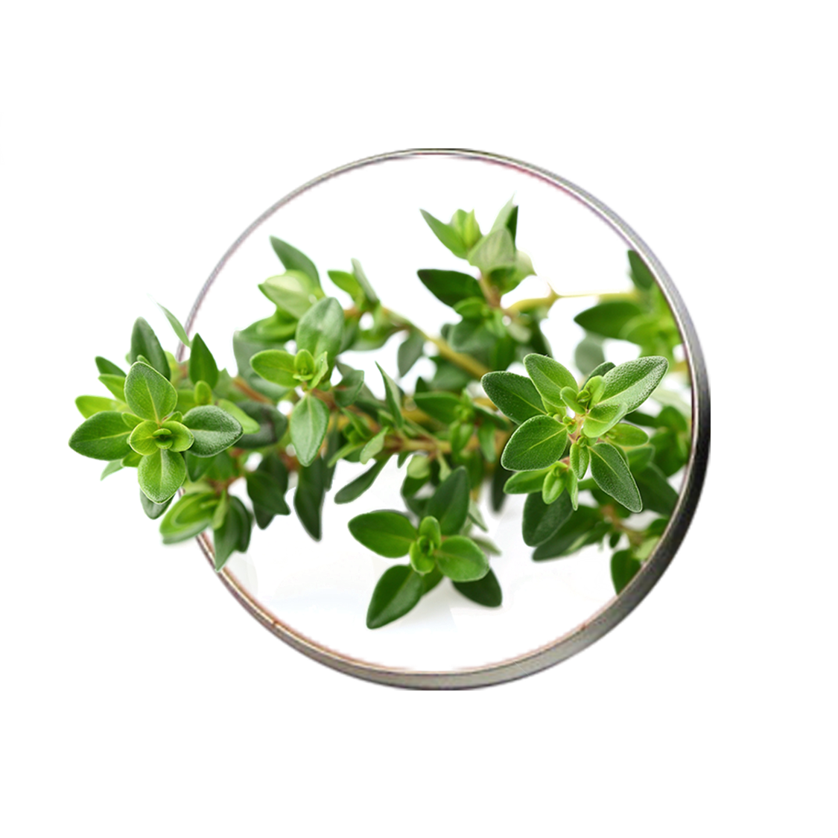
Growth and Essential Oil Content of Thyme (Thymus vulgaris L.) under Megastim111 Foliar Application
Dr. Kharman Kh. Qader

