Slide 1
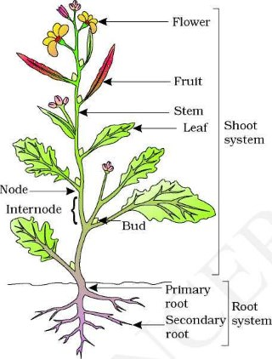
Parts of Plant
Lecture 3

Slide 2
Parts of Plant
Plants are one of the most essential living organisms on earth. They are immensely beneficial to both animals and human beings. They produce oxygen which is crucial for the survival of living organisms. Overall, different parts of plants have different roles to perform.
They act as a source of food and oxygen and maintain the ecological balance.

Slide 3
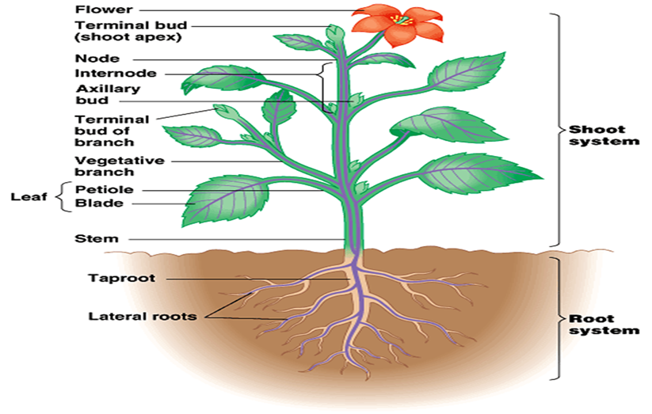
Parts Of Plant
The main parts of a plant include:
Roots
Stem
Leaves
Flowers

Slide 4
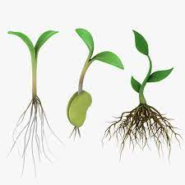
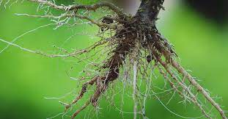
Parts of Plant 1. Roots
Roots are the most important and underground part of a plant, which are collectively called the root system. The apical part of the root is covered by the root cap that protects the root apex.

Slide 5
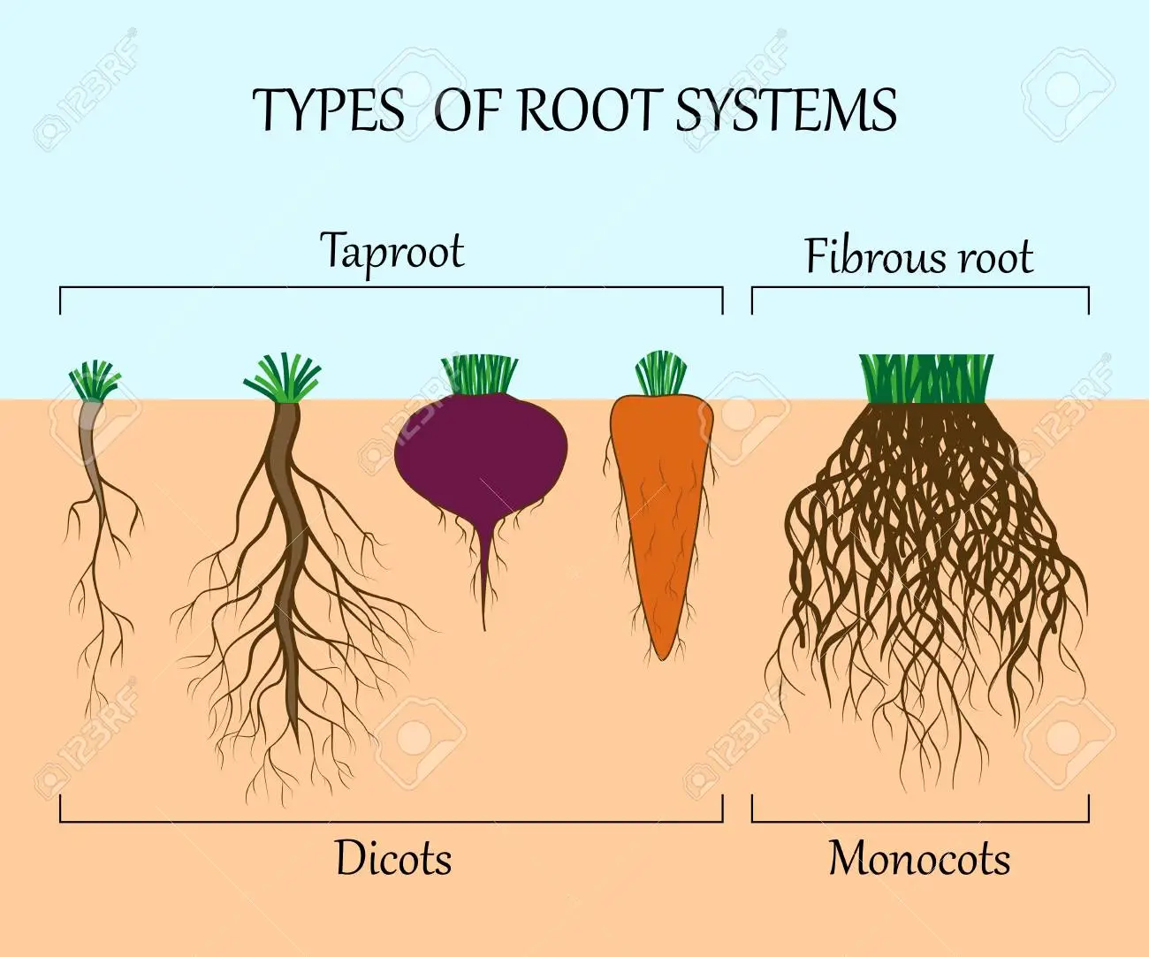

Slide 6
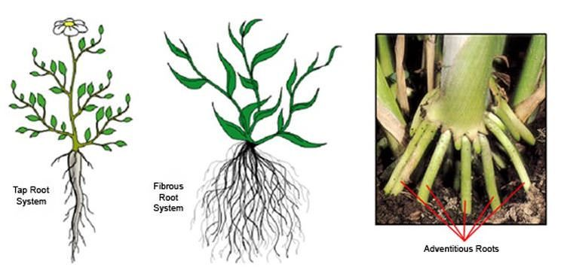
Types of root
Tap root (primary root) – It is the primary and the main root that develops from the radicle, bears numerous branches and remains underground.
Secondary root
Adventitious root – These are roots that develop from any part of the plant except the radicle. They may be aerial or underground

