Slide 1
Experiment No.4
Gear Trains

Slide 2
AIM:-To study different types of gear trains
Theory:-
There are several types of gear trains. In some cases, the axes of rotation of the gears are fixed in space. In one case, gears revolve about axes which are not fixed in space.
Therefore the gear trains can be classified into the following cases:
Simple gear train.
Compound gear train.
Reverted gear train.
Epicyclic or Planetary gear train.

Slide 3
Simple gear train
In this gear train, there are series of gears which are capable of receiving and transmitting motion from one gear to another. They may mesh externally or internally. Each gear rotates about separate axis fixed to the frame. Figures show two gears in external meshing and internal meshing.

Slide 4
The two meshing gears in external meshing rotate in opposite sense whereas in internal meshing they rotate in same sense.

Slide 5
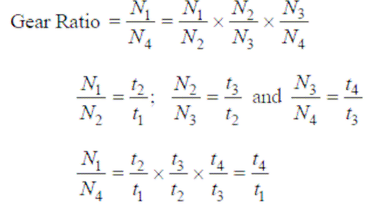
Let N1, N2, N3,…be speed in rpm of gears 1,2,3,…and t1, t2, t3,…be number of respective gears 1, 2, 3,…,etc.
In this gear train, gear 1 is input, gear 4 is output and gears 2, 3 are intermediate gears. The gear ration of the gear train is given by

Slide 6
In simple gear train, there can be more than two
gears also as shown in figure below:

