Slide 1
Derivatives
and
Applications

Slide 2
The Differentiation Rules:
There are three kinds of differentiation rules. First, any basic function has a specific rule giving its derivative. Second, the chain rule will find the derivative of a chain of functions. Third, there are general rules that allow us to calculate the derivatives of algebraic combinations ,example: sums, products, and quotients of any functions provided we know the derivatives of each of the component functions.

Slide 3
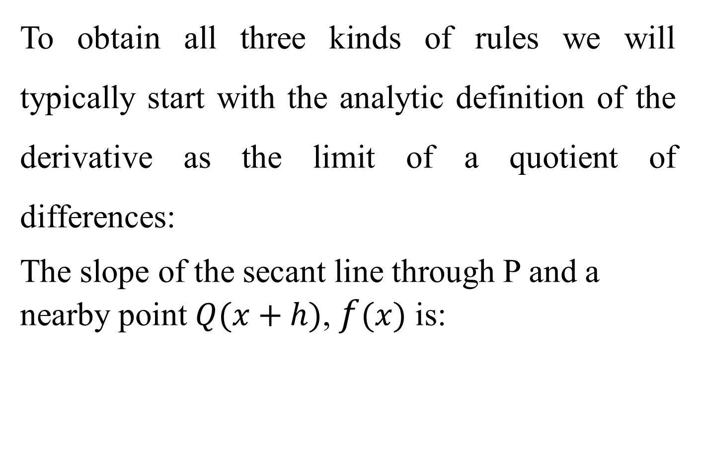
To obtain all three kinds of rules we will typically start with the analytic definition of the derivative as the limit of a quotient of differences:
The slope of the secant line through P and a nearby point $Q(x+h)$, $f(x)$ is:

Slide 4

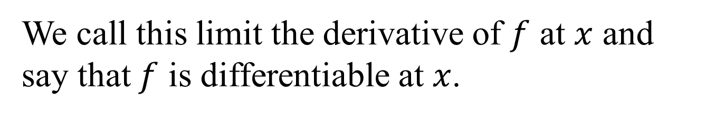
The slope of the graph at P is the limit of the secant slope as Q approach P along the graph, then
We call this limit the derivative of $f$ at $x$ and say that $f$ is differentiable at $x$.

Slide 5
Example

Slide 6
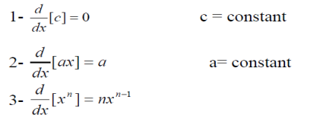

Differentiation by (constant, power, sum, difference, product and Quotient) Rules
Let $u =f(x)$and $v = g(x)$

Slide 7
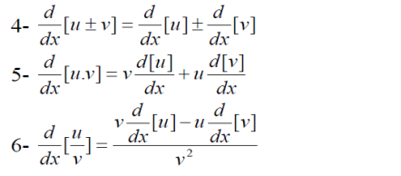

Slide 8
Example

Slide 9
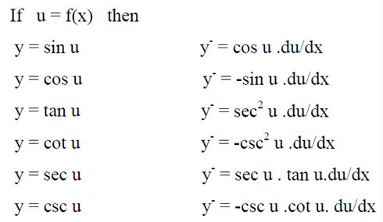
Derivative of Trigonometric Functions

Slide 10
Example

Slide 11
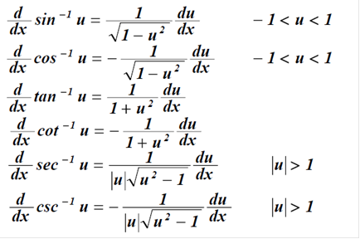
Derivative of Inverse Trigonometric Functions
If u is any differentiable function of x, then:

Slide 12
Example

Slide 13
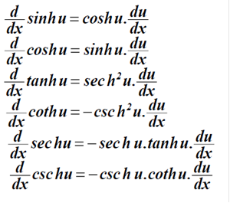
Derivative of Hyperbolic Function
If u is any differentiable function of x, then:

Slide 14
Example

Slide 15
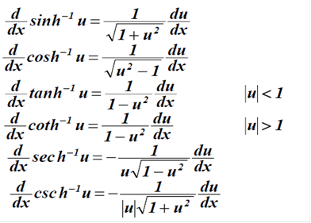
Derivative of Inverse Hyperbolic Function
If u is any differentiable function of x, then:

Slide 16
Example

Slide 17
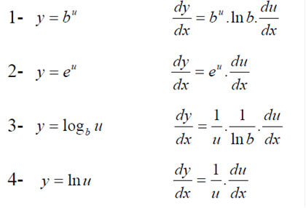

Derivative of Exponential and Logarithmic Function
If $u = f(x)$

Slide 18
Example

Slide 19


The Chain Rule
$$When y=g (t) and x=f (t)$$
Then
And when

Slide 20
Example

Slide 21
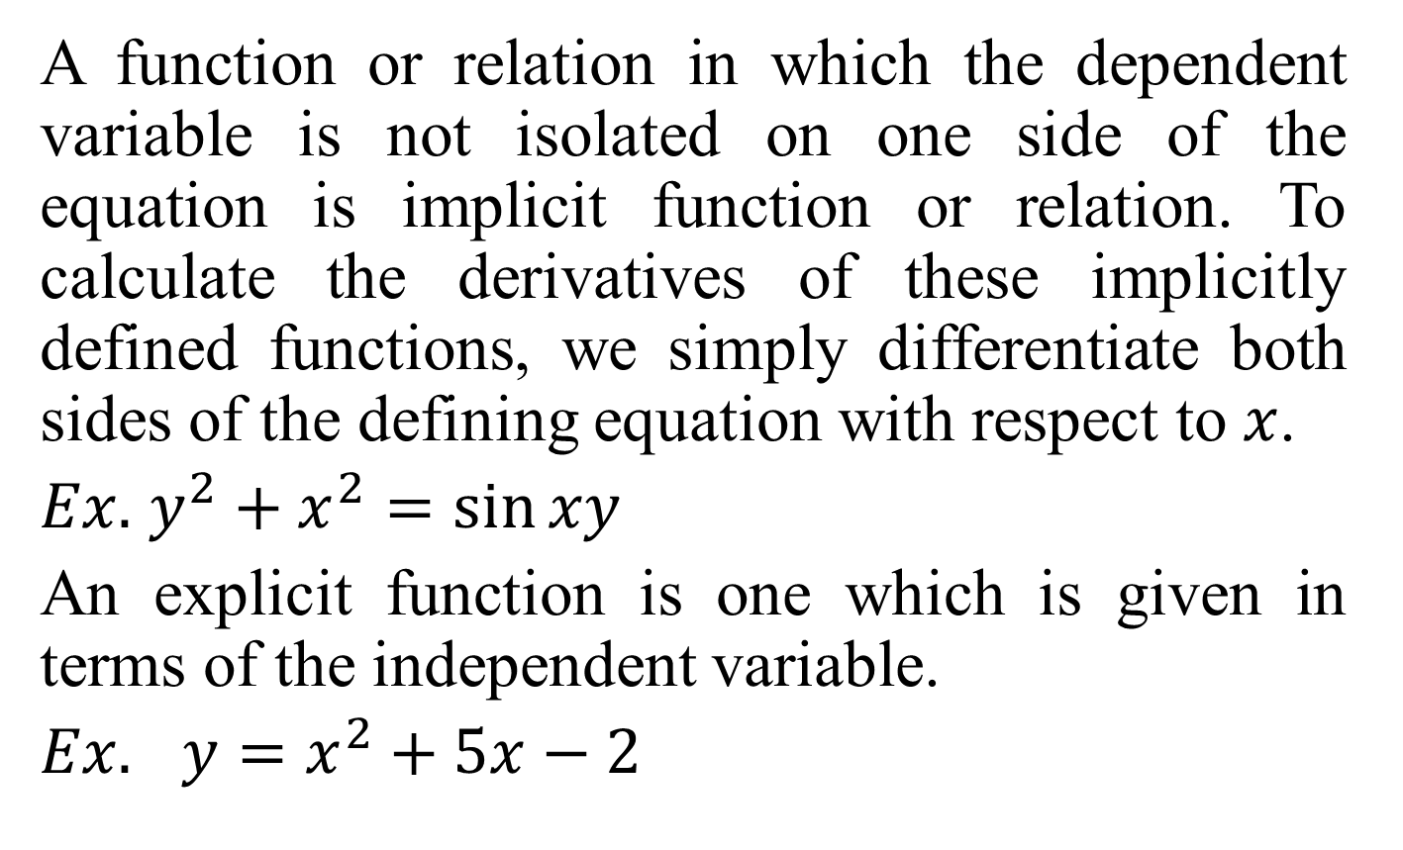
Implicit Differentiation
A function or relation in which the dependent variable is not isolated on one side of the equation is implicit function or relation. To calculate the derivatives of these implicitly defined functions, we simply differentiate both sides of the defining equation with respect to $x$.
$Ex.$ $y^{2}+x^{2}=\sin{xy}$
An explicit function is one which is given in terms of the independent variable.
$Ex.$ $y=x^{2}+5x−2$

Slide 22
Example

Slide 23
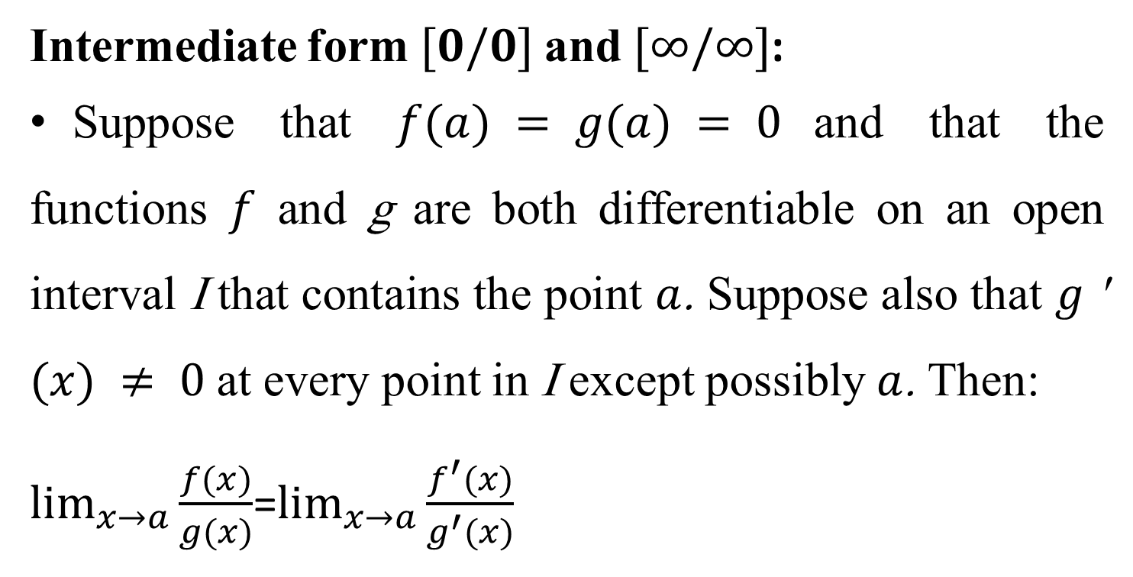
L’Hôpital’s Rule
Intermediate form $[0/0]$and $[∞/∞]$:
Suppose that $f(a) = g(a) = 0$and that the functions $f$ and g are both differentiable on an open interval I that contains the point $a$. Suppose also that $g$' $(x) ≠ 0$at every point in I except possibly $a$. Then:
$\lim_{x→a}{\frac{f(x)}{g(x)}}$=$\lim_{x→a}{\frac{f^{′}(x)}{g^{′}(x)}}$

Slide 24
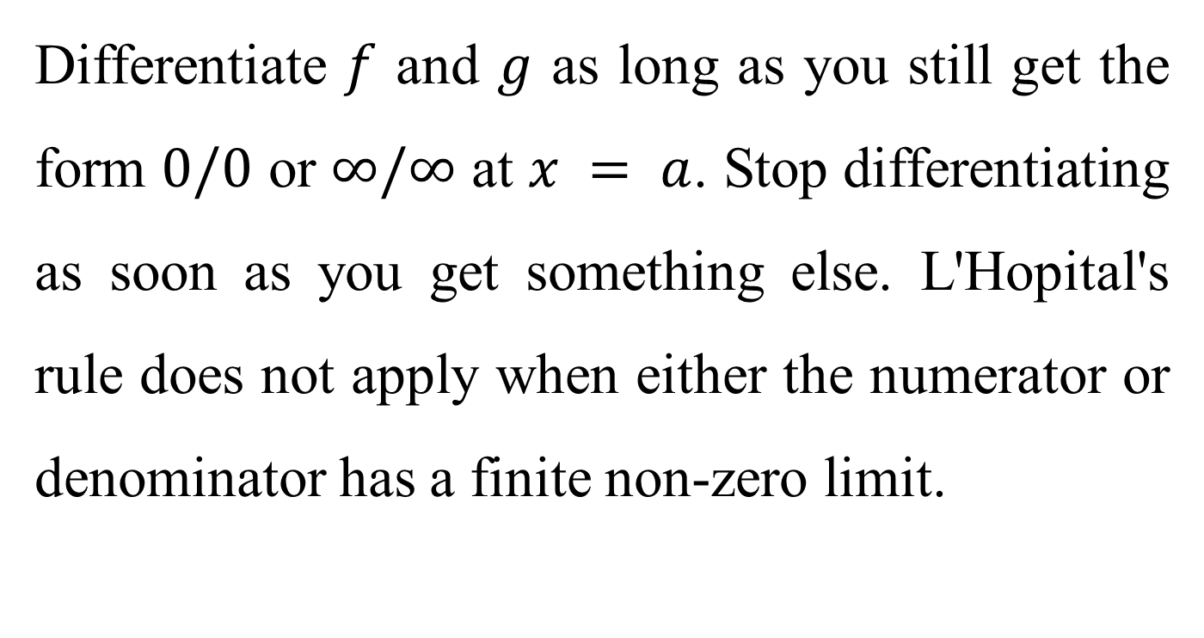
Differentiate $f$ and $g$ as long as you still get the form $0/0$ or $∞/∞$ at $x = a$. Stop differentiating as soon as you get something else. L'Hopital's rule does not apply when either the numerator or denominator has a finite non-zero limit.

Slide 25
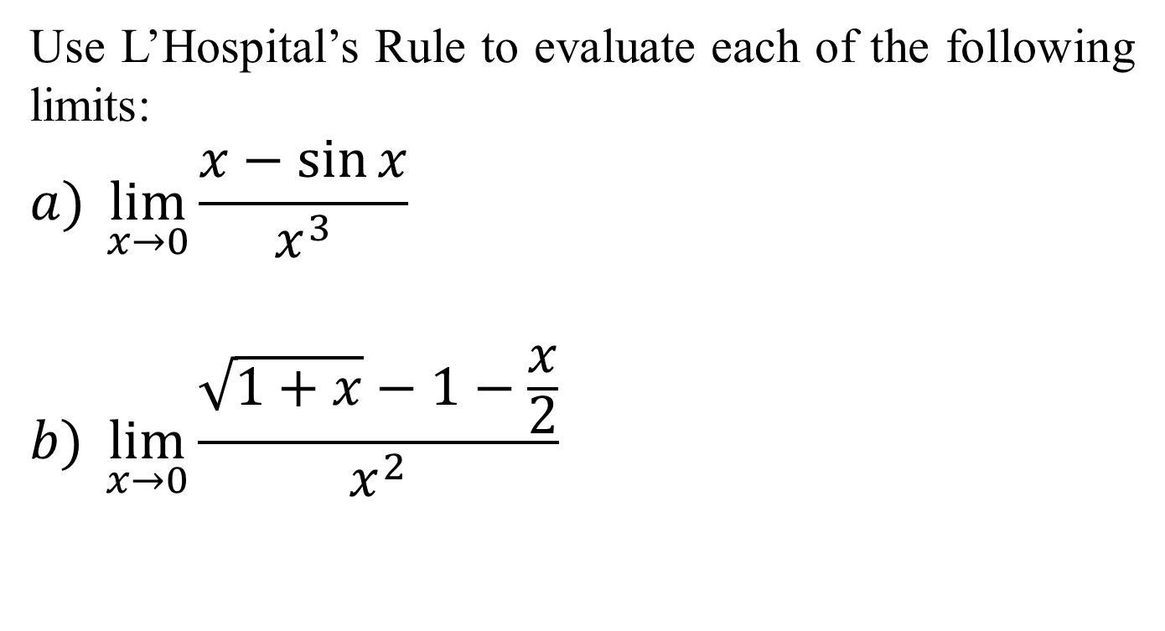
Example
Use L’Hospital’s Rule to evaluate each of the following limits:
$$a) \lim_{x→0}{\frac{x−\sin{x}}{x^{3}}}$$
$$b) \lim_{x→0}{\frac{\sqrt{1+x}−1−\frac{x}{2}}{x^{2}}}$$

Slide 26

Solution:
$a) \lim_{x→0}{\frac{x−\sin{x}}{x^{3}}}$ $\frac{0}{0}$
$\underset{x→0}{=lim}{\frac{1−\cos{x}}{{3x}^{2}}}$ $\frac{0}{0}$
$\underset{x→0}{=lim}{\frac{\sin{x}}{6x}}$ $\frac{0}{0}$
$$\underset{x→0}{=lim}{\frac{\cos{x}}{6}}$$
$$=\frac{1}{6}$$

Slide 27

$b) \lim_{x→0}{\frac{\sqrt{1+x}−1−\frac{x}{2}}{x^{2}} \frac{0}{0}}$
$\underset{x→0}{=lim}{\frac{\frac{1}{2}{(1+x)}^{\frac{−1}{2}}−\frac{1}{2}}{2x}}$ $\frac{0}{0}$
$\underset{x→0}{=lim}{\frac{\frac{−1}{4}{(1+x)}^{\frac{−3}{2}}}{2}}$
$$=\frac{−1}{8}$$

Slide 28




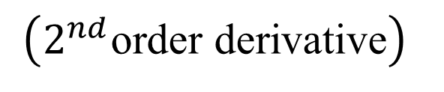
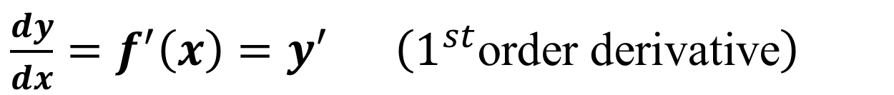
Second and Higher Order Derivatives
If $y = f(x)$
$\frac{dy}{dx}=f^{′}\left(x\right)=y^{′}$ $\left(1^{st}\text{order} \text{derivative}\right)$
$$\left(2^{nd}\text{order} \text{derivative}\right)$$
$$\left(n^{th}\text{order} \text{derivative}\right)$$

Slide 29
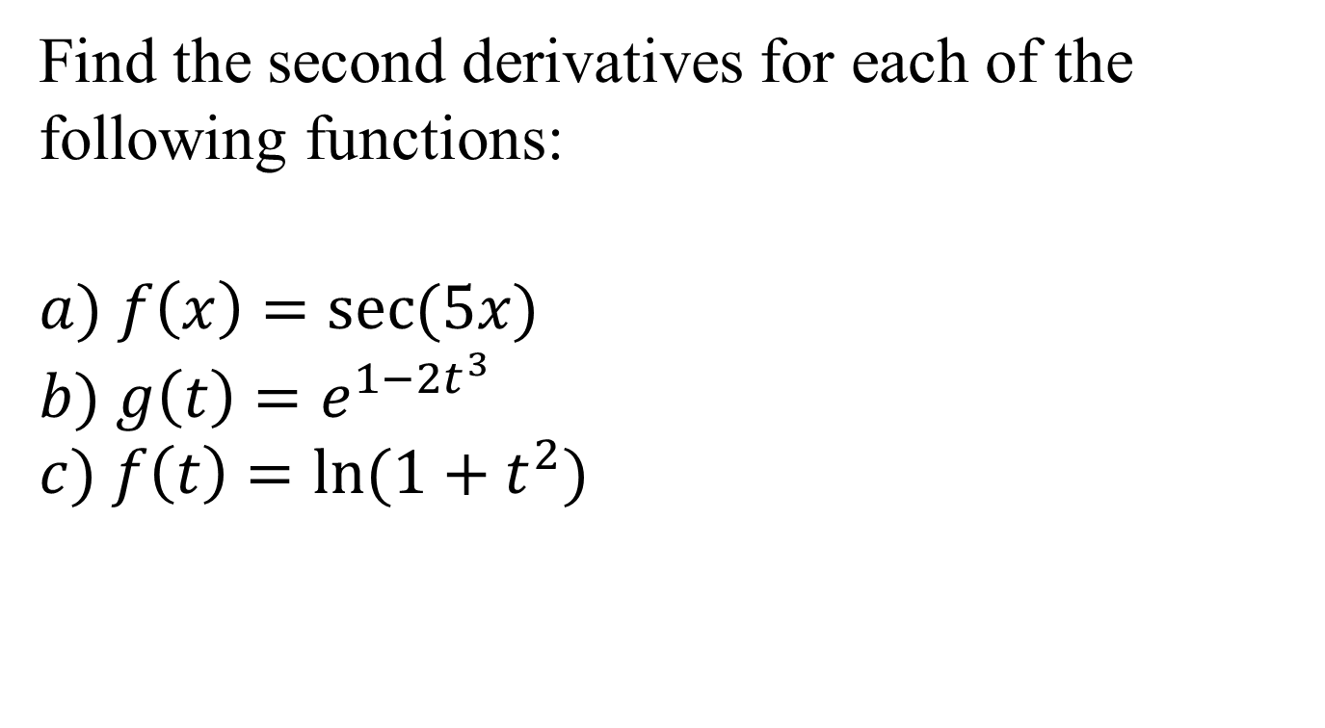
Example
Find the second derivatives for each of the following functions:
$$a) f\left(x\right)=\sec{(5x)}$$
$$b) g\left(t\right)=e^{1−2t^{3}}$$
$$c) f\left(t\right)=\ln{(1+t^{2})}$$

Slide 30
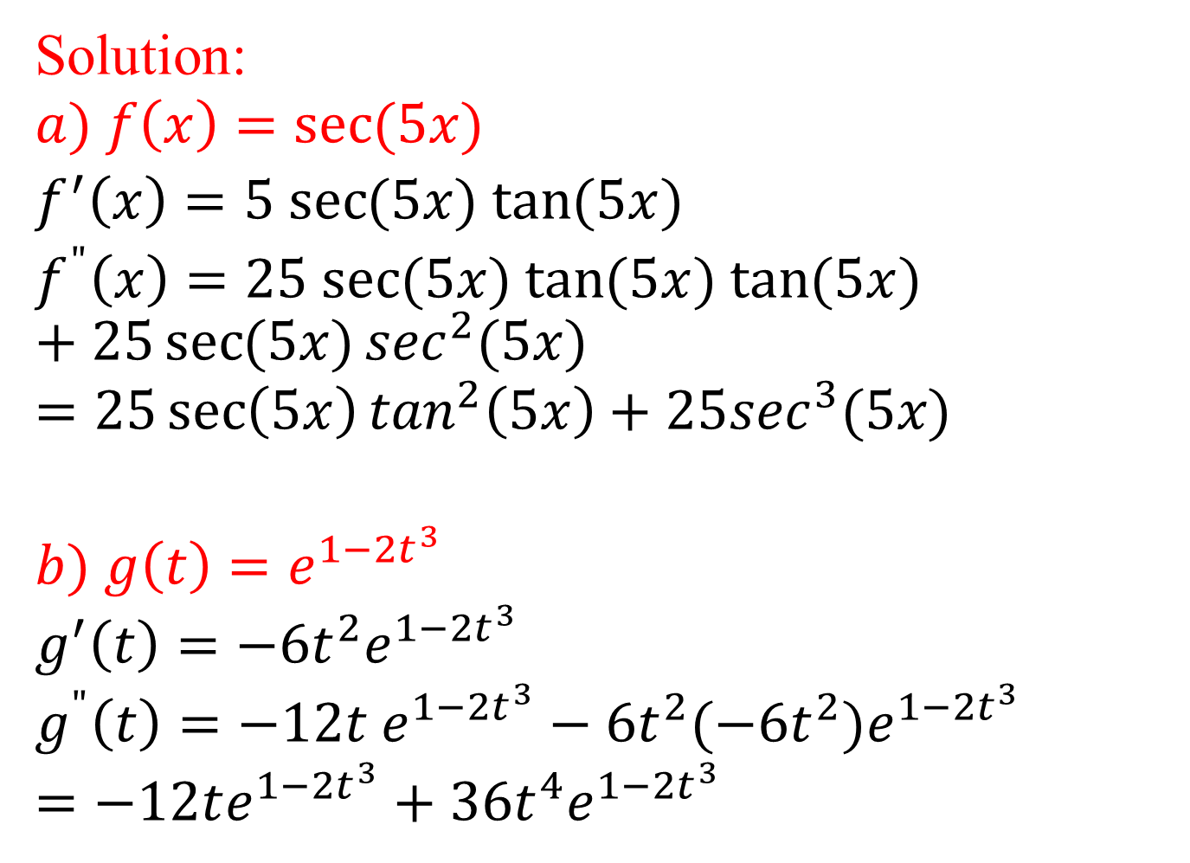
Solution:
$$a) f\left(x\right)=\sec{(5x)}$$
$f^{′}\left(x\right)=5$ $\sec{(5x)}$ $\tan{(5x})$
$f^{"}\left(x\right)=25$ $\sec{(5x)}$ $\tan{(5x})$ $\tan{(5x})+25\sec{(5x)}\sec^{2}(5x)$
$$=25\sec\left(5x\right)\tan^{2}\left(5x\right)+25\sec^{3}(5x)$$
$$b) g\left(t\right)=e^{1−2t^{3}}$$
$$g^{′}\left(t\right)=−6t^{2}e^{1−2t^{3}}$$
$$g^{"}\left(t\right)=−12t e^{1−2t^{3}}−6t^{2}(−6t^{2})e^{1−2t^{3}}$$
$$=−12te^{1−2t^{3}}+36t^{4}e^{1−2t^{3}}$$

Slide 31
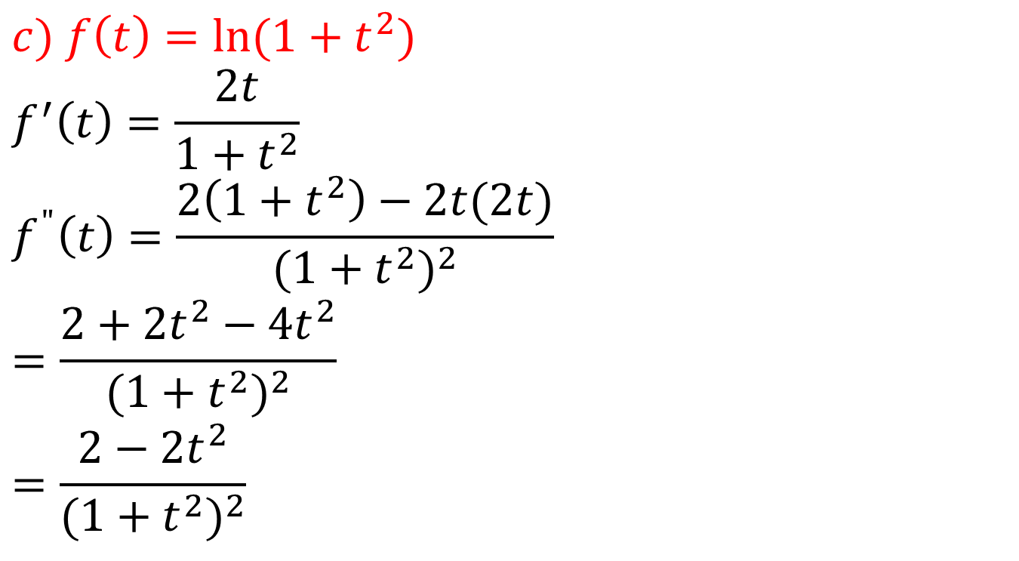
$$c) f\left(t\right)=\ln{(1+t^{2})}$$
$$f^{′}\left(t\right)=\frac{2t}{1+t^{2}}$$
$$f^{"}\left(t\right)=\frac{2\left(1+t^{2}\right)−2t(2t)}{{(1+t^{2})}^{2}}$$
$$=\frac{2+2t^{2}−4t^{2}}{{(1+t^{2})}^{2}}$$
$$=\frac{2−2t^{2}}{{(1+t^{2})}^{2}}$$

Slide 32
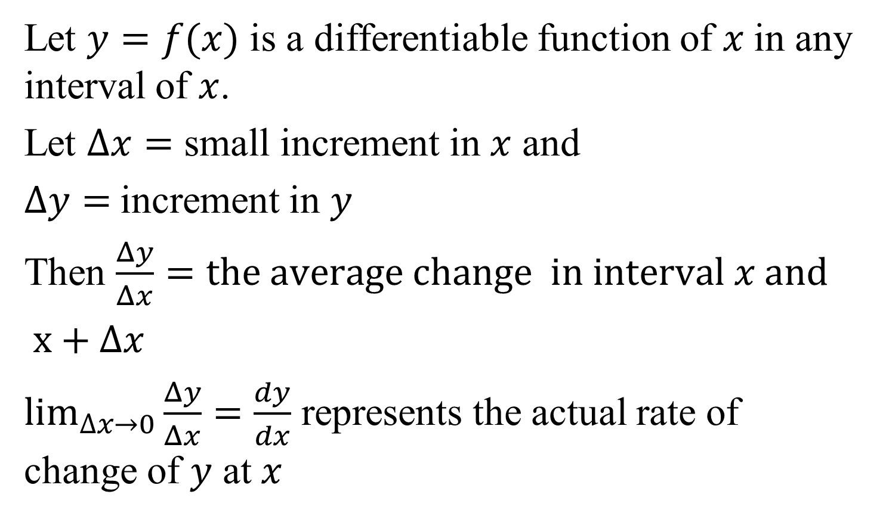
The Rate of change
Let $y=f(x)$ is a differentiable function of $x$in any interval of $x$.
Let $∆x=$ small increment in $x$ and
$∆y=$increment in $y$
Then $\frac{Δy}{Δx}=the average change in interval x and$
$x+$ $∆x$
$\lim_{∆x→0}{\frac{Δy}{Δx}=\frac{dy}{dx}}$ represents the actual rate of change of $y$ at $x$

Slide 33

Note
If r, v and s are radius, volume and surface area, then $\frac{dr}{dt},\frac{dv}{dt},$ $\frac{ds}{dt}$are their rate of change with respect to time (t).

Slide 34
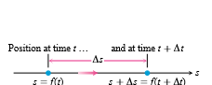
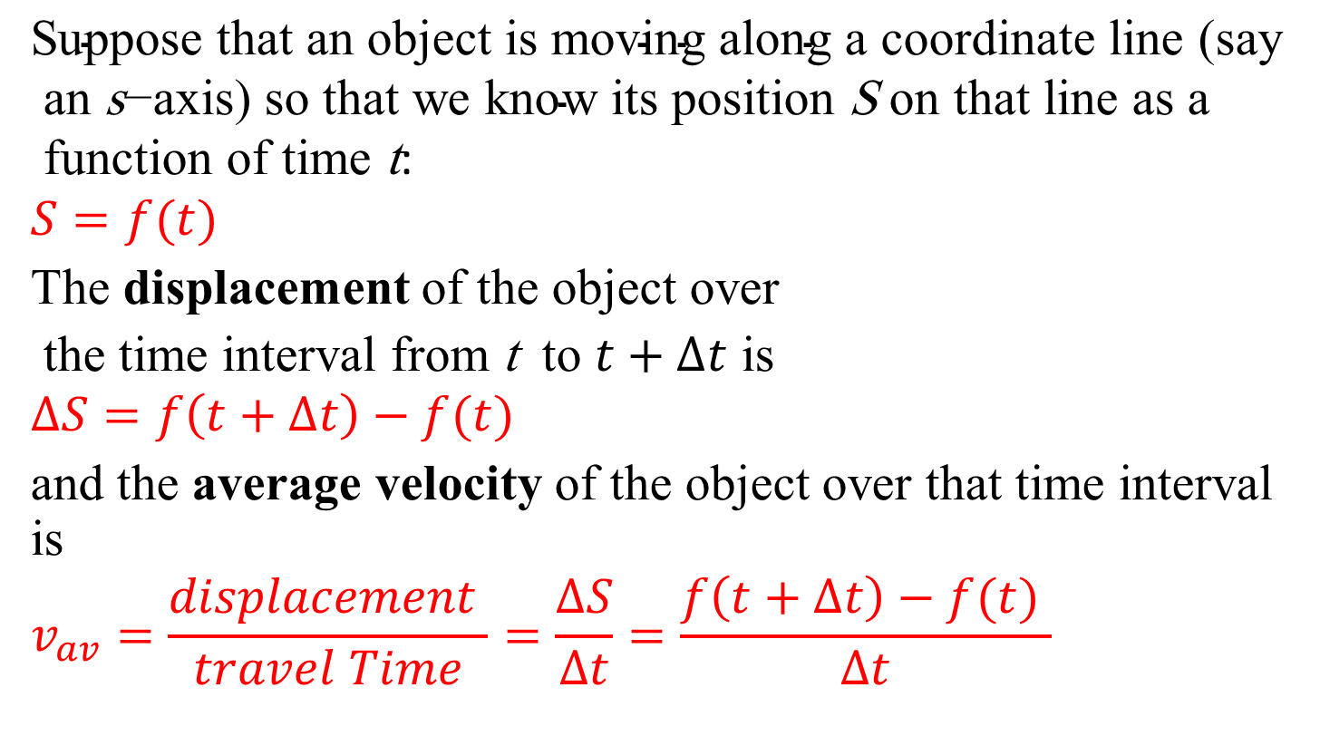
Displacement, Velocity, Speed,
Acceleration
$$\text{Suppose} \text{that} \text{an} \text{object} \text{is} \text{moving} \text{along} \text{a} \text{coordinate} \text{line}\text{ (}\text{say} \text{an} \text{s}\text{−}\text{axis}\text{) }\text{so} \text{that} \text{we} \text{know} \text{its} \text{position} \text{S} \text{on} \text{that} \text{line} \text{as} \text{a} \text{function} \text{of} \text{time} \text{t}\text{:}$$
$$S=f(t)$$
The displacement of the object over
the time interval from t to $t+∆t$ is
$$∆S=f\left(t+∆t\right)−f(t)$$
and the average velocity of the object over that time interval is
$$v_{av}=\frac{displacement }{travel Time}=\frac{∆S}{∆t}=\frac{f\left(t+∆t\right)−f(t) }{∆t}$$

Slide 35
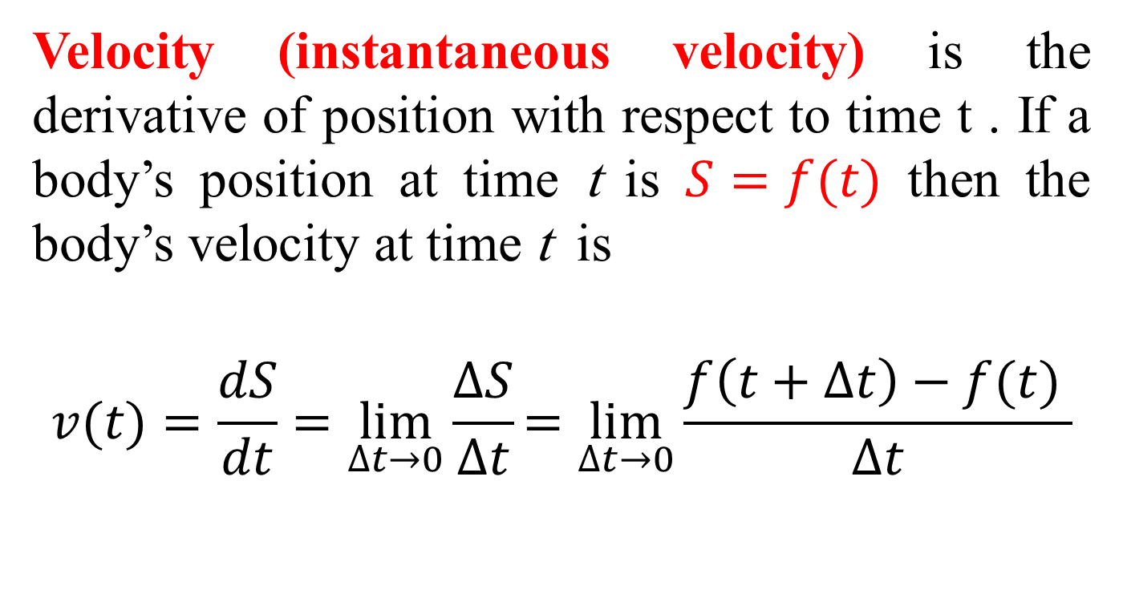
Velocity
Velocity (instantaneous velocity) is the derivative of position with respect to time t . If a body’s position at time t is $S=f(t)$ then the body’s velocity at time t is
$$v(t)=\frac{dS}{dt}=\lim_{∆t→0}\frac{∆S}{∆t}=\lim_{∆t→0}{\frac{f\left(t+∆t\right)−f(t) }{∆t}}$$

Slide 36

Speed
Speed is the absolute value of velocity.
speed$=$ $v(t)$ = $\frac{ds}{dt}$

Slide 37
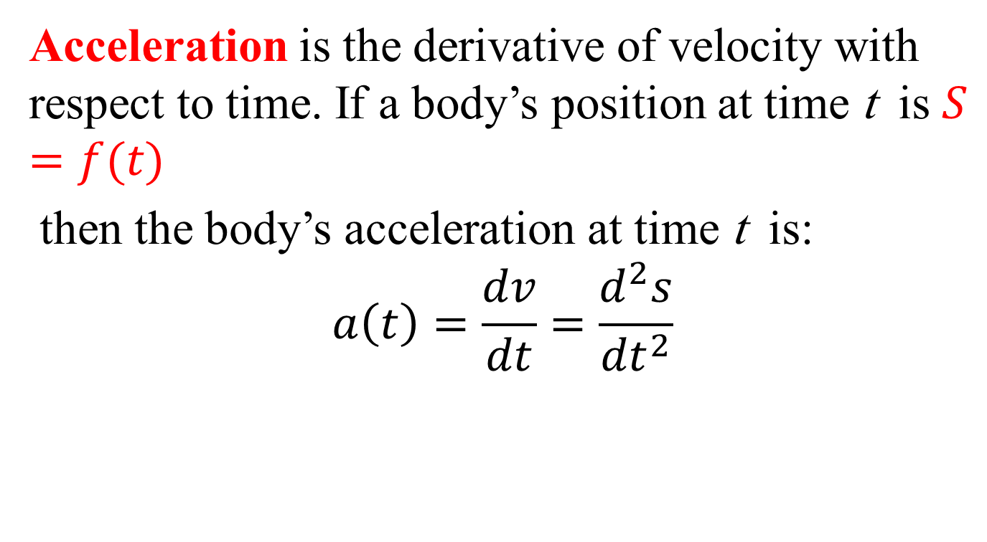
Acceleration
Acceleration is the derivative of velocity with respect to time. If a body’s position at time t is $S=f(t)$
then the body’s acceleration at time t is:
$$a\left(t\right)=\frac{dv}{dt}=\frac{d^{2}s}{{dt}^{2}}$$

Slide 38
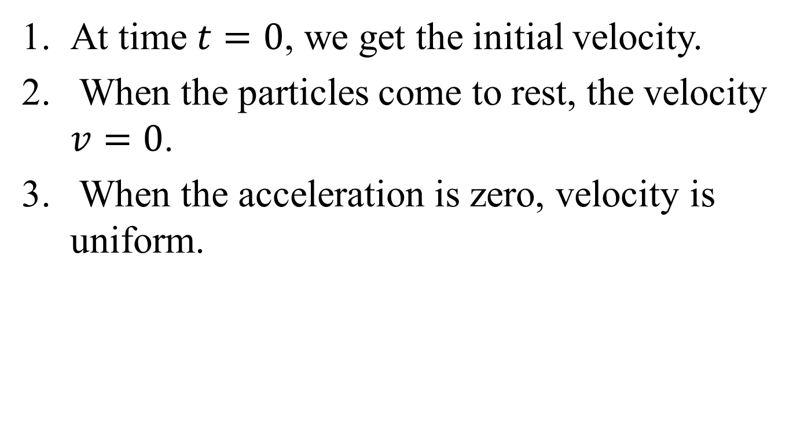
Notes
At time $t=0$, we get the initial velocity.
When the particles come to rest, the velocity $v=0$.
When the acceleration is zero, velocity is uniform.

Slide 39
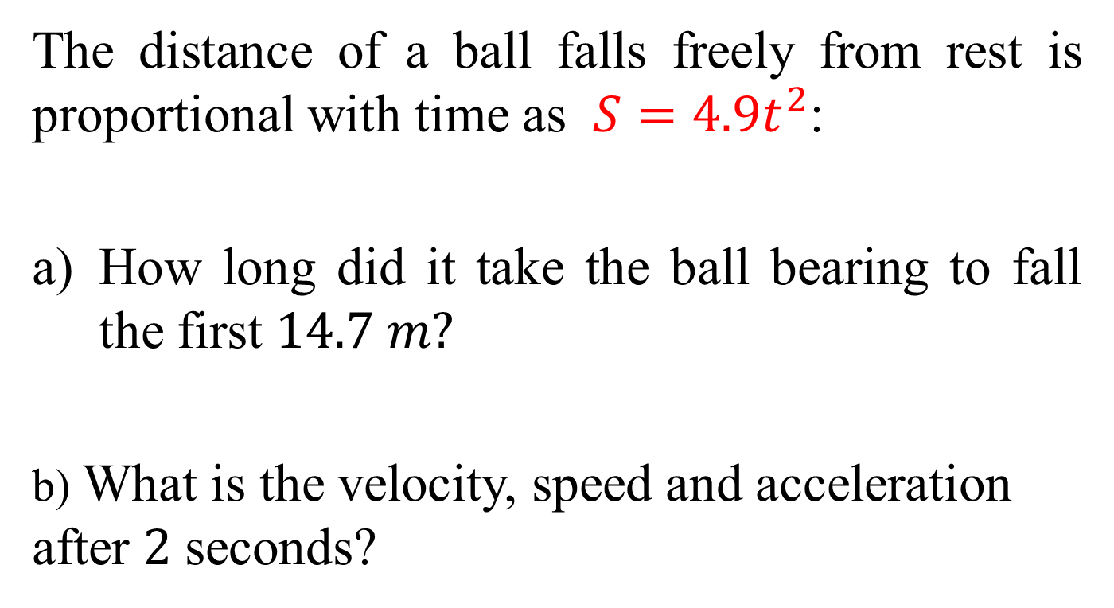
Example
The distance of a ball falls freely from rest is proportional with time as $S=4.9t^{2}$:
How long did it take the ball bearing to fall the first $14.7 m?$
b) What is the velocity, speed and acceleration after $2$ seconds?

Slide 40
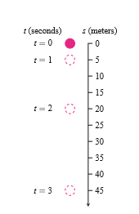
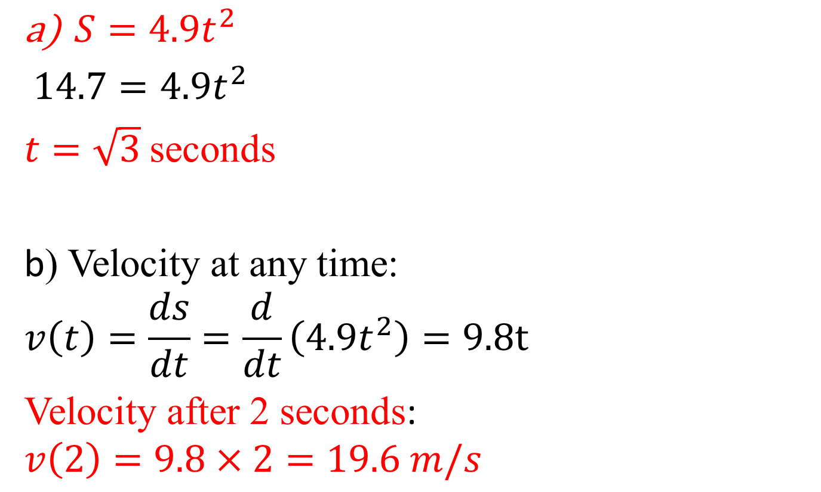
Solution
$S=4.9t^{2}$
$14.7=4.9t^{2}$
$t=\sqrt{3}$ seconds
b) Velocity at any time:
$$v\left(t\right)=\frac{ds}{dt}=\frac{d}{dt}\left(4.9t^{2}\right)=9.8t$$
Velocity after 2 seconds:
$$v\left(2\right)=9.8×2=19.6 m/s$$

Slide 41
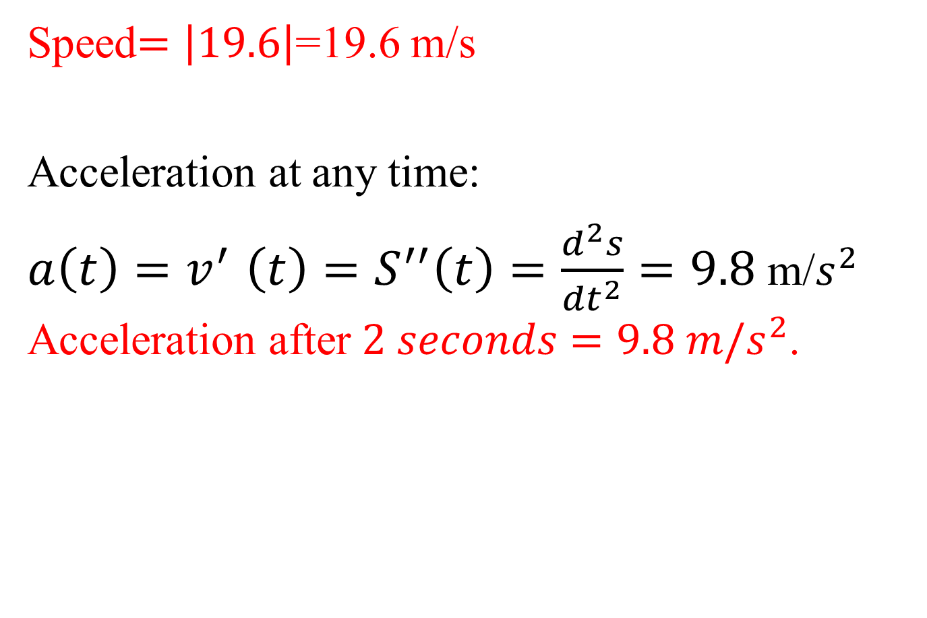
Speed$=\left|19.6\right|$=19.6 m/s
Acceleration at any time:
$a\left(t\right){=v}^{′}\left(t\right)=S^{′′}\left(t\right)=\frac{d^{2}s}{{dt}^{2}}=9.8$m/$s^{2}$ Acceleration after $2 seconds=9.8 m/s^{2}$.

Slide 42
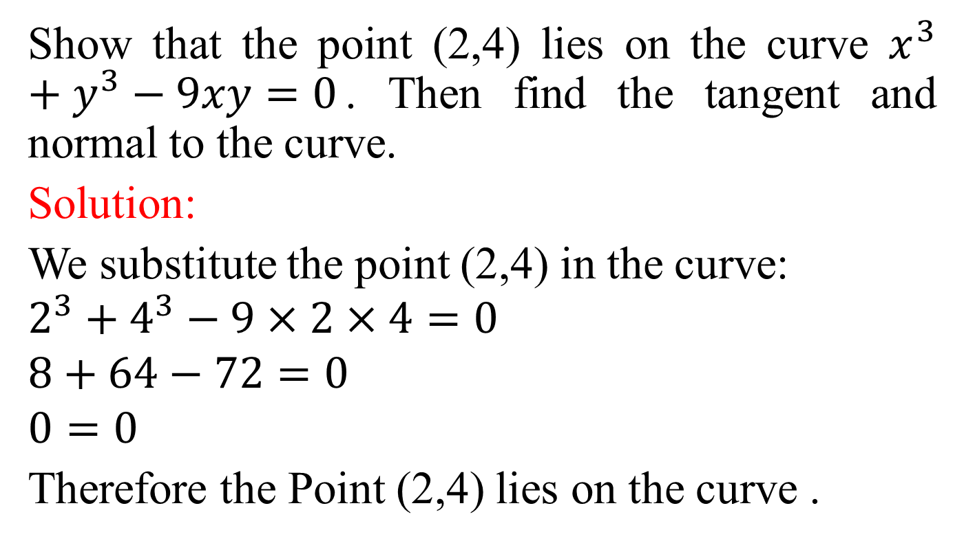
Example
Show that the point (2,4) lies on the curve $x^{3}+y^{3}−9xy=0$. Then find the tangent and normal to the curve.
Solution:
We substitute the point (2,4) in the curve:
$$2^{3}+4^{3}−9×2×4=0$$
$$8+64−72=0$$
$$0=0$$
Therefore the Point (2,4) lies on the curve .

Slide 43
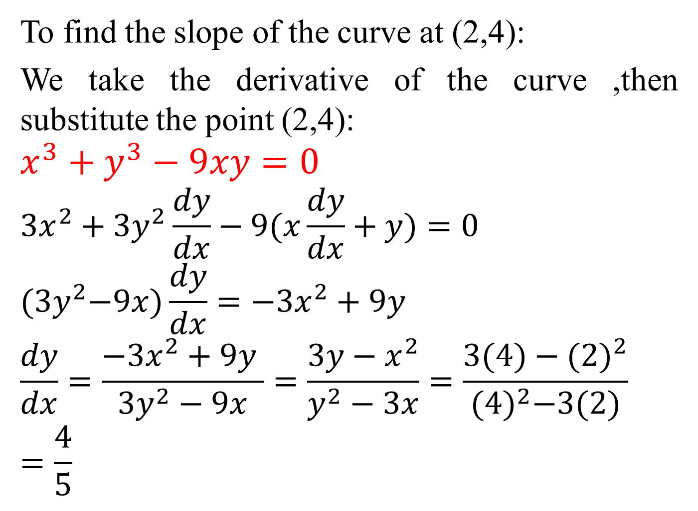
To find the slope of the curve at (2,4):
We take the derivative of the curve ,then substitute the point (2,4):
$$x^{3}+y^{3}−9xy=0$$
$${3x}^{2}+{3y}^{2}\frac{dy}{dx}−9(x\frac{dy}{dx}+y)=0$$
$${(3y}^{2}−9x)\frac{dy}{dx}=−{3x}^{2}+9y$$
$$\frac{dy}{dx}=\frac{−{3x}^{2}+9y }{{3y}^{2}−9x}=\frac{3y−x^{2}}{y^{2}−3x}=\frac{3(4)−{(2)}^{2}}{{(4)}^{2}−3(2)}$$
$$=\frac{4}{5}$$

Slide 44
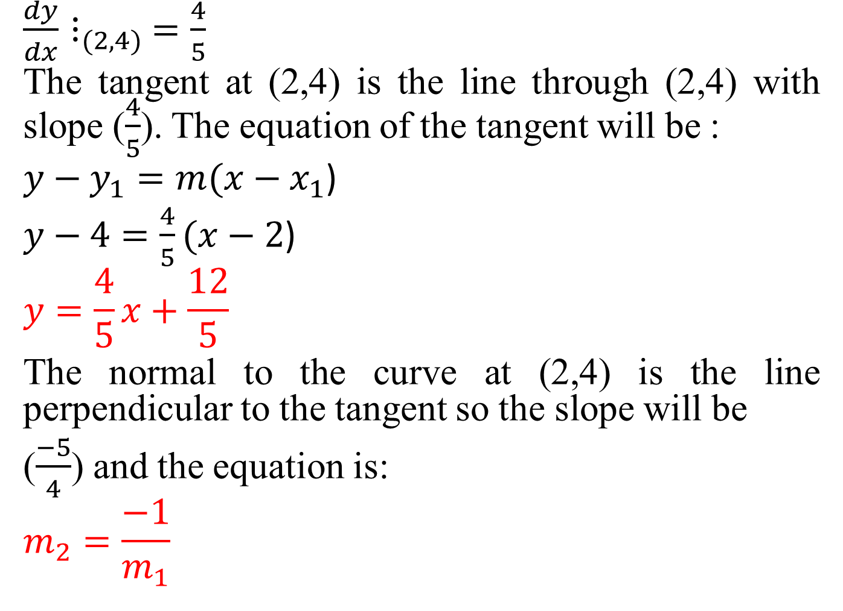
$\frac{dy}{dx}⋮_{(2,4)}$ $=\frac{4}{5}$
The tangent at (2,4) is the line through (2,4) with slope ($\frac{4}{5}$). The equation of the tangent will be :
$y−y_{1}=m(x−x_{1}$)
$y−4=\frac{4}{5}(x−2$)
$$y=\frac{4}{5}x+\frac{12}{5}$$
The normal to the curve at (2,4) is the line perpendicular to the tangent so the slope will be
($\frac{−5}{4}$) and the equation is:
$$m_{2}=\frac{−1}{m_{1}}$$

Slide 45

$y−y_{1}=m(x−x_{1}$)
$y−4=\frac{−5}{4}(x−2$)
$$y=\frac{−5}{4}x+\frac{13}{2}$$

Slide 46
Related Rates Equations
In this section we look at problems that ask for the rate at which some variable changes. In each case the rate is a derivative that has to be computed from the rate at which some other variable (or perhaps several variables) is known to change. To find it, we write an equation that relates the variables involved and differentiate it to get an equation that relates the rate we seek to the rates we know. The problem of finding a rate you cannot measure easily from some other rates that you can is called a related rates problem.

Slide 47
Example
A man, walking at night, is walking directly towards a street light. The light is 10 feet off the ground, and the man is 6 feet tall and walking at 4 feet per second. When the man is 8 feet from the street light, how fast is the length of his shadow changing?

Slide 48

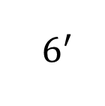

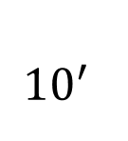





Solution
The street light
$A$
$D$
$Man$
${10}^{′}$
$6^{′}$
$C$
$B$
$x$
E
$y$

Slide 49
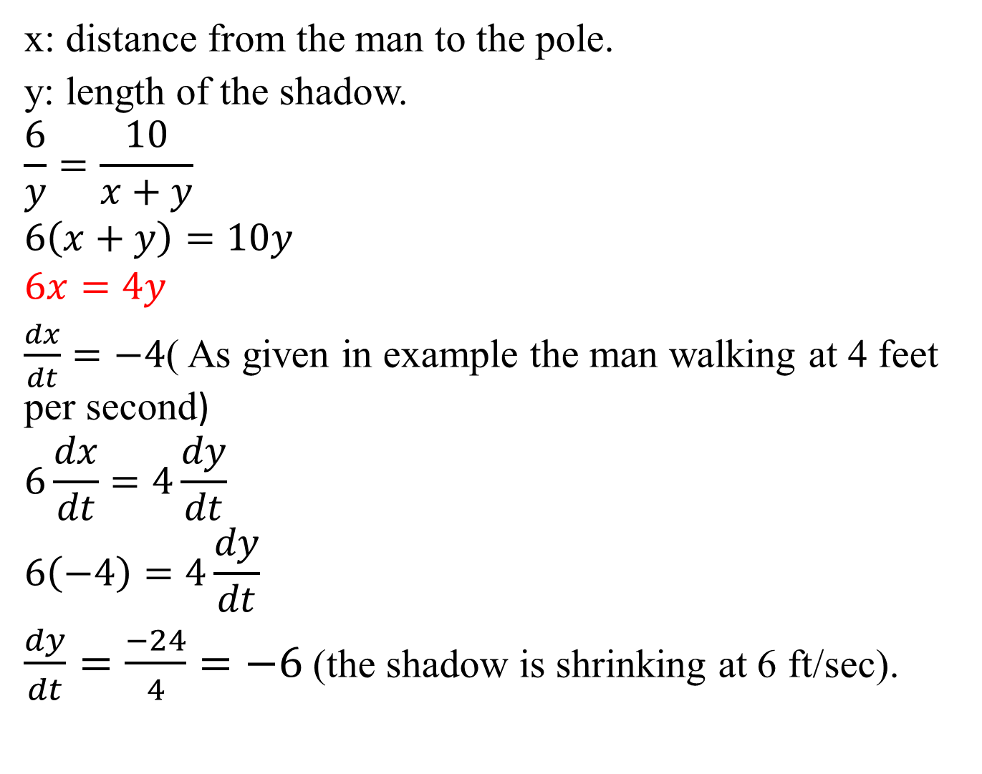
x: distance from the man to the pole.
y: length of the shadow.
$$\frac{6}{y}=\frac{10}{x+y}$$
$$6\left(x+y\right)=10y$$
$$6x=4y$$
$\frac{dx}{dt}=−4$( As given in example the man walking at 4 feet per second)
$$6\frac{dx}{dt}=4\frac{dy}{dt}$$
$$6\left(−4\right)=4\frac{dy}{dt}$$
$\frac{dy}{dt}=\frac{−24}{4}=−6$ (the shadow is shrinking at 6 ft/sec).

Slide 50
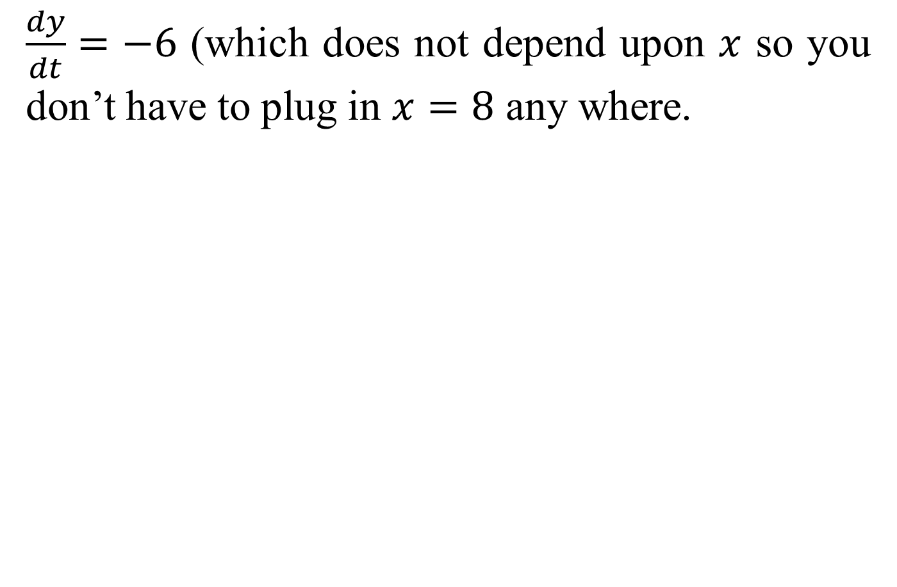
$\frac{dy}{dt}=−6$ (which does not depend upon $x$ so you don’t have to plug in $x=8$ any where.

Slide 51
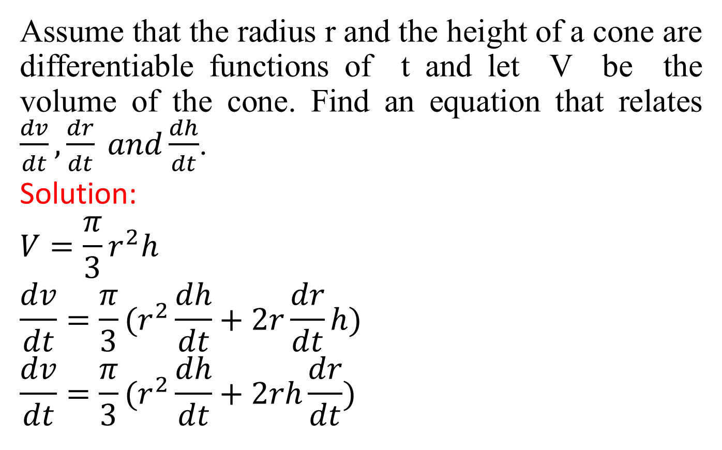
Example
Assume that the radius r and the height of a cone are differentiable functions of t and let V be the volume of the cone. Find an equation that relates $\frac{dv}{dt},\frac{dr}{dt} and\frac{dh}{dt}$.
Solution:
$$V=\frac{π}{3}r^{2}h$$
$$\frac{dv}{dt}=\frac{π}{3}(r^{2}\frac{dh}{dt}+2r\frac{dr}{dt}h)$$
$$\frac{dv}{dt}=\frac{π}{3}(r^{2}\frac{dh}{dt}+2rh\frac{dr}{dt})$$

