Slide 1
CHAPTER Two
Bridge circuits and their applications

Slide 2
Introduction
Bridges are often used for the precision measurement of component values, like resistance, inductance, capacitance, etc. The simplest form of a bridge circuit consists of a network of four resistance arms forming a closed circuit as shown in .Fig. 4.1

Slide 3
D.C. Wheatstone bridge
The most common and simplest bridge network to find the resistance is the DC Wheatstone Bridge. This bridge is used where small changes in resistance are to be measured like in sensor applications. This is used to convert a resistance change to a voltage change of a transducer.

Slide 4
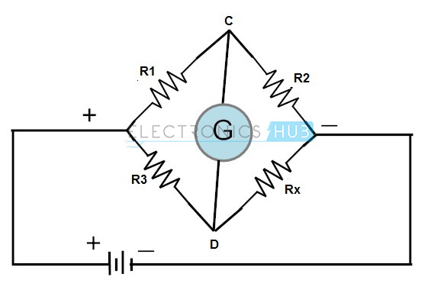
D.C. Wheatstone bridge
A Wheatstone bridge consists of four resistors that are connected in the shape of a diamond with the supply source and indicating instruments as shown in figure
This bridge is used to find the unknown resistance very precisely by comparing it with a known value of resistances. In this bridge null or balanced condition is used to find the resistance

Slide 5
D.C. Wheatstone bridge
For this bridge balanced condition voltage at points C and D must be equal. Hence, no current flows through the galvanometer. For getting the balanced condition one of the resistors must be variable
The voltage at point D $V_{D}=\frac{E∗R_{X}}{R_{3}+R_{X}}$
The voltage at point C $V_{C}=\frac{E∗R_{2}}{R_{1}+R_{2}}$

Slide 6
The voltage (V) across galvanometer or between C and D is:
$V_{CD}=V_{D}−V_{C}⟹\frac{E∗R_{X}}{R_{3}+R_{X}}−$ $\frac{E∗R_{2}}{R_{1}+R_{2}}$
When the bridge is balanced V_{CD} = 0
$\frac{E∗R_{X}}{R_{3}+R_{X}}−$ $\frac{E∗R_{2}}{R_{1}+R_{2}}=0$
$\frac{E∗R_{X}}{R_{3}+R_{X}}=$ $\frac{E∗R_{2}}{R_{1}+R_{2}}⟹R_{X}\left(R_{1}+R_{2}\right)=R_{2}$($R_{3}+R_{X}$)
$R_{X}=\frac{R_{2}R_{3}}{R_{1}}$
Unbalanced Wheatstone Bridge

Slide 7
Unbalanced Wheatstone Bridge
The unbalanced bridge is used to measure some transducer quantities, such as strain, temperature, or pressure.
The bridge is balanced at a known point, then the amount of deviation, as indicated by the output voltage, indicates the amount of change in the parameter being measured.

Slide 8
The value of the parameter being measured can be determined by the amount that the bridge is unbalanced.
Tiny changes in transducer resistance will unbalance the bridge, thereby providing a measurement reading

Slide 9
Example:-
Consider using a Wheatstone bridge having R1 = 200 Ω and R2 = 2000 Ω to measure a resistance Rm . The bridge is balanced by adjusting R3 until R3 = 250 Ω . What is the value of Rm ?
Solution:

Slide 10
Example:-
Consider using a Wheatstone bridge having R1 = 200 Ω and R2 = 2000 Ω to measure a resistance, Rm , of a temperature sensor. Suppose the resistance of the temperature sensor, Rm , in Ω, is related to the temperature T, in °C, by the equation
Rm =1500 + 25T
The bridge is balanced by adjusting R3 until R3 = 250 Ω . What is the value of the temperature?

Slide 11
Solution

Slide 12
HW
Consider using a Wheatstone bridge having R1 = 200 Ω and R2 = 2000 Ω to measure a resistance, Rm , of a temperature sensor. Suppose the resistance of the temperature sensor, Rm , in Ω, is related to the temperature T, in °C, by the equation
Rm =1500 + 25T
The temperature is expected to vary over the range 0 to 100 °C. Over what range must R3 vary in order for the bridge to measure temperature over the range 0 to 100 °C?

Slide 13
HW
For the Wheatstone bridge circuit of Fig., solve the following problems:
If R1 = 1 Ω, R2 = 2 Ω, and Rx = 3 Ω, to what value should R3 be adjusted so as to achieve a balanced condition?
(b) If V₀ = 6 V, Ra = 0.1 Ω, and Rx were then to deviate by a small amount to Rx = 3.01 Ω, what would be the reading on the ammeter ?

Slide 14
AC Bridge Circuits
AC bridge circuits work on the same basic principle as DC bridge circuits: that a balanced ratio of impedances (rather than resistances) will result in a "balanced" condition as indicated by the null-detector device.
• Null detectors for AC bridges may be sensitive electromechanical meter movements, oscilloscopes (CRT's), headphones (amplified or unamplified), or any other device capable of registering very small AC voltage levels.

Slide 15
A.C . Wheatstone bridge
An AC Wheatstone Bridge is similar to a DC Wheatstone Bridge except for:
Common AC Source.
Resistances R may be replaced by impedances Z.
When measuring impedances, an AC Wheatstone Bridge is often referred to as a general impedance bridge.

Slide 16
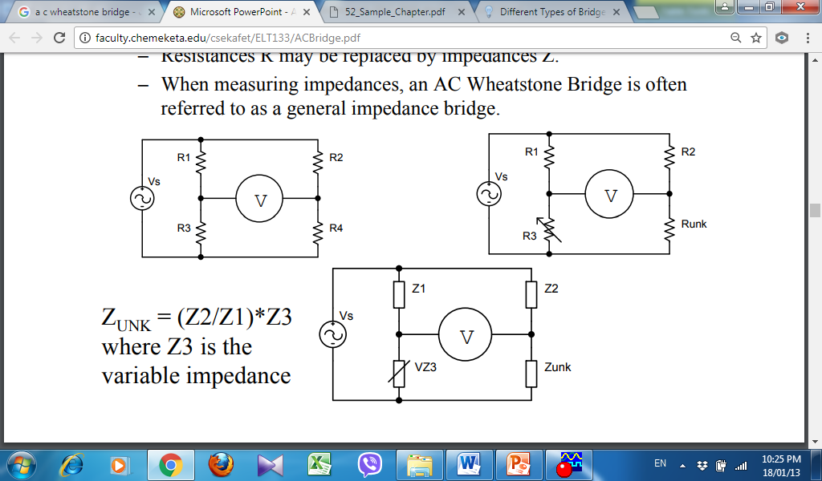
A.C . Wheatstone bridge

