Slide 1
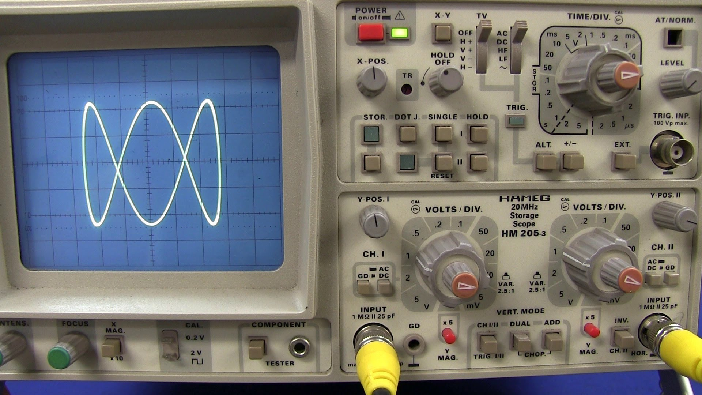
CHAPTER TWO Cathode Ray Oscilloscope

Slide 2
Cathode Ray Oscilloscope
The Cathode Ray Oscilloscope (CRO) is a very useful and versatile laboratory instrument used for display, measurement and analysis of waveform of electrical and electronic circuits.

Slide 3
CRO Construction
The heart of the Oscilloscope is the Cathode Ray Tube which it consists of four main parts:
Electron Gun
Deflection part
Post deflection Acceleration
Screen

Slide 4
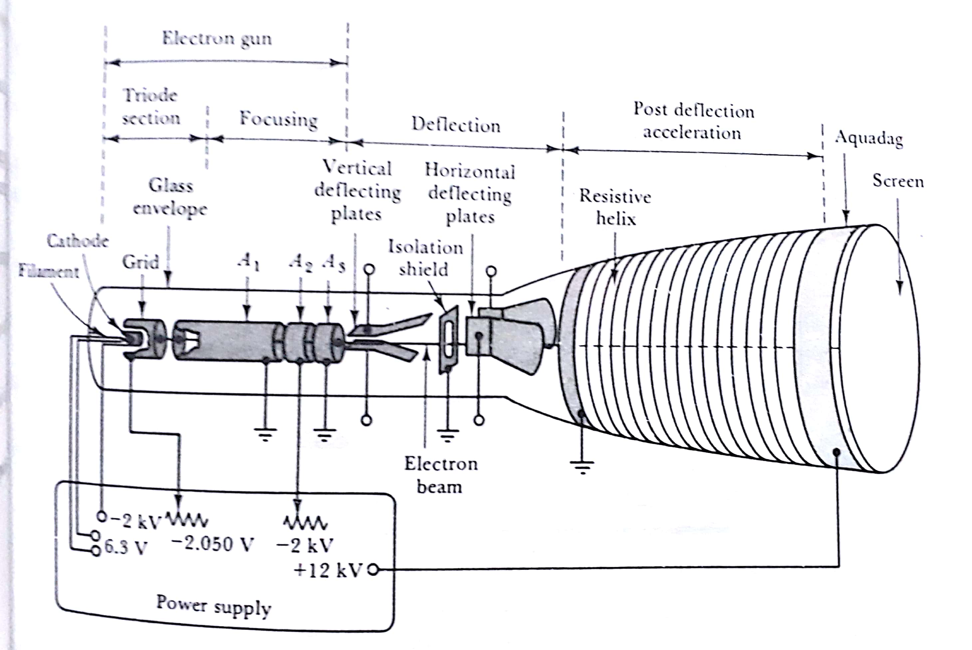

Slide 5
Electron Gun
This section is responsible for generating the electrons and directed them toward the next section (Deflecting), the electron gun composed of two main parts:
Triode section
Filament
Cathode
Grid
First Anode (A1)
2. Focusing
Second Anode (A2)
Third Anode (A3)

Slide 6
Triode section
Filament : It is a heater to Heat the Cathode
Cathode :Made of Nickel and it is a cylinder shaped with a flat, oxide-coated electron emitting surface directed toward the hole in the Grid.

Slide 7
Triode section
Grid: It is a nickel cup with a hole in it, almost completely encloses the cathode, and connected to a potential with a cathode and they control the number of electrons directed to the screen (Brightness control).
First Anode (A1): It is a cylinder shaped, open at one end and closed at the other end with a hole at the center of the closed end, it accelerates the electron to the focusing section

Slide 9
Focusing
Second Anode (A2) : It is connected to a high negative voltage to produce equipotential lines to focus the electrons to a fine point on the screen.
Third Anode (A3) : It accelerates the electron after they focused .

Slide 10
