Slide 1
10th Lecture (,Wood, Glass)
Prepared by :Dr. Lana Abubakr Ali
24-4-2024

Slide 2
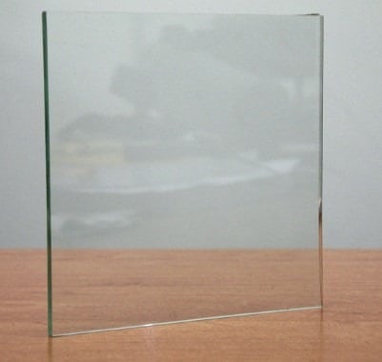
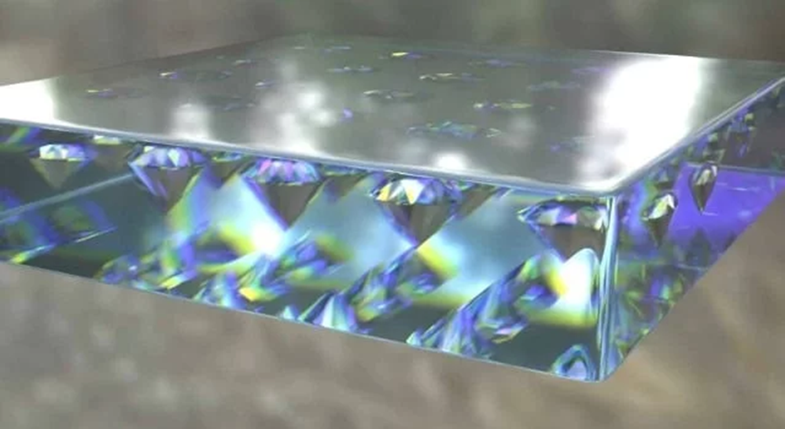
4. Extra Clean Glass
Extra clean glass has two special properties, photo catalytic and hydrophilic. Because of these properties, it acts as stain proof and gives beautiful appearance. Maintenance is also easy.
5. Chromatic Glass
Chromatic glass is used in ICU’s, meeting rooms etc. it can control the transparent efficiency of glass and protects the interior from daylight.

