Slide 1
^{1st} Lecture (Type And Typology in Architecture)
Prepared by: Dr. Lana Abubaker Ali
27-2-2024

Slide 2
Terminologies Definition
Type
Before going into the discussion on type and typology in architecture, it would be beneficial to explore the origins of the words and definition of the term 'type.' The word's origin can be traced back to a Greek phrase around the 7th and 6th centuries BC.
"typto," which means "to beat, to hit, to mark
When reviewing philosophical and psychology on perception, It observed that typos is used to signify a concept like "model," indicating a collection of fundamental characteristics found in a specific group of persons, known as the type.

Slide 3
Typology
The term "typology" originates in the mid-nineteenth century. De Mauro suggests that the name "typology" came up because of an increase of interest in abstract models during that period. The phrase was used to describe the study of kinds; the comparative analysis and classification of structural or other qualities into types.
In Paleontology, typology is the study of identifiable sets characterized by the consistency resulting from the repetition of a single cultural type.
In sociology, ideal types are investigated and serve as the organizing concept for investigations into diverse, specific socio-cultural institutions.

Slide 4
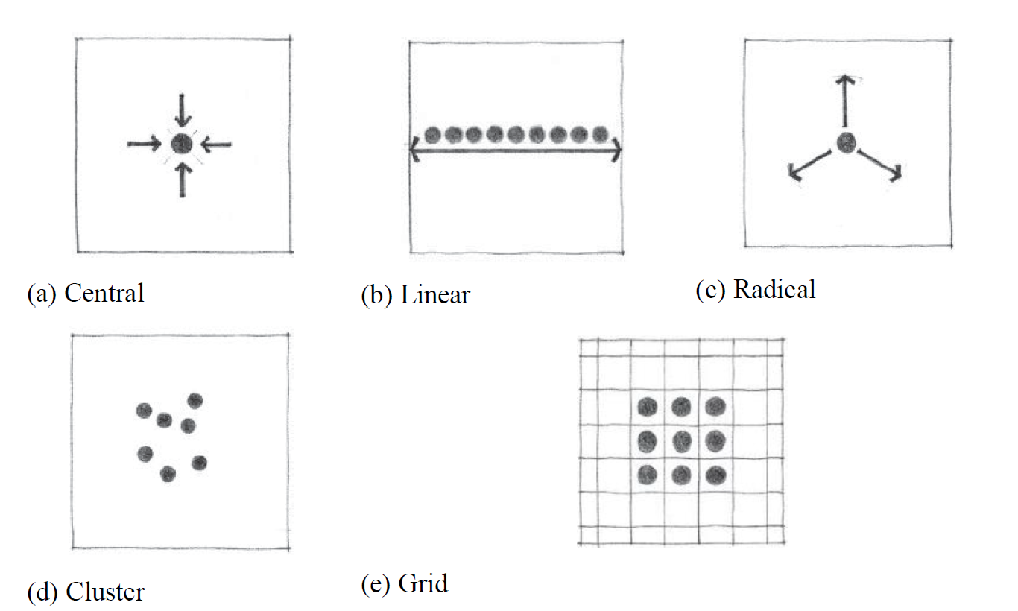
The word (Architectural Typology)
In architecture, a typology is a diagram that identifies the typical qualities of a group of structures; the fundamental issue here is the correct interpretation of similarity measurements. Additionally, the many forms of spatial organization outlined in (Ching, 2014) clarified the typological organization and the fundamental formal characteristics of buildings such as (central type, linear type, radial type, clustered type, and grid type) which are presented

