Slide 1
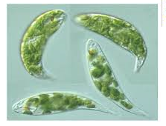
Division: Euglenophyta
Class: Euglenophyceae
Order: Euglenales
Family: Euglenaceae

Slide 2
The distinguishable characters of the Division:
1- The majority of Euglenphyta are unicellular flagellates. However have stages during which the cells are enclosed within a mucilage capsule (palmelloid stages)
2- The flagella arise from the bottom of a flask shaped invagination or ampulla, consisting of a canal and reservoir which is located at the anterior end of the cell.

Slide 3
3- The flagella arise from the bottom of a flask shaped.
4- There are almost two flagella, but one of these is often so short that it lies entirely within the ampulla.
Prepared by Assis. Prof. Yadi O. Al-Barzinjy

Slide 4
5- Some euglenoid are autotrophs contain chloroplasts that contains the photosynthetic pigments chlorophyll a and b as in the division Chlorophyta.
6- Others are heterorophs (Euglenozoa) and can ingest or absorb their food by phagocyosis, prey such as bacteria and smaller flagellates are ingested through a cytosome.

Slide 5
7- Some autotrophic species of Euglena become heterotrophic when light levels are low.
8- The orange –red eye spote is free in the cytoplasm and consists of a number of droplets containing Caretenoids.
9- The reservoir polysaccharide is paramylon. This lies in the cytoplasm in the form of granules.

Slide 6
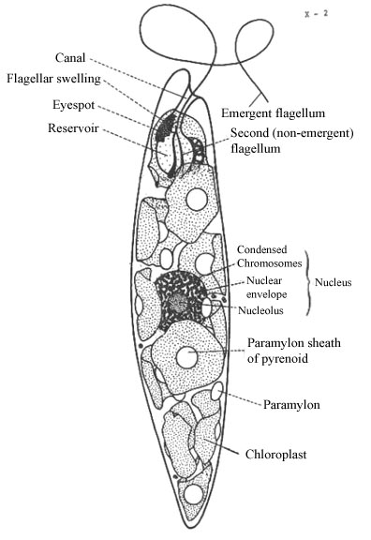
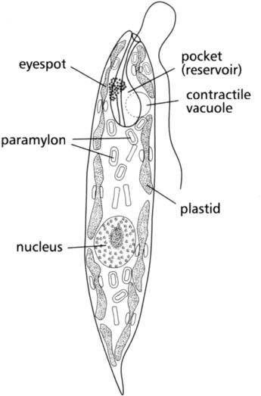
Prepared by Assis. Prof. Yadi O. Al-Barzinjy

Slide 7
10- Organisms are aquatic fresh water algae, and have contractile vacuole, several chloroplasts and lack a cell wall.
11- The outer part of the cell consists of a firm but flexible layer called a pellicle which can not probably be considered a cell wall.
12- Reproduction occurs by longitudinal cell division.

Slide 8
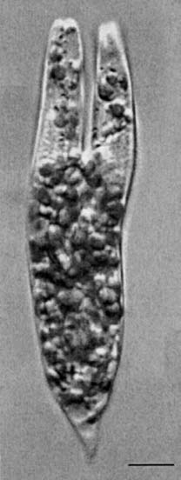

Slide 9
The most characteristic genus is Euglena, common in ponds and pools, especially when the water has been polluted by organic materials.
There are approximately 1,000 species of euglenoids.
Prepared by Assis. Prof. Yadi O. Al-Barzinjy

Slide 10
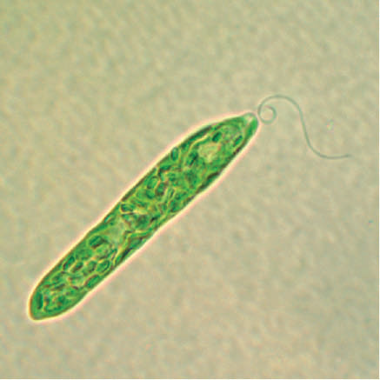
Division: Euglenophyta
Class: Euglenophyceae
Order: Euglenales
Family: Euglenaceae
Genus 1- Euglena sp.

Slide 11
Genus 1- Euglena sp.
Eu = good, glene = eye
1- Euglena is characterized by the presence of a single flagellum.
2- Plastid shape is variable but often discoid
3- Cells are cylindrical, fusiform (not flattened).
4- Most Euglena species are elongated with around anterior and the posterior tapered to a point.

Slide 13
Genus 2- Phacus sp.
1- Cells are oval to nearly circular, and flattened.
2- There is just a single emergent flagellum.
3- They have a pellicle sufficiently rigid.
4- Plastids are numerous, small spherical.
5- Some species are noticeably twisted just at the posterior.

Slide 14
