Slide 1
Division: Bryophyta
Class3: Bryopsida (Mosses)
The class Bryopsida is the largest group of Bryophytes. It includes 660 genera and 14500 species which occur in almost all parts of the world.

Slide 2
General characters of Bryopsida
The gametophyte has two growth stages: (i) protonema stage (ii) leafy stage or gametophores.
The plants are differentiated to rhizoid, axis and leaves.
Rhizoids are multicellular and branched.
In general leaves are in three rows and arranged spirally.
Sporophyte has a capsule, with a greater proportion of sterile tissue.

Slide 3
Order: Sphagnales
Family: Sphagnaceae
Sphagnum sp.
It is commonly called peat moss or bog moss (Peat moss is a dead form of Sphagnum moss). The genus has 320 species, majority of the species grow in aquatic areas.

Slide 4
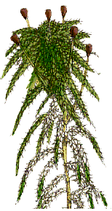
Sphagnum sp.
External morphology

Slide 5
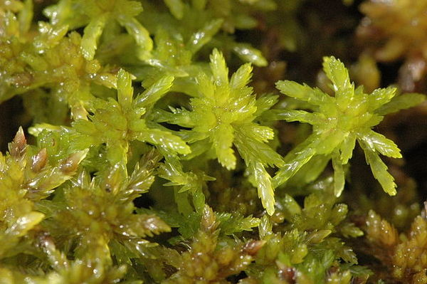
External morphology
The plant is gametophyte often called gametophores.
The color of the gametophyte differs from species to another. It may be pale or dark green, brown or pink...etc.
Prepared by: Assis. Prof. Yadi O. Al-Barzinjy

Slide 6
The gametophyte has a thick central axis called the stem. The stem shows lateral branching. The top of the plant or capitulum has compact clusters of young branches.
In aquatic forms, rhizoids usually disappear.

Slide 7
The main axis as well as the branches is densely covered with small sessile leaves. The leaves are spirally arranged and they don’t have mid rib.

Slide 8
Anatomy of leaves
The leaves are one cell thick and have two type of cells: narrow (chlorophyll containing) cells and hyaline cells alternating with each other.
The chlorophyllous cells are narrow filled with chloroplasts.
The hyaline cells are rhomboidal in shape, without any protoplast in them. They are colorless and filled with water.
Prepared by: Assis. Prof. Yadi O. Al-Barzinjy

Slide 9
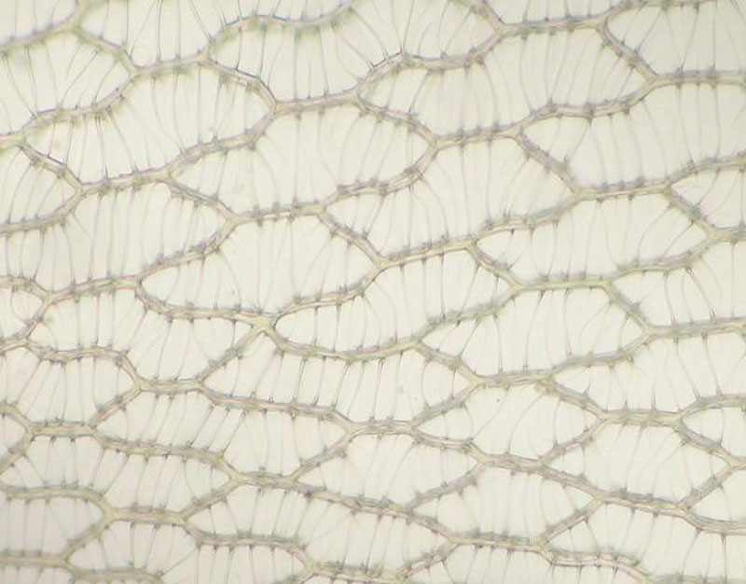
Surface view of Sphagnum leaf

Slide 10
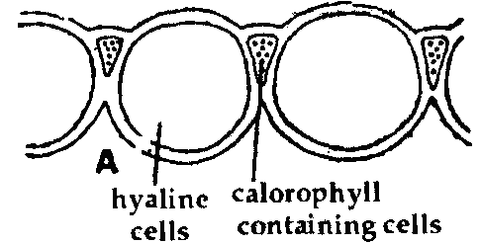
T. S leaf of S. acutifolium

Slide 11
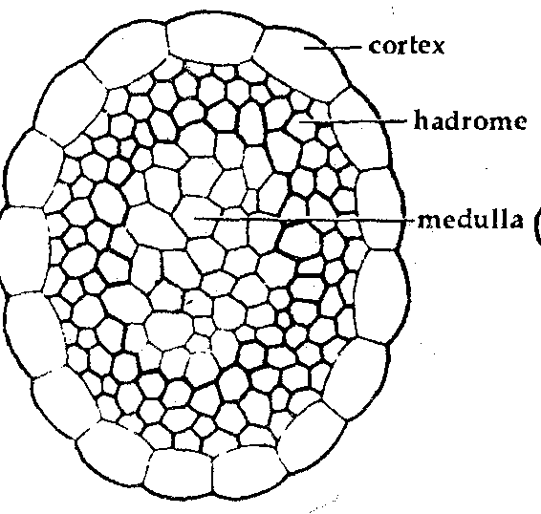
Anatomy of axis
The innermost tissue is medulla, cells of which is small, elongated, collenchymatous and help in conduction.
Surrounding the
medulla are few layers
of thick walled cells
known as hadrome.

Slide 12
Anatomy of axis
Surrounding the hadrom tissue is the outermost region known as cortex.

Slide 13
Sex Organs
Sex organs, are born on short lateral branches inserted near the apex of a gametophyte on separate branches.

Slide 14
I) Antheridial branches and antheridium
The antheridal branches are spindle shaped.
They are covered by leaves which are red, purple, brown or yellow in color.
A single antheridium arises from
the axil of each leaf.

Slide 15
A mature antheridium has long multicellular stalk.
An External features of antheridal branch

Slide 16
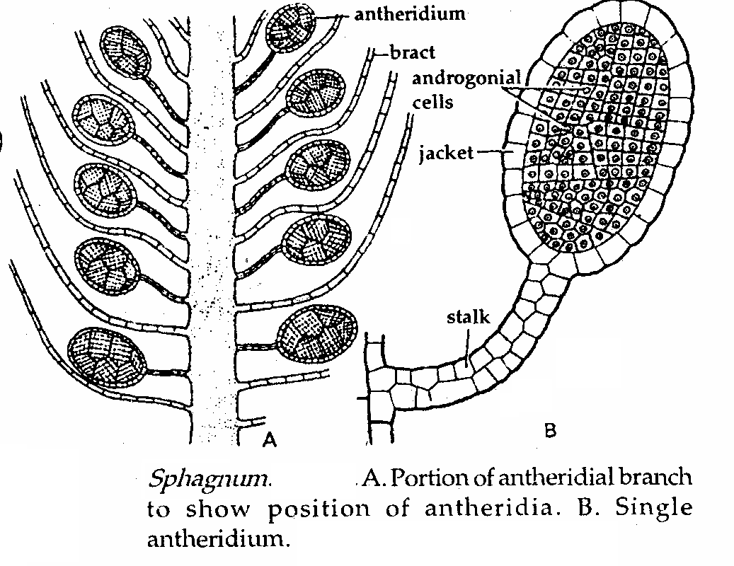

Slide 17
II) Archegonial branches and archegonium
The archegonial branches are purple colored, these bear large leaves known as perichaetial leaves.
Each archegonial branch has usually three archegonia.
The position of archegonium is apical.
A mature archegonium has, stalk, egg cell, venter canal cell, 8-9 neck canal cell, and the cover cells are not present.

Slide 18
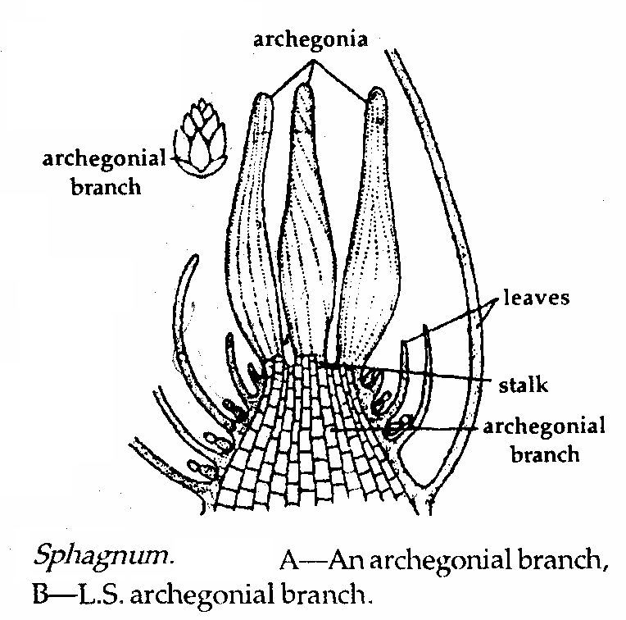

Slide 19
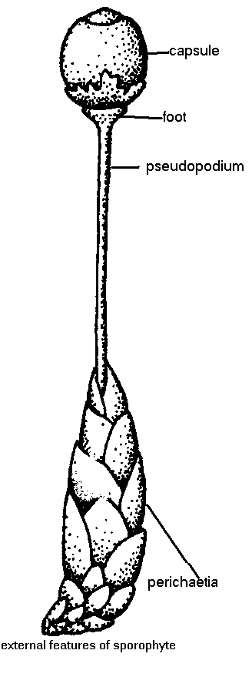
Sporophyte
Sporophyte elevated above the gametophyte by an elongation of stalk of gametophytic tissue called pseudopodium.

Slide 20
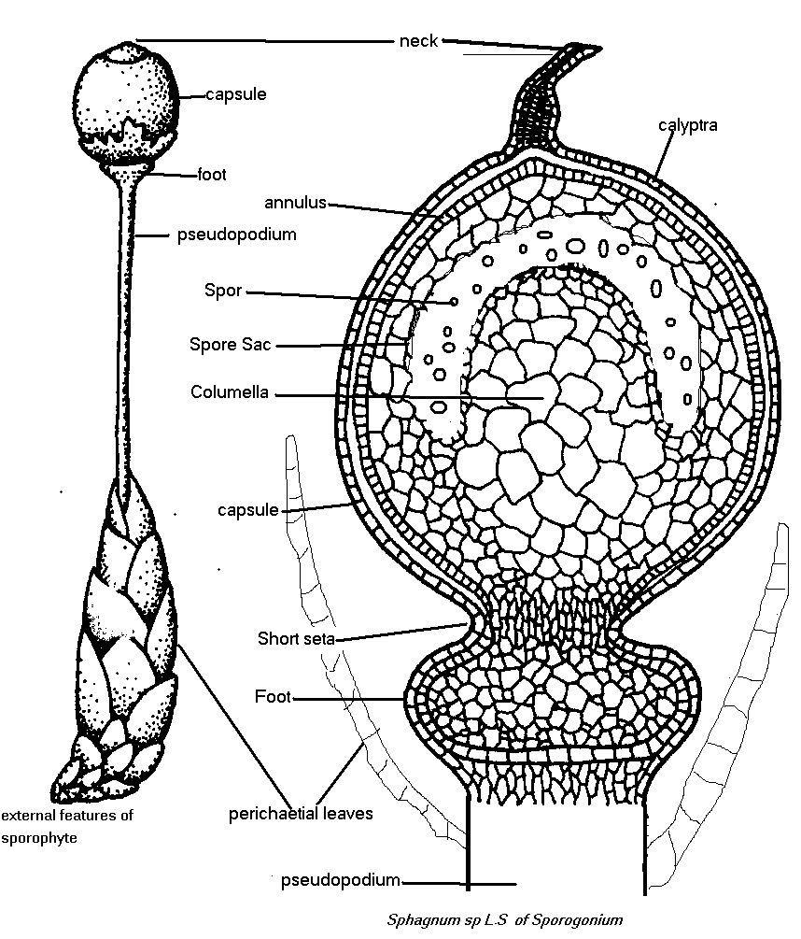
Sporophyte
It consists of a large bulbous foot and nearly spherical,
black colored
capsule.
In the center of
capsule there is
a multicellular
columella.

Slide 21
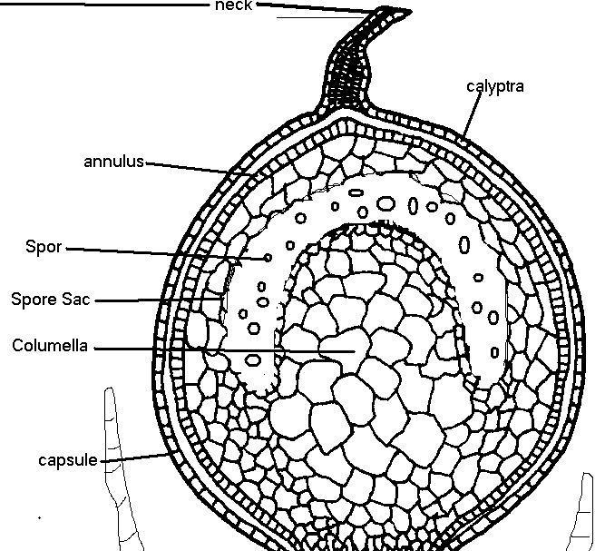
Sporophyte
4. Collumella is over arched by a dome shaped spore sac filled with spores.
5. In the
uppermost
region of
capsule, a
transverse
thin strip of
cells forms the
annulus.

Slide 22
Importance of Sphagnum sp.
1- Sphagnum is a reliable indicator of acidic condition.
Peat moss is an important plant in agriculture. It's often added to soil to help hold moisture around plants. Members of this genus can hold large quantities of water inside their cells; some species can hold up to 20 times their dry weight in water. C

Slide 23
Peat moss is also a critical element for growing mushrooms.
Peat is harvested as an important source of fuel in certain parts of the world. .

