Slide 1
Uses of toxicity tests in aquatic systems
Determination of LD₅₀ of CuSO₄ on Euglena sp. Or Amoeba

Slide 2
Median Lethal Dose (LD50): A lethal dose for 50% of the test organisms. The dose of toxicant producing 50% mortality in a population. A value used in presenting mammalian toxicity, expressed as mg of toxicant per Kg of body weight (mg/Kg).
LD₅₀: stands for lethal dose; LD₅₀ is the dose that causes fatality in 50% of a sample group of an organism.
LC₅₀: stands for lethal concentration; LC₅₀ is the concentration that causes fatality in 50% of a sample group of an organism.
EC₅₀: Stands for effective concentration; EC50 is the concentration that has an effect on 50% of the test group of an organism especially in case of higher organism.

Slide 3
Amoeba: move by pseudopodia. Have glassy skeletons and they are needle like psuedopods. Having rigid shells and move by protoplasmic streaming.
Euglena: photosynthetic, unicellular, have two flagella; contain chlorophylls (a and b). Some are photosynthetic, others heterotrophic.

Slide 4
Procedure:
Bring a pond sample to the lab.
Prepare slides using wet mount method.
Count number of Euglena sp. Or Amoeba sp. Or any other organism, and record your result (no. / 2) ≈ (half no.).
Prepare different concentrations of CuSO₄ or HgCl₂ or MnSO₄ and add your pond water sample.
After 2 weeks (24hr) (intermediate term toxicity test, prepare slides from each concentrations and count your test species organisms.
If the no. of test organism is equal or more than half of the original no., then it is the LD₅₀.

Slide 5
Uses of toxicity tests in aquatic systems
Cytotoxicity test of cuso4 on aquatic plants (algae)
Notes:
c

Slide 6
Chara sp. (Muskgrasses, Stonewort) belong to the following classification:
Division: Charophyta (the stoneworts and Brittleworts)
Class: Charophyceae
Order: Charales
Family: Characeae

Slide 7
Chara is commonly called muskgrass because of its distinctive odor. Chara has a strong musk or garlic odor when crushed. It is coarse to the touch. Chara - dark grey-green with orange or green pinpoints on the branches. Chara is common in freshwater areas with silty or sandy beds. It is usually more noticed in droughts when the water level drops.

Slide 8
Although these common lake inhabitants look similar to many under water plants; they are actually algae. Muskgrasses are green or gray-green colored algae that grow completely submersed in shallow (4 cm) to deep (20m) water. Individuals can vary greatly in size, ranging from (5 cm to 1m) in length. The main "stem" of musk grasses bears whorls of branchlets, clustered at regularly spaced joints. When growing in hard water in hard water, musk grasses sometimes become coated with lime, giving them a rough gritty feel.

Slide 9
Body structure:-
1. Body consists of nodes and internodes, provided by lateral determinate branches (or leaves) and have apical cell.
2. Reproductive organs (Gametangia) are complex and surrounded by a protective cover of sterile cells.
3. All of the growth originates from an apical cell at the end of the "stem".
4. Zoospores are S- shaped with a pair of flagella.
5. Zygote grows and develops to protonema, then produce the mature organism.

Slide 10
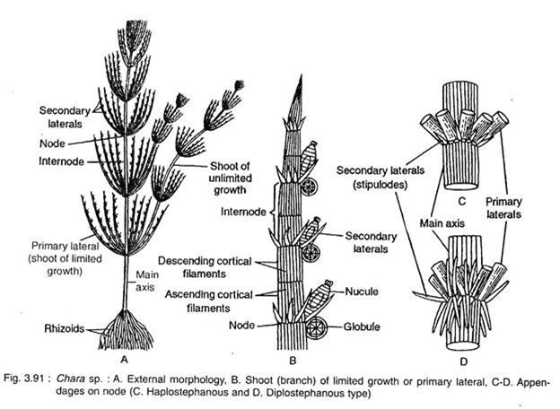

Slide 11
6. They are benthic fresh water organisms, so they have rhizoides.
7. They grow in ponds and lakes which have lime stone sediment.
8. They are large in size and can be described by naked eye.
9. Chloroplast is lentic shaped and located at the cell margine.
10 . They have undifferentiated vegetative tissue (leaves, roots, stems) and do not produce flower and fruit.

Slide 12
11. Sexual reproduction by oogamy through producing globules and nucules. Also there is a sexual reproduction or vegetative reproduction.
Sexual: the gametangia develop in the axis at the nodes which arising laterally in the nodal region. Each gametangia composed of oogonium and antheridium.
Sexual: globule contains spiral shaped antherozoite provided by a pair of anterior flagella and nucule consist of egg surrounded by sterile cells in a spirally arrangement pattern called tube cells. At the top of nucule there are five corona cells in one row arrangement.

Slide 13
Nucule
Globule

Slide 14
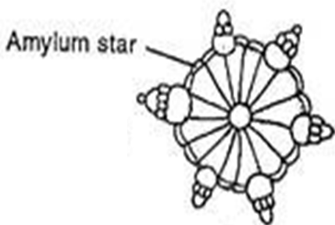
b. Vegetative reproduction:
Protonema like outgrowth from nodes
Bulbis which born on rhizoids
Amylum star produced on lower nodes of main axis.
Tubers produced on lower nodes of main axis.

Slide 15
Procedure:
1. From a synthetic or natural aquatic ecosystem take samples of algae (e.g Chara sp.).
2. Prepare CuSO₄ in different concentration :( 0.1, 0.5 and 1%) etc.
3. Place Chara sp. Samples in to beakers containing CuSO₄ at different prepared concentrations.
4. Apply toxicity test (short, intermediate or long term). Note: you must put a control (i.e CuSO₄ conc. Is zero or not contain CuSO₄).
5. After the test has been completed, slides prepared from each
6. Observe the differences in cell structure, globules, nucules, branches, leaves, rhizoids …etc.
7. Prepare your scientific lab report.

