Slide 1
University of Salahaddin
College of Science -Erbil
Department of physics
1st lecture in electronics for 3rd stage physics
Electronics
Dr. Lary H. Slewa
lary.slewa@su.edu.krd
2021-2022
Notes:
In the first I would like to introduce myself my name is lary I do my master in solid state physics in college of science physics department
Today we will taking about semiconductor,
Any one here have any idea about semiconductor ????
this lecture will help to understand the meaning of semiconductor so please pay u attention to me

Slide 2
Out line
CHAPTER ONE
General Introduction to Semiconductor Physics
1.1- Energy band in Solid (band theory):
1.2- Conductors, Insulators, and Semiconductors:
1.3- Atomic Binding in Semiconductors
1.4- Types of Semiconductors
1.5- P-N Junction
1.6- I-V characteristic for PN-junction dioad
Notes:
In the first of this lec we will taking about band theory I will try to remember u some old information that u have been studied in preview stage

Slide 3
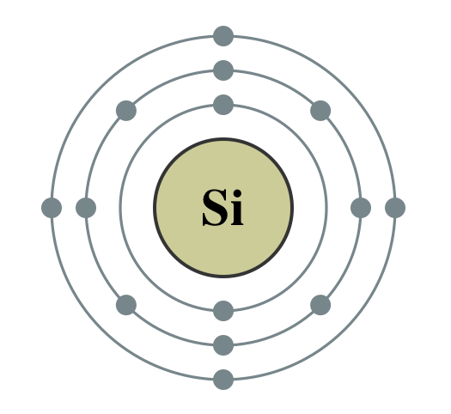
1.1- Energy band in Solid:
If we have a single isolated atom according to (Q. M.), electrons can occupy discrete energy levels (E₁, E₂, E₃,…,E_{n}).
Energy level /eV
Electron in last energy level called Valance electron.
Next
E₃
C.B
E₂
E₄
E₃
V.B
E₁
E₂
E₁
1-atom
2-atom
3-atom
N- atom
No. of atom
Fig(1.1)
Notes:
As you study before if we ……..
These electron are very important because they are responsible for making bond between atome to built the material and also are responsible for connecting the current in material
Now if we draw agraphe between the energy levels in y-axise and number of atom in x-axise for 1 single isolated atome we have discret energy level
Because the material is composed of many atoms
What will be happened if we brought two atoms together in very close distance there energy level will over lap on each over , there is signification change in there energy this energy level will be siplie to the two energy level there is very small distance between them around (10^-19) eV
For three atoms we have three energy level for N number of atoms we have N number of energy level
And the distance between these energy level are very small around (10^-19)( they appear as a band)
A band which is occupied by the valence electrons or a band having highest energy is defined as valence band.
And the next unfilled energy level is called conduction band
This is called the band structure of given atom.
Lets focused on this part
Becouse the material is composed of many atoms if we brought two atom to build the molcular there is signification change in there energy level
the distance between these energy level are very small
For N number of energy level
Now lets foucse only on this part which is called energy band digram

Slide 4
Energy band diagram
Unoccupied state left behind them is called hole.
Energy/eV
When some of the valence electron absorbing energy from external source, they become free.
Conduction band
E₄
Energy band gap
Valence band
E₃
E₂
The electrons in the inner band which are strongly bond to the nucleus, are called core electrons.
E₁
Fig(1.2)
Which one is faster e- or h+??
Notes:
In the energy band diagram the electron in……
They are not free thus they are unable for passing current
The valence band may be partially or completely filled.
Have no roll in the connecting the current
They obserbe a small amount of energy and moving from valance band to conduction band
By helping the valace electron to jumb inside them

Slide 5
1.2- Conductors, Insulators, and Semiconductors:
Classification of material based on energy band theory
Insulator
Conductor
Semiconductor
(C.B)
(C.B)
(C.B)
Eg= 0eV
Eg=large
Eg= 1.1eV
(V.B)
(V.B)
At room temperature
(V.B)
At room temperature electrons will move from V.B to C.B
(V.B) and (C.B) overlaps on each other.
At T= 0K
At room temperature
(V.B) is fully occupied with electrons.
Fig (1.3)
Notes:
At room tempertuer The valance band and conduction band are overlap on each other there is no energy band gap betwwen then Eg =0 what is meaning that the is mean the most of valance electon are moving free inside the material we do not need to aplly any energy to make them moving free becouse they are free these electron are responsbale for connecting the current in conductro that why conductor matrial are able for connecting the current

Slide 6
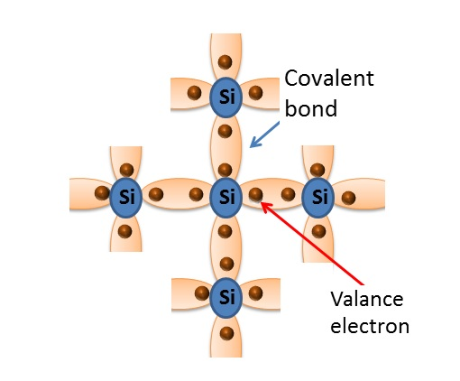
1.3- Atomic Binding in Semiconductors
The crystalline structure of Si
Notes:
To understand the procces of the conductivity of intrinsic semiconductor we sholud know the crystal structure
Here we have the nuclied of silicon and each atome of si have four valance electron
And bonded with four other atom by shear their valance electron
At zero k all electron are stronle bonded with antome we have no free e and no unoccupied stated in crystall strutuer that why intrnsic semiconductor working as a perfect insulator
At room tempertuer some of valance e obserb enoght amont of thernal energy and thet brek there bond and become free
These electron moving freely insude the materal in all direction and unoccuped syate helpe the other valance electron to jumbe inside them but when we applide electric filed these electron moving in opposted direction o

Slide 7
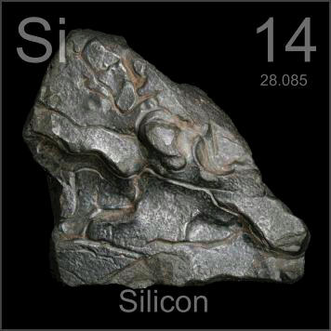
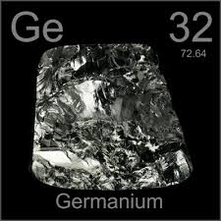
1.3- Classification of semiconductor materials:
Intrinsic
Adding impurity
Extrinsic
A small mount of impurity added to pure semiconductor in a process is called Doping.
A semiconductor in a very pure form is called Intrinsic semiconductor.
Germanium (Eg=0.72eV) and Silicon (Eg=1eV) are Intrinsic semiconductor.
Why??
Notes:
This process hepe us to increase the conducivity of intrinsic semiconductor
Why we will do that we already have conductor
Becouse by control the amount of impurity we will control the conductivity and that is very important in electnic device

Slide 8
Intrinsic
At room temperature
At T = zero K ------ insulator
Covalent bond
Si
Si
Si
Si
Si
Si
Pair (electron & hole)
Si
Si
Si
Valance electron
The crystalline structure of Si
Notes:
To understand the procces of the conductivity of intrinsic semiconductor we sholud know the crystal structure
Here we have the nuclied of silicon and each atome of si have four valance electron
And bonded with four other atom by shear their valance electron
At zero k all electron are stronle bonded with antome we have no free e and no unoccupied stated in crystall strutuer that why intrnsic semiconductor working as a perfect insulator
At room tempertuer some of valance e obserb enoght amont of thernal energy and thet brek there bond and become free
These electron moving freely insude the materal in all direction and unoccuped syate helpe the other valance electron to jumbe inside them but when we applide electric filed these electron moving in opposted direction o

Slide 9
Extrinsic
N-type
P-type
Impurity atom with 5- valance electron like phosphor (P).
Impurity atom with 3- valance electron like Boron (B).
Si
Si
Si
Si
Si
Si
Si
Si
Si
p
Si
Si
Si
B
Si
Si
Si
Si
Si
Si
The crystalline structure of Si
The crystalline structure of Si
Fig(1.5)

Slide 10
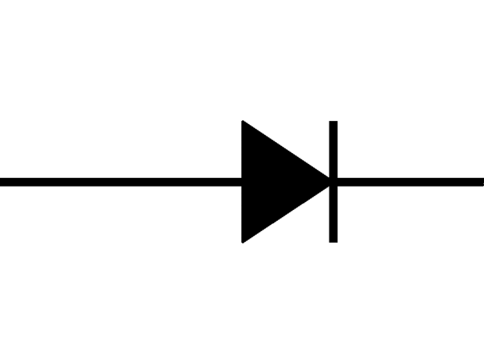
PN- junction
N- type
P-type
Si
Si
Si
Si
Si
Si
p
B
B
Si
Si
Si
p
Si
Si
Si
B
p
B
Si
Si
Si
Si
Si
Si
Si
Si
Si
Si
B
p
p
p
Si
Si
Minority (h+)
Majority (e-)
Majority (h+)
Minority (e-)

Slide 11
PN- junction
N- type
Depletion Reign
P-type
+
-
Si
Si
Si
Si
B
Si
Si
Si
p
+
-
Si
Si
Si
B
Si
Si
p
Si
Si
+
-
Si
Si
Si
Si
Si
Si
Electric filed prevent charge to move through the junction

Slide 12
PN- junction Forword basing
N- type
Depletion Reign
P-type
-
+
+
-
-
+
-
+
-
+
-
+
-
-
+
+
-
-
+
I=3mA
I= (I_{h}+I_{e}) major + (I_{h}+I_{e}) minor
(I_{h}+I_{e}) major >>>(I_{h}+I_{e}) minor

Slide 13
PN- junction Revers basing
N- type
Depletion Reign
P-type
-
+
+
+
-
-
-
+
-
+
+
-
-
-
+
+
-
+
-
+
+
-
-
-
+
I=µA
I= ( (I_{h}+I_{e}) minor

Slide 14
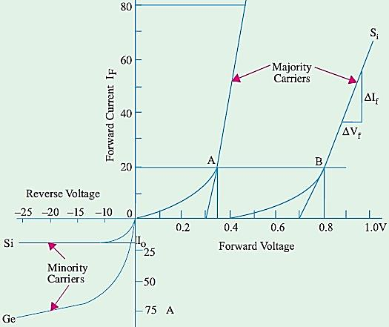
IV- Characteristic for PN-junction diode
threshold voltage (Vth) or
cut-in voltage or
knee voltage =0.3 for Ge
=0.7 for Si
V < Vth, current flow is negligible.
reverse saturation current
This slight increase is due to the impurities on the surface of the semiconductor which behaves as a resistor and hence obeys Ohm’s law. This gives rise to a very small current called surface leakage current.

Slide 15
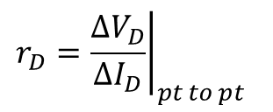
Resistance levels
As the operating points of diode move from one region to another the resistance of the diode will also be change due to nonlinear shape of the characteristic curve, three different levels will be introduced in this section
DC or static Resistance
AC or Dynamic resistance:
Average AC Resistance
If a sinusoidal rather than DC input is applied to the varying input will move the instantaneous operation point to up and down a region of the characteristics
If the point signal is sufficiently large to produce a broad swing
$$R_{DC}=\frac{V_{D}}{I_{D}} at pt D$$
$${\left.r_{D}=\frac{∆V_{D}}{∆I_{D}}\right|}_{pt to pt}$$
$r_{ac}=\frac{∆V_{D}}{∆I_{D}}$ at point D

Slide 16
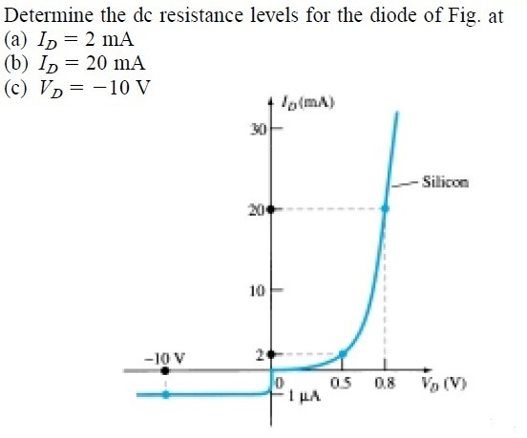

Slide 17
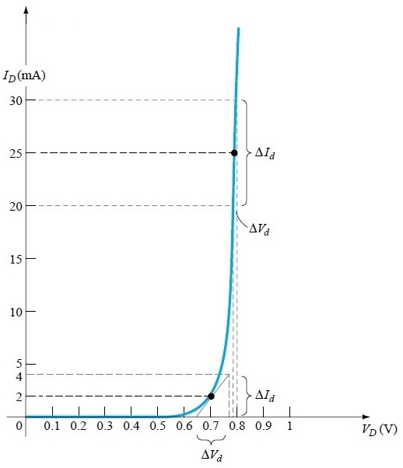
At below Fig.
I_{D}=30mA V_{d}=0.8V
I_{D}=20mA V_{d}=0.78V
I_{D}=4mA V_{d}=0.76V
I_{D}=0mA V_{d}=0.65V

Slide 18
Home work 1:
1. The current in an intrinsic semiconductor is due to
(a) conduction-band electrons
(b) valence-band electrons
(c) holes in the valence band
(d) thermally-generated of electron-hole.
2. Conduction electrons have more mobility than holes because they
(a) are lighter
(b) experience collisions less frequently
(c) have negative charge
(d) need less energy to move them.

Slide 19
Home work 1:
6. Electon-hole pairs are produced by
(a) recombination (b) thermal energy. (c) ionization (d) doping
7. Recombination takes place when
(a) an electron falls into a hole.
(b) a positive and a negative ion bond together
(c) a valence electron becomes a conduction
(d) a crystal is formed
8. When a P-N junction is formed, diffusion current causes
mixing of current carriers
(b) forward bias
(c) reverse bias
(d) barrier potential.

Slide 20
Home work 1:
9. Any voltage that is connected across a P-N junction is called ............. voltage.
Breakdown (b) barrier (c) bias. (d) reverse
10. The area within a semiconductor diode where no mobile current carriers exist when it is formed is called .......... region.
Depletion.
Saturation
Potential barrier
Space charge

Slide 21
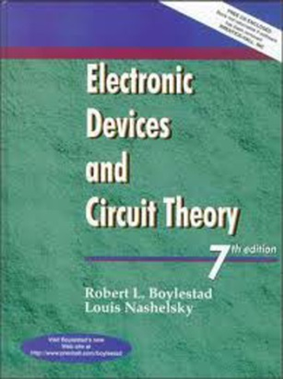
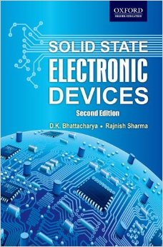
References
Electronic Device and circuit theory
By R. Boylestand and L. Nashelsky, 7th edition.
Solid State Electronic Devices
By: Ben G. Streetman, 3rd edition, 2014, Ch. 3, p.63.

