Slide 1
Operation amplifier (op-amps)
Electronic 3rd stage
Dr. Lary hana slewa
Lary.slewa@su.edu.krd

Slide 2
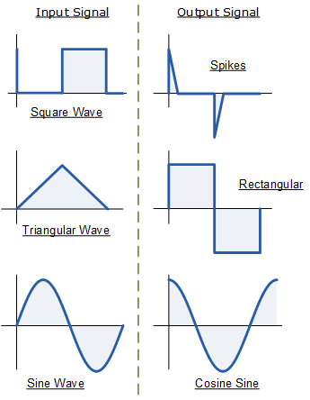
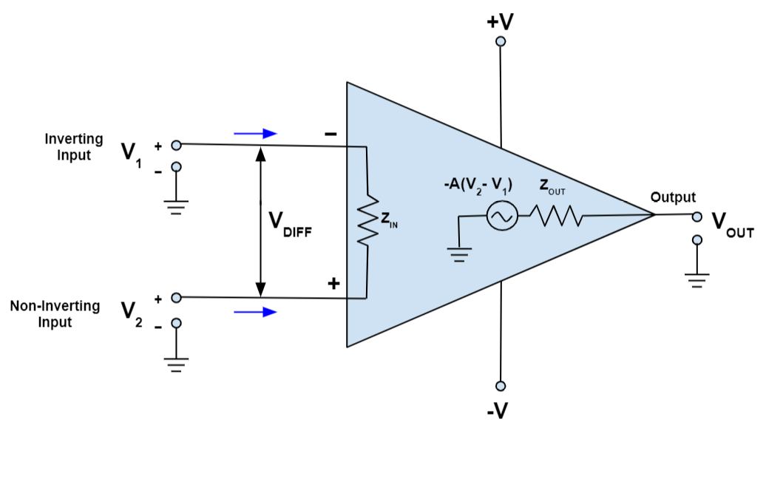
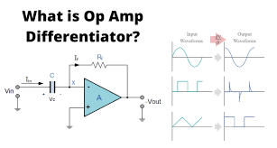
  What is an OP-AMP ?
An operational amplifier (often op amp or opamp) is a DC-coupled high-gain electronic voltage amplifier with a differential input and, usually, a single-ended output.
In this configuration, an op amp produces an output potential that is typically 100,000 times larger than the potential difference between its input terminals.
Opamp as differentiator
Operational amplifiers had their origins in analog computers, where they were used to perform mathematical operations in linear, non-linear, and frequency-dependent circuits, and as a ADC converter.
An OP-AMP is so named because it was originally designed to perform mathematical operations like summation, subtraction, multiplication, differentiation and integration etc.

Slide 3
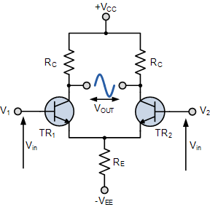
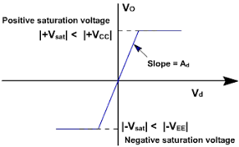
(Differential Amplifier):
The circuit below shows a generalized form of a differential amplifier with two inputs marked V₁ and V₂. The two identical transistors TR1 and TR2 are both biased at the same operating point with their emitters connected together and returned to the common rail, -V_{EE} by way of resistor Re
The circuit operates from a dual supply +V_{CC} and -V_{EE} which ensures a constant supply. The voltage that appears at the output, V_{out} of the amplifier is the difference between the two input signals as the two base inputs are in anti-phase with each other.
The function of differential amplifier is to amplify the difference of two signals.
V_{out1}
V_{out2}
I_{tail}= 2I_{E}
Vin⁺=Vin⁻
I_{c1}=I_{c2}
V_{out1}=V_{out2}
V_{out}= A (Vin⁺- Vin⁻)
Voltage transfer curve of op amps
Where A is the gain equal to (10⁵- 10⁶)

Slide 4
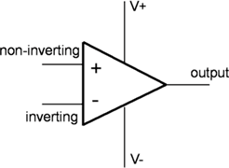
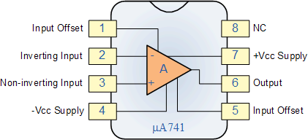
Basic Op-amp Symbol
An Operational Amplifier is basically a five -terminal device which consists of two high impedance inputs. One of the inputs is called the Inverting Input, marked with a negative or “minus” sign, ( – ). The other input is called the Non-inverting Input, marked with a positive or “plus” sign ( + ).
All OP-AMPs have a minimum of 5-terminals :
inverting input terminal,
non-inverting input terminal,
output terminal,
positive bias supply terminal,
negative bias supply terminal
The OP-AMP’s input can be single mode or double-mode (differential mode input) depending on whether input voltage is applied to one input terminal only or to both. Similarly, amplifier’s output can also be either single-ended or double- ended. The most common configuration is two input terminals and a single output.

Slide 5
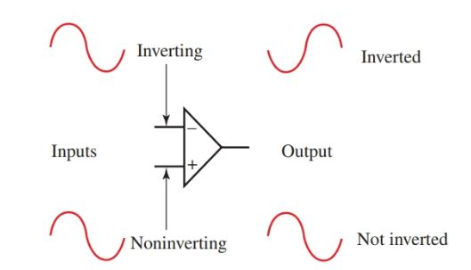
  Polarity Conventions
the input terminals have been marked with minus (-) and plus (+) signs. These are meant to indicate the inverting and non- inverting terminals only .
It simply means that a signal applied at negative input terminal will appear amplified but phase-inverted at the output terminal .
Similarly, signal applied at the positive input terminal will appear amplified and in phase at the output.
V_{o}=-AV2
V2
V_{o}=A(V1-V2)
V1
V_{o}=AV1
Obviously, these plus and minus polarities indicate phase reversal only. It does not mean that voltage V1 and V2 are negative and positive respectively.
Additionally, it also does not imply that a positive input voltage has to be connected to the plus-marked non-inverting terminal 2 and negative input voltage to the negative-marked inverting terminal 1.

Slide 6
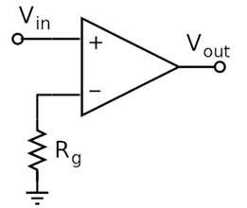
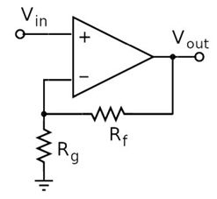
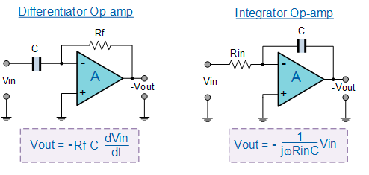
Open and closed loop amplifier
When an OP-AMP is operated without connecting any resistor or capacitor from its output to any one of its inputs (i.e., without feedback), it is said to be in the open-loop condition.
To make an op amp useful as an amplifier, you must use it in a feedback circuit, which reduces the gain to a more manageable amount. A resistor is used to reduce the voltage that is feed back to the input. This type of circuit is called a closed loop amplifier because a closed circuit path exists between the output and the input.
These feedback components determine the resulting function or “operation” of the amplifier and by virtue of the different feedback configurations whether resistive, capacitive or both, the amplifier can perform a variety of different operations.
Feed back
resistance

Slide 7
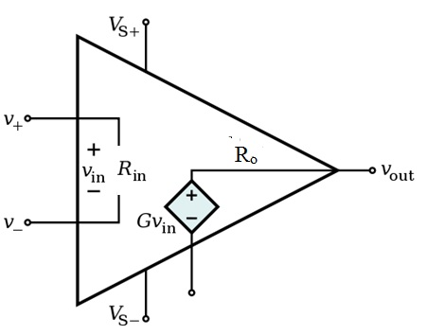
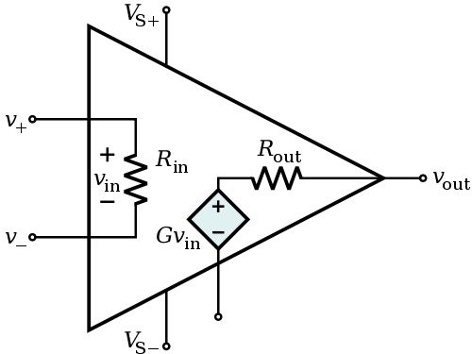
Equivalent Circuit for Operational Amplifiers
Ideal Operational Amplifiers
Practice Operational Amplifiers
R_{in}= infinity (open)
R_{o}= 0 (short)
A_{v}== infinity
BW= infinity
R_{in}= large
R_{o}= small
A_{v}= large
BW= wide

Slide 8
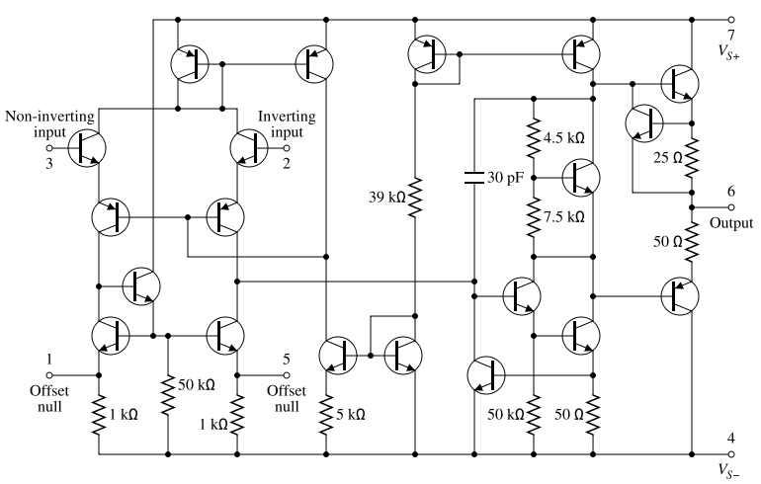

a complete circuit or group of circuits manufactured in a single piece of silicon
741 op-amp
The 741 Op Amp IC is a monolithic integrated circuit, comprising of a general purpose Operational Amplifier. It was first manufactured by Fairchild semiconductors in the year 1963. The number 741 indicates that this operational amplifier IC has 7 functional pins, 4 pins capable of taking input and 1 output pin.
IC 741 Op Amp can provide high voltage gain and can be operated over a wide range of voltages, which makes it the best choice for use in integrators, summing amplifiers and general feedback applications. It also features short circuit protection and internal frequency compensation circuits built in it. This Op-amp IC comes in the following form factors:
Fairchild semiconductors company
A standard 741 is made up of a circuit containing 20 transistors and 11 resistors. All of them are integrated into a monolithic chip.
https://www.electronicshub.org/ic-741-op-amp-basics/
https://www.youtube.com/watch?v=hUu3SqRSYyA
Transistor-level schematic for a 741 op-amp

Slide 9
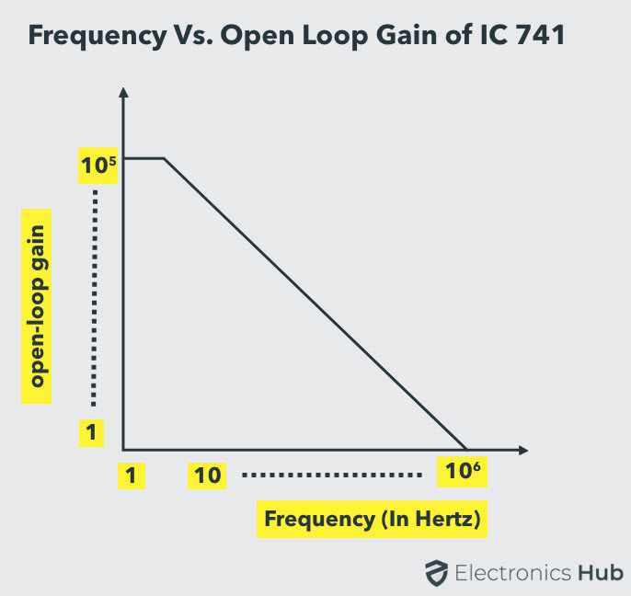
Gain vs Frequency Characteristics
The gain of operational amplifier IC 741 is not constant and varies depending on the frequency of input signal. The below graph illustrates the relation between them:
Open loop configuration (high gain – at low frequency (<Fc (10Hz))- small BW
-20 dB
https://www.youtube.com/watch?v=wfkzz1rg-xk
Close loop
operational amplifier IC 741
You can observe that the gain remains constant at around 200,000 when the operational amplifier is operated at frequencies below 10Hz. As the frequency of input signal increases, the gain reduces and approaches unity at frequencies around 1000,000Hz.
Fc
Fc
Unity gain frequency

Slide 10

  Virtual Ground and Summing Point
This fig shown an OP-AMP which employs negative feedback with the help of resistor Rf which feeds a portion of the output to the in-put.
Since input and feedback currents are al- gebraically added at point A , it is called the summing point.
The concept of virtual ground arises from the fact that input voltage vi at the inverting terminal of the OP-AMP is forced to such a small value that, for all practical purposes, it may be assumed to be zero. Hence, point A is essentially at ground voltage and is referred to as virtual ground. Obviously, it is not the actual ground, which, is situated below.
  Why Vi is Reduced to Almost Zero ?
When V1 is applied, point A attains some positive potential and at the same time V0 is brought into existence. Due to negative feedback, some fraction of the output voltage is fed back to point A antiphase with the voltage already existing there (due to V1).
The algebraic sum of the two voltages is almost zero so that Vi = 0. Obviously, Vi will become exactly zero when negative feedback voltage at A is exactly equal to the positive voltage pro- duced by V1 at A.
Another point worth considering is that there exists a virtual short between the two terminals of the OP-AMP because Vi = 0. It is virtual because no current flows (remember i = 0) despite the existence of this short.

Slide 11
    OP-AMP Applications
  1. Linear Amplifier
2. as unity follower,
3. Adder or Summer
4. Subtractor
5. Integrator
6. Differentiator
7. Comparator.

Slide 12
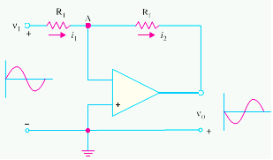
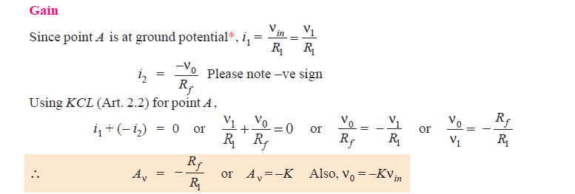
  1. Linear Amplifier
We will consider the functioning of an OP-AMP as constant-gain amplifier both in the inverting and non-inverting configurations.
(a) Inverting Amplifier or Negative Scale.
As shown in Fig. , non inverting terminal has been grounded, whereas R1 connects the input signal V₁ to the inverting input. A feed- back resistor R_{f} has been connected from the output to the inverting input
It is seen from above, that closed-loop gain of the inverting amplifier depends on the ratio of the two external resistors R₁ and R_{f} and is independent of the amplifier parameters.
It is also seen that the OP-AMP works as a negative scaler. It scales the input i.e., it multiplies the input by a minus constant factor K.

Slide 13
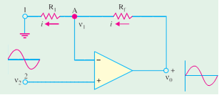
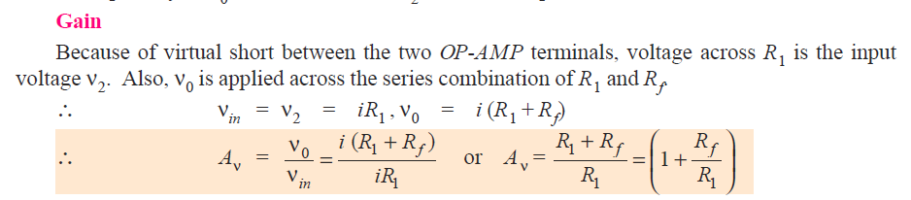
(b) Non-inverting Amplifier or Positive Scaler
This circuit is used when there is need for an output which is equal to the input multiplied by a positive constant. Such a positive scaler circuit which uses negative feedback but provides an output that equals the input multiplied by a positive constant is shown in Fig.
Since input voltage V2 is applied to the non-inverting terminal, the circuits is also called non-inverting amplifier
Here, polarity of n0 is the same as that n2 i.e., both are positive.
Gain
Because of virtual short between the two OP-AMP terminals, voltage across R1 is the input voltage n2. Also, n0 is applied across the series combination of R1 and Rf.

Slide 14
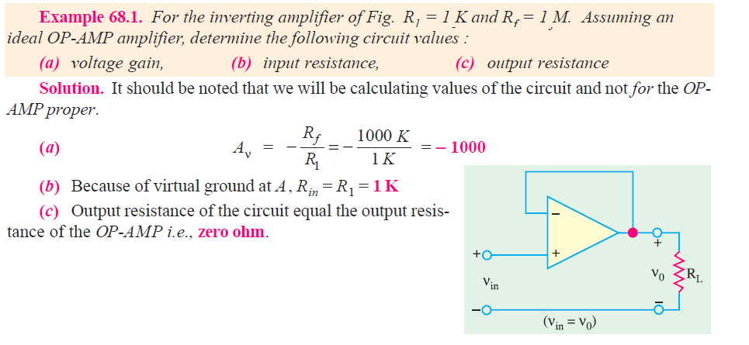
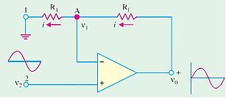

Slide 15
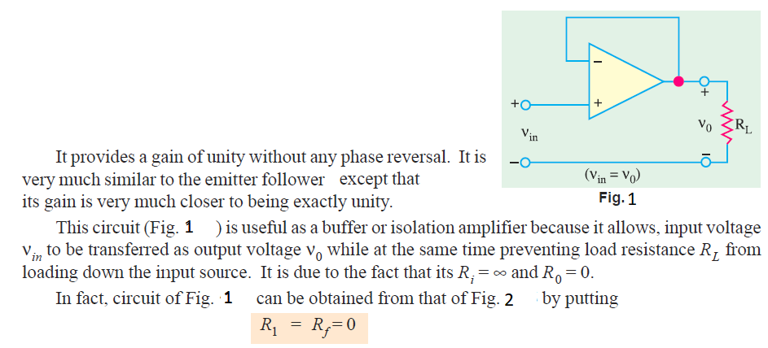
  2. Unity Follower
Vo=Vin+
Gain=1
Rin =∞V
Roui=0V

Slide 16
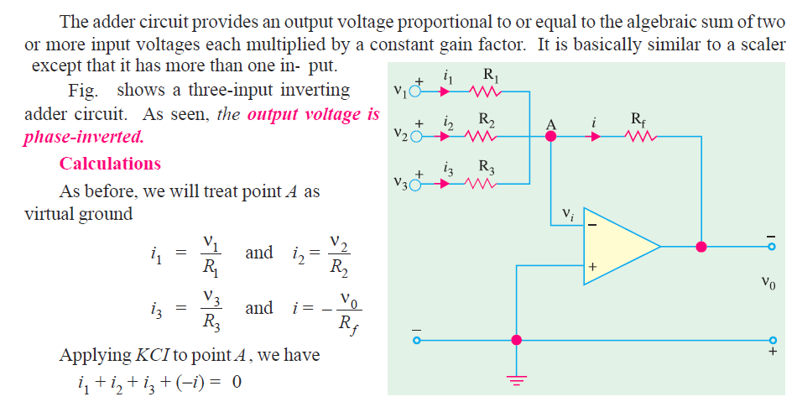
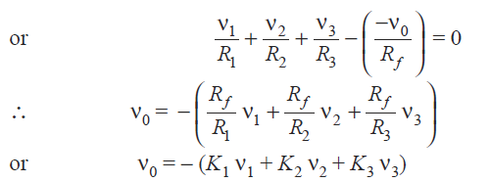
  3. Adder to Summer

Slide 17
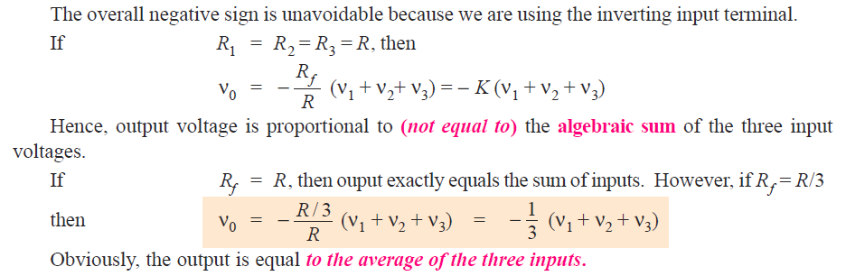

Slide 18
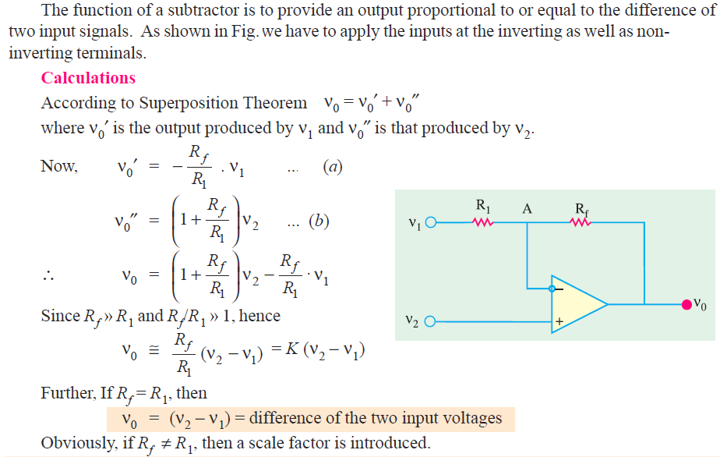
  Subtractor

Slide 19
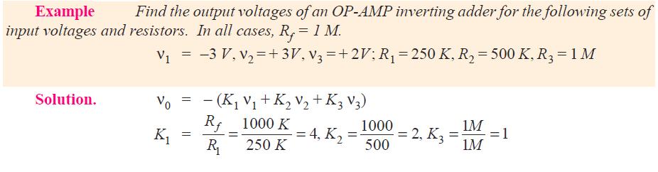
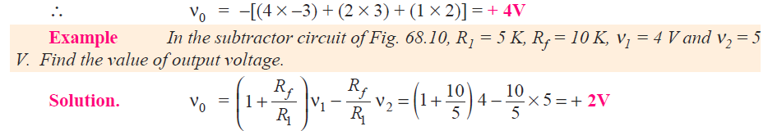
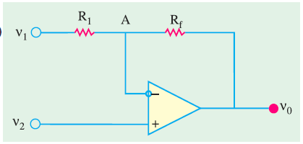

Slide 20

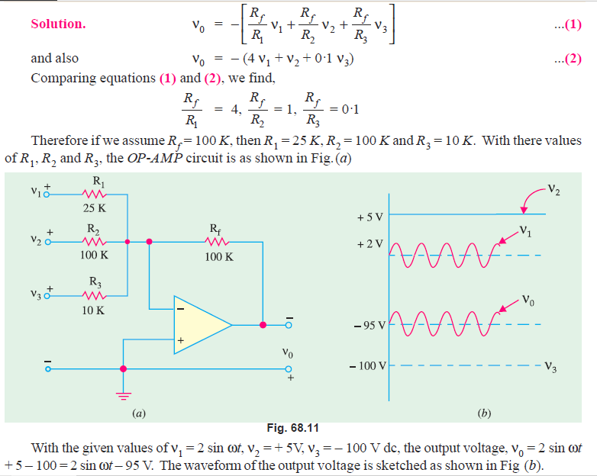
1000K

Slide 21
NUMBER SYSTEMS &
LOGIC GATES
Electronic 3rd stage
Dr. Lary Hana Slewa
Lary.slewa@su.edu.krd

Slide 22
Introduction to number systems
The number systems are used quite frequently in the field of digital electronics and computers. However the type of number system used in computers could be different at different stages of the usage. For example, when a user key-in some data into the computer, s(he), will do it using decimal number system i.e. the system we all have used for several years for doing arithmetic problems. But when the information goes inside the computer, it needs to be converted to a form suitable for processing data by the digital circuitry. Similarly when the data has to be displayed on the monitor for the user, it has to be again in the decimal number system.
There are four systems of arithmetic which are often used in digital circuits. These systems are:
    Decimal—it has a base of 10 i.e. it uses 10 different symbols to represent numbers.
    Binary—it has a base of 2 i.e. it uses only two different symbols.
    Octal—it has a base of 8 i.e. it uses eight different symbols.
    Hexadecimal—it has a base of 16 i.e. it uses sixteen different symbols.
    — decimal system uses powers of 10 — binary system uses power of 2 — octal system uses powers of 8 — hexadecimal system uses powers of 16.

Slide 23
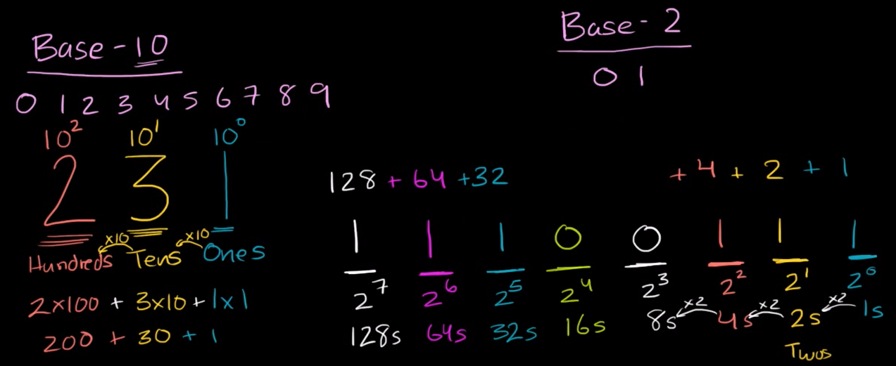
Decimal and binary number system
Decimal numbers are used to represent quantities which are outside the digital system. Binary system is extensively used by digital systems like digital computers which operate on binary information.
Decimal
Base 10
0 1 2 3 4 5 6 7 8 9
binary
Base 2
0 1
128+ 64 +32+ + + 4+ 2+ 1
1 1 0 0 1 1 1
2⁷ 2⁶ 2⁵ 2⁴ 2³ 2² 2¹ 2⁰
10² 10¹ 10⁰
2 3 1
Hundreds Tens Ones
1*200+ 3*10+ 1*1
2573 = 2 ´ 10³ + 5 ´ 10² + 7 ´ 10¹ + 3 ´ 10⁰

Slide 24
Decimal to binary converter
2⁰=1
2¹=2
2²=4
2³=8
2⁴=16
2⁵=32
2⁶=64
2⁷=128
13= 8+ 5
2³ 2² 2¹
13= 8 + 4 +1
1 eight+ 1 four +1 one
1 0 1
Eights fours twos ones
114= 64+ 50
64+32+18
64+32+16+2
1 1 1 0 0 1 0
64s 32s 16s 8s 4s 2s 1s

Slide 25
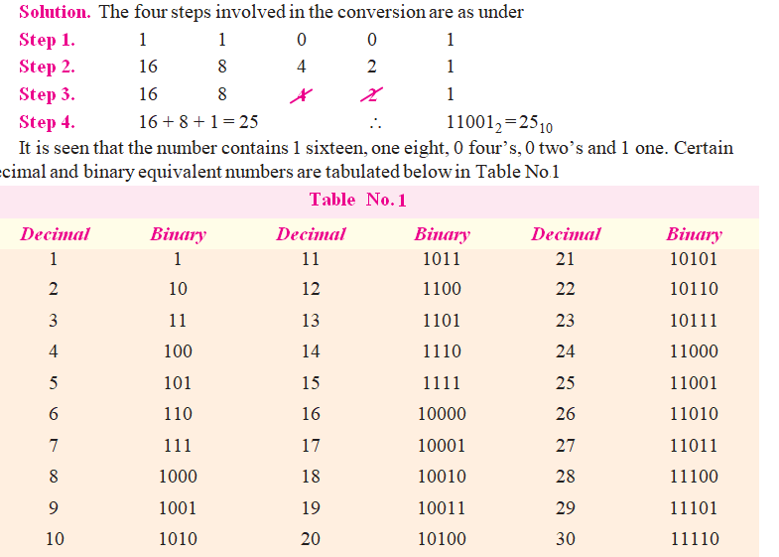
  Binary to Decimal Conversion
Following procedure should be adopted for converting a given binary integer (whole number) into its equivalent decimal number :
Step 1. Write the binary number i.e. all its bits in a row.
Step 2. Directly under the bits, write 1, 2, 4, 8, 16, starting from right to left.
Step 3. Cross out the decimal weights which lie under 0 bits.
Step 4. Add the remaining weights to get the decimal equivalent
Example: Convert 11001 to its equivalent decimal number.

Slide 26
  Definition of a Logic Gate
A logic gate is an electronic circuit which makes logic decisions. It has one output and one or more inputs. The output signal appears only for certain combinations of input signals.
Logic gates are the basic building blocks from which most of the digital systems are built up.
They implement the hardware logic function based on the logical algebra developed by George Boole which is called Boolean algebra in his honour.
A unique characteristic of the Boolean algebra is that variables used in it can assume only one of the two values i.e. either 0 or 1. Hence, every variable is either a 0 or a 1.
Boolean algebra is a branch of mathematics that deals with operations on logical values with binary variables

Slide 27
  Positive and Negative Logic
In computing systems, the number symbols 1 and 0 represent two possible states of a circuit or device. It makes no difference if these two states are referred to as ON and OFF, CLOSED and OPEN, HIGH and LOW and PLUS and MINUS or TRUE and FALSE depending on the circumstances. Main point is that they must be symbolized by two opposite conditions.
In positive logic, a 1 represents
    an 1. ON circuit 2. a CLOSED switch 3. a HIGH voltage 4. a PLUS sign 5. a TRUE statement Consequently,
a 0 represents
1. an OFF circuit 2. an OPEN switch 3. a LOW voltage 4. a MINUS sign 5. a FALSE statement.
In negative logic, just opposite conditions prevail.
Suppose, a digital system has two voltage levels of 0V and 5V. If we say that symbol 1 stands for 5V and symbol 0 for 0V, then we have positive logic system. If, on other hand, we decide that a 1 should represent 0 V and 0 should represent 5V, then we will get negative logic system.
Suppose, in a circuit, the two voltage levels are 2V and 10V. Then for positive logic, the 1 represents 10V and the 0 represents 2V (i.e. lesser of the two voltages). If the voltage levels are -2V and - 8V, then, in positive logic, the 1 represents - 2V and the 0 represents - 8V (i.e. lesser of the two voltages).
Unless stated otherwise, we will be using only positive logic in this chapter.

Slide 28
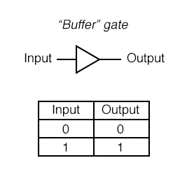
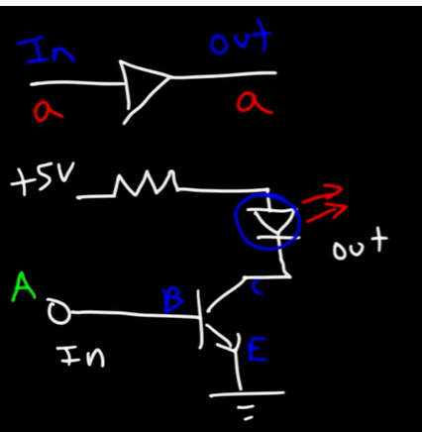
The “Buffer” Gate
A Buffer is Logic Gate that has only one Input, its Output follows the same Logic State as the Input
https://www.youtube.com/watch?v=JQBRzsPhw2w
symbol
Truth tables

Slide 29
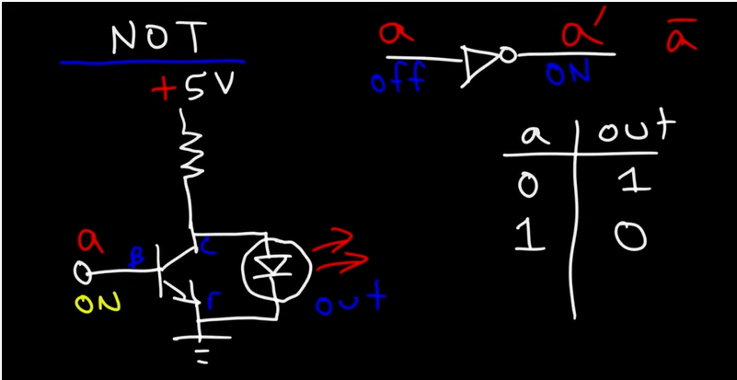
A NOT gate
is a logic gate that inverts the digital input signal. For this reason, a NOT gate is sometimes is referred to as an inverter. A NOT gate always has high (logical 1) output when its input is low (logical 0). Conversely, a logical NOT gate always has low (logical 0) output when the input is high (logical 1).
symbol and truth table for a NOT gate is shown below:

Slide 30
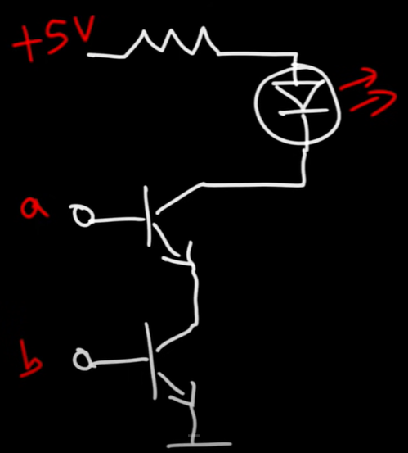
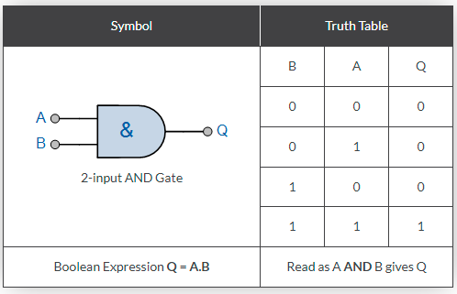
A and gate
If both A and B are true, then Q is true”
The logic or Boolean expression given for a digital logic AND gate is that for Logical Multiplication which is denoted by a single dot or full stop symbol, ( . ) giving us the Boolean expression of: A.B = Q.
2-input Transistor AND Gate

Slide 31
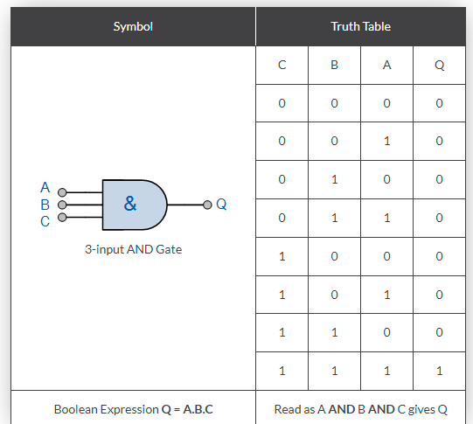
3-input Transistor AND Gate

Slide 32
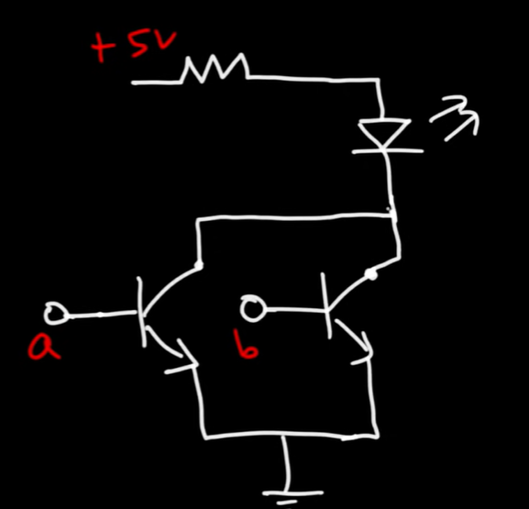
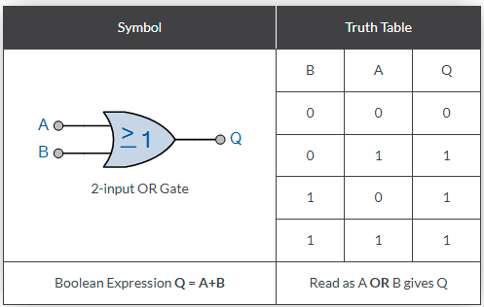
A OR gate
If either A or B is true, then Q is true
The logic or Boolean expression given for a digital logic OR gate is that for Logical Addition which is denoted by a plus sign, ( + ) giving us the Boolean expression of: A+B = Q.

Slide 33
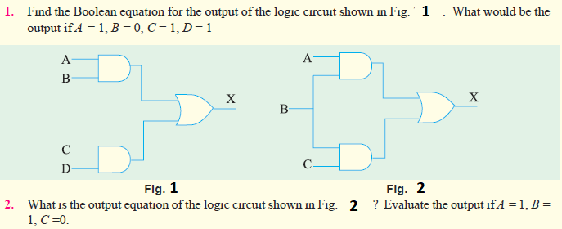
H.W

Slide 34
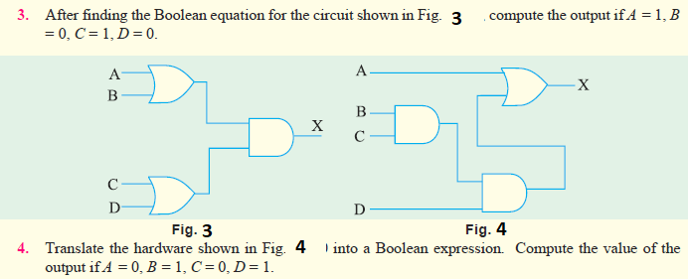
H.W

