Slide 1
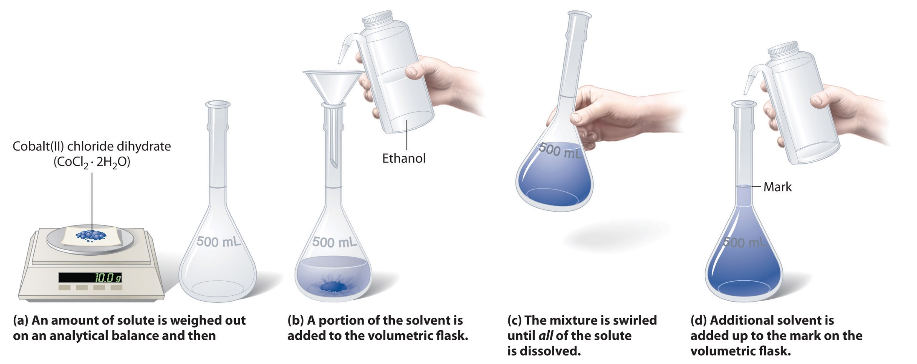
Volumetric Analysis
Practical Chemistry
2nd Stage- Medical Physics
Dr. Ibrahim Q. Saeed
MSc. Sarah Assaf
MSC. Laween A. Star

Slide 2
Glassware's for Volumetric Analysis

Slide 4
Stirrer
Washing bottle
Reagent bottle

Slide 5
Titration: is a process in which a standard solution (known conc.) is added to a solution of an analyte until the reaction between them is attained equivalence point.

Slide 6
Equivalence point: Is the point in a titration when the amount of added standard solution is exactly equivalent to the amount of analyte. The moles of titrant (standard solution) equal the moles of the solution with unknown concentration.
At equivalent point:
(no. of eq. titrant) = (no. of eq. titrand)
(Normality = No.of equivalent of solute / V_{(L)} )
No.of eq. = N x V
(N × V)_{Standard} = (N × V)_{Analyte}

Slide 7
End point: Refers to the point at which the colour of indicator changes in a titration. which signals the completion of the reaction.
Indicators: Chemical compounds undergo change in colour during titration which indicates the end point.
Acid-base indicators are generally weak organic acids or bases which, upon dissociation or association, undergo internal structural changes at a specific range of pH that give rise to alterations in color.

Slide 8
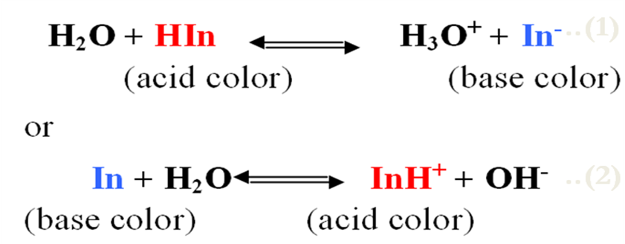
For the first indicator (1), HIn will be the major constituent in strongly acidic solutions and will be responsible for the "acid color" of the indicator, whereas In⁻ will represent its "base color"
For the second indicator (2), the species In will predominate in basic solutions and thus be responsible for the “base color”, whereas InH⁺ will constitute the “acid color”.

Slide 9
Indicators | Color in acidic medium | Color in higher pH | pH range
Thymol blue | Red | Yellow | 1.2 – 3.0
Methyl orange | Red | Yellow | 3.1 – 4.4
Methyl red | Red | Yellow | 4.2 – 6.2
Phenolphthalein | Colorless | Pink | 8.3 – 10

Slide 10
Primary standard
Are materials containing a precisely known concentration of a substance for use in volumetric (titrimetric) analysis.
the term “primary standard” refers to a compound uses to determine the concentration of another compound or solution.
A primary standard doesn't decompose , absorb or react with any components of air.

Slide 11
Important requirements for a primary standard are the following:
High purity.
High stability.
It has a large molecular weight to minimize the relative error during weighing the substance.
It must be non-hygroscopic.
Low cost.
The substance must not be poison.
Soluble in a solvent (especially water).

Slide 12
Secondary standard:
Is a compound whose purity has been established (determined) by titration with the primary standard and serves as the reference material for a titrimetric method of analysis.
Standard solution:
Is a reagent of exactly known concentration that is used in a titrimetric analysis, and it's prepared either from primary standard material or its concentration determined by standardization with primary standard material.

Slide 13
Reactions in titrimetric analysis must fulfill the following conditions:
There must be a simple reaction which can be expressed by a chemical equation. The substance to be determined should react completely with the reagent.
The reaction should be relatively fast. (Most ionic reactions satisfy this condition).
There must be an alteration (change) in some physical or chemical property of the solution at equivalence point.
An indicator should be available which, by a change in physical properties (color or formation of a precipitate), should sharply define the end point of the reaction.

Slide 14
Types of titration according to the chemical reaction
1-Neutralization titration (Acid-base titration).
NaOH + HCl NaCl + H₂O
2-Precipitation titration.
AgNO₃ + NaCl AgCl + NaNO₃
3-Reduction-oxidation titration (Redox titration).
5Fe²⁺ + Mn⁷⁺ + 8H⁺ 5Fe³⁺ + Mn²⁺ + 4H₂O
4-Complexation titration.
Hg²⁺ + 4I⁻ HgI₄²⁻

