Slide 1
Salahaddin University
College of Agriculture
Animal Resource Dpt.
PRACTICAL OF POULTRY Product Technology
Measurement of Meat Quality
Fourth CLASS
2022 - 2023
Mrs. Lina Salah

Slide 2
Measurement of Meat Quality
The global growing demand for poultry meat has pressurize nutritionists and breeders to improve the feed efficiency and growth rate of birds, reduce abdominal fatness and increase the size of breast muscle. Furthermore, the shift towards further processed products has underscored the necessity for higher standards in poultry meat to improve sensory and functional properties. The composition and quality of poultry meat are influenced by various factors such as age, sex, genotype, rearing conditions, pre-slaughter treatment of birds and diet, and additives added to feed.

Slide 3
Water Holding Capacity (WHC)
WHC is the ability of meat to retain its moisture when exposed to external forces (e.g. heating, pressing, etc.).
WHC is determined in terms of drip loss and cooking loss based on the method described by Honikel (1998).

Slide 4
Measurement of Meat Quality
Water Holding Capacity (WHC)
Drip Loss Measurement
At day 0, approximately 30 g of fresh Pectoralis major muscle will be individually weighed and recorded as the initial weight (W1). The samples will be packed in sealed polyethylene plastic bags; vacuum packaged, placed within a container and will be stored in a chiller at 4 °C. The samples are immediately removed from the bags, gently blotted dry, weighed and recorded as W2 (final weight) and this was done after 7 d of storage, The percentage of drip loss will be calculated and expressed as the percentage of differences of sample initial weight. After 7 d of storage the sample weight will be divided by sample initial weight (Honikel, 1998),

Slide 5
using the following equation:

Slide 6
2- Cooking Loss
Samples of Pectoralis major muscle from each treatment are individually weighed and recorded as the initial weight (W1). Samples are cooked in a water bath at 80 °C for 20 minutes in plastic bags. Thereafter, they are cooled at 25 ºC for 20 min, reweighed and recorded as W2. Cooking loss is calculated as follow:
Cooking loss %= [W1 -W2/W1] ×100
Where W1=weight before cooking, W2 = weight after cooking.

Slide 7
Meat tenderness measurement
Shear force will be determined from samples of Pectoralis major muscle that will be previously used for cooking loss. The cooked samples were cut into sub-samples after overnight storage at 4 °C. Subsamples of 1 cm (height) × 1 cm width × 2 cm (length) dimension will be sheared perpendicular to the longitudinal direction of the fibres (Sazili et al., 2005) by the Volodkevitch bite jaw attached to a texture analyser (TA.HD plus R, Stable Micro System, Surrey, UK). Shear force values will be recorded as the average of all sub-samples value and the results were expressed as g.

Slide 8
Muscle pH measurement
The pH of pulverized muscles will be read using a pre calibrated portable pH meter (Mettler Toledo, AG 8603, Switzerland) as described by AMSA (2012). The pH meter will be calibrated with a pH 4.0 buffer and then with a pH 7.0 buffer prior use. Each frozen pulverized sample (0.5 g) was homogenized (Wiggen Hauser® D-500, Germany) for 20 s with 10 mL of 5 mM sodium iodoacetate, 150 mM KCl solution to prevent further glycolysis. The pH of the resultant homogenate is measured at 20±1 ºC using the electrode attached to the pH meter.

Slide 9
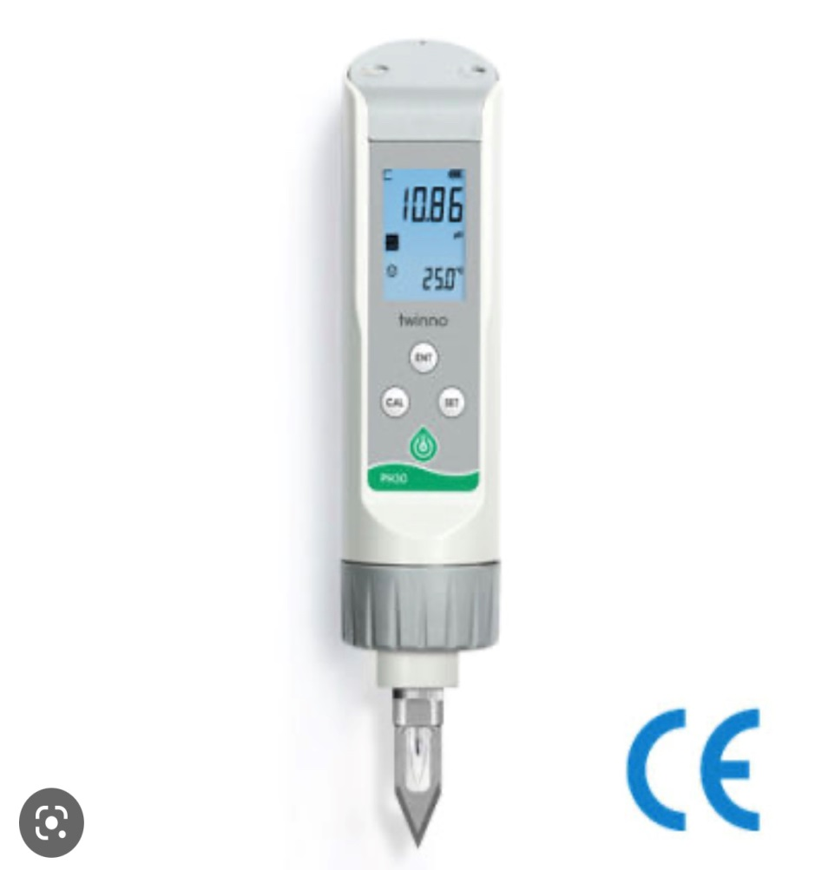
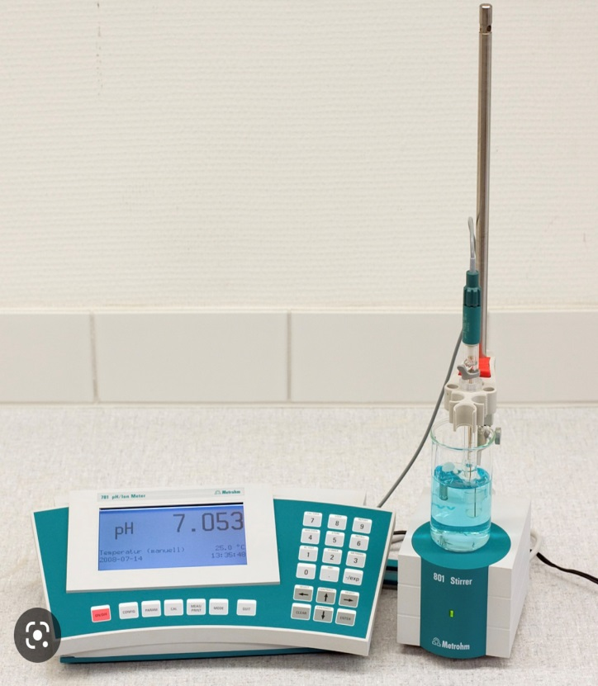
PH- Meter direct method indirect method

Slide 10
Colour Measurement
The samples will be stored in -80 ºC freezer for 1 week,, and thawed overnight at 4 °C. The air-tight packaging will be removed and the samples will be bloomed at 25 ºC for 20 min. The colour coordinates was determined using Colour Flex spectrophotometer (Hunter Lab Reston, VA, USA) based on the International Commission on Illumination (CIE) Lab-values (also known as lightness (L*), redness (a*) and yellowness (b*).

Slide 11
