Slide 1
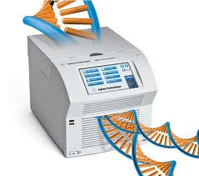
PCR
Polymerase chain reaction (PCR) is a primer mediated enzymatic amplification of specifically cloned or genomic DNA sequences. The purpose of a PCR is to make a huge number of copies of a gene or fragment of DNA.

Slide 2
Applications of PCR:
1. Used in molecular biology research to identify new genes.
2. Early detection of viral diseases.
3. Gene expression level by using RNA-PCR.
4. Trace forensic evidence of even mixed samples can be analyzed.
5. Environmental and food pathogens can be quickly identified.
6. PCR facilitates cloning of DNA and sequencing by the Sanger method.

Slide 3
PCR Process The PCR process requires a repetitive series of the three fundamental steps that defines one PCR cycle:
1. Double-stranded DNA template denaturation at 94-96 °C (Denaturation).
The DNA sequence which is to be amplified by PCR is known as the template. During the denaturation, the double strand melts open to single stranded DNA, all enzymatic reactions stop.

Slide 4
2. Annealing of two oligonucleotide primers to the single-stranded template at ~50-60 °C (Annealing).
After denaturation, the reaction is quickly cooled, preventing immediate reannealing of long DNA strands. Due to their small size, oligos now rapidly anneal to the single strands of DNA at positions containing specified template sequence. In these positions, they act as primers for Taq polymerase. Formation of the specific primer-template complex is highly temperature dependent.

Slide 5
3. Enzymatic extension of the primers to produce copies that can serve as templates in subsequent cycles (Extension).
This is the final step of the PCR cycle in which the temperature of the reaction is adjusted to the optimum for Taq polymerase activity, which is ~72 C. During this step, the polymerase enzyme incorporates nucleotides into the DNA strand, producing a complementary copy of the DNA template in the region specified by the annealed primer.

Slide 6
PCR Diagram Principles

Slide 7
PCR reaction components
PCR involves preparation of the sample, the master mix and the primers, followed by detection and analysis of the reaction products. These steps are discussed below.
Basic PCR reaction components are as follows:
1. Target DNA (Template)
2. Primers (Forward & Reverse Primer)
3. DNA polymerase
4. MgCl2
5. dNTPs
6. 10x Reaction Buffer
7. Water (ddH2O)

Slide 8
Target DNA (Template)
The choice of the target DNA is dictated by the specific experiment. The recommended amount of template for standard PCR is:
1- a maximum of 500 ng of human genomic DNA
2- 1–10 ng bacterial DNA
3- 0.1–1 ng plasmid DNA
Primers
A primer is a short synthetic oligonucleotide which is used in many molecular techniques from PCR to DNA sequencing. These primers are designed to have a sequence which is the reverse complement of a region of template or target DNA to which we wish the primer to anneal.
Guidelines for primer design.
Primers should be 17-28 bases in length;
2. Base composition should be 50-60% (G+C)
3. Tm (melting temperature) between 55-80oC are preferred;
4. 3'-ends of primers should not be complementary;
5. Primer self-complementarity should be avoided;

Slide 9
Tm Calculation
DNA has a stability that depends on the sequence of the double helix. Heat can be used to disrupt this duplex. The temperature at which half the molecules are single-stranded and half are double-stranded is called the Tm of the complex. Because of the greater number of intermolecular hydrogen bonds, higher G+C content DNA has a higher Tm than lower G+C content DNA. A simple, generic formula for calculating the Tm is:
Tm = 4(G+C) + 2(A+T) °C
A variety of software packages are available to perform more accurate Tm predictions using sequence information. Because the specificity of the PCR process depends on successful primer binding events at each amplicon end, the annealing temperature is selected based on the the melting temperatures of the two primers. Usually, the annealing temperature is chosen a few degrees below the annealing temperatures of the primers (– 5°C).

Slide 10
DNA polymerase
The choice of the DNA polymerase is determined by the aims of the experiment. There are a variety of commercially available enzymes. The most commonly used and most extensively studied enzyme is Taq DNA polymerase.

Slide 11
MgCl2 concentration
Magnesium chloride is an essential cofactor for the Taq DNA polymerase used in PCR, and its concentration must be optimized for every primer:template system.
Deoxynucleotide triphosphate (dNTP)
Deoxynucleotides provide both the energy and nucleosides for the synthesis of DNA. It is important to add equal amounts of each nucleotide (dATP, dTTP, dCTP, dGTP) to the master mix to prevent mismatches of bases.
Buffers
The optimal PCR buffer concentration, salt concentration, and pH depend on the DNA polymerase in use. The PCR buffer for Taq DNA polymerase consists of 50 mM KCl and 10 mM Tris-HCl, pH 8.3, at room temperature. This buffer provides the ionic strength and buffering capacity needed during the reaction.

Slide 12
Sample Volume and Reaction Tubes
Most PCR protocols are performed at the 25 μL - 50 μL scale in 0.2 mL or 0.5 mL microcentrifuge tubes.
Carryover Prevention
PCR has the potential sensitivity to amplify single molecules, so PCR products that can serve as templates for subsequent reactions must be kept isolated after amplification. Even tiny aerosols can contain thousands of copies of carried-over target molecules that can convert a true negative into a false positive. As with any high sensitivity technique, frequent use of positive and negative controls (PC & NC) is required for each amplification.
PCR Amplification Cycles
The number of PCR amplification cycles should be optimized with respect to the starting concentration of the target DNA. It is between 30 – 45 cycles to amplify.

Slide 13
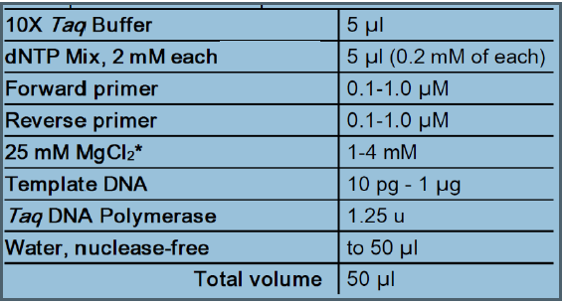
PROTOCOL
To prepare several parallel reactions and to minimize the possibility of pipetting errors, prepare a PCR master mix by mixing water, buffer, dNTPs, primers and Taq DNA polymerase. Prepare sufficient master mix for the number of reactions Plus one extra. Aliquot the master mix into individual PCR tubes and then add template DNA.
1. Gently vortex and briefly centrifuge all solutions after thawing.
2. Place a thin-walled PCR tube on ice and add the following components for each 50 μl reaction

Slide 14
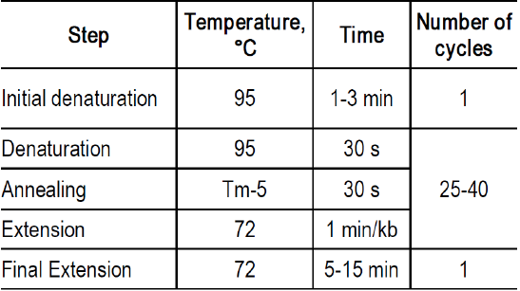
3. Gently vortex the samples and spin down.
4. Perform PCR using recommended thermal cycling conditions:

Slide 15
The complete sequence of B1 gene repeat (2214 bp), amplified segment bolded, and primer annealing position underlined (http://www.ncbi.nlm.nih.gov).

Slide 16
Example
Amplify 115 bp of T. gondii in a genomic DNA extract of a patient?
Sequences of the primers using to amplify the Toxoplasma gondii B1 gene.

Slide 17
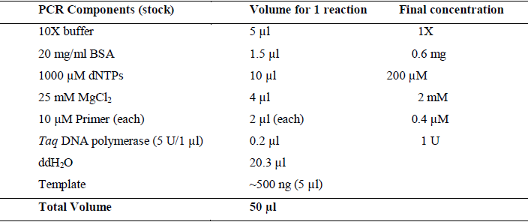
PCR preparation mix
In lab you have following PCR component as stock solution:
PCR Cocktail with final concentration.

