Slide 1
Molecular Biology

Slide 2
Molecular Biology
Molecular biology; the branch of biology that study gene structure and function at the molecular level.
The Molecular biology field overlaps with other areas, particularly genetics and biochemistry.
The Molecular biology allows the laboratory to be predictive in nature; events that occur in the future.

Slide 3
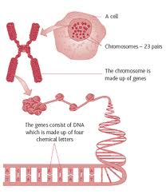
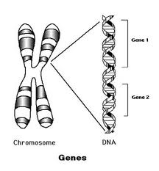
Gene : Unit of heredity
The DNA segments that carries genetic information are called genes.
It is normally a stretch of DNA that codes for a type of protein or for an RNA chain that has a function in the organism.
Genes hold the information to build and maintain an organism's cells and pass genetic traits to offspring.

Slide 4
Characteristics of Nucleic Acids
1- Two types of nucleic acids: RNA & DNA
2- DNA is encoded with four interchangeable "building blocks", called "bases", Adenine, Thymine, Cytosine, and Guanine, with Uracil rarely replacing Thymine
3- RNA has five different bases: adenine, guanine, cytosine and uracil.

Slide 5
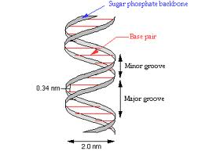
Size:
The DNA chain is 22 to 26 Ångströms wide (2.2 to 2.6 nanometres), and one nucleotide unit is 3.3 Å (0.33 nm) long.

Slide 6
Practical requirements for molecular biology research Equipment
Much of the equipment and facilities needed for molecular biology research will already be present in a well equipped biology laboratory.

Slide 7
General facilities
You will require access to the following general facilities:
Microbiological facilities:
• Autoclaves for sterilizing media
• Clean areas for molecular biology work
• 37°C room or incubator. Incubators can be used as an alternative but it must be possible to incubate Petri dishes as well as cultures in test-tubes and flasks
• Darkroom facilities:

Slide 8
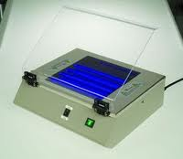
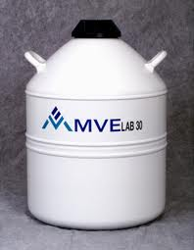
• Short-wavelength (302 or 366 nm) UV transilluminator
• Camera for recording agarose gels
• Cold room
• Sub-zero storage facilities:
• -80°C freezer
• Liquid nitrogen storage vessels
• Wet-ice machine and dry-ice storage

Slide 9
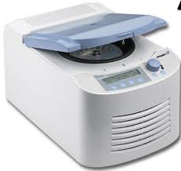
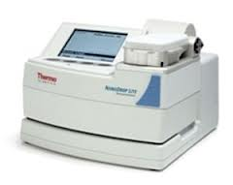
Departmental equipment
These items can be shared by a number of groups:
• Ultracentrifuge capable of 70 000 r.p.m.,
• Refrigerated (cooler) centrifuge capable of 25 000 r.p.m., plus rotors for 50-500 ml buckets
• 100°C oven
• UV spectrophotometer (Nanodrpe)

Slide 10
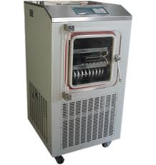
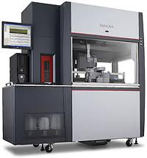
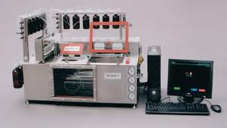
• Vacuum drier or freeze-drier
• Automated DNA-sequencing machine
• Oligonucleotide (primer) synthesis machine

Slide 11
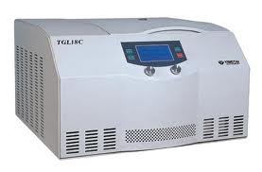
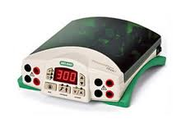
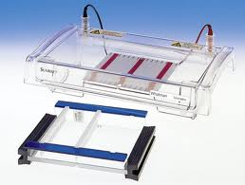
Laboratory equipment
Each group carrying out molecular biology experiments will require these items, possibly in multiple numbers:
• Bench-top centrifuge, capable of 5000 - 14000r.p.m.
• 200 V power supply for agarose gels.
• Horizontal gel apparatus (e.g. 10 x 10 cm, 15 x 10 cm, and 15 X 15 cm)

Slide 12
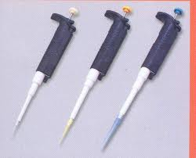
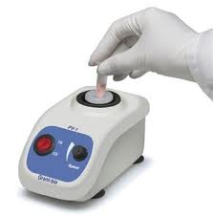
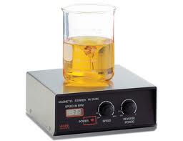
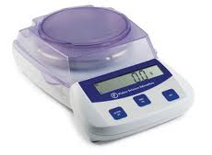
• Pipettes
• Water baths: ideally three, one set at 37°C, one at 65°C and one varied for requirements
• Vortex mixer
• Magnetic stirrer
Two-point top pan balance

Slide 13
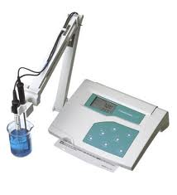
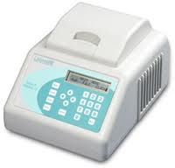
• pH meter
• Microwave oven for melting agar and preparing agarose
• Thermal cycler for PCR
• Double-distilled water supply
• Refrigerator
• -20°C freezer
• Computer: for virtually all molecular biology applications a networked PC

Slide 14
Health hazards and safety procedures
Safety is an individual responsibility and you must ensure that you are aware of the health hazards and have identified the appropriate safety requirements before embarking on molecular biology experiments.
1. Microbiological safety
2. Chemical hazards
3. Ultraviolet radiation
4. High-voltage electricity

Slide 15
Experimental skills
The following are the key aspects of laboratory practice for a successful molecular biologist:
1. Learn how to pipette down to 1 μl accurately.
2. Develop a steady hand for loading samples on to gels and for other manipulations.
3. Do not allow stocks of enzymes to warm up to room temperature: keep in the freezer and take out only for as long as it takes to remove an aliquot.

Slide 16
4. Autoclave plastic ware (pipette tips, microcentrifuge tubes, etc.) and keep sterile before use.
5. Always use double-distilled water.
6. Get into the habit of wearing disposable gloves at all times.

Slide 17
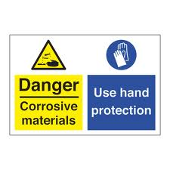
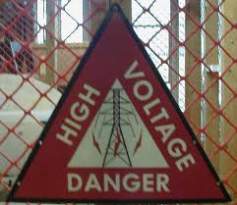
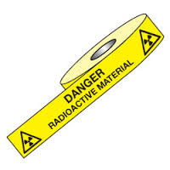
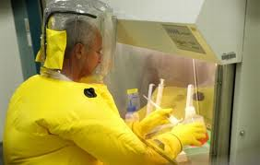
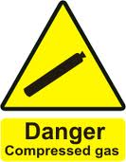
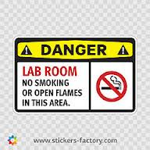
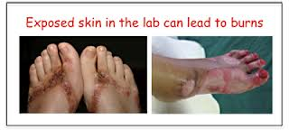
logo

