Slide 1
Taenia
A Tapeworm

Slide 2
Taenia, commonly called tapeworm because of its long, flat, ribbon-like body-form, is exclusively endoparasitic flatworm. Various species of Taenia parasitize man and other animals. The common species of Taenia parasitizing man are T. solium (the pork tapeworm), T. saginata (the beef tapeworm), T. acanthotrias and T. nana. T. pisiformis, T. caninum. T. cucumarinll and T. madagas­cariensis are commonly found parasitizing dogs and cats. T. flavopunctata parasitizes mouse and rat. Other tapeworms like Moniezia parasitizes sheep, Hymenolepis (the dwarf tapeworm) parasitizes children, mice and rat and Echinococcus (probably the smallest tapeworm) parasitizes dogs, cats and wolves. However, Taenia solium has been described in detail in the following pages.

Slide 3
Taenia solium (The pork tapeworm of man)
Systematic position
Phylum: Platyhelminthes
Class: Cestoda
Subclass: Eucestoda
Order: Taenioidae
Genus Taenia
Specie: solium

Slide 4
HABIT AND HABITAT
Taenia solium, the pork tapeworm of man, as adult lives in the intestine of man leading an endoparasitic life. Its life history is completed in two hosts, i.e., digenetic; man being the primary host and pig as secondary host. Except the adult, various stages of its life history are passed in the body of secondary host. Other animals like goat, cattle, horse and monkey may also serve as secondary host. T. solium is, however, reported from those parts of the world where pork is eaten, either raw or improperly cooked, especially in European countries. Since, it lives in adult stage in the intestine of man, it causes injuries to mucous membrane lining the alimentary canal where it adheres by its scolex; it may even cause mechanical injury by obstructing the passage of alimentary canal; it causes abdominal pains, weakness loss of weight and exces­sive appetite. However, disease caused by this worm is called taeniasis.

Slide 5
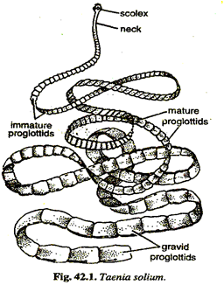

Slide 6
STRUCTURE
The body of Taenia solium is long, dorsoventrally flattened, narrow, ribbon-like, reaching a length of two to three meters. The colour of the body is opaque-white. Body consists of scolex, neck and strobila or body segments.
Scolox, The anterior end of the body of Taenia has a knob-like scolex. The scolex is smaller than the head of a pin about 1 mm in diameter with 4 cup-like muscular suckers having radial muscles, and an anterior round prominence, the rostellum having about 22 to 32 curved, chitinous hooks in two circles, the inner circle with larger hooks and outer circle with smaller ones. The long and short hooks alternate with each other. Each hook is made of a base by which it fixes, a handle directed towards the apex and a conical blade directed outwardly. The rostellum can be protruded sligbtly. The scolex with its suckers and hooks is an organ of attachment to the intestinal wall of the host, thus, working as an organ of adhesion or the holdfast. The scolex is, sometimes, wrongly referred to as 'head' but it cannot be the head because it is neither related to food-perception nor an organ of catching the food.

Slide 7
Neck. Behind the scolex is a thin, small, narrow, unsegmented neck which grows continuous­ly and proliferates proglottids by transverse fission or asexual budding. Therefore, this region is variously called like growth zone, area of proliferation or budding zone, etc.

Slide 8
Strobila. The neck is followed by the flattened, ribbon-like body called strobila. The strobila forms the main bulk of the body and consists of a series of proglottids arranged in a linear fashion. The strobila of a mature tapeworm measures about three meters in length having 800 to 900 proglottids. A proglottid is one complete unit of the body having a complete set of genitalium and surrounding tissue. The linear arrangement or repetition of these units is called proglottization. The proglottids, internally, remain connected together by muscles,excretory vessels and nerve cords. However, proglottids are not metameric segments like those of annelids, arthropods and other animals because these are independent, self-contained units, each with a complete set of reproductive organs both male and female and a part of excretory and nervous systems; and they are formed at the zone of proliferation situated anteriroly behind the scolex. Therefore, the youngest proglottid is next to the neck and the oldest at the posterior end of the strobila. The proglottids in a mature tapeworm are, however, differentiated into three kinds:

Slide 9
(a) Immature. The proglottids just behind the neck, devoid of reproductive organs are broader than long and are called immature prog1ottlds.These include nearly, 200 anterior proglottids.
(b) Mature. Nearly 100 to 150 proglottids, after immature proglottids, bear male reproductive organs only; as these proglottids are pushed back they develop female reproductive organs also. Thus, the mature proglottids are hermaphrodite and they number about 300 to 400 proglottids. The mature proglottids are squarish in shape.
(e) Gravid. These proglottids are the oldest and towards the posterior side of the strobila and include nearly 150 to 200 proglottids. These segments are longer than their breadth and no reproduc­tive organs are found in them. They contain only branched uterus packed with fertilized eggs.

Slide 10
In fact, the proglottids of strobila widen gradually along their length from anterior to posterior side. The proglottids bear genital papilla and pore, alternating once to right and then to left. In T. solium like other tapeworms, the gravid proglottids are regularly cut off either singly or in group of two to five proglottids from the posterior end of strobila; this is called apolysis. These detached proglottids are passed out from the body of the host during defaecation along with the faeces. The phenomenon of apolysis is significant because it helps in transferring the developing embryos to the outside from the body of primary host so that they can find a secondary host, and it also keeps the size of strobila restricted within a limit due to continuous proliferation of new proglottids from the neck region.

Slide 11
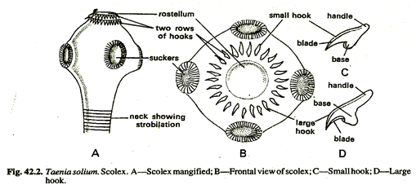

Slide 12
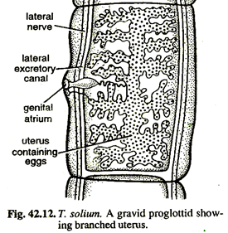

Slide 13
NUTRITION
The alimentary canal is altogether absent in T. solium, therefore, its mode of nutrition is saprozoic, i.e., it absorbs digested liquid food from the intestine of the host through its general body surface. In fact, the digested nutrients like glucose, amino acids, glycerol, etc., from the host's intestine, particularly form ileum, diffuse directly through its general body surface. It is also thought that as its scolex is deeply anchored into the intestinal mucosa, hence, it also absorbs tissue fluids from the host. The reserve food is stored as glycogen and lipoids in the parenchyma.
RESPIRATION
The mode of respiration is anaerobic, as the tapeworm lives in the intestinal contents which is oxygen free. The energy is derived from the breakdown of glycogen. During the breakdown process carbon dioxide, fatty acids and other organic .acids are produced as waste products. The CO2 is diffused out through its general body surface, while fatty acids, etc., are removed through the excretory system. It is interesting to note that whenever free oxygen is available to tapeworm, it consumes the oxygen and the rate of consumption being maximum in the anterior proglottids which gradually decreases towards the posterior side of the body.

Slide 14
REPRODUCTION
It has already been referred to, that nearly 300 to 400 proglottids of mature proglottids are hermaphrodite having complete sets of male and female reproductive organs.
Copulation and fertilization: Self-fertilization occurs by the insertion of the cirrus of one proglottid into the vagina of the same proglottid and sperms are deposited there. From the vagina the sperms come to lie in the seminal receptacle from where they fertilize the eggs in oviduct. But cross-fertilization between different proglottids of the same tapeworm is very common. Actually, T. solium is protandrous, i.e., the testes mature first. Hence, after copulation the sperms are stored tem­porarily in the seminal receptacle waiting for the maturity of the eggs and when such eggs come in the oviduct, fertilization occurs. After fertilization the eggs are transformed into capsules and packed in the uterus. Later, the various reproductive organs degenerate and the uterus become distended and branched having more than 30,000-40.000 egg capsules.

Slide 15
Formation of egg capsules. Just after fertiliza­tion, the zygote gets surrounded by yolk in the ootype received from the vitelline glands through the vitelline duct. The zygote and the yolk then become enclosed in a thin shell or chorionic membrane which is formed from the yolk material. The structure, thus, formed, is called capsule which passes into the uterus. The secre­tion of Mehils's gland facilitates the passage of capsule in the uterus. However, the gravid proglottid gets separated from the strobila and passes out with the faeces of the host.
LIFE HISTORY

Slide 16
Taenia saginata:
Taenia saginata com­monly called beef tapeworm is found in intestine of man. It is cosmopolitan in distribution. The body of the worm is dor­soventrally flattened and much larger than Taenia solium , reaches a length of 5 to 6 metres. Body is divisible into scolex, neck and strobila. Scolex is 1.5 to 2 mm in diameter, bears four large suckers for adhesion and devoid of rostellar hooks. Both mature and ripe proglottids are larger than those of T. solium. Life history is similar to that of T. solium. Intermediate hosts are cattle, usually cow and buffalo. Infection takes by ingestion of improperly cooked beef.

Slide 17
