Slide 1
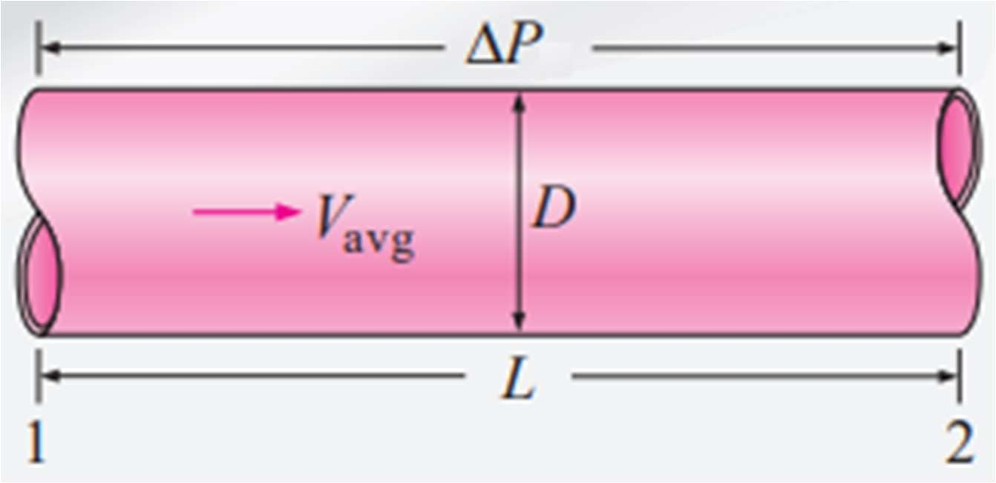
Mechanic-Mechatronics Dep.
Fluid Dynamics, 2024
CHAPTER TWO
Pressure Drop and Head Loss in Close Conduits
A quantity of interest in the analysis of pipe flow is the
power
requirements
of the fan or to maintain flow. If
pump
dP/dx = constant,
∆𝑷 = 𝑷_{𝟏} − 𝑷_{𝟐} =
𝟑𝟐𝝁𝑳𝑽_{𝒂𝒗𝒈}
_{𝑫}𝟐
In practice, it is found convenient to express the pressure loss for all types of fully
developed internal flows
(laminar or turbulent flows, circular or noncircular pipes,
smooth or rough surfaces, horizontal or inclined pipes) as
∆𝑷 = 𝒇
𝑳 𝝆𝑽^{𝟐}
𝒂𝒗𝒈
𝑫 𝟐
f is the Darcy friction factor, it is also called the Darcy–Weisbach friction factor
𝒇 =
𝟖𝝉_{𝒘}
𝝆𝑽^{𝟐}
𝒂𝒗𝒈
Friction factor for fully developed laminar flow in a circular pipe,
𝟔𝟒
𝒇 =
𝑹𝒆
In the analysis of piping systems, pressure losses are commonly expressed in terms of the equivalent fluid column height, called the head loss h_{L}.
_{𝑳 𝑽}𝟐
∆𝑷
𝝆𝒈 𝑫 𝟐𝒈
𝑳
𝒂𝒗𝒈
The head loss h_{L} represents the additional height that the fluid needs to be raised by a pump in order to overcome the frictional losses in the pipe. The head loss is caused by viscosity, and it is directly related to the wall shear stress.

Slide 2
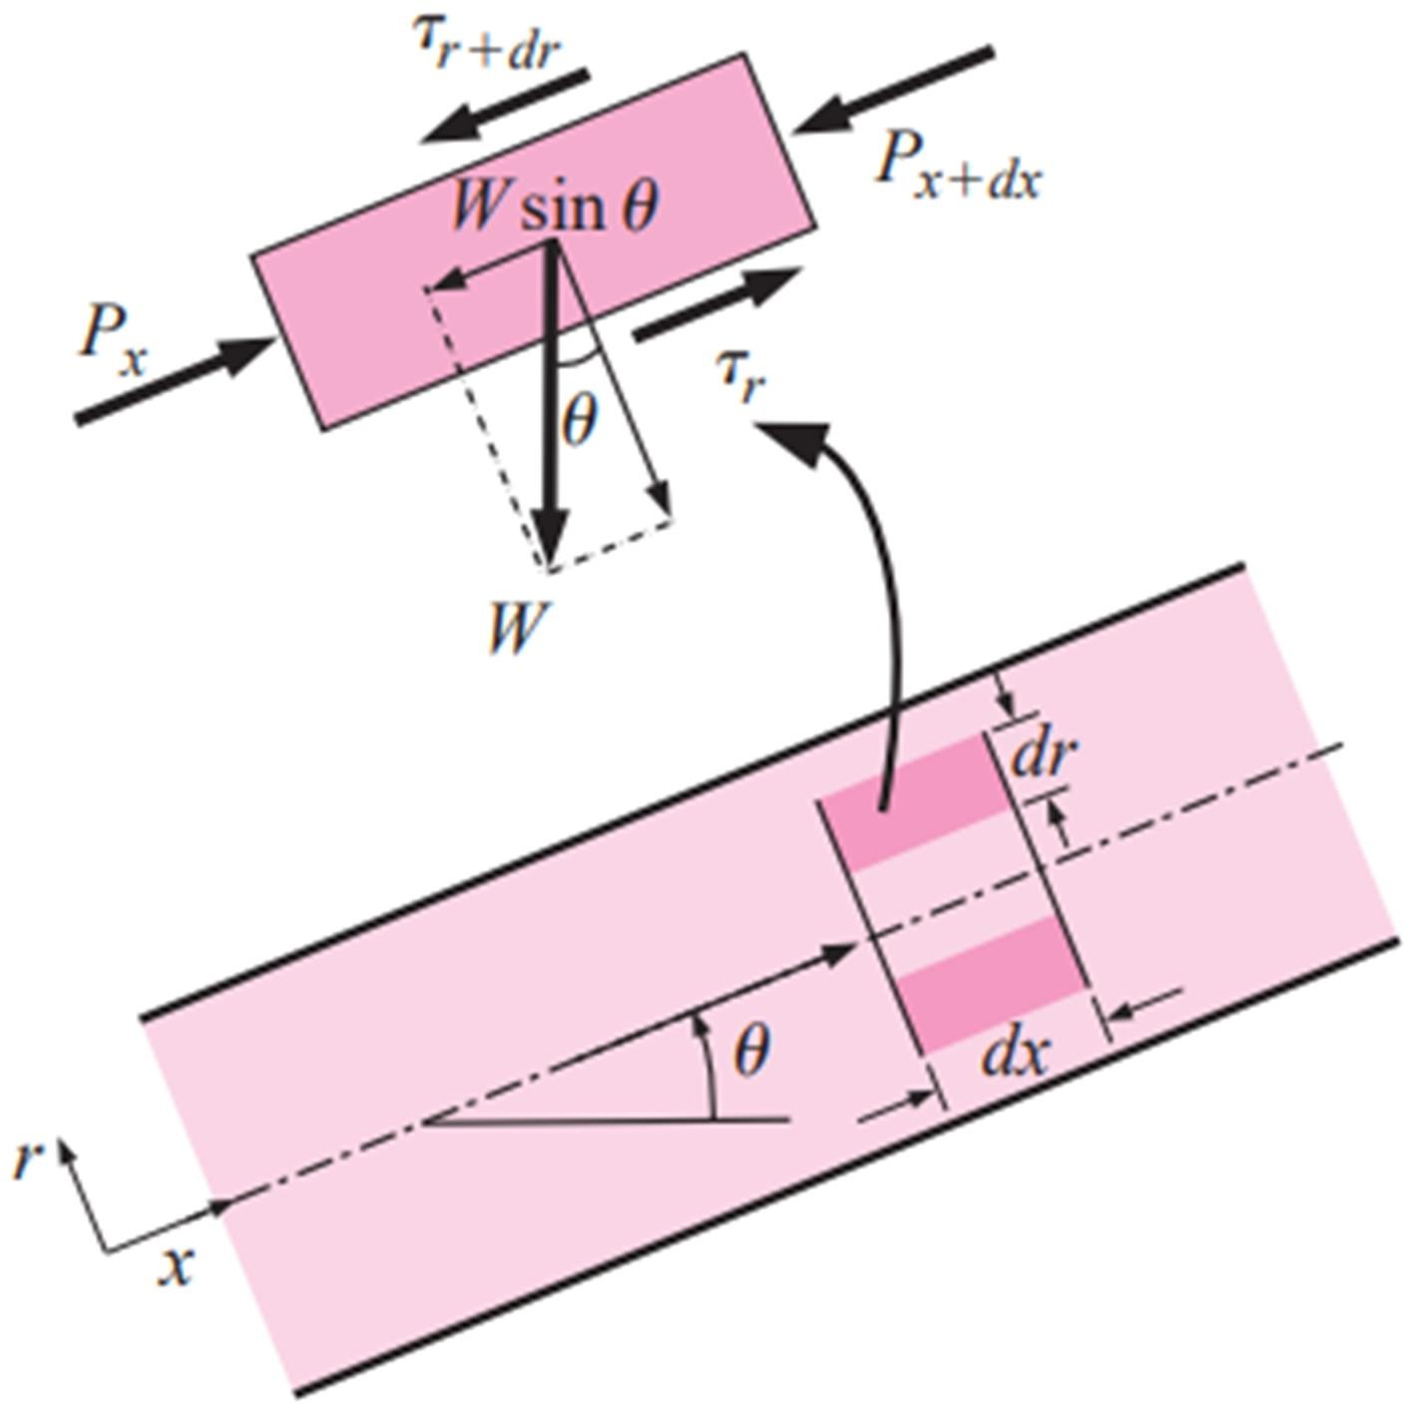
Mechanic-Mechatronics Dep.
Fluid Dynamics, 2024
The or the h_{L} Pipe system consists of the head loss due to viscous
overall head loss
effects in the straight pipes, termed the and denoted
and the head
major loss
hLmajor
loss in the various pipe components, termed the and denoted h_{Lminor}, and
minor loss
hL = hL,major + hL,minor
Once the pressure loss (or head loss) is known, the required pumping power to overcome the pressure loss is determined from
𝑾̇ _{𝒑𝒖𝒎𝒑,𝑳} = 𝑸∆𝑷_{𝑳} = 𝑸𝝆𝒈𝒉_{𝑳} = 𝒎̇ 𝒈𝒉_{𝑳}
The average velocity for laminar flow in a horizontal pipe is,
∆𝑷 × 𝑫^{𝟐}
^{𝑽}𝒂𝒗𝒈 ⁼
𝟑𝟐𝝁𝑳
Then the volume flow rate for laminar flow through a horizontal pipe of diameter D
and length L becomes
𝑸 = 𝑽 × 𝑨 = 𝑽
𝝅
𝟐
or
𝒂𝒗𝒈 𝒄
𝒂𝒗𝒈 × _{𝟒} ^{𝑫}
𝑸 =
∆𝑷 × 𝝅𝑫^{𝟒}
𝟏𝟐𝟖𝝁𝑳
Energy equation for steady, incompressible one-dimensional flow in terms of heads
𝑷_{𝟏}
_{𝑽}𝟐 _{𝑽}𝟐
+ ^{𝟏} + 𝒛_{𝟏} + 𝒉_{𝒑𝒖𝒎𝒑} =
𝑷_{𝟐}
^{+ 𝟐 + 𝒛}𝟐 ^{+ 𝒉}𝒕𝒖𝒓𝒃𝒊𝒏𝒆 ^{+ 𝒉}𝑳
𝝆𝒈 𝟐𝒈
𝝆𝒈 𝟐𝒈
For inclined pipes
(∆𝑷 − 𝝆𝒈𝑳 𝒔𝒊𝒏𝜽) × 𝑫^{𝟐}
^{𝑽}𝒂𝒗𝒈 ⁼
𝟑𝟐𝝁𝑳
𝑸 =
(∆𝑷 − 𝝆𝒈𝑳 𝒔𝒊𝒏𝜽) × 𝝅𝑫^{𝟒}
𝟏𝟐𝟖𝝁𝑳
Note: Uphill flow: θ>0 and sinθ>0,
Downhill flow: θ<0 and sinθ<0

Slide 3
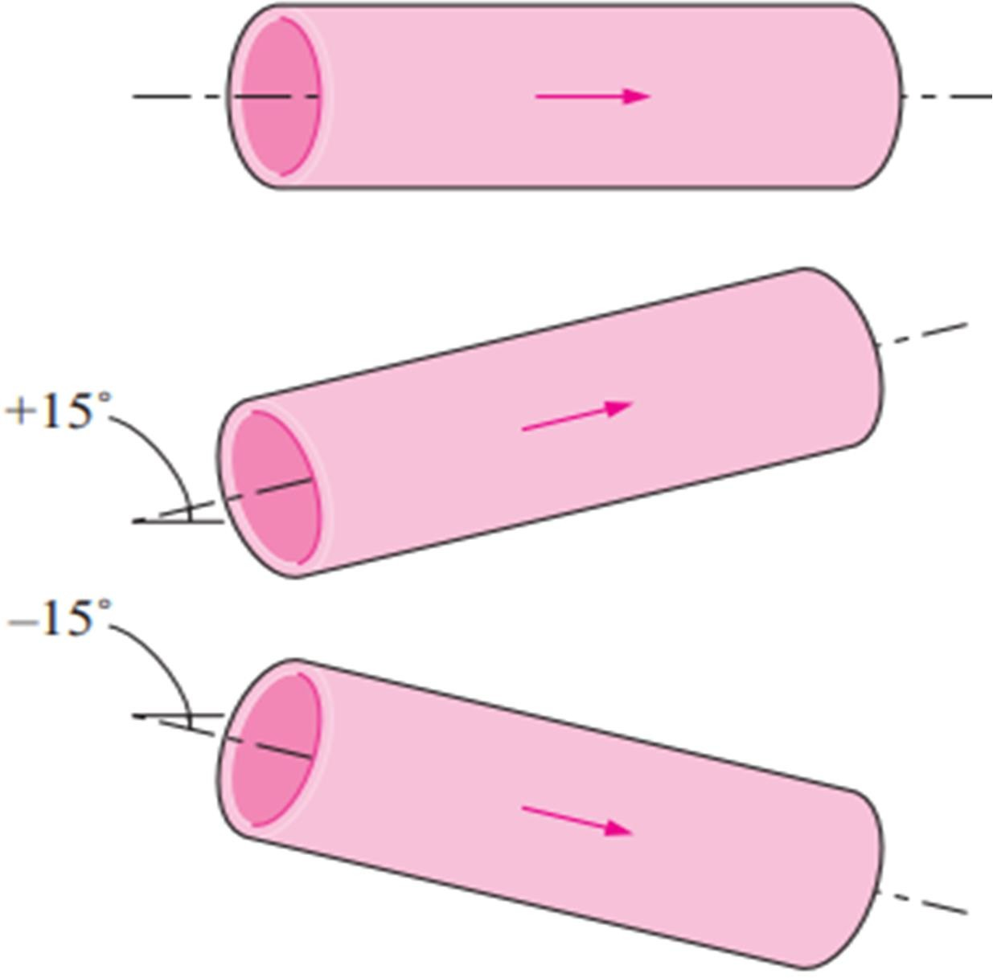
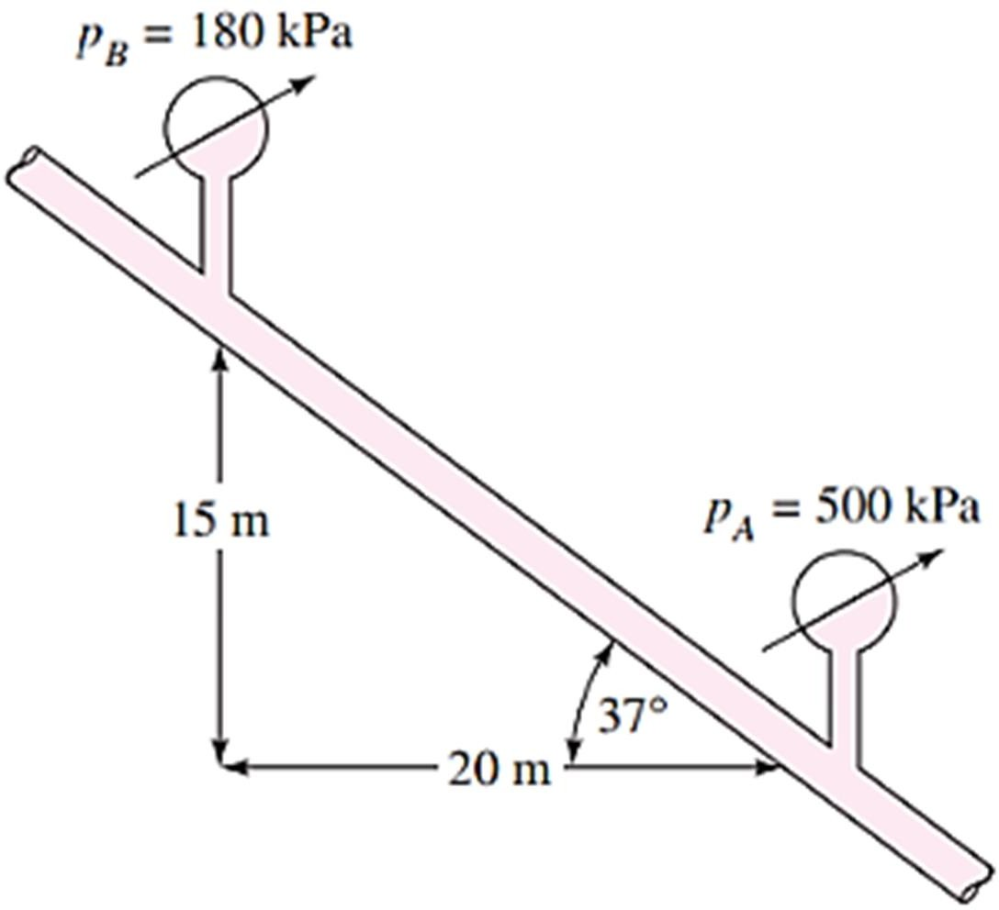
Mechanic-Mechatronics Dep.
Fluid Dynamics, 2024
Ex2-1: Consider the flow of oil, v=0.0026m²/s, 40cm diameter pipeline with average velocity of 0.5 m/s. A 300 m long section of the pipeline passes through the icy waters of a lake. Disregarding entrance effects, find the pumping power required to overcome the pressure losses and to maintain the flow of oil in the pipe
Ex2-2: Oil at 20°C (ρ=888 kg/m³ and µ=0.8 kg/m·s) is flowing steadily through a 5cm diameter 40m long pipe. The pressure at the pipe inlet and outlet are measured to be 745 and 97 kPa, respectively. Determine the flow rate of oil through the pipe assuming the pipe is (a) horizontal,
(b) inclined 15° upward, (c) inclined 15° downward. Also verify that the flow through the pipe is laminar.
Ex2-3: Oil (ρ=900 kg/m³ & µ=0.4 N.s/m²) flows in a 2cm pipe of diameter. FIND
(a) What pressure drop Δp, is needed to produce a flow rate of 2×10⁻⁵ m³/s; if the pipe is horizontal with x₁= 0 and x₂=10 m? (b) How steep a hill,θ, must the pipe be on if the oil is to flow through the pipe at the same rate as in part (a), but with p₁=p₂
Ex2-4: SAE 30 (ρ=891 kg/m³ & µ=0.4 N.s/m²) oil at 20°C flows in the 3-cm-diameter pipe, which slopes at 37°. For the pressure measurements shown, determine (a) whether the flow is up or down and (b) Flow rate in m³/h.

Slide 4
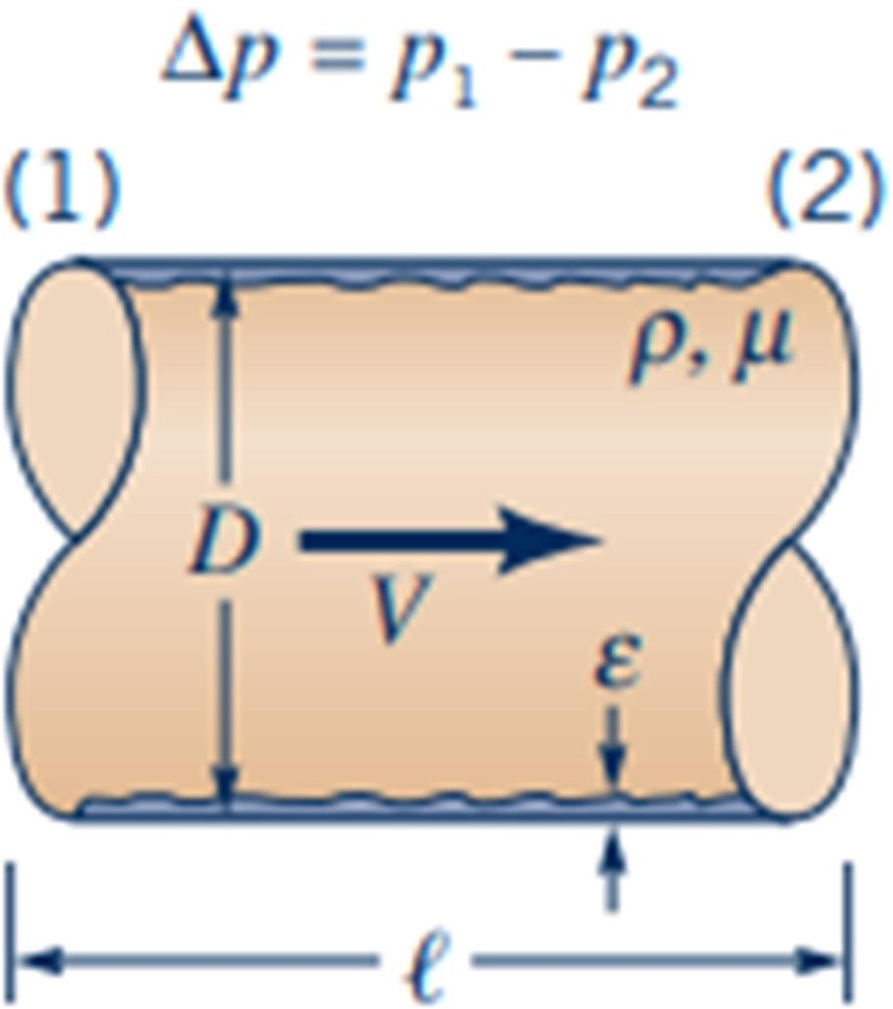
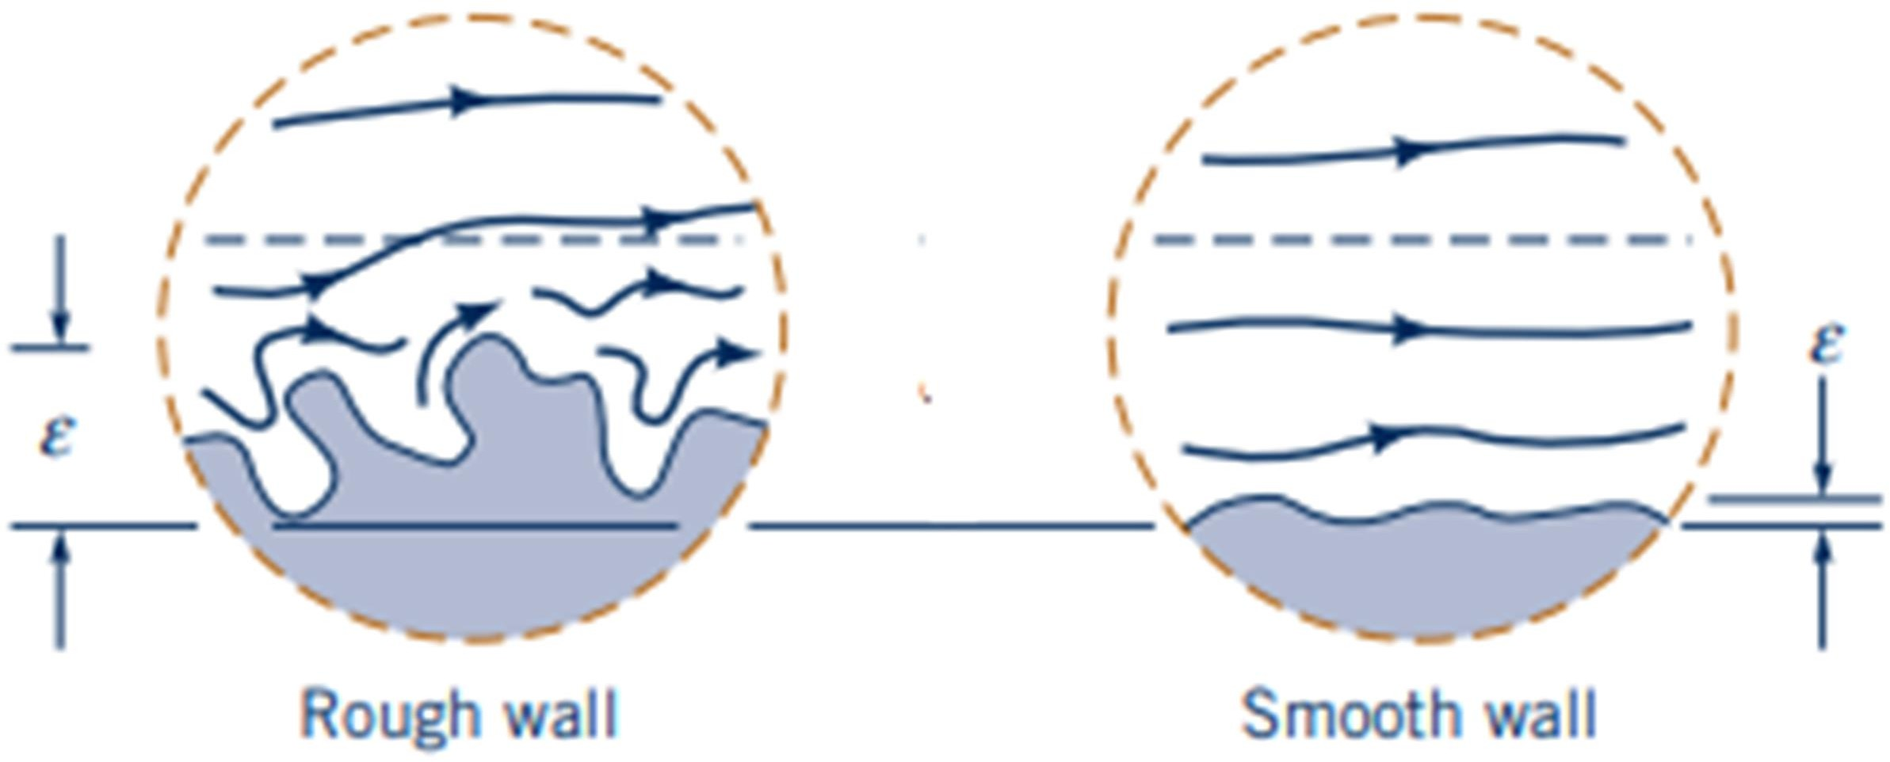
Mechanic-Mechatronics Dep.
Fluid Dynamics, 2024
Pressure Loss in Turbulent flows
The pressure drop ΔP for steady incompressible turbulent flow in a circular pipe of diameter D can be written in functional form as
ΔP=Ff (V, D, L, ɛ, µ, ρ)
Where V is the average velocity, L is the pipe length, ɛ and is a measure of the roughness of the pipe wall. The dependence of ΔP on the fluid properties µ and ρ is expected because of the dependence of τ on these parameters.
The in
pipe flow depends on the
friction factor
fully developed turbulent
Reynolds
number
and the relative roughness ɛ/D, which is the of the mean
ratio
height of
roughness
of the pipe to the pipe diameter. The functional form of this dependence
can’t be obtained from a theoretical analysis, and all available results are obtained
from using artificially roughened surfaces.
painstaking experiments
The friction factor was calculated from the measurements of the flow rate and the pressure drop. The experimental results obtained are presented in tabular, graphical, and functional forms obtained by curve-fitting experimental data. For transition and
turbulent flow in smooth as well as rough pipes, the following known as the Colebrook equation:
implicit relation
𝟏 𝜺/𝑫 𝟐. 𝟓𝟏
= −𝟐. 𝟎𝒍𝒐𝒈 ( + )
√𝒇 ^{𝟑. 𝟕} 𝑹𝒆 × √𝒇

Slide 5
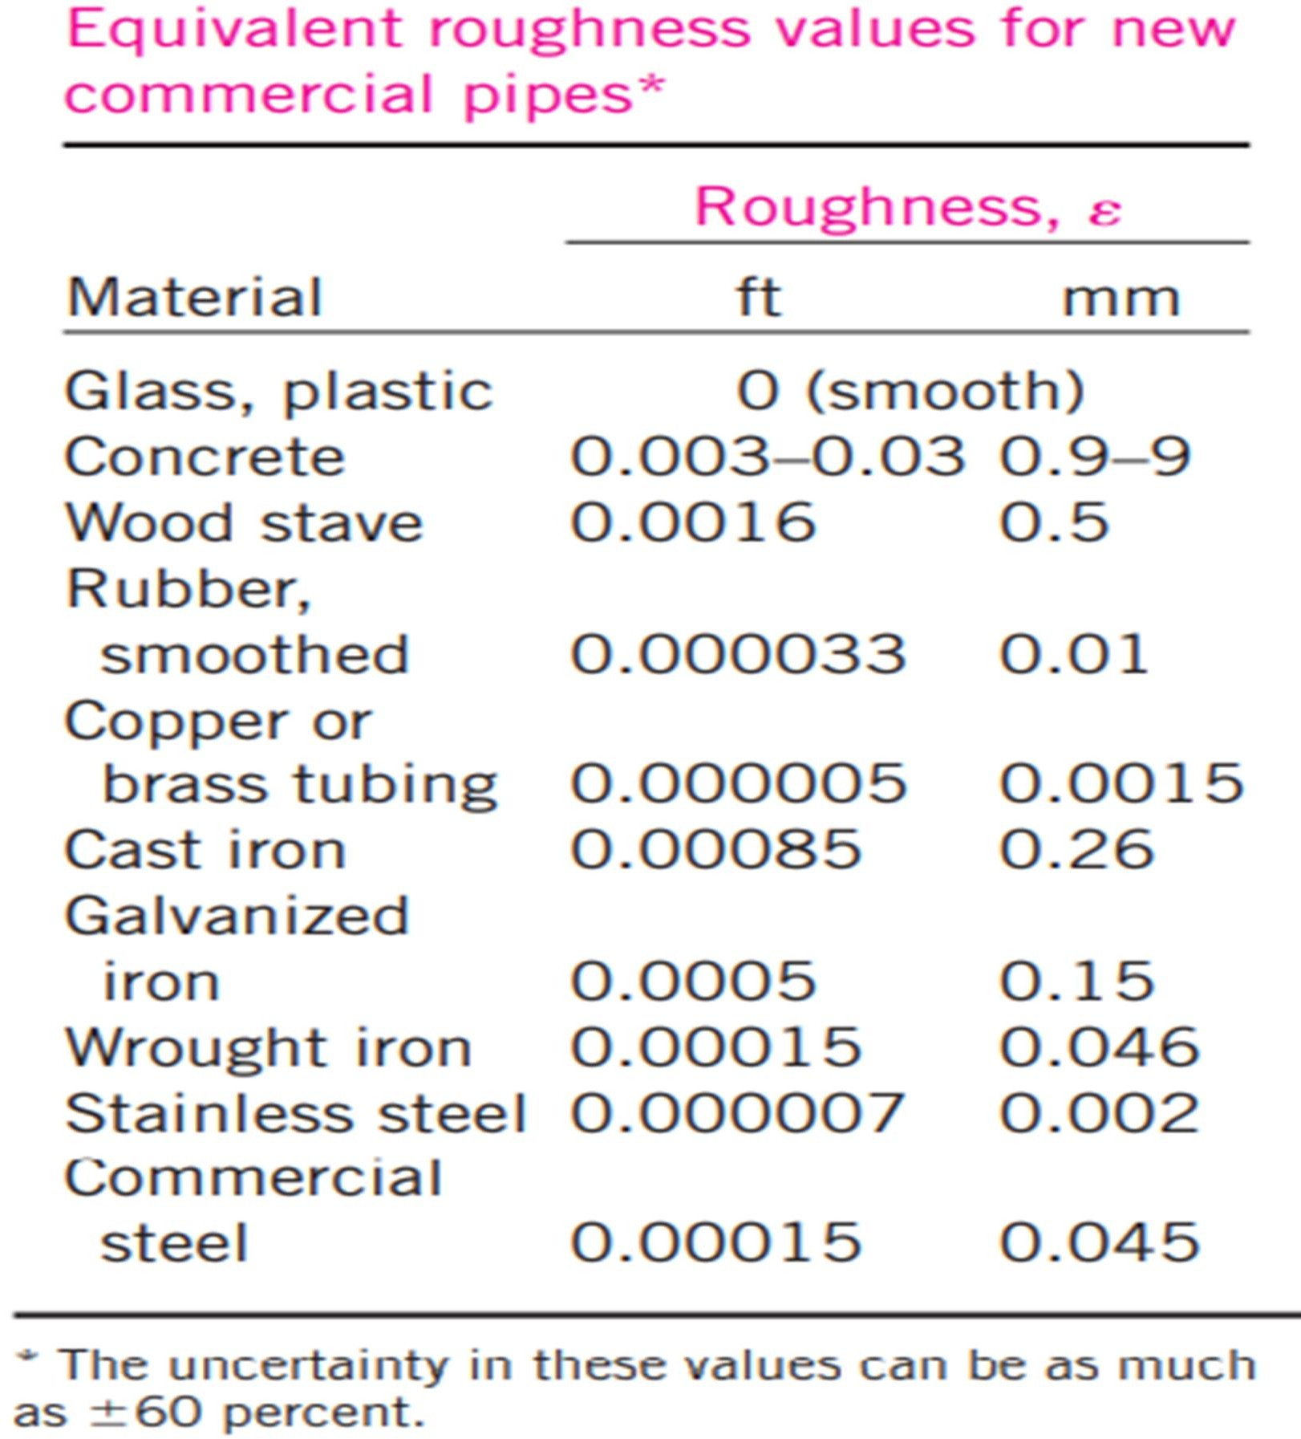
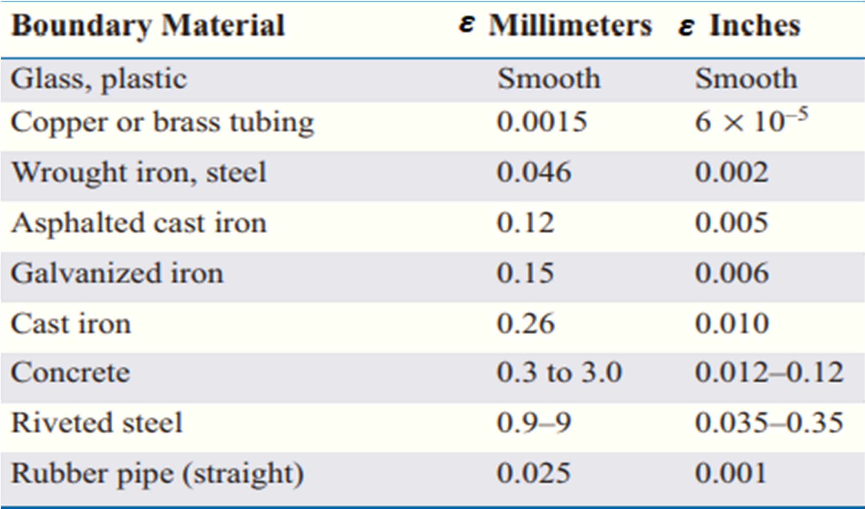
Mechanic-Mechatronics Dep.
Fluid Dynamics, 2024
The Moody chart presents the friction factor for pipe flow as a function of the Reynolds number and ɛ/D over a wide range. It is developed for circular pipes, and noncircular pipes by replacing the diameter by the hydraulic diameter.
Commercially available pipes differ from those used in the experiments in that the roughness of pipes in the market is not uniform and it is difficult to give a precise description of it. Equivalent roughness values for some commercial pipes are given in shown Table as well as on the Moody chart. But it should be kept in mind that
these values are for new pipes, and the may
relative roughness of pipes
increase
with use corrosion, scale buildup, and precipitation. As a result,
as a result of
the friction factor may increase by a factor of 5 to 10. The Colebrook equation is implicit in f, and thus the determination of the friction factor requires some iteration unless an equation solver. An approximate explicit relation for f was given by S. E. Haaland in 1983 as
𝟏 𝟔. 𝟗 𝜺/𝑫
𝟏.𝟏𝟏
≅ −𝟏. 𝟖𝒍𝒐𝒈 [ + ( ) ]
√𝒇
𝑹𝒆 𝟑. 𝟕
The results obtained from this relation are within 2 percent of those obtained from
the Colebrook equation.

Slide 6
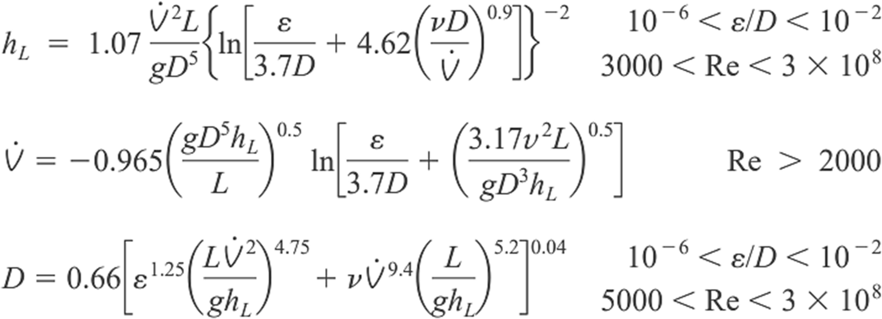
Mechanic-Mechatronics Dep.
Fluid Dynamics, 2024
Types of Fluid Flow Problems
In the design and analysis of piping systems that involve the use of the Moody chart (or the Colebrook equation), we usually encounter three types of problems (the fluid and the roughness of the pipe are assumed to be specified in all cases)
Determining the pressure drop (or head loss) when the pipe length and diameter are given for a specified flow rate (or velocity)
Determining the flow rate when the pipe length and diameter are given for a specified pressure drop (or head loss)
Determining the pipe diameter when the pipe length and flow rate are given for a specified pressure drop (or head loss)
Problems of the first type are straightforward and can be solved directly by using the Moody chart. Problems of the second type and third type are commonly encountered in engineering design (in the selection of pipe diameter, for example, that minimizes the sum of the construction and pumping costs), but the use of the Moody chart with such problems requires an iterative approach unless an equation solver is used.
To avoid tedious iterations in head loss, flow rate, and diameter calculations, Swamee and Jain proposed the following explicit relations in 1976 that are accurate to within 2 percent of the Moody chart:
Q
Q
Q
Q
Q

Slide 7
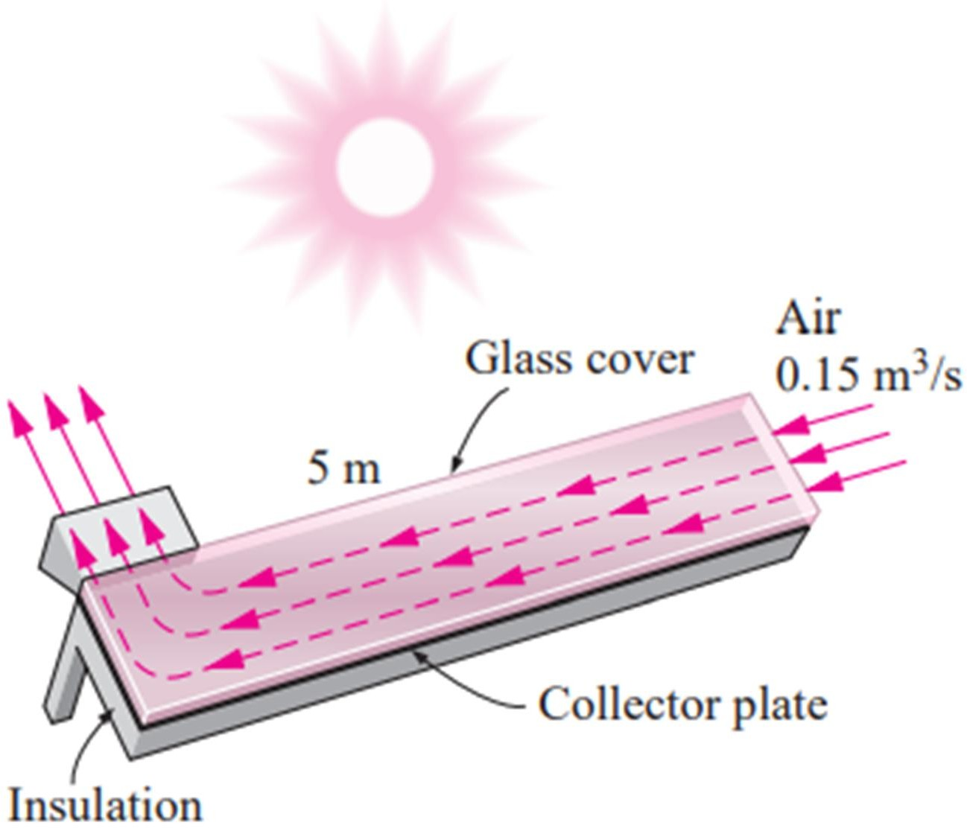
Mechanic-Mechatronics Dep.
Fluid Dynamics, 2024
Ex2-5: Water at 20°C (ρ= 998 kg/m³ and µ=1.002×10⁻³) is flowing steadily in a 5 cm diameter horizontal pipe made of stainless steel at a rate of 0.006 m³/s. Determine the pressure drop, the head loss, and the required pumping power input for flow over a 60 m long section of the pipe.
Ex2-6: Kerosene at 20°C is pumped at 0.15 m³ /s through 20 km of 16-cm-diameter castiron horizontal pipe. Compute the input power in kW required if the pumps are 85 percent efficient.
Ex2-7: Water at 15°C (ρ=999.1 kg/m³ and µ=1.138×10⁻³ kg/m·s) is flowing steadily in a 30 m long and 4 cm diameter horizontal pipe made of stainless steel at a rate of 8 L/s Determine (a) the pressure drop, (b) the head loss, and (c) the pumping power requirement to overcome this pressure drop.
Ex2-8: Consider an air solar collector that is 1m wide, 5m long and has a constant spacing of 3cm between the glass cover and the collector plate. Air flows at an average temperature of 45°C at a rate of 0.15m³/s through the 1m wide edge of the collector along the 5m long passageway. Disregarding the entrance and roughness effects, determine the pressure drop in the collector.
Ex2-9: Heated air at 1atm and 35ºC is to be transported in a 150-m-long circular plastic duct at a rate of 0.35m³/s. If the head loss in the pipe is not to exceed 20 m, determine the minimum diameter of the duct.
Ex2-10: Gasoline at a rate of (0.1m³/s) is being discharged from a pipe at point 2 at elevation 66.66m. Point 1 is located 965.5 m along the pipe from point 2, is at elevation 82.65, and pressure there is 2.5 kPa. If the pipe roughness is 0.5 mm, what pipe diameter is needed for discharge gasoline. Assume the flow velocity is constant in each point (y=7.05kN/m³, µ=2.92×10⁻⁴ N.s/m², p=719kg/m³)

Slide 8
Mechanic-Mechatronics Dep.
Fluid Dynamics, 2024
Ex2-11: The head loss per kilometer of 20 cm asphalted cast-iron pipe is 12.2 m. What is the flow rate of water through the pipe?
Ex2-12: Water (T=20°C) flows from a tank through a 50 cm diameter steel pipe. Determine the discharge of water
MINOR LOSSES
The fluid in a typical piping system passes through various fittings, valves, bends, elbows, tees, inlets, exits, enlargements, and contractions in addition to the pipes. These components interrupt the smooth flow of the fluid and cause additional losses because of the flow separation and mixing they induce. In a typical system with long pipes, these losses are minor compared to the total head loss in the pipes (the major losses) and are called minor losses. In some cases the minor losses may be greater than the major losses. This is the case, for example, in systems with several turns and valves in a short distance. The head loss introduced by a completely open valve, for example, may be negligible. But a partially closed valve may cause the largest head loss in the system.
Minor losses are usually expressed in terms of the loss coefficient K_{L} (also called the resistance coefficient), defined as
𝑲 =
𝒉_{𝑳}
𝑳
𝑽^{𝟐}/(𝟐𝒈)
The total head loss in a piping system is determined from
hL,total = hL,major + hL,minor
∞
𝑳 𝑽^{𝟐}
∞
+ Σ 𝑲
𝒋
_{𝑽}𝟐
𝒉
𝑳,𝒕𝒐𝒕𝒂𝒍
= Σ 𝒇
𝒊
𝑳,𝒋 _{𝟐𝒈}
𝒊
^{𝒊} 𝑫_{𝒊} 𝟐𝒈

