Slide 1
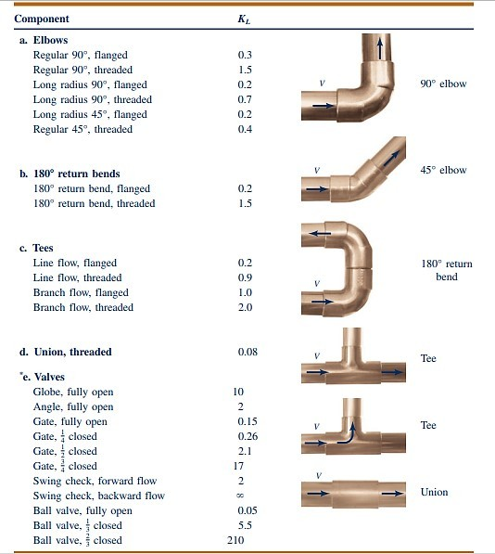

Slide 2
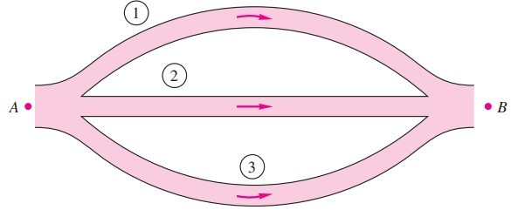
CHAPTER THREE
Pump and Piping Networks
Most piping systems encountered in practice such as the water distribution systems in cities or commercial or residential establishments involve numerous parallel and series connections as well as several sources (supply of fluid into the system) and loads (discharges of fluid from the system)
When the pipes are connected in series, the flow rate through the entire system remains constant regardless of the diameters of the individual pipes in the system. The total head loss in this case is equal to the sum of the head losses in individual pipes in the system, including the minor losses.
The expansion or contraction losses at connections are considered to belong to the smaller-diameter pipe since the expansion and contraction loss coefficients are defined on the basis of the average velocity in the smaller-diameter pipe.
For a pipe that branches out into two or more parallel pipes and then rejoins at a junction downstream, the total flow rate is the sum of the flow rates in the individual pipes. Pressure drops in each individual pipe connected in parallel must be the same since ΔP and the junction pressures PA & PB are the same for all the individual pipes.]
Pipes/Pumps in Series | Pipes/Pumps in Parallel
QA-B = Q1= Q2=Q3=…. = Constant | Qtotal= QA-B = Q1+Q2+Q3+….
Δhtotal= ΔhA-B = Δh1 + Δh2 + Δh3 + … | ΔhA-B = Δh1 = Δh2 = Δh3 =…..= Constant

Slide 3
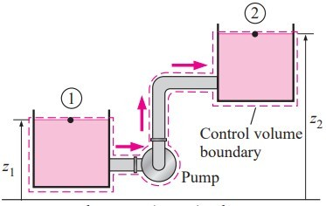
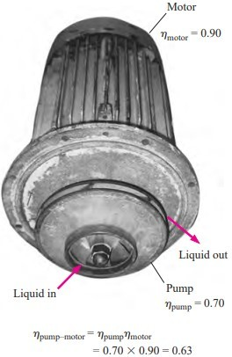
Piping Systems with Pumps and Turbines
When a piping system involves a pump and/or turbine, the steady-flow energy equation on a unit-mass basis can be expressed as
It can also be expressed in terms of heads as
Many practical piping systems involve a pump to move a fluid from one reservoir to another. Taking points 1 and 2 to be at the free surfaces of the reservoirs, the energy equation in this case reduces for the useful pump head required to
Once the useful pump head is known, the mechanical power that needs to be delivered by the pump to the fluid and the electric power consumed by the motor of the pump for a specified flow rate are determined from

Slide 4
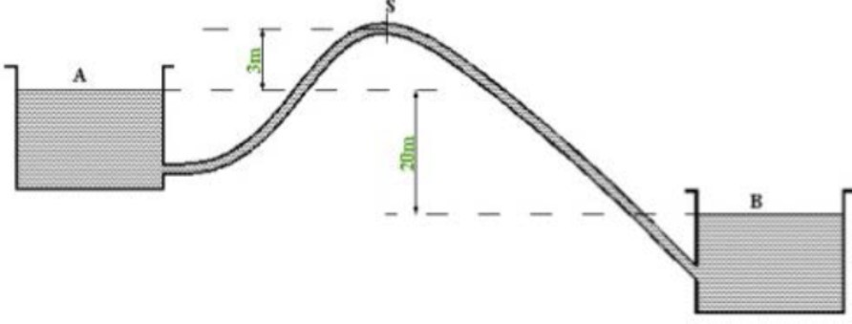
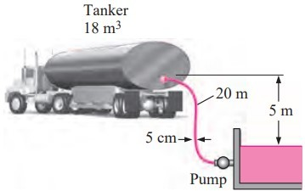
Ex 3-1: The following steel siphon (L=500 m, D=200 mm) connects two reservoirs with a constant elevation difference of 20 m. The distance between reservoir A and siphon summit S is 100 m. Assume f =0.020, calculate steady state flow rate between the two reservoirs and the pressure head at the summit S.
Ex 3-2: A vented tanker is to be filled with fuel oil (ρ=920 kg/m³ , μ=0.045 kg/m·s) from an underground reservoir using a 20m long, 5cm diameter plastic hose with a slightly rounded entrance and two 90° flanged smooth bends. The elevation difference between the oil level in the reservoir and the top of the tanker where the hose is discharged is 5 m. The capacity of the tanker is 18 m³ and the filling time is 30 min. Taking overall pump efficiency of 82%, determine the required power input to the pump (Neglecting the exit effect).
Ex 3-3: Both pipes shown have an equivalent sand roughness ɛ of 0.10mm and a discharge of 0.1 m³/s. D1 = 15 cm,L1 = 50 m, D2 = 30 cm, and L2 = 160m. Determine the difference in the water-surface elevation between the two reservoirs. (Neglecting inlet and exit effects).

Slide 5
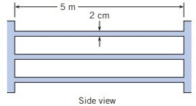
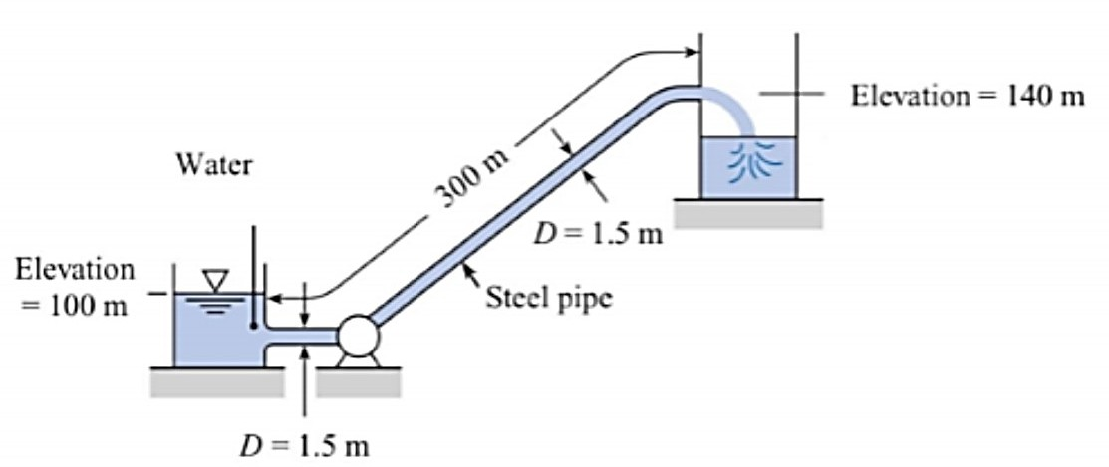
Ex 3-4: A shell-and-tube heat exchanger is being designed as a component of a geothermal power system in which heat is transferred from the
geothermal brine (saltwater) to a clean fluid. The heat exchanger consists of 100 galvanized-iron tubes 2cm in diameter and 5m long. The fluid temperature is 200⁰C, the density is 860kg/m³, and the viscosity is 1.35x10⁻⁴ N.s/m. The total mass flow rate through the exchanger is 50kg/s. Calculate the power required to operate the heat exchanger, neglecting entrance and outlet losses. After continued use, 2mm of scale develops on the inside surfaces of the tubes. This scale has an equivalent roughness of 0.5 mm. Calculate the power required under these conditions.
Ex 3-5: Two sharp ended pipes of diameter d1=50mm, and d2=100 mm, each of length L=100 m, are connected in parallel between two reservoirs which have a difference of level h=10 m. If the Darcy coefficient f=0.008 for each pipe, calculate:
(a) The rate of flow for each pipe, (b) the diameter D of a single pipe 100 m long that would give the same flow if it was substituted for the original two pipes.
Ex 3-6: Water is pumped at a rate of 25 m³/s from the reservoir and out through the steel pipe, which has a diameter of 1.5 m and well-rounded at the inlet as shown in the Figure. What power must be supplied to the water? (Ignore pipe exit loss,  =1.31×10⁻⁶ m²/s)

Slide 6
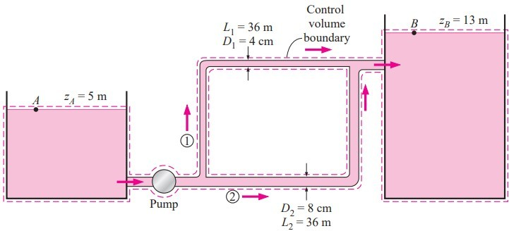
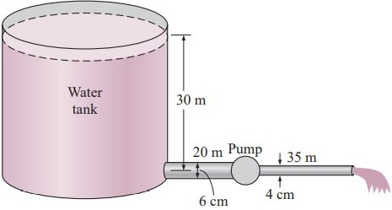
Ex 3-7: Water at 20oC is to be pumped from a reservoir (ZA = 5 m) to another reservoir at a higher elevation (ZB = 13m) through two 36 m long pipes connected in parallel. The pipes are made of commercial steel, and the diameters of the two pipes are 4 and 8 cm. Water is to be pumped by a 70 percent efficient motor–pump combination that draws 8 kW of electric power during operation. The minor losses and the head loss in that connect the parallel pipes to the two reservoirs are considered to be negligible. Determine the total flow rate between the reservoirs and the flow rate through each of the parallel pipes.
Ex 3-8: Water at 15°C is to be discharged from a reservoir at a rate of 18 L/s using two horizontal cast iron pipes connected in series and a pump between them. The first pipe is 20 m long and has a 6 cm diameter, while the second pipe is 35 m long and has a 4-cm diameter. The water level in the reservoir is 30 m above the centerline of the pipe. The pipe entrance is sharp-
edged, and losses associated with the connection
of the pump are negligible. Find the required pumping head and the minimum pumping power to maintain the indicated flow rate.
Ex 3-9: In the commercial steel parallel pipe system shown, pipe 1 has a length of 1000 m and diameter of 50 cm. Pipe 2 is 1500m long and 40cm in diameter. What is the division of the flow of water at 100ºC if the total
discharge is to be 1.2m³/s, and the two pipes have same friction factor.

