Slide 1
FLUID MECHANICS CHAPTER TWO PART THREE
HYDROSTATIC FORCES ON SUBMERGED PLANE SURFACES-EX 2
HYDROSTATIC FORCES ON INCLINED SUBMERGED PLANE SURFACES

Slide 2
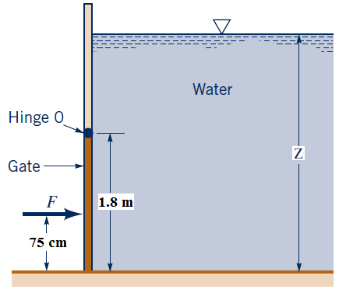
Ex 2:
A rectangular gate 1.8 m tall and 1.5 m wide in the side of an open tank is
held in place by the force F as indicated in Figure. The weight of the gate is negligible, and the hinge at O is frictionless. (a) Determine the water depth, z, if the resultant hydrostatic force of the water acts 75 cm above the bottom of the gate, i.e., it is collinear with the applied force F. (b) For the depth of part (a), determine the magnitude of the resultant hydrostatic force..
Solution:
Assumption:- P_{atm} = 0
z = 6.3 m and
s = 6.3 – 1.8 = 4.5 m
F_{R} = ρ g (s + b/2 ) × A
F_{R} = 1000 × 9.81 × (4.5+0.9 ) × (1.5 × 1.8) ≈ 143 kN

Slide 3
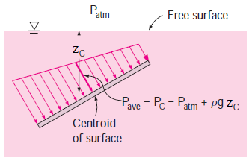
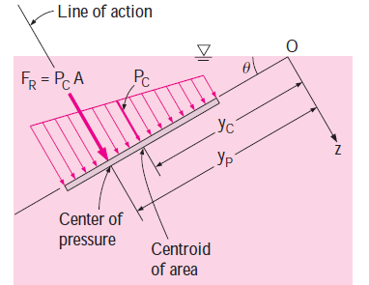
SUBMERGEDINCLINED PLANE SURFACES:
F_{R} = (P_{o} + ρg y_{C} sinθ )A = (Po + ρg z_{C})A

Slide 4
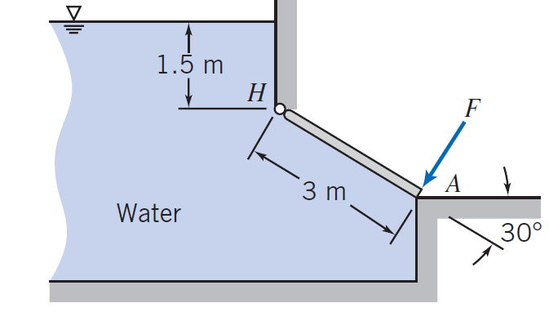
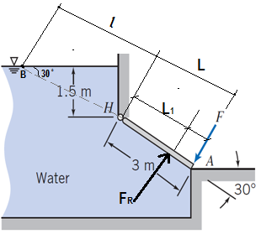
Ex 3:
The shown gate is hinged at H. The gate is 3 m wide normal to the plane of the diagram. Calculate the force required at A to hold the gate closed.
Solution:
sin 30 = 1.5 / l ➔ l = 3 m
F_{R} = ρ g (s + b/2 ) × A
F_{R} = 1000 × 9.81 × (3+ 1.5 ) × (3 × 3)
F_{R} ≈ 397 kN
y_{p}= 4.67 m = Center of Pressure or position of the F_{R}
from the water surface (Point B)
L₁ = position of the F_{R} from the gate pin H
L₁ = 4.67 – 3 = 1.67 m
Σ M_{H} =0
397 × 1.67 = F × 3
F ≈ 221 kN

Slide 5
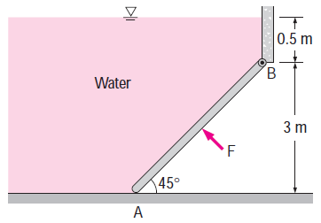
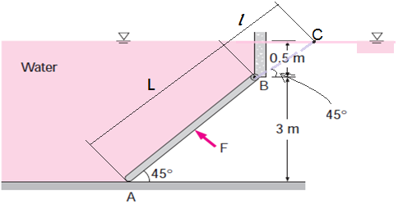
Ex 4:
A 5-m-wide rectangular gate shown in Figure, is hinged at B and leans against the floor at A making an angle of 45° with the horizontal. The gate is to be opened from its lower edge by applying a normal force at its center. Find the minimum force F required to open the water gate.
Solution:
sin 45 = 3 / L ➔ L = 4.243 m
F_{R} = ρ g (s + b/2 ) × A
F_{R} = 1000 × 9.81 × (0.5+ 1.5 ) × (5 × 4.243)
F_{R} ≈ 416 kN
sin 45 = 0.5 / l
l = 0.7071 m

Slide 6
y_{p}= 3.359 m

Slide 7
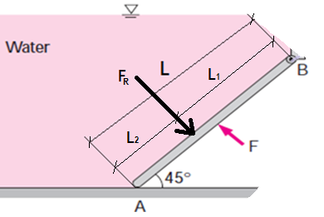
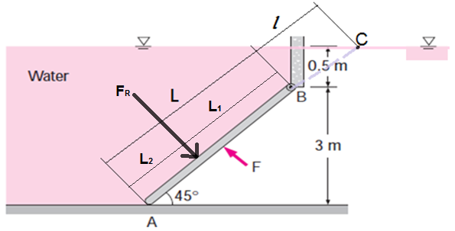
y_{p}= 3.359 m = Center of Pressure or position of the F_{R} from the water surface (Point C)
L₁ = position of the F_{R} from the gate pin B
L₁ = 3.359 – 0.7071 = 2.6519 m
Σ MB =0
416 × 2.6519 = F × (4.243/2)
F ≈ 520 kN

Slide 8
END OF THE SECOND PART

