Slide 1
Plant Responses

Slide 2
Animals often quickly respond to a stimulus with an appropriate behavior.
For example animals are apt to change their location.
Plants, which are rooted in one place, change their growth pattern in response to a stimulus.
The first step toward a response is reception of the stimulus.

Slide 3
The next step is transduction, meaning that the stimulus has been changed into form that meaningful to the organism.
Finally, a response is made by the organism.
In this lecture, we consider four plant responses: tropism, nastic movement, photoperiodism, and response to the biotic environment.

Slide 4
Tropism
Growth toward or away from a unidirectional stimulus is called tropism.
Unidirectional means that the stimulus is coming from only one direction instead of multiple directions.
Growth toward a stimulus is called a positive tropism.
Growth away from a stimulus is called a negative tropism.

Slide 5
Tropisms are due to differential growth-one side of an organ elongates faster than the other, and the result is curving toward or away from the stimulus.
A number of tropism have been observed in plants.
The three best-known tropisms are gravitropism (gravity), phototropism (light), and thigmotropism (touch).

Slide 6
Gravitropism
When an upright plant is placed on its side, the stem displays negative gravitropism because it grows upward, opposite the pull of gravity.
Root cap cells contain sensors called statoliths, which are starch grains located within amyloplasts, a type of plastid.
Under the influence of gravity, the amyloplasts settle to a lower part of the cell.

Slide 7
Gravitropism
How amyloplasts affect auxin levels is uncertain, but some change in auxin distribution appears to take place.
Stems and roots may respond differently to auxin, such that the cells on the upper surface of a root elongate so that the root curves downward, and cells on the lower surface of a stem elongate, so that the stem curves upwards.

Slide 8
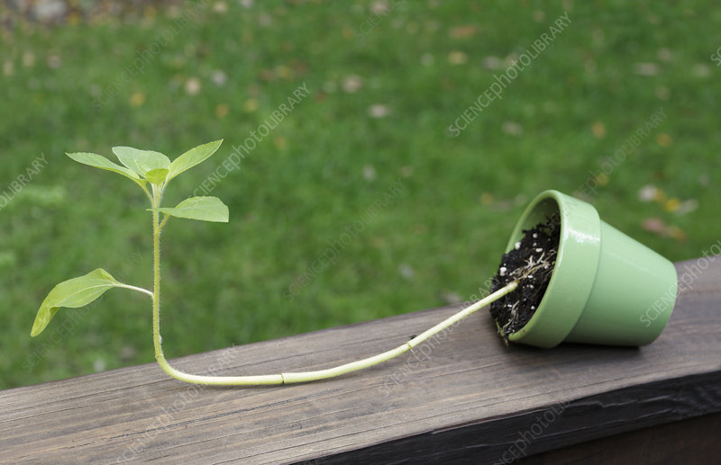

Slide 9
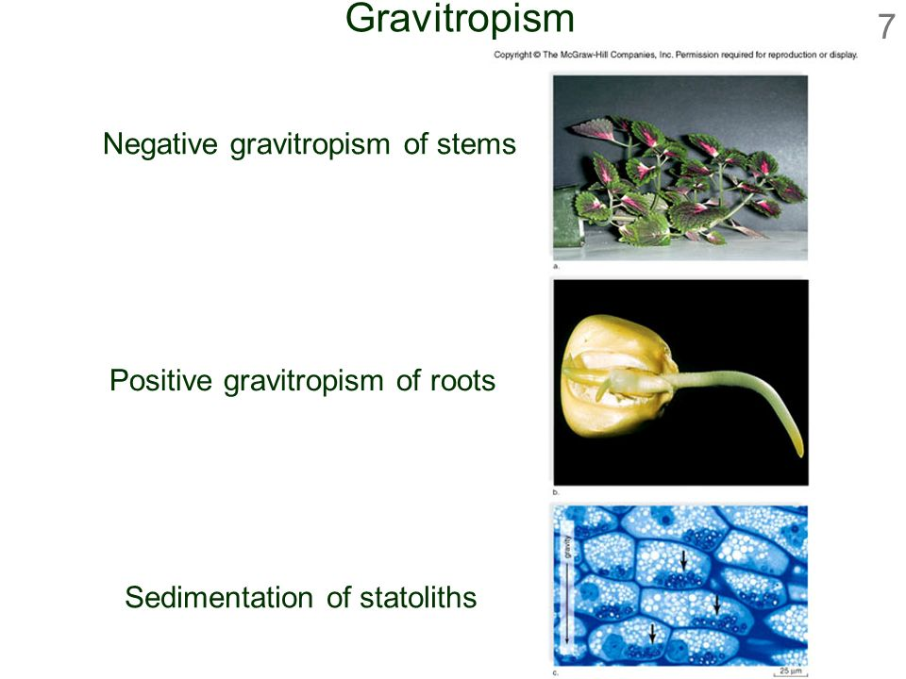

Slide 10
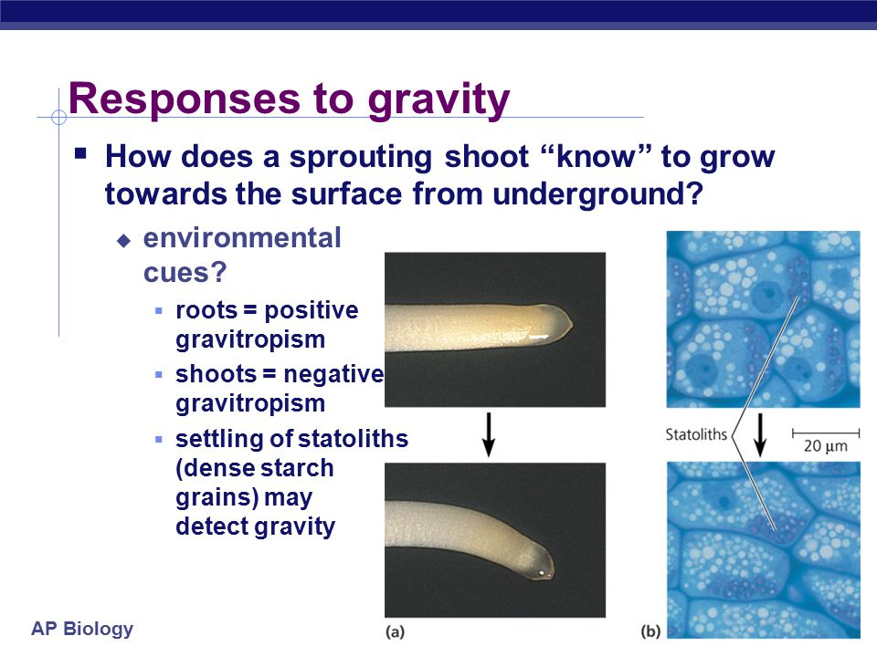

Slide 11
Phototropism
As also discussed previously, positive phototropism of stems occurs because the cells on the shady side of the stem elongate due to the presence of auxin.
Botanists now know that phototropism occurs because plants respond to blue light.
When blue light is absorbed, the pigment portion of a photoreceptor, called phototropin, undergoes a conformation change.

Slide 12
Phototropism
This change result in the transfer of a phosphate group from ATP to a protein portion of the photoreceptor.
The phosphorylated photoreceptor triggers a transduction pathway that, in some unknown way, leads to the entry of auxin into the cell.

Slide 13
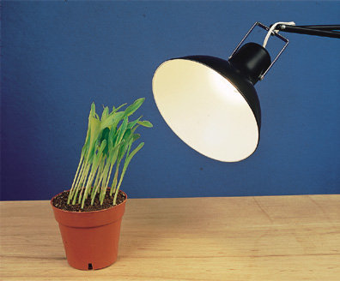

Slide 14
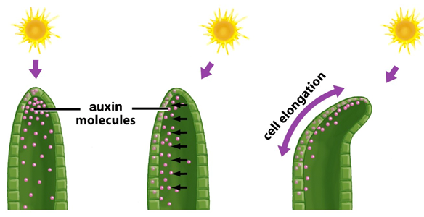

Slide 15
Thigmotropism
Unequal growth due to contact with solid objects is called thigmotropism.
An example of this response is the coiling of tendrils or the stems of plants, such as the stems of pea and morning glory plants.
A flowering plant grows straight until it touches something.
Then the cells in contact with an object, such as a pole, grow less while those on the opposite side elongate.

Slide 16
Thigmotropism
Thigmotropism can be quite rapid; tendrils have been observed to encircle an object within 10 minutes.
The response isn’t always immediate-tendrils touched in the dark will respond once they are illuminated.
ATP rather than light initiates the response.
It is possible that auxin and ethylene play a role in the process since they are capable of inducing curvature of tendrils even in the absence of touch.

Slide 17
