Slide 1
Bayesian Theorem
Aviation Engineering-Salahaddin University
Lect. Assistant
Maikey Zaki

Slide 2
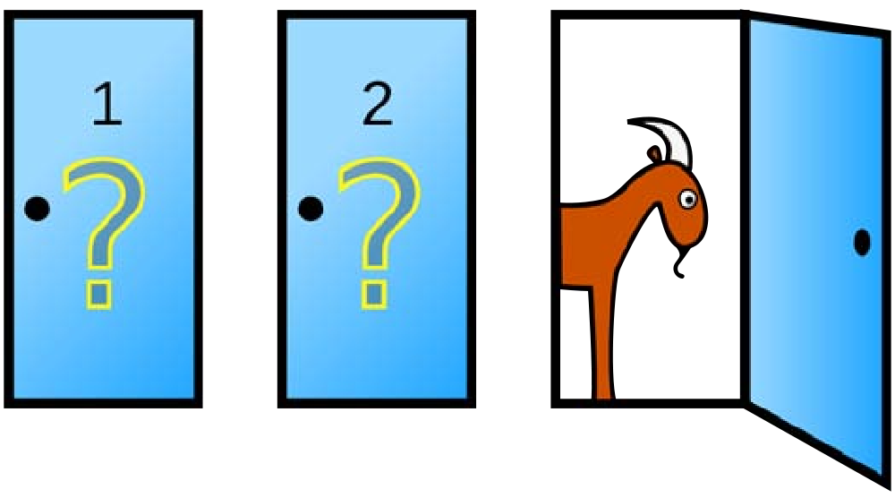
Conditional Probability, Independence, Bayes’ Theorem
18.05 Spring 2014
January 1, 2017 2 / 23

Slide 3
Sample Space Confusions
Sample space = set of all possible outcomes of an experiment.
The size of the set is NOT the sample space.
Outcomes can be sequences of numbers.
Examples.
Roll 5 dice: Ω = set of all sequences of 5 numbers between 1 and 6, e.g. (1, 2, 1, 3, 1, 5) ∈ Ω.
The size |Ω| = 6⁵ is not a set.
Ω = set of all sequences of 10 birthdays,
e.g. (111, 231, 3, 44, 55, 129, 345, 14, 24, 14) ∈ Ω.
|Ω| = 365
10
3. n some number, Ω = set of all sequences of n birthdays.
|Ω| = 365^{n} .
January 1, 2017 3 / 23

Slide 4
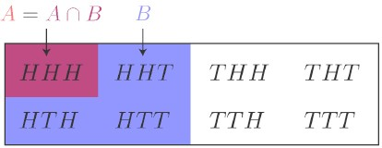
Conditional Probability
‘the probability of A given B ’.
P(A ∩ B)
P (B )
P (A|B ) =
, provided P (B ) =/ 0.
B
A
A ∩ B
Conditional probability: Abstractly and for coin example
January 1, 2017 4 / 23

Slide 5
Table/Concept Question
(Work with your tablemates, then everyone click in the answer.)
Toss a coin 4 times. Let A = ‘at least three heads’ B = ‘ﬁrst toss is tails’.
1. What is P (A|B )? (a) 1/16 (b) 1/8
(c) 1/4
(d) 1/5
2. What is P (B |A)?
(a) 1/16 (b) 1/8 (c) 1/4 (d) 1/5
January 1, 2017 5 / 23

Slide 6
Table Question
“Steve is very shy and withdrawn, invariably helpful, but with little interest in people, or in the world of reality. A meek and tidy soul, he has a need for order and structure and a passion for detail.”∗
What is the probability that Steve is a librarian? What is the probability that Steve is a farmer?
∗From Judgment under uncertainty: heuristics and biases by Tversky and Kahneman.
January 1, 2017 6 / 23

Slide 7
Multiplication Rule, Law of Total Probability Multiplication rule: P (A ∩ B ) = P (A|B ) · P (B ).
Law of total probability: If B₁, B₂, B₃ partition Ω then
P (A) = P (A ∩ B₁) + P (A ∩ B₂) + P (A ∩ B₃)
= P (A|B₁)P (B₁) + P (A|B₂)P (B₂) + P (A|B₃)P (B₃)
Ω
B₁
A ∩ B₁
A ∩ B2 A ∩ B₃
B₂
B₃
January 1, 2017 7 / 23

Slide 8
Trees
Organize computations Compute total probability Compute Bayes’ formula
Example. : Game: 5 red and 2 green balls in an urn. A random ball is selected and replaced by a ball of the other color; then a second ball is drawn.
What is the probability the second ball is red?
What is the probability the ﬁrst ball was red given the second ball was red?
5/7 2/7
First draw
R₁ G₁
4/7 3/7 6/7 1/7
R₂ G₂ R₂ G₂
Second draw
January 1, 2017 8 / 23

Slide 9
Concept Question: Trees 1
x
A₁
y
A₂
B₁
_{z} B₂
B₁
B₂
C₁
C₂
C₁
C₂
C₁
C₂
C₁
C₂
1. The probability x represents
P (A₁)
P (A₁|B₂)
P (B₂|A₁)
(d) P (C₁|B₂ ∩ A₁).
January 1, 2017 9 / 23

Slide 10
Concept Question: Trees 2
x
A₁
y
A₂
B₁
_{z} B₂
B₁
B₂
C₁
C₂
C₁
C₂
C₁
C₂
C₁
C₂
2. The probability y represents
P (B₂)
P (A₁|B₂)
P (B₂|A₁)
(d) P (C₁|B₂ ∩ A₁).

Slide 11
Concept Question: Trees 3
x
A₁
y
A₂
B₁
_{z} B₂
B₁
B₂
C₁
C₂
C₁
C₂
C₁
C₂
C₁
C₂
3. The probability z represents
P (C₁)
P (B₂|C₁)
P (C₁|B₂)
(d) P (C₁|B₂ ∩ A₁).

Slide 12
Concept Question: Trees 4
x
A₁
y
A₂
B₁
_{z} B₂
B₁
B₂
C₁
C₂
C₁
C₂
C₁
C₂
C₁
C₂
4. The circled node represents the event
C₁
B₂ ∩ C₁
A₁ ∩ B₂ ∩ C₁
(d) C₁|B₂ ∩ A₁.

Slide 13
Let’s Make a Deal with Monty Hall
One door hides a car, two hide goats. The contestant chooses any door.
Monty always opens a diﬀerent door with a goat. (He can do this because he knows where the car is.)
The contestant is then allowed to switch doors if she wants.
What is the best strategy for winning a car?
(a) Switch (b) Don’t switch (c) It doesn’t matter

Slide 14
Board question: Monty Hall
Organize the Monty Hall problem into a tree and compute the probability of winning if you always switch.
Hint ﬁrst break the game into a sequence of actions.

Slide 15
Independence
Events A and B are independent if the probability that one occurred is not aﬀected by knowledge that the other occurred.
Independence ⇔ P (A|B ) = P (A)
⇔ P (B |A) = P (B )
(For any A and B )
(provided P (B ) =/ 0) (provided P (A) /= 0)
⇔ P (A ∩ B ) = P (A)P (B )

Slide 16
Table/Concept Question: Independence
(Work with your tablemates, then everyone click in the answer.)
Roll two dice and consider the following events
A = ‘ﬁrst die is 3’
B = ‘sum is 6’
C = ‘sum is 7’
A is independent of
(a) B and C
(c) C alone
(b) B alone
(d) Neither B or C .

Slide 17
Bayes’ Theorem
Also called Bayes’ Rule and Bayes’ Formula.
Allows you to ﬁnd P (A|B ) from P (B |A), i.e. to ‘invert’ conditional probabilities.
P(B|A) · P(A)
P (A|B ) =
P (B )
Often compute the denominator P (B ) using the law of total probability.

Slide 18
Board Question: Evil Squirrels
Of the one million squirrels on MIT’s campus most are good-natured. But one hundred of them are pure evil! An enterprising student in Course 6 develops an “Evil Squirrel Alarm” which she oﬀers to sell to MIT for a passing grade. MIT decides to test the reliability of the alarm by conducting trials.

Slide 19
Evil Squirrels Continued
When presented with an evil squirrel, the alarm goes oﬀ 99% of the time.
When presented with a good-natured squirrel, the alarm goes oﬀ 1% of the time.
If a squirrel sets oﬀ the alarm, what is the probability that it is evil?
Should MIT co-opt the patent rights and employ the system?

Slide 20
One solution
(This is a base rate fallacy problem)
We are given:
P(nice) = 0.9999, P(evil) = 0.0001 (base rate)
P(alarm | nice) = 0.01, P(alarm | evil) = 0.99
P(alarm | evil)P(evil)
P(evil | alarm) =
P(alarm)
P(alarm | evil)P(evil)
=
P(alarm | evil)P (evil) + P(alarm | nice)P(nice)
(0.99)(0.0001)
=
(0.99)(0.0001) + (0.01)(0.9999)
≈ 0.01

Slide 21
Squirrels continued Summary:
Probability a random test is correct | = | 0.99
Probability a positive test is correct These probabilities are not the same! | ≈ | 0.01
Alternative method of calculation:
 | Evil | Nice
Alarm | 99 | 9999 | 10098
No alarm | 1 | 989901 | 989902
 | 100 | 999900 | 1000000

Slide 22
Washington Post, hot oﬀ the press
Annual physical exam is probably unnecessary if you’re generally healthy
For patients, the negatives include time away from work and possibly unnecessary tests. “Getting a simple urinalysis could lead to a false positive, which could trigger a cascade of even more tests, only to discover in the end that you had nothing wrong with you.” Mehrotra says.
http://www.washingtonpost.com/national/health-science/
annual-physical-exam-is-probably-unnecessary-if-youre-generall 2013/02/08/2c1e326a-5f2b-11e2-a389-ee565c81c565_story.html

Slide 23
Table Question: Dice Game
The Randomizer holds the 6-sided die in one ﬁst and the 8-sided die in the other.
The Roller selects one of the Randomizer’s ﬁsts and covertly takes the die.
The Roller rolls the die in secret and reports the result to the table.
1
2
3
Given the reported number, what is the probability that the 6-sided die was chosen? (Find the probability for each possible reported number.)

Slide 24
18.05 Introduction to Probability and Statistics
Spring 2014
MIT OpenCourseWare https://ocw.mit.edu
For information about citing these materials or our Terms of Use, visit: https://ocw.mit.edu/terms .

