Slide 1
Google Collab
Aviation Engineering-Salahaddin University
Lect. Assistant
Maikey Zaki

Slide 2
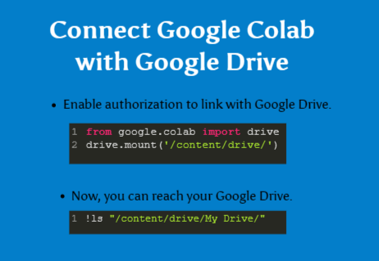

Slide 4
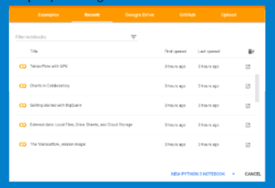

Slide 5
The End

