Slide 1
Python Programming with Google Colab
Lect. Assistant
Maikey Zaki
Aviation Engineering-Salahaddin University

Slide 2
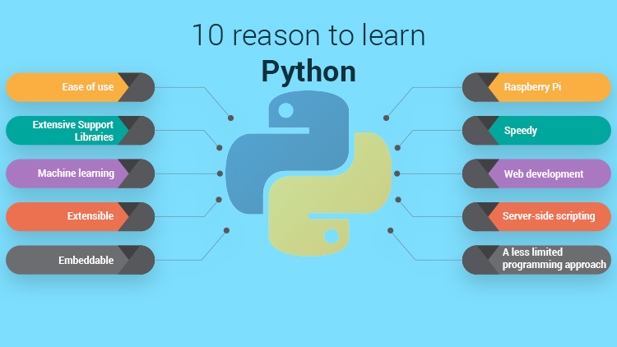
Why Python

Slide 3
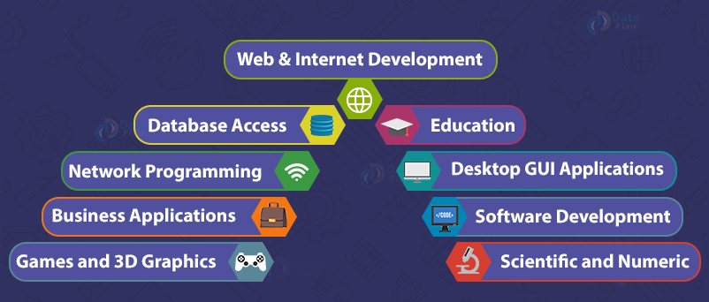
Python Applications

Slide 4
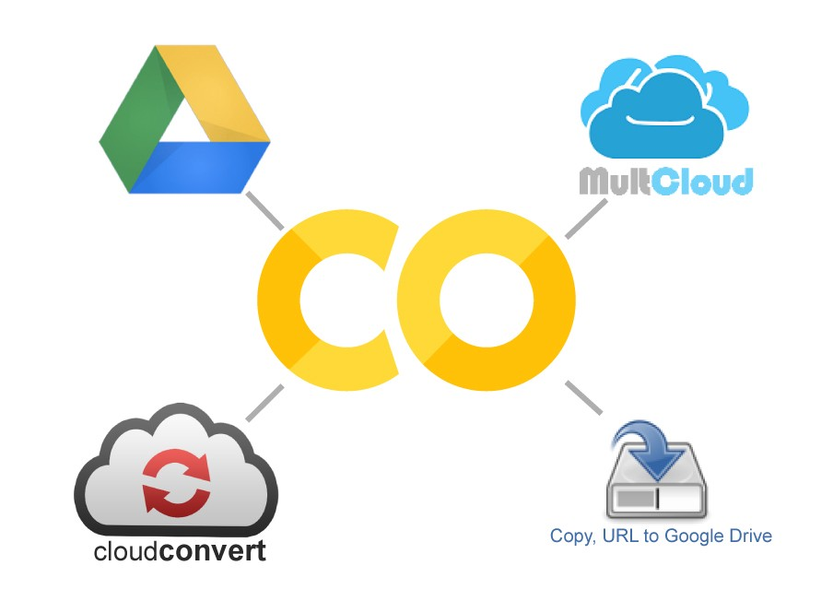
Google Colab

Slide 5
Why Google Colab
Google Colab comes with collaboration backed in the product.
It also runs on Google servers
Don’t need to install anything
Notebooks are saved to your Google Drive account
Google Colab recently added support for Tensor Processing Unit ( TPU ) apart from its existing GPU and CPU instances. So, it’s a big deal for all deep learning people

Slide 6
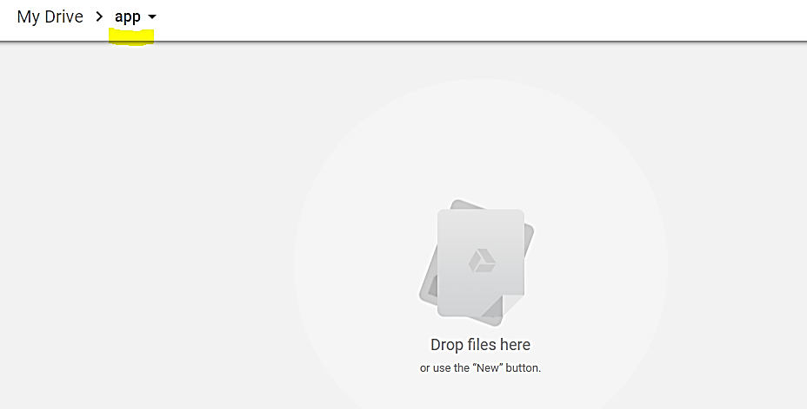
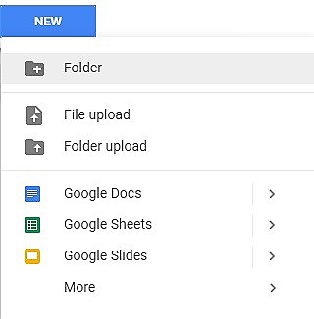
Creating Folder on Google Drive

Slide 7
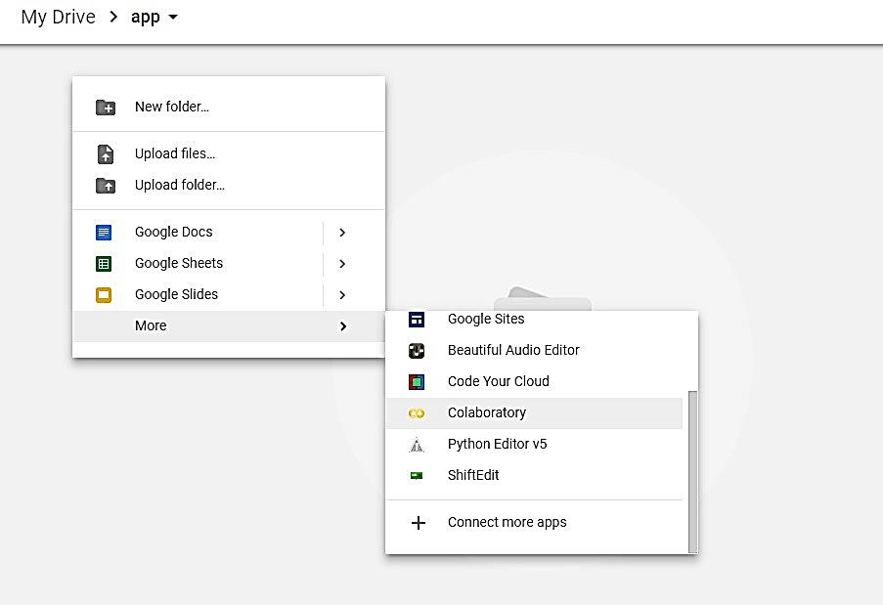
Creating New Colab Notebook
Create a new notebook via Right click > More > Colaboratory

Slide 8
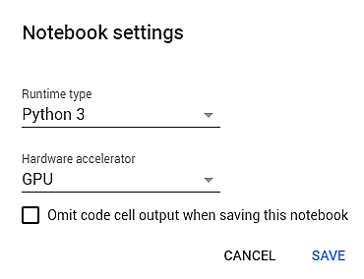
Notebook Settings
Edit > Notebook settings or Runtime>Change runtime type and select GPU as Hardware accelerator

Slide 9
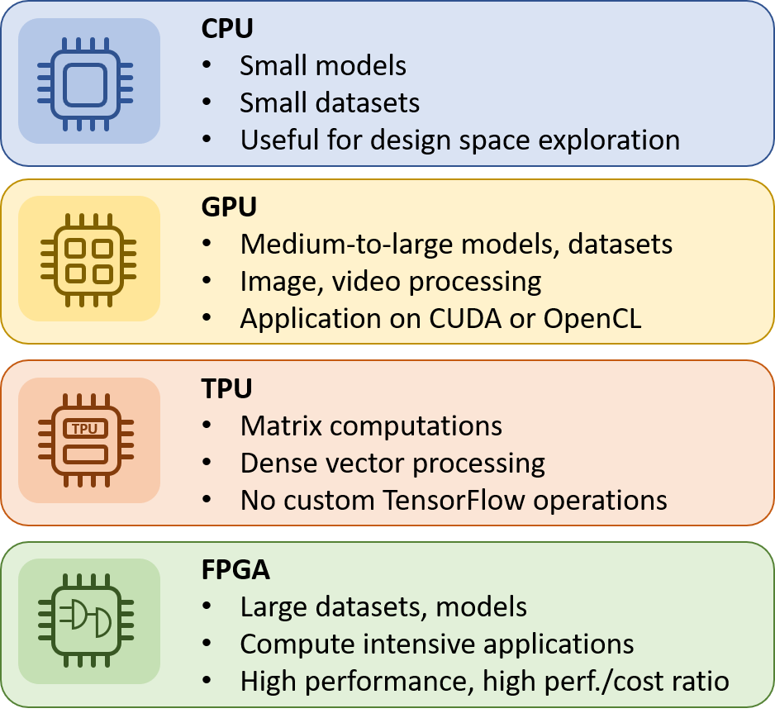
Hardware accelerator

Slide 10
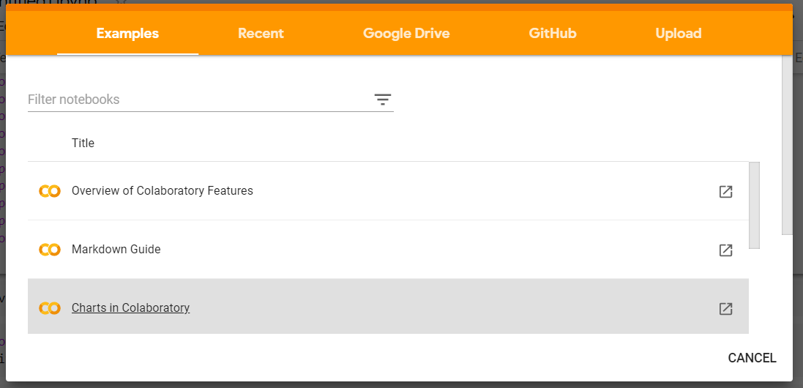
Open python notebook in different ways

Slide 11
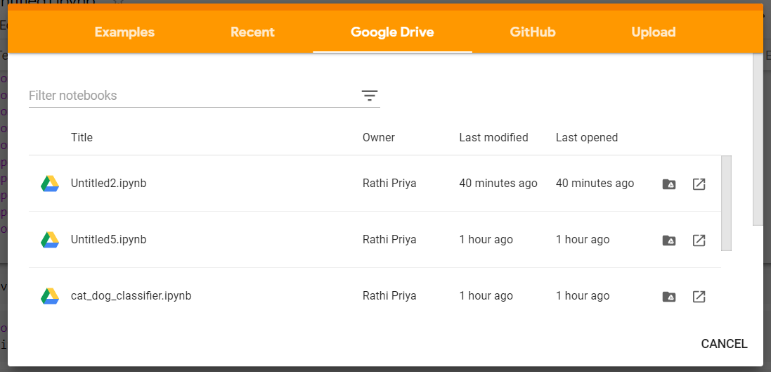
Google Drive

Slide 12
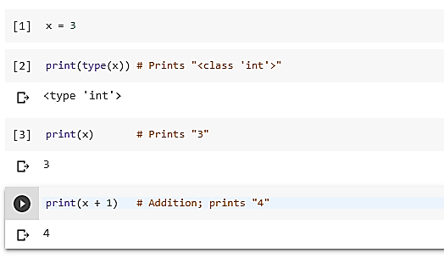
Running Basic Python Codes with Google Colab

Slide 13
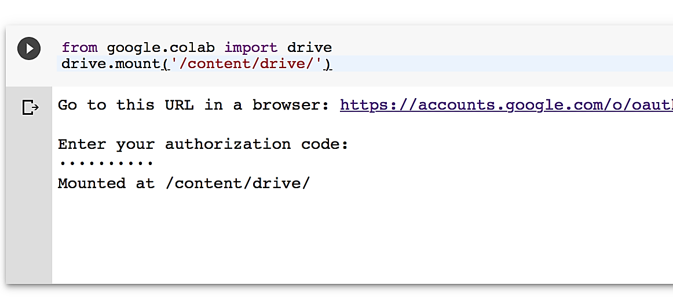
Running or Importing .py Files with Google Colab

Slide 14
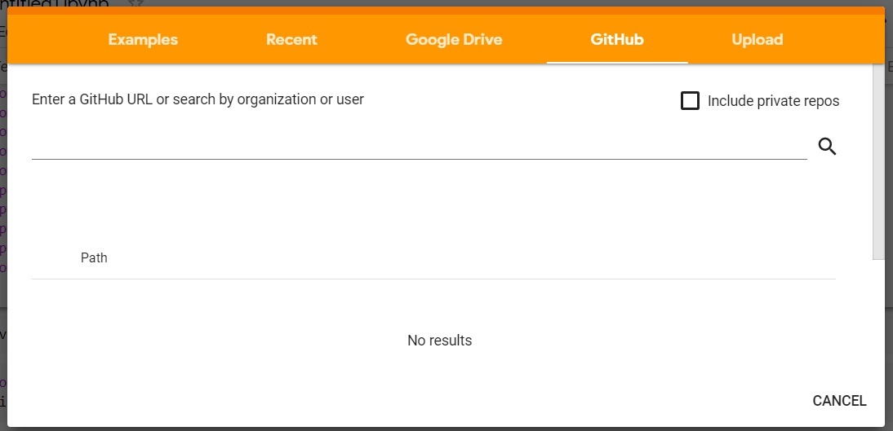
Clone GitHub repos

Slide 15
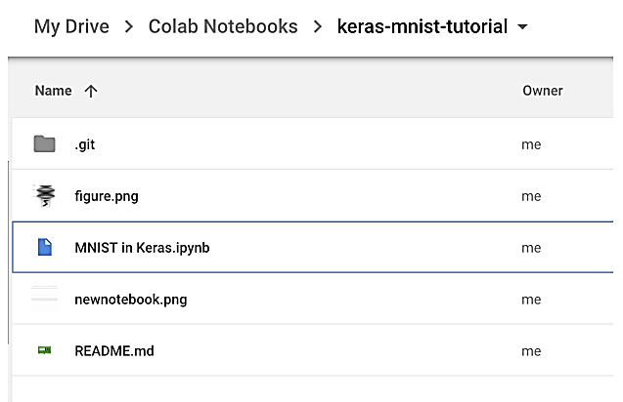
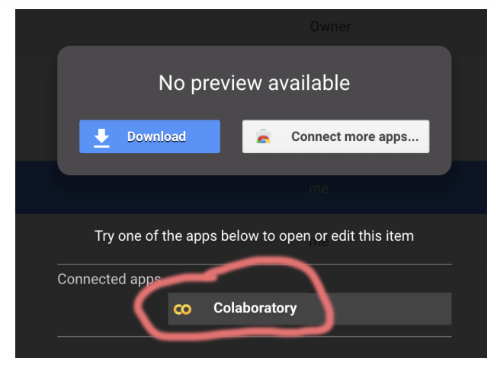
GitHub Repo

Slide 16
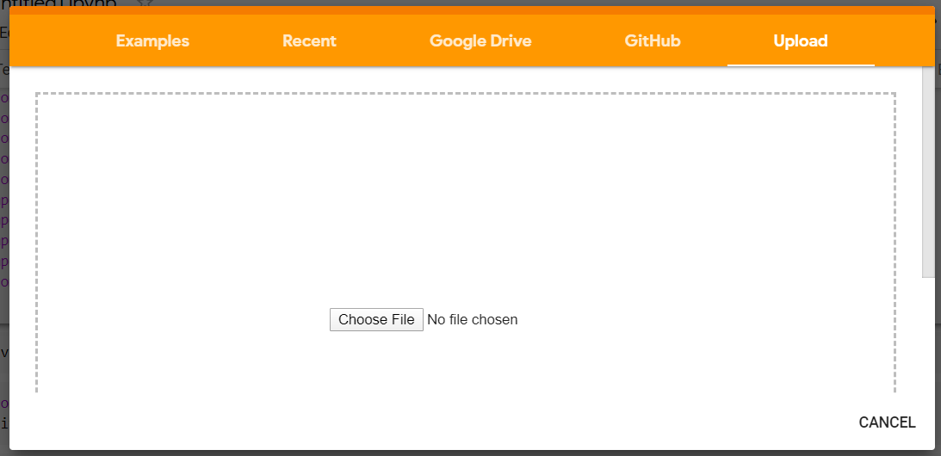
Upload Python Code

Slide 17
Thank you

