Slide 1
Principles Accounting in English 2
PRINCIPLES OF ACCOUNTING
CHAPTER ONE
(Adjusting the Accounts)
ACCOUNTING DEPATMENT
2022-2023
Adjusting the Accounts
| P a g e - 1 -

Slide 2
PRINCIPLES OF ACCOUNTING
TIMING ISSUES
We would need no adjustments if we could wait to prepare financial statements until a company ended its operations. At that point, we could easily determine its final balance sheet and the amount of lifetime income it earned.
However, all companies find it desirable to report the results of their activities on a frequent basis. For example, management usually wants monthly financial statements. Therefore, accountants divide the economic life of a business into artificial time periods. This convenient assumption is referred to as the time period assumption.
Fiscal and Calendar Years
Both small and large companies prepare financial statements periodically in order to assess their financial condition and results of operations. Accounting time periods are generally a month, a quarter, or a year. Monthly and quarterly time periods are called interim periods. Most large companies must prepare both quarterly and annual financial statements.
An accounting time period that is one year in length is a fiscal year. A fiscal year usually begins with the first day of a month and ends twelve months later on the last day of a month. Most businesses use the calendar year (January 1 to December 31) as their accounting period. Some do not. Companies whose fiscal year differs from the calendar year include Delta Air Lines, June 30, and Walt Disney Productions, September 30. Sometimes a company’s year-end will vary from year to year. For example, PepsiCo’s fiscal year ends on the Friday closest to December 31, which was December 30 in 2006 and December 29 in2007.
Accrual- vs. Cash-Basis Accounting
What you will learn in this chapter is accrual-basis accounting. Under the accrual basis, companies record transactions that change a company’s financial statements in the periods in which the events occur. For example, using the accrual basis to determine net income means companies recognize revenues when earned (rather than when they receive cash). It also means recognizing expenses when incurred (rather than when paid).
An alternative to the accrual basis is the cash basis. Under cash-basis accounting, companies record revenue when they receive cash. They record an expense when they pay out cash.The cash basis seems appealing due to its simplicity, but it often produces misleading financial statements. It fails to record revenue that a company has earned but for which it has not received the cash. Also, it does not match expenses with earned revenues. Cash-basis accounting is not in accordance with generally accepted accounting principles (GAAP).
Individuals and some small companies do use cash-basis accounting. The cash basis is justified for small businesses because they often have few receivables and payables. Medium and large companies use accrual-basis accounting.
REVENUE RECOGNITION PRINCIPLE
The revenue recognition principle dictates that companies recognize revenue in the accounting period in which it is earned. In a service enterprise, revenue is considered to be earned at the time the service is performed. To illustrate, assume that Dave’s Dry Cleaning cleans clothing on June 30 but customers do not claim and pay for their clothes until the first week of July. Under the revenue recognition principle, Dave’s earns revenue in June when it performed the service, rather than in July when it received the cash. At June 30, Dave’s would report a receivable on its balance sheet and revenue in its income statement for the service performed.
MATCHING PRINCIPLE
| P a g e - 1 -

Slide 3
PRINCIPLES OF ACCOUNTING
Accountants follow a simple rule in recognizing expenses: “Let the expenses follow the revenues.”
That is, expense recognition is tied to revenue recognition. In the dry-cleaning example, this principle means that Dave’s should report the salary expense incurred in performing the June 30 cleaning service in the income statement for the same period in which it recognizes the service revenue. The critical issue in expense recognition is when the expense makes its contribution to revenue. This may or may not be the same period in which the expense is paid. If Dave’s does not
pay the salary incurred on June 30 until July, it would report salaries payable on its June 30 balance sheet.
THE BASICS OF ADJUSTING ENTRIES
The trial balance—the first summarization of the transaction data—may not contain up-to-date and complete data. This is true for several reasons:
Some events are not recorded daily because it is not efficient to do so. For example, companies do not record the daily use of supplies or the earning of wages by employees.
Some costs are not recorded during the accounting period because they expire with the passage of time rather than as a result of daily transactions. Examples are rent, insurance, and charges related to
the use of equipment.
Some items may be unrecorded. An example is a utility bill that the company will not receive until the next accounting period.
A company must make adjusting entries every time it prepares financial statements.
Types of Adjusting Entries
Deferrals
Prepaid Expenses. Expenses paid in cash and recorded as assets before they are used or consumed.
Unearned Revenues. Cash received and recorded as liabilities before revenue is earned.
Accruals
Accrued Revenues. Revenues earned but not yet received in cash or recorded.
Accrued Expenses. Expenses incurred but not yet paid in cash or recorded.
Deferrals
| P a g e - 3 -

Slide 4
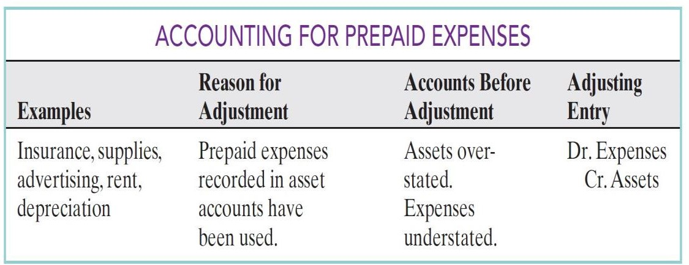
PRINCIPLES OF ACCOUNTING
1. Prepaid Expenses:
Example
/ Ahmad Company purchased supplies costing $2,500 on October recorded
that transaction by increasing (debiting) the asset Supplies. This account shows a balance of $2,500 in the October 31 trial balance. An inventory count at the close of
*business on October 31 reveals that $1,000 of supplies are still on hand. Thus, the
cost of supplies used is $1,500 ($2,500 - $1,000). Ahmad Company makes the following adjusting entry.
Supplies Expense 1,500
Supplies 1,500 (To record supplies used)
If Ahmad company does not make the adjusting entry, October expenses will be understated
and net income overstated by $1,500. Also, both assets and owner’s equity will be overstated by
$1,500 on the October 31 balance sheet.
Example
/ On October 4, Ahmad company paid $600 for a one-year fire insurance
policy. Coverage began on October 1. Ahmad company recorded the payment by increasing (debiting) Prepaid Insurance. This account shows a balance of $600 in the October 31 trial balance. Insurance of $50 ($600 / 12) expires each month. Thus, Ahmad company makes the following adjusting entry.
Insurance Expense 50
Prepaid Insurance 50 (To record insurance expired)
If Ahmad company does not make this adjustment, October expenses will be understated and
net income overstated by $50. Also, both assets and owner’s equity will be overstated by $50 on the October 31 balance sheet.
Example
/ Ahmad Company purchased office equipment amount of 5000$ estimates
depreciation on the office equipment to be $480 a year, or $40 per month. Thus, Ahmad Company makes the following adjusting entry to record depreciation for October.
Depreciation Expense 40
Accumulated Depreciation-Office Equipment 40 (To record monthly depreciation)
Deferrals
| P a g e - 3 -

Slide 5
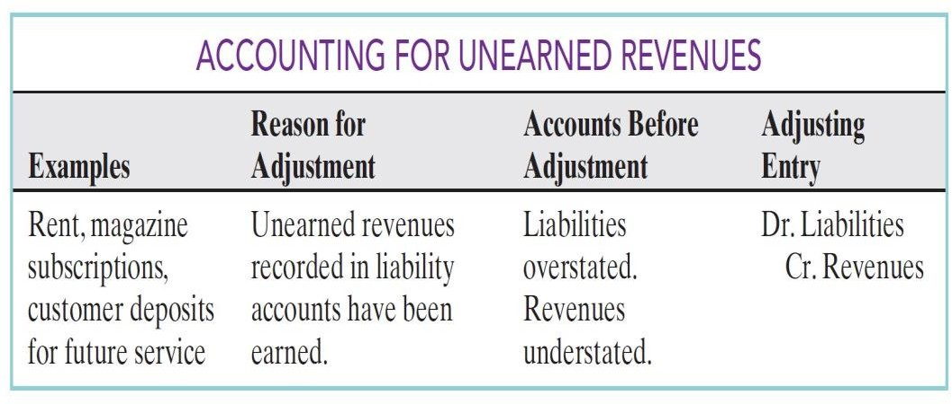
PRINCIPLES OF ACCOUNTING
2. Unearned Revenues
Example
/ Ahmad Company received $1,200 on October 2 from Hallo Company
services expected to be completed by December 31. Ahmad Company credited the payment to Unearned Service Revenue; this account shows a balance of $1,200 in the October 31 trial balance. Analysis reveals that the company earned $400 of those fees in October. Thus, it makes the following adjusting entry.
Unearned Revenue 400
Service Revenue 400 (To record revenue for services provided)
Without this adjustment, revenues and net income are understated by $400 in the income
statement. Also, liabilities are overstated an owner’s equity understated by $400 on the October 31 balance sheet.
Accruals
1. Accrued Revenues
Example
/ In October Ahmad Company earned $200 for services that have not been
recorded. Ahmad Company makes the following adjusting entry on October 31.
Accounts Receivable 200
Service Revenue 200 (To record revenue for services provided)
Without the adjusting entry, assets and owner’s equity on the balance sheet, and revenues and
net income on the income statement, are understated.
Accruals

Slide 6
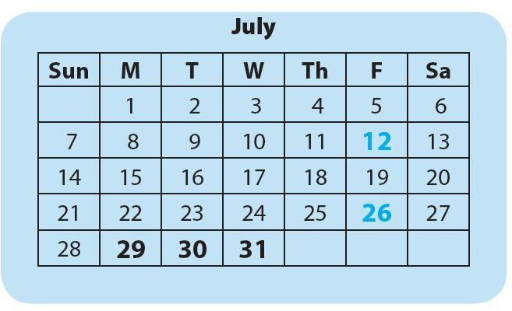
PRINCIPLES OF ACCOUNTING
2. Accrued Expenses
Example
/(Accrued Interest) / Ahmad Company signed a $5,000, 3-month note
payable on October 1.The note requires Ahmad Company to pay interest at an annual rate of 12%.
Three factors determine the amount of interest accumulation:
(1) the face value of the note,
b(2) the interest rate, which is always expressed as an annual rate,
(3) the length of time the note is outstanding.
For Ahmad Company , the total interest due on the note at its due date is $150 ($5,000 face value 12% interest rate 3/12 time period). The interest is thus $50 per month. Illustration shows the formula for computing interest and its application to for Ahmad Company the month of October. Note that the time period is expressed as a fraction of a year.
Oct. 31
Interest Expense 50
Interest Payable 50
(To record interest on notes payable)
Without this adjusting entry, liabilities and interest expense are understated, and net income and owner’s equity are overstated.
Example/ (Accrued wages & Salaries) / Ahmad Company has two pay periods a month rather than one. In July, its pay periods end on the 12th and the 26th, as indicatedn in the calendar below.
The wage rate is $2,400 every two weeks, or $240 per day ($2,400 / 10 working days), the expense is $720 ($240 X 3 days). On July 31, Ahmad record the $720 accrual of unrecorded wages.
July 31
Wages Expense 720
Wages Payable 720
Without the $720 adjustment for Wages, Ahmad Company ’s expenses are understated $720, and its liabilities are understated $720.

Slide 7
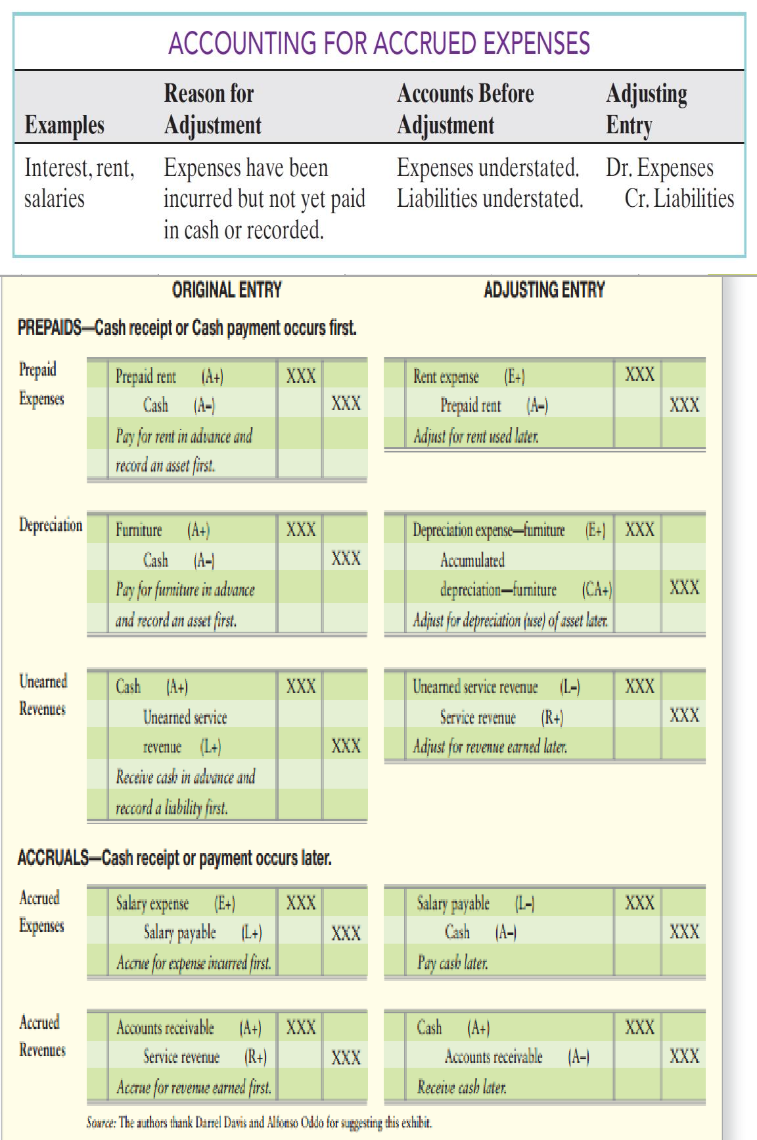
PRINCIPLES OF ACCOUNTING
Example 1
Amin Company encounters the following situations:
Amin Company collects $1,000 from a customer in 2010 for services to be performed in 2011.
Amin Company incurs utility expense which is not yet paid in cash or recorded.
Amin Company’s employees worked 3 days in 2010, but will not be paid until 2011.
Amin Company earned service revenue but has not yet received cash or
recorded the transaction.
Amin Company paid $2,000 rent on December 1 for the 4 months starting December 1.
Amin Company received cash for future services and recorded a liability until
the revenue was earned.

Slide 8
PRINCIPLES OF ACCOUNTING
Amin Company performed consulting services for a client in December 2010. On December 31, it billed the client $1,200.
Amin Company paid cash for an expense and recorded an asset until the item
was used up.
Amin Company purchased $900 of supplies in 2010; at year-end, $400 of supplies remain unused.
Amin Company purchased equipment on January 1, 2010; the equipment will
be used for 5 years.
Amin Company borrowed $10,000 on October 1, 2010, signing an 8% one-year note payable.
Instructions (Requirement)
Identify what type of adjusting entry (prepaid expense, unearned revenue, accrued expense, accrued revenue) is needed in each situation, at December 31, 2010.
Example 2
Erbil Company has the following balances in selected accounts on December 31, 2010.
Accounts Receivable
Accumulated Depreciation—Equipment
Equipment
Interest Payable
Notes Payable
Prepaid Insurance
Salaries Payable
Supplies
Unearned Consulting Revenue
$ -0-
-0-
7,000
-0-
10,000
2,100
-0-
2,450
40,000
All the accounts have normal balances. The information below has been gathered at December 31, 2010.
Erbil Company borrowed $10,000 by signing a 12%, one-year note on September 1, 2010.
A count of supplies on December 31, 2010, indicates that supplies of $800 are
on hand.
Depreciation on the equipment for 2010 is $1,000.
Erbil Company paid $2,100 for 12 months of insurance coverage on June 1, 2010.
On December 1, 2010,Erbil Company collected $40,000 for consulting services
to be performed from December 1, 2010,through March 31, 2011.
Erbil Company performed consulting services for a client in December 2010.The client will be billed $4,200.
Erbil Company pays its employees total salaries of $9,000 every Monday for
the preceding 5-day week (Monday through Friday). On Monday, December 29,employees were paid for the week ending December 26. All employees worked the last 3 days of 2010.

Slide 9
PRINCIPLES OF ACCOUNTING
Instructions (Requirement)
Prepare adjusting entries for the seven items described above.
Example 3
Awat Company accumulates the following adjustment data at December 31.
Services provided but not recorded total $750.
Store supplies of $300 have been used.
Utility expenses of $225 are unpaid.
Unearned revenue of $260 has been earned.
Salaries of $900 are unpaid.
Prepaid insurance totaling $350 has expired.
Instructions:
For each of the above items indicate the following.
The type of adjustment (prepaid expense, unearned revenue, accrued revenue, or accrued expense).
The status of accounts before adjustment (overstatement or understatement).
Example 4
The ledger of Dldar Company on March 31 of the current year includes the following selected accounts before adjusting entries have been prepared.
 | Debit | Credit
Prepaid Insurance | 3600
Supplies | 2800
Equipment | 25000
Accumulated
Depreciation—Equipment |  | 8400
Notes Payable |  | 20000
Unearned Rent Revenue |  | 9900
Rent Revenue |  | 60000
Interest Expense |  | 0
Wages Expense |  | 14000
An analysis of the accounts shows the following.
The equipment depreciates $400 per month.
One-third of the unearned rent revenue was earned during the quarter.
Interest of $500 is accrued on the notes payable.
Supplies on hand total $700.
Insurance expires at the rate of $200 per month.
Instructions:
Prepare the adjusting entries at March 31, assuming that adjusting entries are made quarterly. Additional accounts are: Depreciation Expense, Insurance Expense, Interest Payable, and Supplies Expense.

Slide 10
PRINCIPLES OF ACCOUNTING
Example 5
Aso, opened a dental practice on January 1, 2010. During the first month of operations the following transactions occurred.
Performed services for patients (customer) who had dental plan insurance. At
January 31, $875 of such services was earned but not yet recorded.
Utility expenses incurred but not paid prior to January 31 totaled $520.
Purchased dental equipment on January 1 for $80,000, paying $20,000 in cash and signing a $60,000, 3-year note payable. The equipment depreciates $400 per month. Interest is $500 per month.
Purchased a one-year malpractice insurance policy on January 1 for $12,000.
Purchased $1,600 of dental supplies. On January 31, determined that $400 of supplies were on hand.
Instructions:
Prepare the adjusting entries on January 31. Account titles are: Accumulated Depreciation—Dental Equipment, Depreciation Expense, Service Revenue, Accounts Receivable, Insurance Expense, Interest Expense, Interest Payable, Prepaid Insurance, Supplies, Supplies Expense, Utilities Expense, and Utilities Payable.
Example 6
Akam Company
Trial Balance October 31, 2010
Details | Debit | Credit
Cash | $15,200
Advertising Supplies | 2,500
Prepaid Insurance | 600
Office Equipment | 5,000
Notes Payable |  | $ 5,000
Accounts Payable |  | 2,500
bUnearned Revenue |  | 1,200
C. R. Byrd, Capital |  | 10,000
C. R. Byrd, Drawing | 500
Service Revenue |  | 10,000
Salaries Expense | 4,000
Rent Expense | 900
Total | 28700 | 28700
Assume the following adjustment data:
1. Advertising supplies on hand at October 31 total $500.

Slide 11
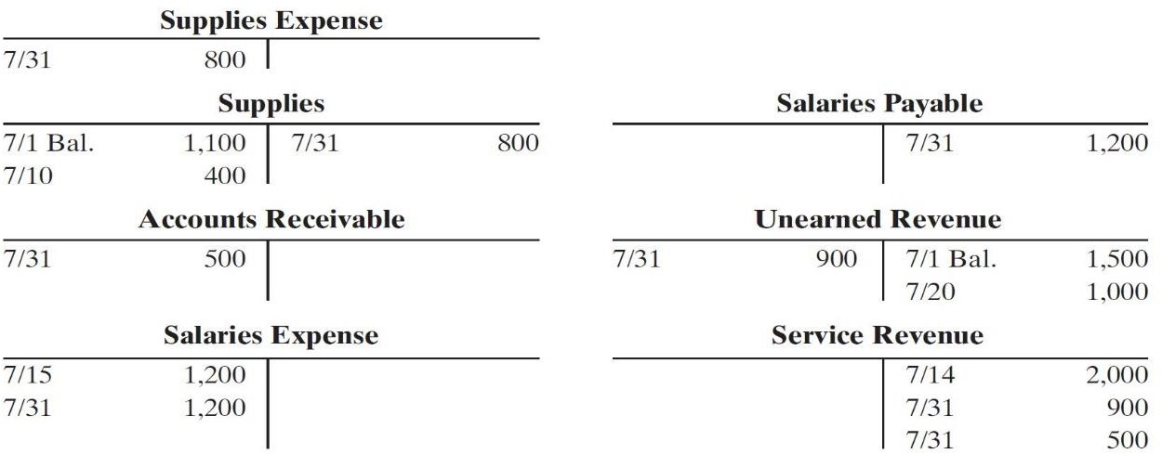
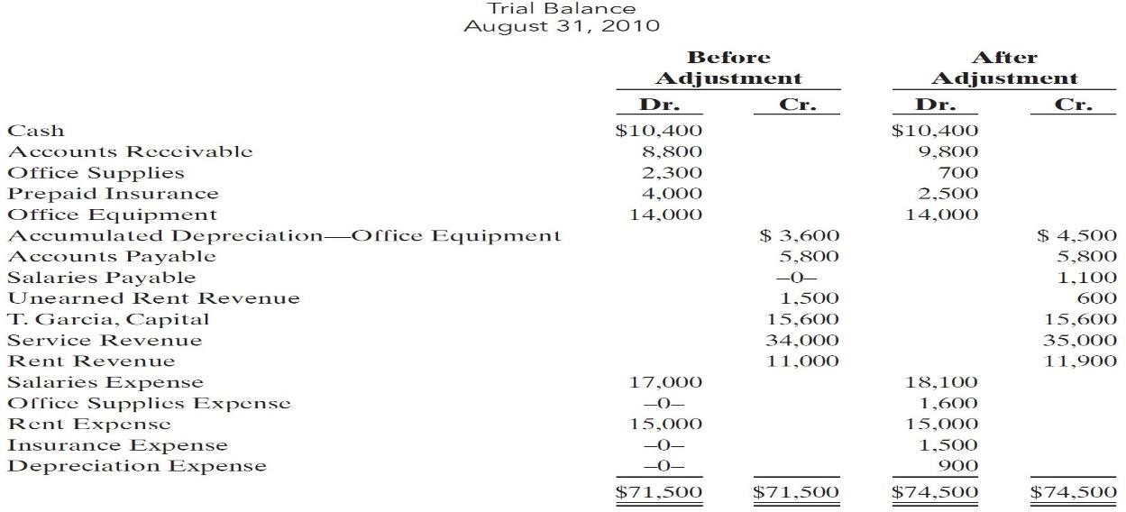
PRINCIPLES OF ACCOUNTING
Expired insurance for the month is $100.
Depreciation for the month is $50.
Unearned revenue earned in October totals $600.
Services provided but not recorded at October 31 are $300.
Interest accrued at October 31 is $70.
Accrued salaries at October 31 are $1,500.
Instructions:
Prepare the adjusting entries for the items above.
Example 7
Selected accounts of Saman Company are shown below.
Instructions:
After analyzing the accounts, journalize (a) the July transactions and (b) the adjusting entries that were made on July 31. (Hint: July transactions were for cash.)
Example 8
The trial balances before and after adjustment for Garmyan Company at the end of its fiscal year are presented below.
Instructions: Prepare the adjusting entries that were made.
| P a g e - 11 -

