Slide 1
Principles Accounting in English 2
PRINCIPLES OF ACCOUNTING
CHAPTER TWO
PROPERTY, PLANT, AND EQUIPMENT
ACCOUNTING DEPATMENT
2022-2023
CHAPTER TWO
PROPERTY, PLANT, AND EQUIPMENT (FIXED ASSETS)

Slide 2
PRINCIPLES OF ACCOUNTING
The major characteristics of property, plant, and equipment are as follows.
They are acquired for use in operations and not for resale.
They are long-term in nature and usually depreciated. Property, plant, and equipment yield services over a number of years.
They possess physical substance. Property, plant, and equipment are tangible assets characterized by physical existence or substance.
DETERMINING THE COST OF PLANT ASSETS
The cost principle requires that companies record plant assets at cost.Thus Rent-A-Wreck records its vehicles at cost. Cost consists of all expenditures necessary to acquire the asset and make it ready for its intended use.
For example, the cost of factory machinery includes the purchase price, freight costs paid by the purchaser, and installation costs. Once cost is established, the company uses that amount as the basis of accounting for the plant asset over its useful life.
In the following sections, we explain the application of the cost principle to each of the major classes of plant assets.
Land
To illustrate, assume that Hayes Manufacturing Company acquires real estate at a cash cost of
$100,000. The property contains an old warehouse that is razed مده at a net cost of $6,000 ($7,500 in costs less $1,500 proceeds from salvaged materials).
Additional expenditures are the attorney’s fee, $1,000, and the real estate broker’s commission,
$8,000.The cost of the land is $115,000, computed as follows.
When Hayes records the acquisition, it debits Land for $115,000 and credits Cash for $115,000. To illustrate, assume Merten Company purchases factory machinery at a cash price of $50,000.
Related expenditures are for sales taxes $3,000, insurance during shipping $500, and installation and testing $1,000.The cost of the factory machinery is $54,500, computed as follows.
Merten makes the following summary entry to record the purchase and related expenditures: Factory Machinery 54,500
Cash 54,500
(To record purchase of factory machine)
Example: Assume a company purchased a land, its original cost is $ 50,000, while purchasing there are some other costs which are; $2,500 attorney’s fees, $1,500 Recording Fees, and the company made filling for land it’s cost was $1,000. Calculate the final cost of the land.

Slide 3
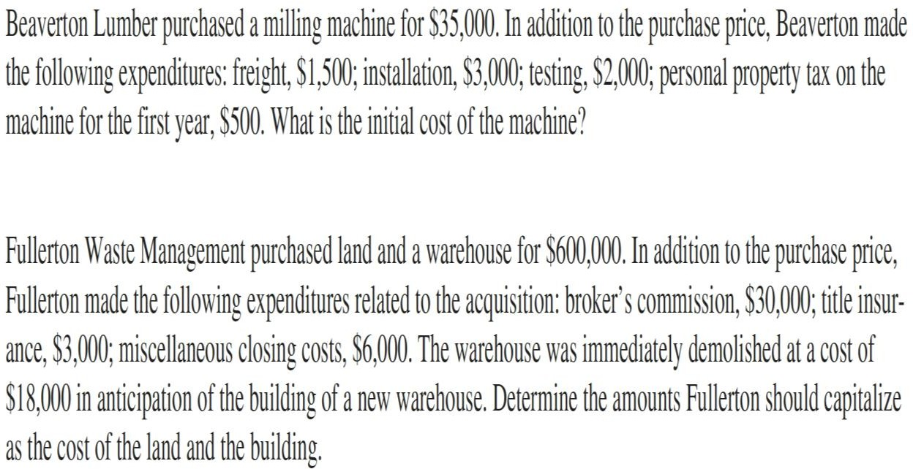
PRINCIPLES OF ACCOUNTING
Example: A company bought a machine for production department, the machine cost was $150,000, transportation cost $2,000, and installation cost by engineers $2,500. Calculate the machine cost.
Examples:
Fixed Assets Depreciation
Property, plant, and equipment and intangible assets are purchased with the expectation that they will provide future benefits. Specifically, they are acquired to be used as part of the revenue-generating operations, usually for several years. Logically, then, the cost of these acquisitions initially should be recorded as assets, and then these costs should be allocated to expense over the reporting periods benefited by their use. That is, their costs are reported with the revenues they help generate.
Let’s suppose that a company purchases a used truck for $8,200 to deliver products to customers. The company estimates that five years from the acquisition date the truck will be sold for $2,200. It
is estimated, then, that $6,000 ($8,200 − 2,200) of the truck’s purchase cost will be used up (consumed) during a five-year useful life.

Slide 4
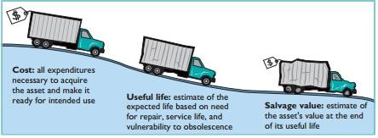
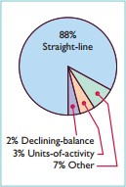
PRINCIPLES OF ACCOUNTING
Basic Factors for calculation depreciation:
The basic factors for calculation of depreciation on fixed assets are:
Cost of the assets.
Estimated working life of the assets.
Estimated scrap value at the end of its life time
De
preciation for Cost Allocation (Methods for Depreciation Calculate)
Depreciation is generally computed using one of the following methods:
Straight-line
Units-of-activity
Declining-balance
Each method is acceptable under generally accepted accounting principles.
Management selects the method(s) it believes to be appropriate. The objective is to select the method that best measures an asset’s contribution to revenue over its useful life. Once a company chooses a method, it should apply it consistently over the useful life of the asset. Consistency enhances the comparability of financial statements. Depreciation affects the balance sheet through accumulated depreciation and the income statement through depreciation expense.

Slide 5
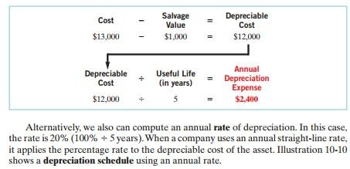
PRINCIPLES OF ACCOUNTING
We will compare the three depreciation methods using the following data for a small delivery truck purchased by Barb’s Florists on January1, 2010.
Cost $13,000
Expected salvage value $1,000 Estimated useful life in years 5 Estimated useful life in miles 100,000
1. Straight Line Method (Fixed percentage Method):
Under this method a fixed amount decreasing of the total cost of the asset every year. At the end of the useful life of the asset, the balance in that asset's account will be equal to its scrap value (if the value of scrap estimated at the beginning).
Under this method the form will be:
Or
Where:
Depreciation | = | Cost Price of asset – Scrap Value
 |  | Estimated life of Asset in year
D | ₌ | C – S
 |  | N
D | = | Amount of depreciation (for one year).
C | = | Cost of asset.
S | = | Scrap value.
N | = | Working life in year.

Slide 6
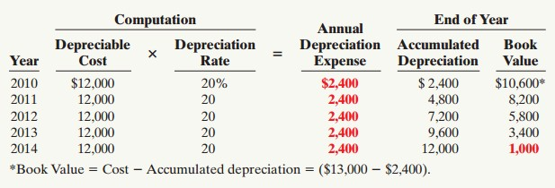
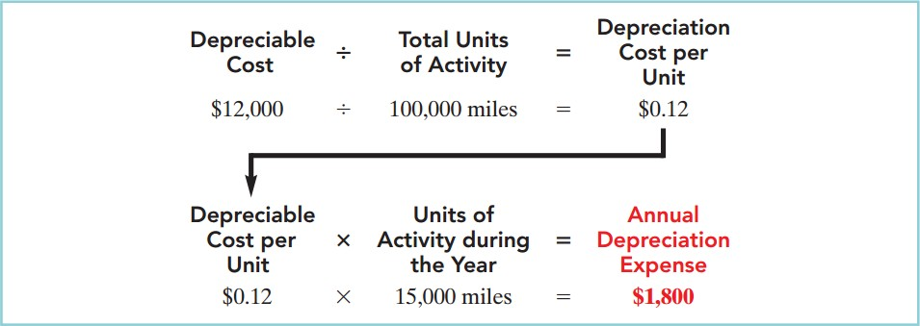
PRINCIPLES OF ACCOUNTING
2. Units-of-activity
3. Declining-balance

Slide 7
PRINCIPLES OF ACCOUNTING
Depreciation accounting:
Indirect method:
This method uses three separate accounts:
A fixed asset account, which records cost of the asset when they purchased.
Depreciation expense account, which shown the fall in the value of the asset occurred within a year.
Accumulated depreciation account, which record the amount of depreciation set
a side year since the data of a question.
The entry passed in journal according to this method is as follows:
31. 12. 2007
By Depreciation Expenses xx
To Accumulated Depreciation xx

Slide 8
PRINCIPLES OF ACCOUNTING
At the end of the period, the depreciation expense is charged to the profit & loss account as follows:
31. 12. 2007
By Profit & Loss xx
To Depreciation expense xx
EXAMPLE
DuPage Company purchases a factory machine at a cost of $18,000 on January 1, 2010. DuPage expects the machine to have a salvage value of $2,000 at the end of its 4-year useful life. During its useful life, the machine is expected to be used 160,000 hours. Actual annual hourly use was: 2010, 40,000; 2011, 60,000; 2012, 35,000; and 2013, 25,000.
Instructions
Prepare depreciation schedules for the following methods:
straight-line.
units-of-activity.
declining-balance using double the straight-line rate.

Slide 9
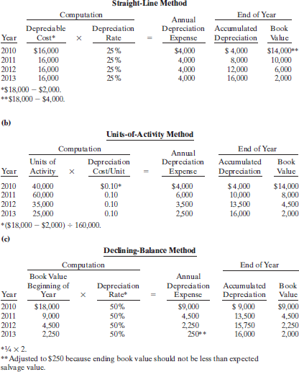
PRINCIPLES OF ACCOUNTING

Slide 10
PRINCIPLES OF ACCOUNTING
Disposal of fixed assets:
Companies dispose of plant assets in three ways—retirement, sale, or Exchange
،Whatever the method, at the time of disposal the company must determine the book value of the plant asset.
As noted earlier, book value is the difference between the cost of a plant Asset and the
accumulated depreciation to date.
1. Retirement of fixed Assets:
To illustrate the retirement of plant assets, assume that Hobart Enterprises retires its computer printers, which cost $32,000. The accumulated depreciation on these printers is $32,000. The equipment, therefore, is fully depreciated (zero book value).
The entry to record this retirement is as follows.
Accumulated Depreciation—Printing Equipment 32,000 Printing Equipment 32,000
(To record retirement of fully depreciated equipment)
If a company retires a plant asset before it is fully depreciated, and no cash is received for scrap or salvage value, a loss on disposal occurs. For example, assume that Sunset Company discards delivery equipment that cost $18,000 and has accumulated depreciation of $14,000. The entry is as follows
Accumulated Depreciation—Delivery Equipment Loss on Disposal
Delivery Equipment
14,000
4,000
(To record retirement of delivery equipment at a loss)
18,000
2. Sale of Fixed assets:
In a disposal by sale, the company compares the book value of the asset with the proceeds received from the sale. If the proceeds of the sale exceed the book value of the plant asset, a gain on disposal occurs. If the proceeds of the sale are less than the book value of the plant asset sold, a loss on disposal occurs.
GAIN ON DISPOSAL
To illustrate a gain, assume that on July 1, 2010, Wright Company sells office furniture for $16,000 cash. The office furniture originally cost $60,000. As of January 1, 2010, it had accumulated depreciation of $41,000. Depreciation for the first six months of 2010 is $8,000. Wright records depreciation expense and updates accumulated depreciation to July 1 with the following entry.
July 1
Depreciation Expense 8,000
Accumulated Depreciation—Office Furniture 8,000

Slide 11
PRINCIPLES OF ACCOUNTING
(To record depreciation expense for the first 6 months of 2010)
After the accumulated depreciation balance is updated, the company computes the gain or loss. Illustration 10-19 shows this computation for Wright Company, which has a gain on disposal of $5,000.
Cost of office furniture |  |  | $60,000
Less: Accumulated depreciation |  | ($41,000 _ $8,000) | 49,000
Book value at date of disposal |  |  | 11,000
Proceeds from sale |  |  | 16,000
Gain on disposal |  |  | $ 5,000
July 1 | Cash | 16,000
Accumulated Depreciation—Office Furniture 49,000
Office Furniture 60,000 Gain on Disposal 5,000
(To record sale of office furniture at a gain)
LOSS ON DISPOSAL
Assume that instead of selling the office furniture for $16,000, Wright sells it for
$9,000. In this case, Wright computes a loss of $2,000 as follows
Cost of office furniture |  | $60,000
Less: Accumulated depreciation |  | 49,000
Book value at date of disposal |  | 11,000
Proceeds from sale |  | 9,000
Loss on disposal |  | $ 2,000
July 1 | Cash | 9,000
 | Accumulated Depreciation—Office Furniture | 49,000
 | Loss on Disposal | 2,000
Office Furniture (To record sale of office furniture at a loss)
60,000
Example
If a car costing 4500 $ was sold on Apr. 1st 2007 by 700 $ cash.
The balance of accumulated depreciation – car on Apr. 1st 2007 is 3250 $. Book value = 4500 – 3250 = 1250 $
Profit or loss on sold = 700 – 1250 = (550) $
The entries for sale in the journal are:
Apr. 1st. 2007
By sundries Cash
Accumulated Depreciation
Loss on Car Sold
To Car
(Being sold car by 700 $ cash)
700
3250
550
2
4500

Slide 12
PRINCIPLES OF ACCOUNTING
Apr. 1st. 2007
By Profit & Loss 550
To Loss on Car Sold 550
(Being close of loss on car sold in profit & loss account)
3. Exchanging of Fixed Assets:
Loss Treatment
To illustrate an exchange that results in a loss, assume that Roland Company exchanged a set of used trucks plus cash for a new semi-truck. The used trucks have a combined book value of $42,000 (cost $64,000 less $22,000 accumulated depreciation). Roland’s purchasing agent, experienced in the second-hand market, indicates that the used trucks have a fair market value of $26,000. In addition to the trucks, Roland must pay $17,000 for the semi-truck. Roland computes the cost of the semitruck as follows:
Fair value of used trucks Cash paid
Cost of semi-truck
$26,000 17,000
$43,000
Roland incurs a loss on disposal of $16,000 on this exchange. The reason is that the book value of the used trucks is greater than the fair market value of these
trucks. The computation is as follows.
Book value of used trucks ($64,000_$22,000) Fair market value of used trucks
Loss on disposal
$42,000 26,000
$16,000
In recording an exchange at a loss, three steps are required: (1) Eliminate the book value of the asset given up, (2) record the cost of the asset acquired, and (3) recognize the loss on disposal. Roland Company thus records the exchange on the
loss as follows.
Semi-truck | 43,000
Accumulated Depreciation—Used Trucks | 22,000
Loss on Disposal | 16,000
Used Trucks |  | 64,000
Cash |  | 17,000
(To record exchange of used trucks for semi-truck.)
Gain Treatment
To illustrate a gain situation, assume that Mark Express Delivery decides to exchange its old delivery equipment plus cash of $3,000 for new delivery equipment. The book value of the old delivery equipment is $12,000 (cost $40,000 less accumulated depreciation $28,000). The fair market value of the old delivery equipment is $19,000.
The cost of the new asset is the fair market value of the old asset exchanged
plus, any cash paid (or other consideration given up). The cost of the new delivery equipment is $22,000 computed as follows.

Slide 13
PRINCIPLES OF ACCOUNTING
Fair market value of old delivery equipment Cash paid
Cost of new delivery equipment
$19,000
3,000
$22,000
A gain results when the fair market value of the old delivery equipment is
greater than its book value. For Mark Express there is a gain of $7,000 on disposal, computed as follows.
Fair market value of old delivery equipment
Book value of old delivery equipment ($40,000_$28,000)
Gain on disposal
$19,000 12,000
$ 7,000
Delivery Equipment (new) 22,000
Accumulated Depreciation—Delivery Equipment (old) Delivery Equipment (old)
Gain on Disposal
Cash
28,000
40,000
7,000
3,000
(To record exchange of old delivery equipment for new delivery equipment) In recording an exchange at a gain, the following three steps are involved: (1)
Eliminate the book value of the asset given up, (2) record the cost of the asset acquired,
and (3) recognize the gain on disposal. Accounting for exchanges of plant assets becomes more complex if the transaction does not have commercial substance. This issue is discussed in more advanced accounting classes.
Example 1
Younger Bus Lines uses the units-of-activity method in depreciating its buses. One bus was purchased on January 1, 2010, at a cost of $168,000. Over its 4-year useful life, the bus is expected to be driven 100,000 miles. Salvage value is expected to be $8,000.
Instructions
Compute the depreciation cost per unit.
Prepare a depreciation schedule assuming actual mileage was: 2010, 26,000; 2011, 32,000; 2012, 25,000; and 2013, 17,000.
Example 2
Kelm Company purchased a new machine on October 1, 2010, at a cost of $120,000. The company estimated that the machine will have a salvage value of $12,000. The machine is expected to be used for 10,000 working hours during its 5-year life.
Instructions
Compute the depreciation expense under the following methods for the year indicated.
Straight-line for 2010.
Units-of-activity for 2010, assuming machine usage was 1,700 hours.
Declining-balance using double the straight-line rate for 2010 and 2011.
Example 3
Brainiac Company purchased a delivery truck for $30,000 on January 1, 2010.The truck has an expected salvage value of $2,000, and is expected to be driven 100,000 miles over its estimated useful life of 8 years. Actual miles driven were 15,000 in 2010 and 12,000 in 2011.
Instructions
Compute depreciation expense for 2010 and 2011 using (1) the straight-line method, (2) the units-of-activity method, and (3) the double-declining balance method.
Assume that Brainiac uses the straight-line method.

Slide 14
PRINCIPLES OF ACCOUNTING
Prepare the journal entry to record 2010 depreciation.
Show how the truck would be reported in the December 31, 2010, balance sheet.
Example 4
Presented below are selected transactions at Ingles Company for 2010.
Jan. 1 Retired a piece of machinery that was purchased on January 1, 2000.The machine cost
$62,000 on that date. It had a useful life of 10 years with no salvage value.
June 30 Sold a computer that was purchased on January 1, 2007.The computer cost $40,000. It had a useful life of 5 years with no salvage value. The computer was sold for $14,000.
Dec. 31 Discarded a delivery truck that was purchased on January 1, 2006. The truck cost
$39,000. It was depreciated based on a 6-year useful life with a $3,000 salvage value.
Instructions
Journalize all entries required on the above dates, including entries to update depreciation, where applicable, on assets disposed of. Ingles Company uses straight-line depreciation. (Assume depreciation is up to date as of December 31, 2009.)
Example 5
Beka Company owns equipment that cost $50,000 when purchased on January 1, 2007. It has been depreciated using the straight-line method based on estimated salvage value of $5,000 and an estimated useful life of 5 years.
Instructions
Prepare Beka Company’s journal entries to record the sale of the equipment in these four independent situations.
Sold for $28,000 on January 1, 2010.
Sold for $28,000 on May 1, 2010.
Sold for $11,000 on January 1, 2010.
Sold for $11,000 on October 1, 2010.
Example 6
If you have this information about the assets (Furniture) of (AL– Mustafa Co.): Cost of the furniture 8000 $ - Balance of accumulated depreciation 5000 $.
And if you know that:
The business (Sold) (Half) of the furniture with profit equal to 20 % from the cost price.
The business (Exchanged) the remaining of the furniture with new one paid 500
$ by check with loss equal to 10 % from the cost price.
Instructions
Journalize the above transactions.
Example 7
At 1 / 7 / 2008 the business bought a (Furniture) worth 3850 $ by cash.
At 1 / 5 / 2009 the business sold the furniture worth 2000 $ by check.
Instructions
Journalize purchasing entry at 1 / 7 / 2008.
Compute annual depreciation expenses using (Straight line method) if you know that the estimated scrap value are 250 $ and the estimated working life are 3 years.

Slide 15
PRINCIPLES OF ACCOUNTING
Journalize depreciation expenses entry by using (Indirect method) at 31/12/2008.
Journalize selling entry at 1 / 5 / 2009.
Example 8
At 1 / 9 / 2007 the business bought (Machinery) with cost 7200 $ by cash (There is no estimated scrap value and the estimated working life are 4 years).
At 1 / 8 / 2009 the business (Exchanged) the machinery with new one valued with
5000 $ and the business paid 1500 $ by check.
Instructions
Journalize the necessary entries.

