Slide 1
Principles Accounting in English 1
PRINCIPLES OF ACCOUNTING
CHAPTER TWO
(Accounting equation)
ACCOUNTING DEPATMENT 2022-2023

Slide 2
PRINCIPLES OF ACCOUNTING
CHAPTER (2)
Accounting equation
We can express the relationship of assets, liabilities, and owner’s equity as an equation, as following:
Basic Equation
This relationship is the basic accounting equation. Assets must equal the sum of liabilities and owner’s equity. Liabilities appear before owner’s equity in the basic accounting equation because they are paid first if a business is liquidated. The accounting equation applies to all economic entities regardless of size, nature of business, or form of business organization. It applies to a small proprietorship such as a corner grocery store as well as to a giant corporation such as PepsiCo. The equation provides the underlying framework for recording and summarizing economic events.
Let’s look in more detail at the categories in the basic accounting equation. Assets: cash, bank, A/R, inventory, land, equipment, building, ….. Etc.
Liabilities: A/P, N/P, Loans, etc.
Owner's equity: The excess of assets over liabilities. The amount of the owner's investment in a business, including: profits from successful operation which have been retained in the business.
INCREASES IN OWNER’S EQUITY
Investments by Owner.
Revenues.
DECREASES IN OWNER’S EQUITY
Drawings.
Expenses.
In summary, owner’s equity is increased by an owner’s investments and by revenues from business operations. Owner’s equity is decreased by an owner’s withdrawals of assets and by expenses. Illustration below expands the basic accounting equation by showing the accounts that comprise owner’s equity. This format is referred to as the expanded accounting equation.

Slide 3
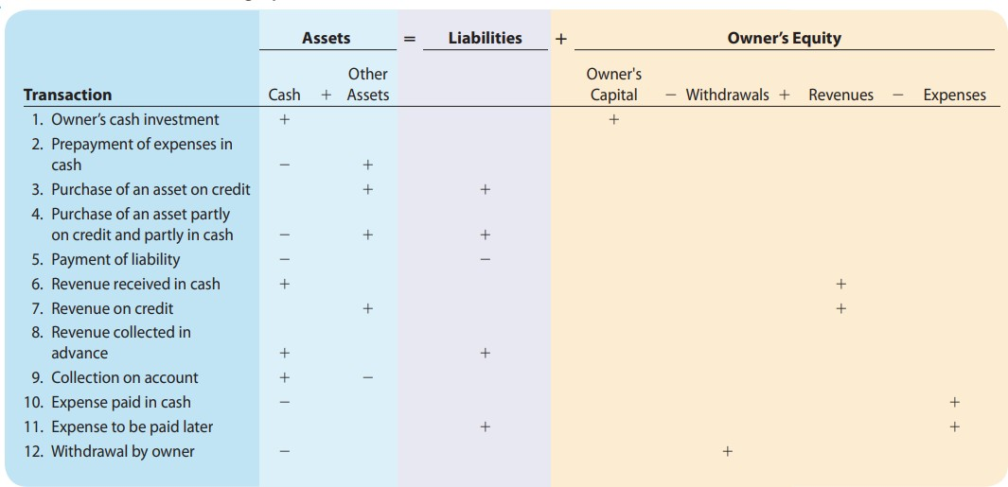
PRINCIPLES OF ACCOUNTING
Example: (1)
Ray Neal decides to open a computer programming service which he names soft byte. On September 1, 2010, he invests $15,000 cash in the business.
Soft byte purchases computer equipment for $7,000 cash.
Soft byte purchases for $1,600 from Acme Supply Company computer paper and other supplies expected to last several months. Acme agrees to allow soft byte to pay this bill in October.
Soft byte receives $1,200 cash from customers for programming services it has
provided.
Soft byte receives a bill for $250 from the Daily News for advertising but postpones payment until a later date.
Soft byte provides $3,500 of programming services for customers. The company
receives cash of $1,500 from customers, and it bills the balance of $2,000 on account.
Soft byte pays the following Expenses in cash for September: store salaries of employees $900, and utilities $200.
Soft byte pays its $250 Daily News bill in cash [in Transaction (5)].
rent $600,
Soft byte receives $600 in cash from customers who had been billed for services [in Transaction (6)].
Ray Neal withdraws $1,300 in cash from the business for his personal use.
Instructions:
Prepare a tabular analysis of the transactions

Slide 4
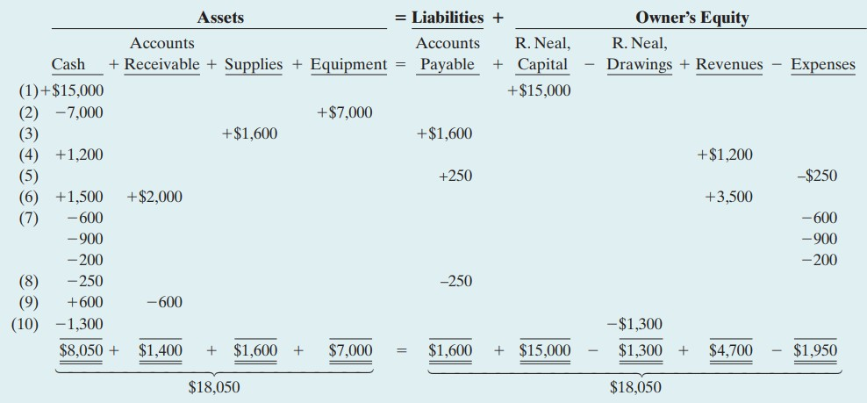
PRINCIPLES OF ACCOUNTING
Example: (2)
Ahmad’s Repair Shop was started on May 1 by Ahmad. A summary transactions are presented below.
Invested $10,000 cash to start the repair shop.
Purchased equipment for $5,000 cash.
Paid $400 cash for May office rent.
Paid $500 cash for supplies.
Incurred $250 of advertising costs in the Beacon News on account.
Received $5,100 in cash from customers for repair service.
Withdrew $1,000 cash for personal use.
Paid part-time employee salaries $2,000.
Paid utility bills $140.
Provided repair service on account to customers $750.
Collected cash of $120 for services billed in transaction (10).
of May
Instructions:
Prepare a tabular analysis of the transactions, using the following column headings: Cash, Accounts Receivable, Supplies, Equipment, Accounts Payable. Ahmad, Capital. Ahmad, Drawings; Revenues, and Expenses.
From an analysis of the owner’s equity columns, compute the net income or
net loss for May.

Slide 5
PRINCIPLES OF ACCOUNTING
Example: (3)
Aram opened a veterinary business in Erbil, on August 1. On
August 31, the balance sheet showed Cash $9,000, Accounts Receivable $1,700, Supplies $600, Office Equipment $6,000, Accounts Payable $3,600, and Aram, Capital $13,700. During September the following transactions occurred.
Paid $2,900 cash on accounts payable.
Collected $1,300 of accounts receivable.
Purchased additional office equipment for $2,100, paying $800 in cash and the balance on account.
Earned revenue of $8,000, of which $2,500 is paid in cash and the balance is due
in October.
Withdrew $1,000 cash for personal use.
Paid salaries $1,700, rent for September $900, and advertising expense $300.
Incurred utilities expense for month on account $170.
Received $10,000 from Capital Bank–money borrowed on a note payable.
Instructions:
Prepare a tabular analysis of the September transactions beginning with August 31 balances. The column headings should be as follows: Cash + Accounts Receivable + Supplies + Office Equipment = Notes Payable + Accounts Payable + Aram, Capital – Aram, Drawings + Revenues - Expenses.
Prepare an income statement for September, an owner’s equity statement for September, and a balance sheet at September 30.
Example (4)
Koyan started his own delivery service, Koyan Deliveries, on June 1, 2010.The following
transactions occurred during the month of June.
June 1 Koyan invested $10,000 cash in the business.
Purchased a used van for deliveries for $12,000. Mark paid $2,000 cash and signed a note payable for the remaining balance.
Paid $500 for office rent for the month.
5 Performed $4,400 of services on account. 9 Withdrew $200 cash for personal use.
12 Purchased supplies for $150 on account.
15 Received a cash payment of $1,250 for services provided on June 5. 17 Purchased gasoline for $100 on account.
20 Received a cash payment of $1,500 for services provided.
23 Made a cash payment of $500 on the note payable. 26 Paid $250 for utilities.
Paid for the gasoline purchased on account on June 17.
Paid $1,000 for employee salaries.
Instructions:
Show the effects of the previous transactions on the accounting equation.

Slide 6
PRINCIPLES OF ACCOUNTING
Example (5)
Presented below is selected information related to Flanagan Company at December 31, 2010.Flanagan reports financial information monthly.
Office Equipment $10,000 Utilities Expense $ 4,000
Cash | 8,000 | Accounts Receivable | 9,000
Service Revenue | 36,000 | Wages Expense | 7,000
Rent Expense | 11,000 | Notes Payable | 16,500
Accounts Payable | 2,000 | Drawings | 5,000
Instructions:
Determine the total assets of Flanagan Company at December 31,2010.
Determine the net income that Flanagan Company reported for December 2010. (c) Determine the owner’s equity of Flanagan Company at December 31,2010.
Example (6)
Now let us illustrate the effect of these transactions upon the accounting equation, and these transactions during November were as follows:
Nov.1 (Mustafa) started the business by depositing 80000 $ in a company Cash
account.
Nov.3 Purchased land for 52000 $ paying cash.
Nov.5 Purchased building for 36000 $ paying 6000 $ in cash and issuing note payable for the remaining 30000 $.
Nov.17 purchased tools and equipment on account 13800 $.
Nov.20 Sold some of the tools at a price equal to their cost, 8800 $ collectible within 45 days.
Nov.25 Received 3600 $ in partial collection of the account receivable from the sale
of tools, and deposit in Bank account.
Nov.26 Paid 6800 $ in partial payment of an account payable. Nov.27 Bought good for 3000 $ by cheque.
Nov.28 Received 500 $ from rent income.
Nov.29 Paid 400 $ as wages and salaries. Nov.30 With draw cash for personal use 300 $.
Instructions:
What is the effect of those transactions on the accounting equation?
Example (7)
The items making up the balance sheet of (Ali's comp.) at December 31, as follow:
Assets : 9500 cash, 8900 A/R, Trucks 58000, office equipment 3800.
Liabilities: 20000 N/P, 5200 A/P.
During a short period after December 31, (Ali's com.) had the following transaction:
Bought office equipment at a cost of 2700 $ cash.
Collected 4000 $ of A/R.

Slide 7
PRINCIPLES OF ACCOUNTING
Paid 3200 $ of A/P.
Borrowed 10000 $ from a bank. Signed a note payable for that amount
Purchased two trucks for 30500 $. Paid 15000 $ cash and signed a note payable.
The Owner, invested 20000 $ as building in the business.
Instructions:
Record the effects of each of the above transactions in the tabular arrangement.
Example (8)
Capital introduced by Ahmed 30000 $.
Purchased a Delivery Truck and paid first installment, 7000 $.
Purchased Merchandise on account 9000 $.
Collection from customers 6000 $.
Payment on account 5000 $.
Payment of Rent 200 $.
Sales on account 12000 $.
Cost of goods sold 7000 $.
Payment of other expenses 400 $.
Advances from customers 5000 $.
Instructions:
Prepare a transaction work sheet with the help of Accounting Equation
Example (9)
1. Started business with the following: (The amounts are in $)
Cash 7500 – Cash in bank 5500 – Goods 6500 – Furniture 2500 – N / P 5000
- Capital?
Bought goods worth 3500 $ (Half) by cash and the remaining by credit.
Exchanged (Furniture) for (Computer) worth 500 $.
The owner withdraws goods worth 500 $ (By selling price) for his personal use.
Received the following revenues:
Interest 200 $ by check – Commission 300 $ by cash.
Sold goods worth 6000 $ by check.
Example (10)
Started business with the following: (The amounts are in $)
Cash 13000 – Cash in bank 12000 – A / R 1000 – N / P 3000 – Capital?
Purchased goods worth 6000 $ by cash.
Pay the (Full) amount of (N / P) by check.
Received (Half) of the (A / R) by cash.
Sold goods worth 4000 $ (Half) of the amount by cash and the remaining by check.
Pay 2000 $ as an expense by check

